Slide 1
Value of Pharmaceuticals in
Managed Care Pharmacy
Created by the School of Pharmacy Relations Committee for AMCP
Updated: January 2026

Slide 2
What is Managed Care Pharmacy?
The practice of managed care pharmacy applies clinical and scientific evidence to support the appropriate use of medications to enhance patient and population health outcomes while optimizing use of limited health care resources
Managed care pharmacy focuses on:
  Developing and applying evidence-based medication use strategies that enhance patient and population health outcomes while optimizing the use of available healthcare resources
Notes:
https://www.amcp.org/about/managed-care-pharmacy-101/managed-care-glossary#M%20-%20R

Slide 3
The Value Equation for Pharmaceuticals
Evidence-based treatments that increase the likelihood of achieving desired health outcomes
Usually defined as drug cost, and as applicable administration and adverse effect costs
Benefit
Cost
VALUE =
  If benefit increases, and cost decreases, the value of the pharmaceutical is increased substantially
  If the benefit remains constant, and the cost increases, the value decreases
  If benefit increases, and cost remains constant, the value increases
Notes:
How do we put a value on pharmaceuticals? What are the variables to be considered? The two variables are quality and cost. The dynamic between these two variables is what determines value.
https://www.pharmacytimes.com/publications/Directions-in-Pharmacy/2015/December2015/The-Changing-Value-Equation-in-Pharmacy

Slide 4
Pharmaceuticals in the Total Healthcare Process
The value of pharmaceuticals is also taken into consideration in context of the total healthcare delivery process
Three options for treatment of disease
Lifestyle changes
Pharmaceuticals
Surgical/Invasive interventions
Least invasive, usually considered first, when appropriate
  Considering a choice between a pharmaceutical regimen or surgical/invasive procedure, most will choose a pharmaceutical regimen if appropriate

Slide 5
The Importance of Innovation
    Pharmaceuticals help people to manage their illnesses and live longer and/or more productive lives
    Pharmaceuticals may reduce costs by preventing expensive hospital treatments and other therapies
    Today’s medicines fund research and development for tomorrow’s prescription drug innovations
    From 2018 through 2024, the FDA averaged about 50 novel drug approvals per year [range of 37-59 approvals per year]
    To assess pharmaceutical value and manage patient access accordingly, managed care entities review clinical and economic data supporting each innovative drug approved by the FDA
Notes:
So, we’ve talked about how medicines can help people manage their illness and lead longer lives, but now let’s look at how medicines can reduce total healthcare costs by preventing the need for other more expensive services like hospital stays and emergency room visits.
Now I know that many people believe that medicines cost too much, but let’s look at what you get for your money in addition to improved health and wellness or treating your illness.
https://pubmed.ncbi.nlm.nih.gov/39942587/

Slide 6
Increasing Life Expectancy
Studies have shown that pharmaceutical innovation was a significant contributor to the increased life expectancy observed worldwide between 1986-2009
Increase in life expectancy associated with new drug launches | Proportion of overall life expectancy associated with new drug launches | Study Description
0.79 years | 40% | Analysis of disease-level data from 52 countries between 1982-2001
1.27 years | 73% | Analysis of data from 30 developed countries between 2000-2009
Notes:
There are lots of reasons we are living longer – we eat healthier, drive safer cars, smoke less, and other things. But new medications account for almost a year of the two years we’ve added. Medicines, simply put, often allow us to live longer by treating serious, life-threatening illnesses such as cancer and HIV, and allow us to better manage chronic conditions such as heart disease and diabetes.
https://www.nber.org/papers/w18235.pdf
https://www0.gsb.columbia.edu/mygsb/faculty/research/pubfiles/1315/LICHTENBERG%20IJHCFE.pdf

Slide 7
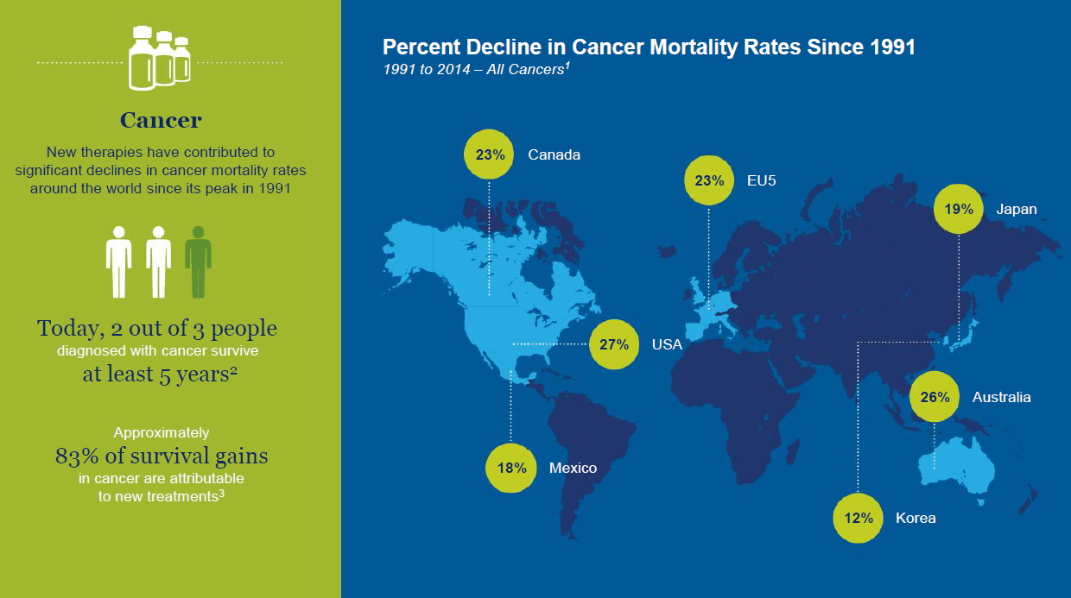
Decreasing Mortality: Cancer
Source: 1WHO Mortality Database (accessed January 2017); 2American Cancer Society Cancer Statistics Center; 3Sun et al., 2008, “The determinants of recent gains cancer survival: an analysis of the surveillance, epidemiology, and end results (SEER) database,” Journal of Clinical Oncology.
Notes:
http://phrma-docs.phrma.org/files/dmfile/PhRMA-International-Costs-in-Context-2017-03-011.pdf

Slide 8
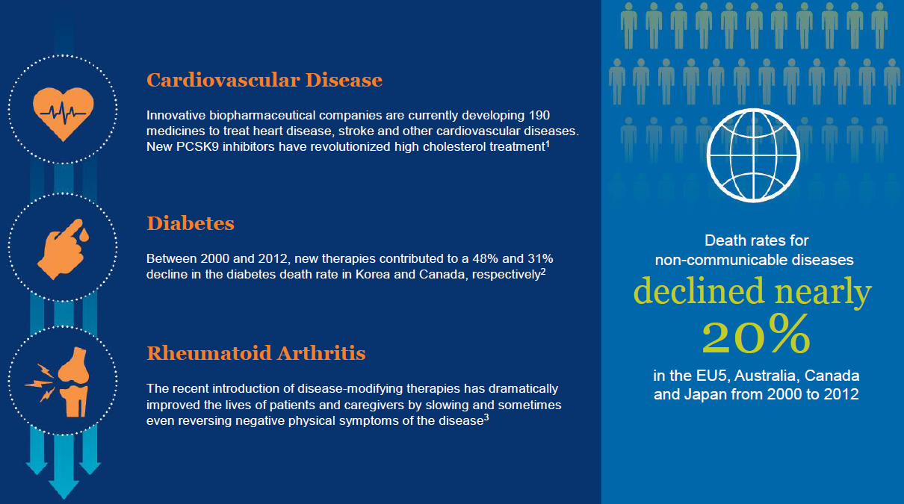
Decreasing Mortality: Chronic Diseases
Note: The four main types of chronic diseases defined by WHO are cardiovascular diseases (e.g. heart attacks and stroke), cancers, chronic respiratory diseases (e.g. chronic obstructed pulmonary disease and asthma) and diabetes. Source: 1US Food and Drug Administration; 2WHO Mortality Database (accessed February 2016); 3Kremer, 2008, “COMET’s path, and the new biologicals in rheumatoid arthritis,” Lancet.
Notes:
http://phrma-docs.phrma.org/files/dmfile/PhRMA-International-Costs-in-Context-2017-03-011.pdf

Slide 9
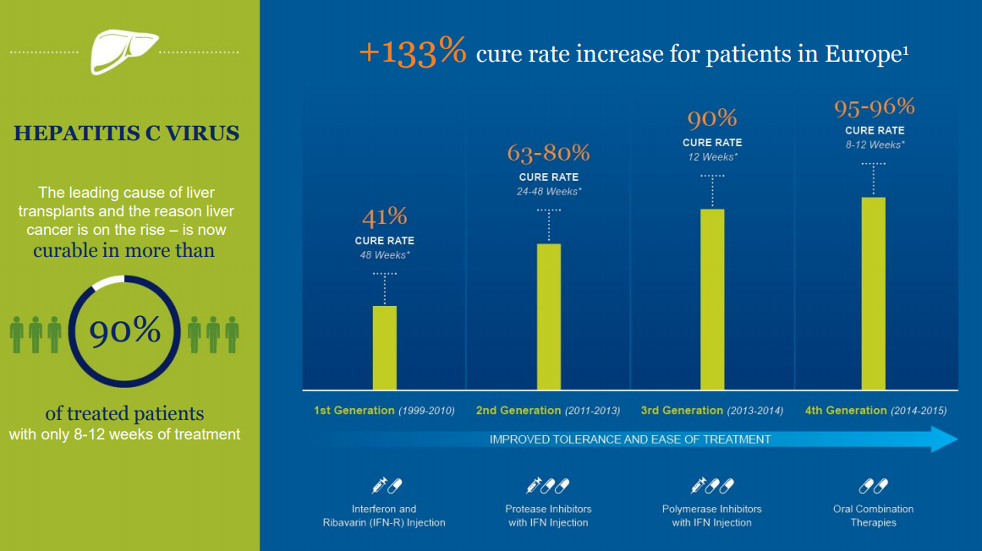
Curing Deadly Diseases: Hepatitis C
Source: 1WHO Mortality Database (accessed January 2017); 2American Cancer Society Cancer Statistics Center; 3Sun et al., 2008, “The determinants of recent gains cancer survival: an analysis of the surveillance, epidemiology, and end results (SEER) database,” Journal of Clinical Oncology.
Notes:
Diseases that were once fatal can now be treated with medication, resulting in dramatic decreases in death rates
http://phrma-docs.phrma.org/files/dmfile/PhRMA-International-Costs-in-Context-2017-03-011.pdf

Slide 10
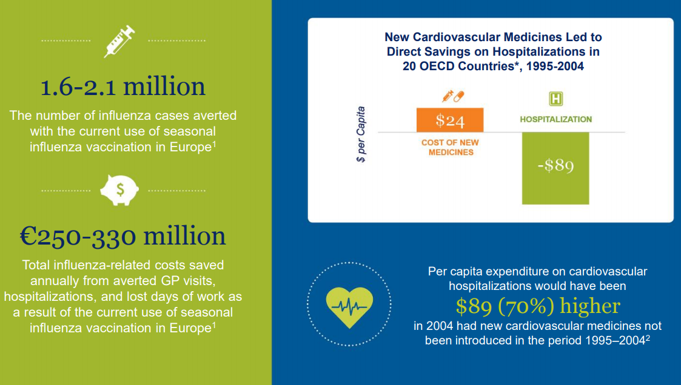
Reducing Hospitalizations and Other Costs
*Countries include Australia, Austria, Belgium, Canada, Czech Republic, Finland, France, Germany, Hungary, Italy, Japan, Korea, New Zealand, Norway, Poland, Slovak Republic, Spain, Switzerland, Turkey, UK and US. Source: 1Preaud, 2014, “Annual public health and economic benefits of seasonal influenza vaccination,” BMC Public Health; 2Lichtenberg, 2009, “Have newer CV drugs reduced hospitalizations in 20 OECD countries? Evidence from longitudinal country-level data on 20 OECD countries, 1995-2003,” Health Economics.
Notes:
http://phrma-docs.phrma.org/files/dmfile/PhRMA-International-Costs-in-Context-2017-03-011.pdf

Slide 11
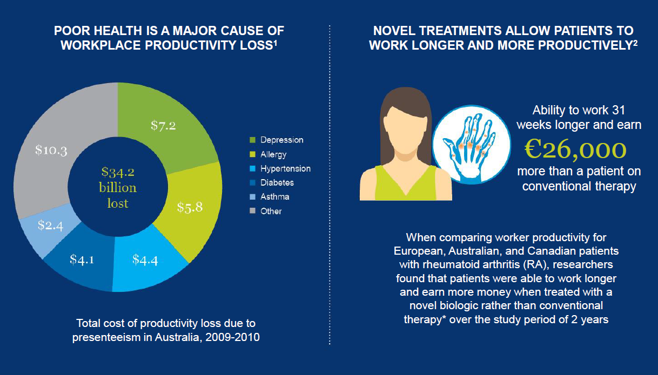
Minimizing Workplace Productivity Loss
Note: Conventional therapy refers to conventional disease-modifying anti-rheumatic drugs. Presenteeism is the act of attending work while sick. Source: 1Victoria Institute of Strategic Economic Studies, 2014, Impact of health on worker attendance and productivity in APEC region; 2Halpern et al., 2009, “Impact of adalimumab on work participation in rheumatoid arthritis: comparison of an open-label extension study and a registry-based control group,” Annals of the Rheumatic Diseases.
Notes:
http://phrma-docs.phrma.org/files/dmfile/PhRMA-International-Costs-in-Context-2017-03-011.pdf

Slide 12
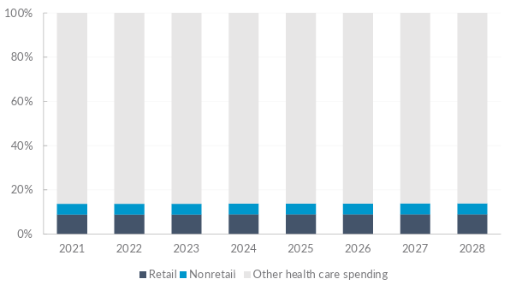
Spending on Medicines Is a Small and Stable Share of Total Healthcare Spending
On average, prescription medicines account for
Projected US Healthcare Expenditures Attributable to Retail and Nonretail Prescription Medicines, 2021-2028
14%
of total healthcare spending
Note: Nonretail prescription medicines are those purchased through physicians’ offices, clinics and hospitals and are typically administered to the patient by the provider. Retail prescription medicines are those filled at retail pharmacies or through mail service.
Notes:
https://phrma.org/resources/prescription-medicines-costs-in-context

Slide 13
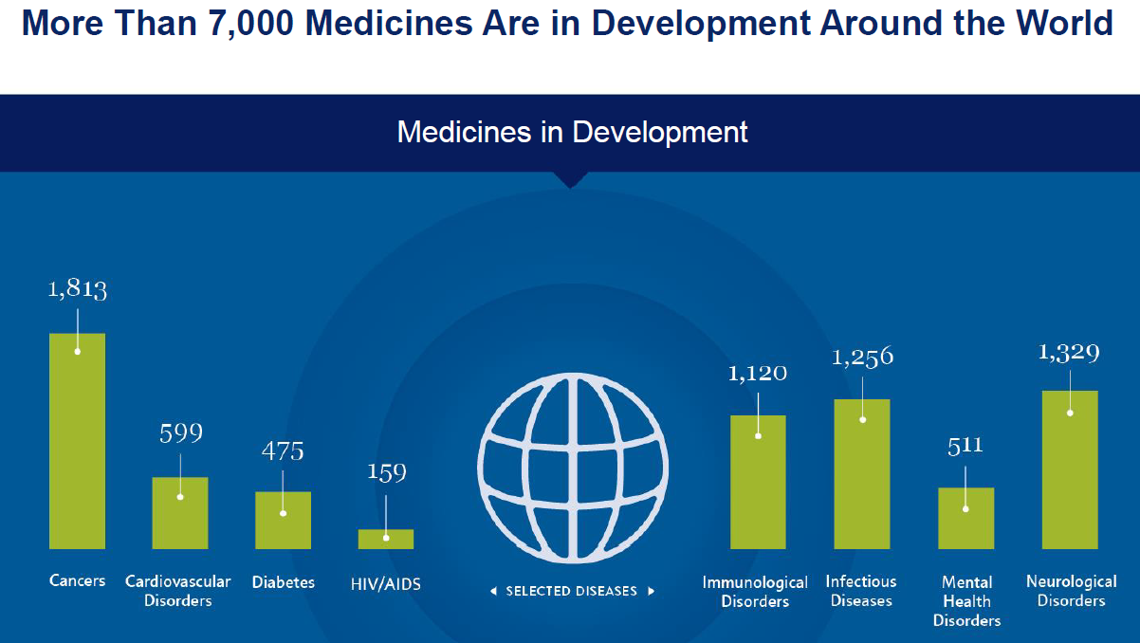
Medicines Are Part of the Solution
Note: Each product is counted exactly once, regardless of the number of indications pursued. Source: Adis R&D Insight Database.
Notes:
http://phrma-docs.phrma.org/files/dmfile/PhRMA-International-Costs-in-Context-2017-03-011.pdf

Slide 14
References
AMCP. Managed Care Glossary. https://www.amcp.org/about/managed-care-pharmacy-101/managed-care-glossary#M%20-%20R. Accessed March 8, 2020.
Trygstad T. The Changing Value Equation in Pharmacy. Pharmacy Times. December 2015. https://www.pharmacytimes.com/publications/Directions-in-Pharmacy/2015/December2015/The-Changing-Value-Equation-in-Pharmacy. Accessed March 8, 2020.
Torre BG and Albericio F. The Pharmaceutical Industry in 2024: An Analysis of the FDA Drug Approvals from the Perspective of Molecules. Molecules. 2025;30(3):482. Available at: https://pubmed.ncbi.nlm.nih.gov/39942587/. Accessed October 2, 2025.
Lichtenberg F. The Impact of New Drug Launches on Longevity: Evidence From Longitudinal, Disease-level Data From 52 Countries, 1982–2001. Int J Health Care Finance Econ. 2005;5(1):47-73. Available at: https://www0.gsb.columbia.edu/mygsb/faculty/research/pubfiles/1315/LICHTENBERG%20IJHCFE.pdf. Accessed March 8, 2020.
Lichtenberg F. Pharmaceutical Innovation and Longevity Growth in 30 Developing and High-income Countries, 2000–2009. Health Policy and Technology. 2014;3(1):36-58. Available at: https://www.nber.org/papers/w18235.pdf. Accessed March 8, 2020.
PhRMA. Prescription Medicines: International Costs in Context. March 2017. http://phrma-docs.phrma.org/files/dmfile/PhRMA-International-Costs-in-Context-2017-03-011.pdf. Accessed March 8, 2020.
PhRMA. Prescription Medicines: Costs in Context. May 2023. https://phrma.org/resources/prescription-medicines-costs-in-context. Accessed October 2, 2025

Slide 15

Mission & Vision
To improve patient health by ensuring access to
high-quality, cost-effective medications and other therapies.

