Slide 1
Medicare Part D Prescription Drug Benefit Overview
Created by the School of Pharmacy Relations Committee for AMCP
Revised: March 2026

Slide 2
Medicare – The Basics
Federal health insurance program administered by the Centers for Medicare & Medicaid Services (CMS)
Program covers individuals:
  ≥ 65 years of age
  Under age 65 with qualifying disabilities or end-stage renal disease (ESRD)
Notes:
https://www.cms.gov/Medicare/Eligibility-and-Enrollment/OrigMedicarePartABEligEnrol

Slide 3
Original Medicare
Medicare Part A (Hospital Insurance):
  Free premium for most people
  Qualified individuals are automatically enrolled when eligible
  Covers inpatient hospital stays, skilled nursing facilities, home health care, and hospice
  Limited drug coverage (drugs given during covered stays)
Notes:
https://www.cms.gov/Medicare/Medicare-General-Information/MedicareGenInfo/index.html

Slide 4
Original Medicare (cont.)
Medicare Part B (Medical Insurance):
  Medicare pays 80% of the Medicare-allowed amount for physician services
  Covers physician office visits, outpatient hospital services, and durable medical equipment (DME)
  Provides benefits for some drugs, including certain chemotherapy drugs, certain drug injections given during an office visit or outpatient facility, and drugs that are given at a dialysis facility
Notes:
https://www.cms.gov/Medicare/Medicare-General-Information/MedicareGenInfo/index.html

Slide 5
Medicare Part B – Covered Drugs
Medicare Part B covers a limited number of outpatient prescription drugs under certain conditions.
Monoclonal antibodies for the treatment of early Alzheimer’s Disease
Drugs used with an item of durable medical equipment (DME):
Some antigens:
HIV prevention drugs.
Injectable osteoporosis drugs.
Erythropoiesis-stimulating agents:
Blood clotting factors
Injectable and infused drugs.
Oral End-Stage Renal Disease (ESRD) drugs
Parenteral and enteral nutrition (intravenous and tube feeding)
Intravenous Immune Globulin (IVIG)
Shots (vaccinations)
Transplant / immunosuppressive drugs
Oral cancer drugs
Oral anti-nausea drugs
Self-administered drugs in hospital outpatient settings
Notes:
https://www.medicare.gov/coverage/prescription-drugs-outpatient
Usually, Part B covers drugs you wouldn't typically give to yourself, like those you get at a doctor's office or in a hospital outpatient setting

Slide 6
Medigap
Often referred to as Medicare Supplement Health Insurance
Insurance sold to individual members
  Generally, one must have Medicare Parts A and B to purchase Medigap
Medigap policies help pay some of the costs (i.e., deductibles, coinsurance) that the original Medicare plan doesn’t cover
  Cannot provide outpatient prescription drug coverage
Notes:
https://www.cms.gov/Medicare/Health-Plans/Medigap/index

Slide 7
Medicare Part C (Medicare Advantage)
Medicare Advantage is a Medicare-approved plan from a private company that offers an alternative to Original Medicare for your health and drug coverage. These “bundled” plans include Part A, Part B, and usually Part D.
In most cases, need to use doctors who are in the plan’s network.
Plans may have lower out-of-pocket costs than Original Medicare.
Plans may offer some extra benefits that Original Medicare doesn’t cover — like vision, hearing, and dental services.
Notes:
https://www.medicare.gov/sign-up-change-plans/types-of-medicare-health-plans/medicare-advantage-plans/how-do-medicare-advantage-plans-work
Updated reference: https://www.medicare.gov/basics/get-started-with-medicare/medicare-basics/parts-of-medicare

Slide 8
Medicare Modernization Act of 2003
Federal legislation signed into law on December 8, 2003
Created a new prescription drug benefit (Medicare Part D) beginning in January 2006
  Available to those members eligible for Medicare Part A or Part B and elderly Medicaid beneficiaries
  Voluntary benefit
  Coverage available through private insurance companies and managed care organizations (MCOs)
Notes:
https://www.ssa.gov/privacy/pia/Medicare%20Modernization%20Act%20(MMA)%20FY07.htm
https://www.kff.org/medicare/fact-sheet/an-overview-of-the-medicare-part-d-prescription-drug-benefit/

Slide 9
Medicare Part D Overview
Medicare prescription drug coverage is available to everyone with Medicare. To get Medicare prescription drug coverage, people must join a plan approved by Medicare that offers Medicare drug coverage. Most people pay a monthly premium for Part D.
Part D plans cover the cost of prescription drugs (including many recommended shots or vaccines). Beneficiaries can either add a Medicare drug plan to Original Medicare (Prescription Drug Plan, PDP), or by joining a Medicare Advantage Plan with drug coverage (MA-PD).
Plans that offer Medicare drug coverage are run by private insurance companies that follow rules set by Medicare.
Members select and enroll in plans annually (open enrollment from October to December)
Notes:
https://www.cms.gov/about-cms/what-we-do/medicare
https://www.medicare.gov/sign-up-change-plans/joining-a-health-or-drug-plan
https://www.cms.gov/Outreach-and-Education/Reach-Out/Find-tools-to-help-you-help-others/Medicare-Open-Enrollment
https://www.kff.org/medicare/fact-sheet/an-overview-of-the-medicare-part-d-prescription-drug-benefit/

Slide 10
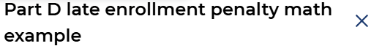
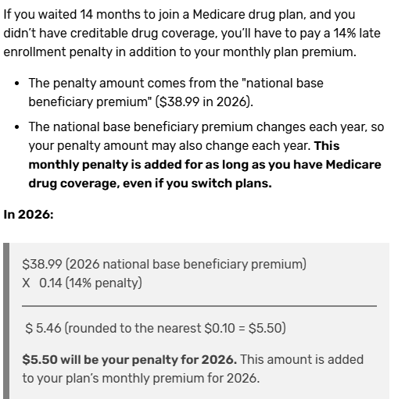
Medicare Part D – Late Enrollment Penalty
Calculation: multiple 1% x times “national base beneficiary premium” ($38.99 in 2026) x number of full, uncovered months where eligible to join Medicare drug coverage but didn’t (and didn’t have other coverage).
Amount rounded to nearest $.10 and added to monthly premium.
Extra Help beneficiaries do not need to pay penalties
Notes:
https://www.medicare.gov/drug-coverage-part-d/costs-for-medicare-drug-coverage/part-d-late-enrollment-penalty

Slide 11
Medicare Part D – Formulary
CMS set guidelines
  Formularies must cover beneficiaries in both community and long-term care settings
  Minimum coverage criteria: 2 drugs per therapeutic category/class
  Majority of drugs in 6 protected classes are covered:
    antidepressants, antipsychotics, anticonvulsants, antiretroviral, immunosuppressant, antineoplastics
  Exceptions:
    multi-source brands of the identical molecular structure
    extended release products when the immediate-release product is included
    products that have the same active ingredient or moiety
    dosage forms that do not provide a unique route of administration (e.g., tablets and capsules versus tablets and transdermals)
Notes:
https://www.cms.gov/Medicare/Prescription-Drug-Coverage/PrescriptionDrugCovContra/Downloads/Part-D-Benefits-Manual-Chapter-6.pdf
Most up-to-date version can always be found here: https://www.cms.gov/medicare/coverage/prescription-drug-coverage-contracting/prescription-drug-benefit-manual

Slide 12
Medicare Part D – Formulary (cont.)
Per CMS, the following drug classes are excluded from coverage under Part D:
  Over-the-counter drugs
  Part A- or Part B-covered drugs
  Excluded drug categories:
    Anorexia/weight loss/weight gain
    Fertility agents
    Agents for cosmetic purposes or hair growth
    Agents for symptomatic relief of coughs and colds
    Prescription vitamins and minerals (except prenatal and fluoride preparations)
    Erectile dysfunction
Notes:
https://www.cms.gov/Medicare/Prescription-Drug-Coverage/PrescriptionDrugCovContra/Downloads/Part-D-Benefits-Manual-Chapter-6.pdf
Most up-to-date version can always be found here: https://www.cms.gov/medicare/coverage/prescription-drug-coverage-contracting/prescription-drug-benefit-manual

Slide 13
Medicare Part D – Formulary (cont.)
Drug formularies are specific to each plan (i.e., coverage will vary from plan to plan)
  Copayment or co-insurance vary
Restrictions on coverage can include:
  Prior authorization (PA)
  Quantity limits (QL)
  Step therapy (ST)
Upcoming drug maintenance and negative formulary changes require a 60-day member notification
  Includes PA, QL, and ST notifications
Notes:
https://www.cms.gov/Medicare/Prescription-Drug-Coverage/PrescriptionDrugCovContra/Downloads/Part-D-Benefits-Manual-Chapter-6.pdf
Most up-to-date version can always be found here: https://www.cms.gov/medicare/coverage/prescription-drug-coverage-contracting/prescription-drug-benefit-manual

Slide 14
Medicare Part D – 2026* Standard Benefit Limits
Part D Coverage Phases
Deductible period: Pay for covered prescription drugs until deductible met.
Initial coverage period: After deductible met, pay copayment or coinsurance until reach $2,100 out-of-pocket costs for 2026.
Catastrophic coverage: After $2,100 in out-of-pocket costs for covered drugs, pay $0 for covered drugs.
Members are responsible for:
  Monthly premium (set by the plan)
  Annual deductible (≤$615 in 2025)
  Health plan drug coverage (copay/coinsurance set by the plan)
* Deductibles, initial, and catastrophic amounts/limits can change. Consult updated resources for current numbers: https://www.medicareinteractive.org/get-answers/medicare-prescription-drug-coverage-part-d/medicare-part-d-costs/phases-of-part-d-coverage
Notes:
https://www.medicare.gov/health-drug-plans/part-d/basics/costs
https://www.medicareinteractive.org/get-answers/medicare-prescription-drug-coverage-part-d/medicare-part-d-costs/phases-of-part-d-coverage

Slide 15
Medicare Part D – Inflation Reduction Act
The prescription drug provisions included in the Inflation Reduction Act will:
Require the federal government to negotiate prices for some drugs covered under Medicare Part B and Part D with the highest total spending, beginning in 2026
Require drug companies to pay rebates to Medicare if prices rise faster than inflation for drugs used by Medicare beneficiaries, beginning in 2023
Cap out-of-pocket spending for Medicare Part D enrollees and make other Part D benefit design changes, beginning in 2024
Limit monthly cost sharing for insulin to $35 for people with Medicare, beginning in 2023
Eliminate cost sharing for adult vaccines covered under Medicare Part D and improve access to adult vaccines in Medicaid and CHIP, beginning in 2023
Expand eligibility for full benefits under the Medicare Part D Low-Income Subsidy Program, beginning in 2024
Further delay implementation of the Trump Administration’s drug rebate rule, beginning in 2027
Notes:
https://www.kff.org/medicare/issue-brief/explaining-the-prescription-drug-provisions-in-the-inflation-reduction-act/
FAQs about the Inflation Reduction Act’s Medicare Drug Price Negotiation Program | KFF

Slide 16
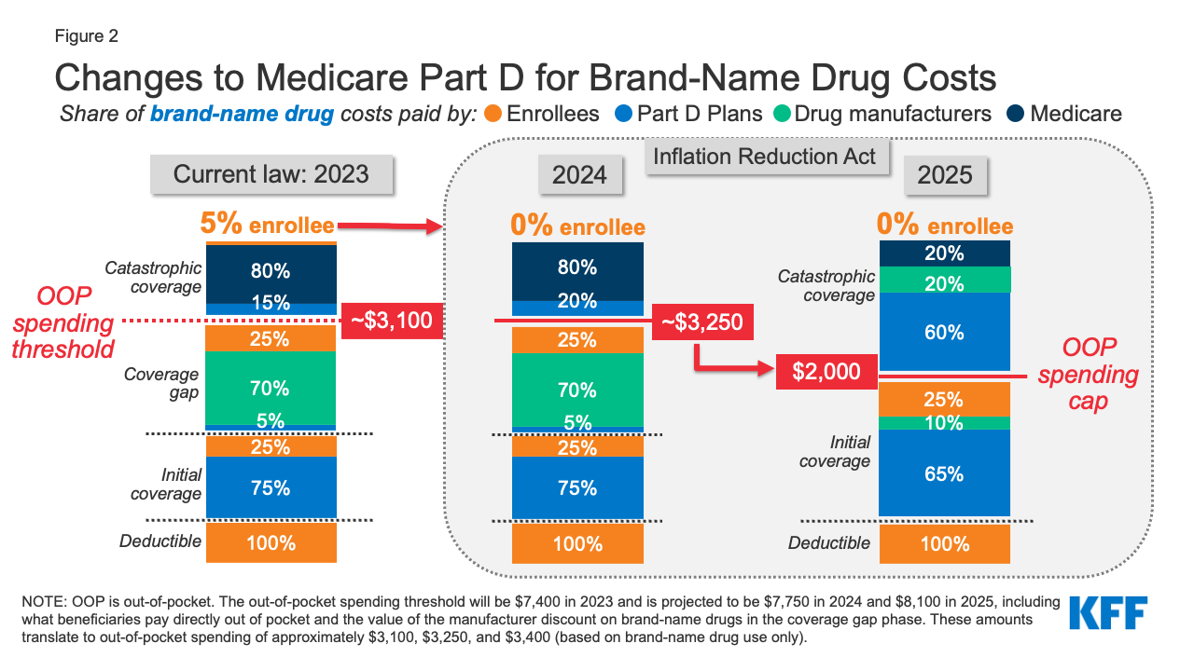
Medicare Part D – Inflation Reduction Act
2024: Law eliminated the 5% coinsurance requirement above the catastrophic coverage threshold, effectively capping OOP costs at $3,250
2025: adds a hard cap on OOP spending of $2,000 (indexed in future years to rate of increase in per capita Part D costs - $2,100 in 2026)
* Deductibles, initial, and catastrophic amounts/limits can change. Consult updated resources for current numbers: https://www.medicareinteractive.org/get-answers/medicare-prescription-drug-coverage-part-d/medicare-part-d-costs/phases-of-part-d-coverage
Notes:
https://www.kff.org/medicare/issue-brief/explaining-the-prescription-drug-provisions-in-the-inflation-reduction-act/

Slide 17
Medicare Part D – Low Income
Dual eligible: Medicaid beneficiaries eligible for Medicare
  Medicare Savings Program (MSP) categories include:
    Qualified Medicare Beneficiary (QMB) Program
    Specified Low-Income Medicare Beneficiary (SLMB)
    Qualifying Individual (QI) Program
    Qualified Disabled Working Individual (QDWI) Program
Extra Help: Federal program that helps pay for some to most of the OOP costs of Part D drugs. Also known as Part D Low-Income Subsidy (LIS)
Notes:
https://www.medicare.gov/medicare-savings-programs
https://www.medicareinteractive.org/get-answers/cost-saving-programs-for-people-with-medicare/the-extra-helplow-income-subsidy-lis-program/extra-help-basics

Slide 18
Medicare Part D – Extra Help Example
Extra Help in 2025
Plan premium: $0
Plan deductible: $0
Prescriptions:
  Up to $12.65
Note: Some plan co-pays may be lower (e.g., $2.00 copay for generic medication).
Notes:
https://www.medicare.gov/medicare-savings-programs
https://www.medicareinteractive.org/get-answers/cost-saving-programs-for-people-with-medicare/the-extra-helplow-income-subsidy-lis-program/extra-help-basics

Slide 19
Medicare Part D – Explanation of Benefits (EOB)
Part D members receive an EOB for each month they fill a prescription, which allows members to monitor their benefit status
Includes a summary of the services and items you received, how much was paid, and how much is owed
An EOB is not a bill, and not the same as a Medicare Summary Notice
Notes:
https://www.medicareinteractive.org/get-answers/medicare-denials-and-appeals/medicare-advantage-appeals/explanation-of-benefits-eob
https://www.medicare.gov/basics/forms-publications-mailings/mailings/costs-and-coverage/explanation-of-benefits

Slide 20
Medicare Part D – Additional Resources
Centers for Medicaid & Medicare Services
  ww.cms.gov
Medicare Plan Finder - Official US government site for Medicare (can compare health and drug plans, https://www.medicare.gov/plan-compare
  www.medicare.gov

Slide 21

Mission
To improve patient health by ensuring access to
high-quality, cost-effective medications and other therapies.

