Slide 1
Health Care Provisions of the Inflation Reduction Act (IRA)
Created by the School of Pharmacy Relations Committee for AMCP
Last Updated March 2026

Slide 2
Objectives
Identify health care provisions of the Inflation Reduction Act (IRA)
Recognize details of Medicare Part D redesign
Define insulin price cap
Describe inflationary rebate penalties and implications
Explain concepts of the Medicare Drug Price Negotiation Program (MDPN) including eligibility, exemption criteria, timeline for implementation, drugs, and value assessment
Assess challenges and implications for managed care pharmacy

Slide 3
Health Care Provisions of the Inflation Reduction Act (IRA)
Goal: To make improvements to Medicare (the largest public health insurer in the US) that will expand healthcare benefits and lower drug costs
Signed into law by the US government in August 2022
Key provisions:
Medicare Part D redesign
Insulin price cap
Inflationary rebate penalties
Medicare Drug Price Negotiation Program

Slide 4
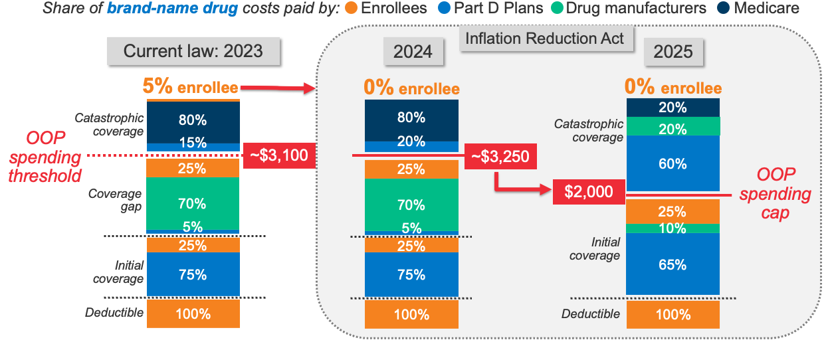
Medicare Part D Redesign
Shifts cost burden for brand-name drugs from beneficiaries to health plans and drug manufacturers
Limits out-of-pocket (OOP) spending on drugs for Medicare beneficiaries to $2,000 per year (increased to $2,100 in 2026)
Manufacturer discount program replaces the coverage gap (donut hole)
Introduces a "smoothing" mechanism allowing beneficiaries to spread out their OOP costs over the course of the year
Removes coinsurance for beneficiaries during the catastrophic phase (catastrophic 20% manufacturer discount + 60% plan liability)
Figure from the Kaiser Family Foundation
Notes:
The OOP threshold will be $7,400 in 2023 and is projected to be $7,750 in 2024 and $8,100 in 2025, including what beneficiaries pay directly out of pocket and the value of the manufacturer discount on brand-name drugs in the coverage gap phase. These amounts translate to OOP spending of ~$3,100, $3,250, and $3,400 (based on brand-name drug use only).

Slide 5
Insulin Price Cap and Inflationary Rebate Penalties
Insulin Price Cap
The Inflation Reduction Act (IRA) requires that all Medicare Plans charge no more than $35 per month for all covered insulins
Insulins covered under Part D went into effect on January 1, 2023
Insulins covered under Part B went into effect on July 1, 2023
Inflationary Rebate Penalties
Under the Inflation Reduction Act, drug prices that rise faster than the rate of inflation are subject to penalties
Inflationary rebates are calculated based on price increases above Consumer Price Index for Urban Consumers (CPI-U) since drug’s base date; rebate is paid by manufacturers to CMS
Notes:
Source: https://www.kff.org/policy-watch/the-facts-about-the-35-insulin-copay-cap-in-medicare/

Slide 6
Medicare Drug Price Negotiation (MDPN) Program
Centers for Medicare & Medicaid Services (CMS) has the authority to directly negotiate the price of certain high-cost drugs with manufacturers to establish a maximum fair price (MFP) for Medicare beneficiaries
Negotiations will occur annually in a phased approach, starting with a small number of drugs and gradually expanding over time
Selected drugs will focus on the most expensive and widely used medications within Medicare. Priority will be given to those that lack generic or biosimilar competition
MFP is based on reference pricing and comparative clinical/economic value assessment relative to therapeutic alternatives
Medicare is required to cover negotiated drugs at the agreed-upon price but may apply formulary management strategies (i.e., step-therapy, prior authorization)

Slide 7
Medicare Drug Price Negotiation (MDPN) Program
Changes to orphan drug identification and timeline for selection after One Big Beautiful Bill Act (OBBBA) changes
For IPAY 2028 and after - orphan drugs designated as a drug for one or more rare diseases or conditions will be excluded from the definition of qualifying single source drug (QSSD)
Previous exemption was limited to orphan drugs designated as a drug for only a single rare disease or condition
IPAY 2028 and after, the time for measuring a former orphan drug's eligibility to be a QSSD will be calculated from the first day after the date of the drug's approval for which the drug does not have orphan drug designation
Increases the time for orphan drugs to be exempt from eligibility for selection

Slide 8
MDPN Program Eligibility and Exemption Criteria
Eligible
Brand-name drugs or biologics without generic or biosimilar competitors
Small molecules: 7 years post-approval
Biologics: 11 years post-approval
Physician-administered and prescription drugs covered by Medicare
Exempt
Drugs with a single orphan indication
Less than $200M in Medicare expenditure
Plasma-derived products
Small biotech drugs (<1% of Medicare expenditure and ≥80% of the total Medicare expenditures for all the manufacturer’s drugs)

Slide 9
Key Events for Price Applicability Year 2027
January 17, 2025
CMS published list of 15 Part D drugs selected for negotiation in 2027
June 1, 2025
Deadline for CMS to submit to manufacturers proposed offer for the MFP
September 30, 2025
Deadline for completion of up to 2 additional negotiation meetings
November 30, 2025
Publication of negotiated MFP
March 1, 2025
Deadline for manufacturers to submit economic and market data to CMS
July 1, 2025
Deadline for manufacturers to respond to CMS’ proposed MFP offer and accept or submit counteroffer
October 31, 2025
Deadline for manufacturers to accept or reject final offer
January 1, 2027
Application of MFP for selected drugs
February 28, 2025
Deadline to sign voluntary agreement to negotiate MFP
June 2025
Optional negotiation meeting between CMS and manufacturers
October 15, 2025
Deadline for CMS to make a final written MFP offer to manufacturers
March 1, 2026
Deadline for CMS to publish the public explanation for the negotiated MFP
Spring 2025
CMS hosts patient-focused round-table events with patients, consumer groups, and clinicians
July 31, 2025
Deadline for CMS to respond to manufacturers MFP counteroffer
November 1, 2025
Deadline for completion of price negotiation process
If CMS rejects the counteroffer, up to 2 additional meetings between CMS and the manufacturer may occur to negotiate counteroffers
Key: CMS, Centers for Medicare & Medicaid Services; MFP, maximum fair price.
FAQs about the Inflation Reduction Act’s Medicare Drug Price Negotiation Program. Kaiser Family Foundation. Published January 23, 2025. https://www.kff.org/medicare/issue-brief/faqs-about-the-inflation-reduction-acts-medicare-drug-price-negotiation-program/
Notes:
https://www.kff.org/medicare/issue-brief/faqs-about-the-inflation-reduction-acts-medicare-drug-price-negotiation-program/

Slide 10
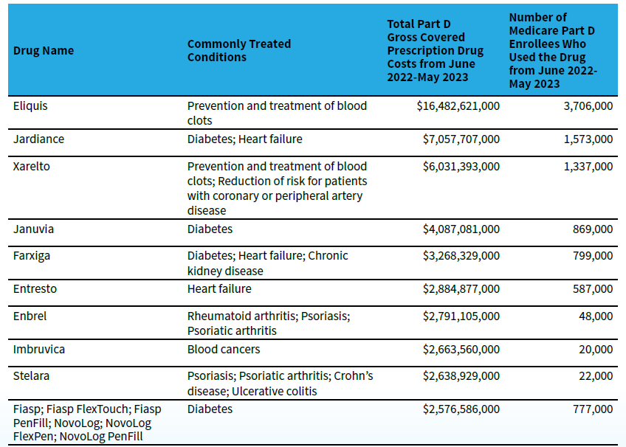
MDPN Program Selected Drugs
IPAY 2026
https://www.cms.gov/files/document/fact-sheet-negotiated-prices-initial-price-applicability-year-2026.pdf
https://www.cms.gov/files/document/factsheet-medicare-negotiation-selected-drug-list-ipay-2027.pdf

Slide 11
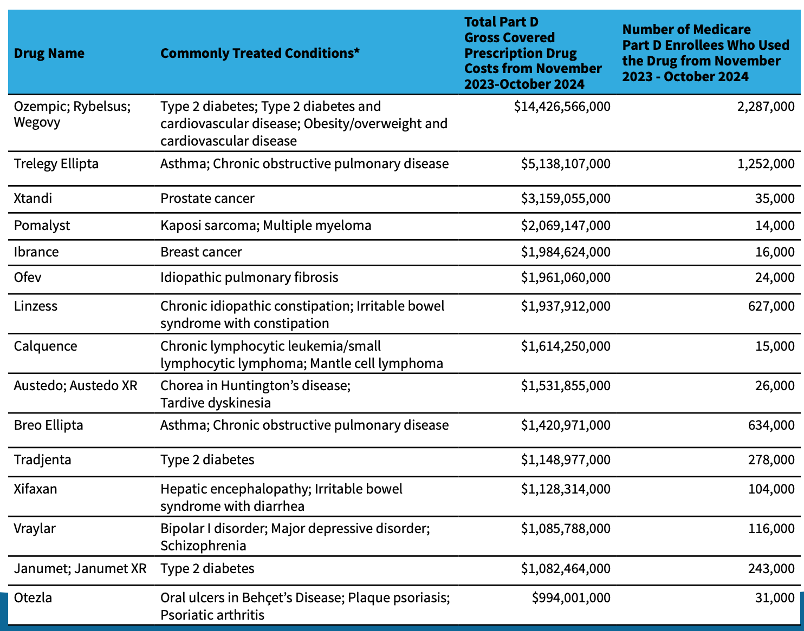
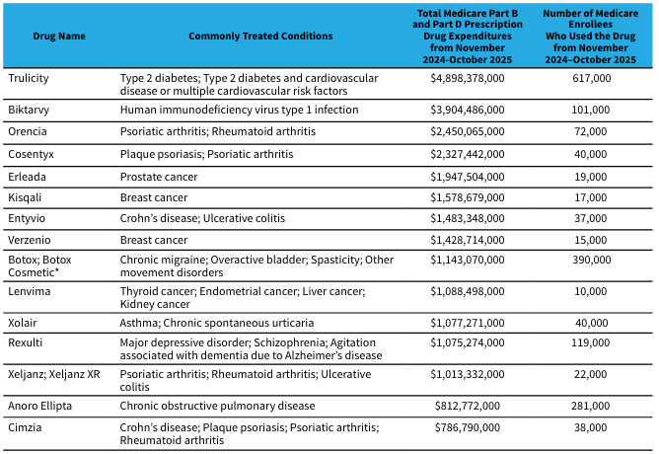
MDPN Program Selected Drugs
IPAY 2027
IPAY 2028
https://www.cms.gov/files/document/fact-sheet-negotiated-prices-initial-price-applicability-year-2026.pdf
https://www.cms.gov/files/document/factsheet-medicare-negotiation-selected-drug-list-ipay-2027.pdf

Slide 12
MDPN Value Assessment Process
Reference pricing against therapeutic alternatives
Comparative evaluation vs therapeutic alternatives
Manufacturers can submit a dossier of evidence (Section I)
Public provides input and can submit relevant evidence
CMS performs their own evaluation
Potential price adjustments based on manufacturer financial data
Outcomes assessed
Efficacy/effectiveness
Safety
Patient-reported
Economic
Subgroup data
Evidence types considered
Clinical trials (naive comparisons)
ITCs/NMAs
RWE
Economic studies (excluding QALYs)

Slide 13
Additional Notes and Considerations
Medicare Part B
IRA inflationary rebates and negotiation program both apply to physician-administered drugs under Part B
Affects specialty pharmacy contracting, buy-and-bill, and competitive dynamics between Part B and Part D pathways for biologics
Biosimilars
A drug loses negotiation eligibility once a biosimilar enters; manufacturers have an incentive to either delay biosimilar entry or price-protect ahead of it

Slide 14
Challenges and Implications for Managed Care Pharmacy
Higher cost burden for health plans and manufacturers may lead to cost-containment pressures such as increased premiums, more restrictive formularies, and changes in manufacturer pricing and patient support programs
Emphasis on comparative clinical and economic value may encourage broader adoption of value-based pricing strategies by health plans
Health plans will need to plan for drugs undergoing negotiations and revise their formularies and management strategies to adapt to the agreed-upon prices
Negotiated prices are publicly available and may influence the contracting and pricing strategies of commercial health plans for both negotiated drugs and therapeutic alternatives
Negotiations may discourage drug innovation and the development of novel medications by shortening the period during which a drug can generate revenue/recoup R&D costs, as the eligibility period is shorter than the typical patent lifespan

Slide 15
Resources
https://www.cms.gov/inflation-reduction-act-and-medicare
https://www.kff.org/medicare/issue-brief/explaining-the-prescription-drug-provisions-in-the-inflation-reduction-act/
https://www.HHS.com/org
https://www.hhs.gov/sites/default/files/ira-postcard-drug-law-english.pdf
https://www.kff.org/policy-watch/the-facts-about-the-35-insulin-copay-cap-in-medicare/

Slide 16

Mission & Vision
To improve patient health by ensuring access to
high-quality, cost-effective medications and other therapies.

