Slide 1
Accountable Care Organizations and Patient-Centered
Medical Homes
Created by the School of Pharmacy Relations Committee for AMCP
Updated: January 2026

Slide 2
Objectives
Describe some issues regarding delivery and payment of healthcare services in United States
Describe Accountable Care Organizations (ACO)
Describe Patient-Centered Medical Homes (PCMH)
List the differences between ACO and PCMH

Slide 3
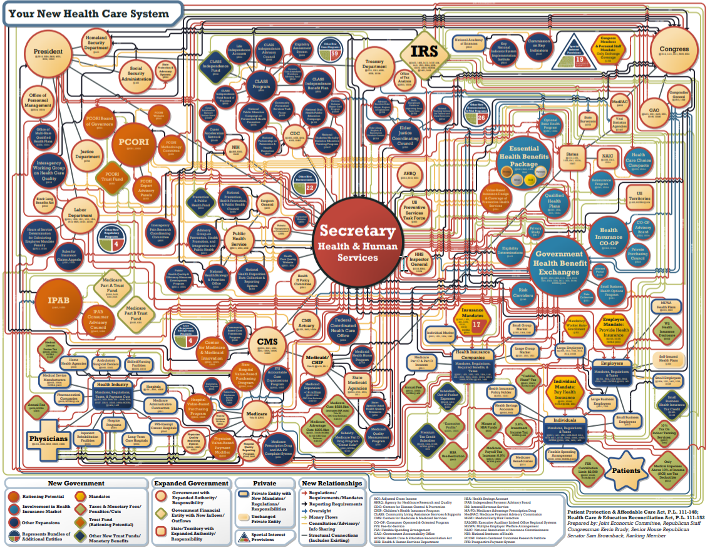
US Healthcare System
Healthcare Chart. Joint Economic Committee
https://www.jec.senate.gov/public/index.cfm/republicans/2010/8/america-s-new-health-care-system-revealed
Accessed November 3, 2024
Notes:
Our healthcare system is a complex, intricate matrix of different stakeholders. With the myriad of stakeholders involved, providing and paying for care becomes complex as well. As a result, our healthcare system is one of the worse performing system among the developed countries.

Slide 4
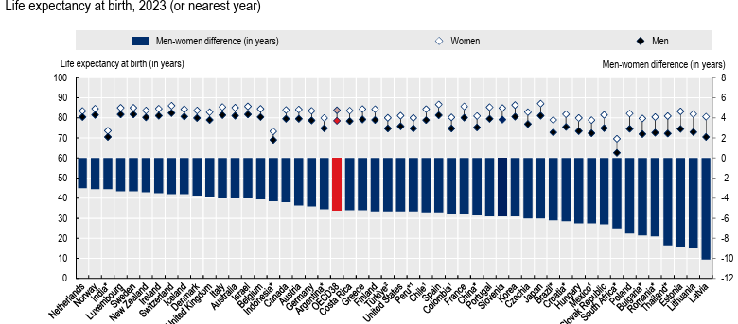
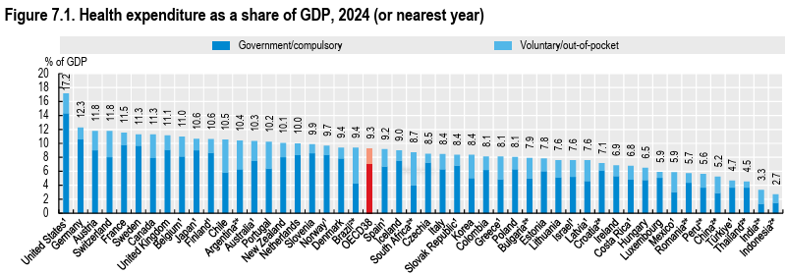
US Healthcare System – Outcomes
OECD (2025), Health at a Glance 2025: OECD Indicators, OECD Publishing, Paris, https://doi.org/10.1787/8f9e3f98-en. Accessed January 20, 2026.
Notes:
US spends almost 2x the avg of the OECD countries per-capita
But performs below avg on many measures. In this slide, we see that US life expectancy is less than the OECD avg. In fact, it is less than the life expectancy of countries like Chile.
There are many reasons for this disconnect between how much we spend for healthcare and what we get in return. One reason is the complexity of the US healthcare system.

Slide 5
US Healthcare System – Issues
Fee-for-Service Model
Providers until recently were paid based on the quantity and complexity of services provided
Payment was not linked to outcomes
No incentive for provider associated with patient outcomes
Fragmented Care Delivery
Seamless transfer of patient information is lacking
Care navigation in the complex healthcare system is challenging for the patient
Inefficient delivery of care and unnecessary services
Notes:
The fee-for-service model often leads to Increased utilization and not necessarily improved outcomes. This is a result of misaligned incentives.
Fragmented care delivery
Often it happens that a patient is referred to a specialist by his/her primary care physician. However, seamless transfer of information doesn’t happen. The primary care physician does not know what the specialist is doing and the specialist does not know what the PCP is doing. The patient who often has poor levels of health literacy doesn’t know what the healthcare providers are doing. The care navigation is often a challenge.
We see that there are issues related to the way we pay for and deliver healthcare. Changes in the way we deliver and pay for care are necessary

Slide 6
Innovative Models
Accountable Care Organizations
Patient-Centered Medical Homes
Notes:
These 2 models change way we pay for and deliver care. These models often exist together; however, there are differences between these two models.

Slide 7
Accountable Care Organizations
“Groups of doctors, hospitals, and other health care professionals that work together to give patients high-quality, coordinated service and health care, improve health outcomes, and manage costs.”
- CMS
CMS. Accountable Care Organizations (ACOs): General Information. https://www.cms.gov/priorities/innovation/key-concepts/accountable-care-and-accountable-care-organizations. Accessed on January 20, 2026.
Notes:
The CMS defines ACO as the following: Accountable Care Organizations (ACOs) are groups of doctors, hospitals, and other health care providers, who come together voluntarily to give coordinated high quality care to the Medicare patients they serve. Coordinated care helps ensure that patients, especially the chronically ill, get the right care at the right time, with the goal of avoiding unnecessary duplication of services and preventing medical errors. When an ACO succeeds in both delivering high-quality care and spending health care dollars more wisely, it will share in the savings it achieves for the Medicare program.
However, this definition fails to recognize the most important feature of an ACO – value-based reimbursement.
In this model, financial incentives/penalties are tied to the outcomes of the patients. In other words, if patients/population meet certain benchmarks, the participating provider/health system get a bonus. If the patients/population do not meet the benchmarks, the participating provider/health system get penalized.

Slide 8
Accountable Care Organizations
Long-term Enhanced ACO Design (LEAD) Model
ACO Primary Care Flex Model
ACO REACH
EOM (Enhancing Oncology) Model
KCC (Kidney Care Choices) Model
Primary Care First Model Options
Vermont All-Payer ACO Model
Features
Upside vs downside risk
Access to capital upfront
Percentage – risk/earnings sharing
Notes:
https://www.cms.gov/priorities/innovation/models?cat=Accountable+Care+Models
There are many ACO models – govt sponsored and Commercial. These models are value-based reimbursement models where the participating providers/health systems are provided a bonus/penalized based on how the population performs.
They differ based on
Upside vs downside risk – some models like the Medicare Shared Savings Program have little to no downside risk. This means that if the population does not perform well, the provider/health system is not penalized. However, if the population is achieving healthier outcomes, the participating provider/health system has an opportunity to get a share of the savings. In other models like the Next Generation ACO model, there is both upside and downside risk (both rewards and penalties)
Access to capital upfront – to improve access in rural areas, health systems are provided capital upfront to set up ACOs in areas of unmet need
Percentage – risk/earnings sharing: There is a lot of variation on the percentage of savings that are shared between the payers and the participating health system

Slide 9
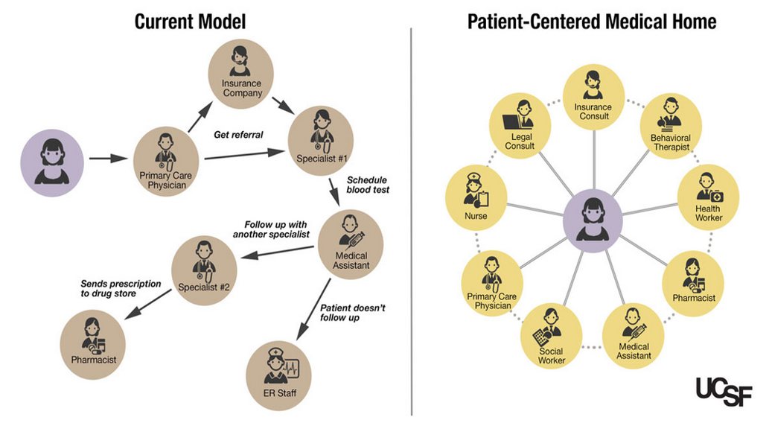
Patient-Centered Medical Home
University of California San Francisco. A Team-Based Approach to Primary Care. https://www.ucsf.edu/news/2014/08/116856/team-based-approach-primary-care. Accessed on November 3, 2024.
Notes:
While ACO addresses the way we pay for care for the most part, PCMH changes the way we deliver care. Systems and processes are put in place to make sure that the patient receives holistic care. Additionally, these systems are required to ensure seamless transfer of information, increased access (extended hours)… The next slide discusses the core components of the PCMH model.

Slide 10
Patient-Centered Medical Home
5 Core Functions
Comprehensive Care
Quality and Safety
Coordinated Care
Patient-Centered Care
Accessible Services
NCQA (2024). "Patient-Centered Medical Home (PCMH)." Retrieved November 3, 2024, from https://www.ncqa.org/programs/health-care-providers-practices/patient-centered-medical-home-pcmh/
Notes:
These are the core functions that are necessary for the practice to get PCMH-certified.
Comprehensive care- The PCMH is oriented toward the “whole person” and is responsible for addressing all the patient’s physical and mental acute, chronic, and preventive health care needs. This involves the direct provision of the appropriate care when possible or arranging for other qualified professionals (such as specialists) to provide care when necessary. Care within the primary care setting is delivered by a team rather than a single clinician, so professionals with different skill sets are available to meet the patient’s needs.
Patient-centered approach- The PCMH provides care that is relationship based and tailored to best meet each patient’s needs, values, culture, and preferences. Each patient has the opportunity to build ongoing, trusting relationships with a team of health care professionals. Clinicians seek to engage patients in their health care; provide the support, education, and information they need to make informed health care decisions; and recognize them as important members of the care team. PCMH clinicians and health care professionals use their cultural competence to treat patients with dignity, respect, and compassion, and they seek to meet patients where they are so that care is delivered in the way that best suits the patient’s needs.
Coordinated care- All of a patient’s health care is coordinated by the PCMH, including care received in hospitals, from specialists (including mental and behavioral health specialists), and through community or home-based services and supports. Coordination of care may be facilitated by patient registries, use of health information technology (such as electronic health records), and other methods. To ensure that care is properly coordinated, the PCMH strives to build strong communication with patients and among all members of a patient’s care team. The goal of coordination is greater efficiency through avoidance of duplication of services, synchronization of services so that they have a maximum impact, and ensuring connection of patients to needed services.
Accessibility of services- To ensure that patients are able to access care when they need it, the PCMH offers short wait times for urgent care, enhanced hours, and around-theclock access to the care team via telephone or electronic methods (email, patient portal, etc.). Care teams also seek out and respond to patient preferences regarding access and communication (e.g., whether patients prefer to communicate via email or telephone, and what language they prefer to use when getting care).
Quality and safety- To achieve optimal patient health outcomes and the highest quality of care, the PCMH is committed to quality improvement (QI), performance improvement, patient satisfaction, and population health management. Practices use evidence-based medicine and decision support tools to guide shared decisionmaking and use patient registries to track the health status of their entire patient panel. Practices use data-driven QI methodologies to continuously monitor performance in a variety of care areas. Patients are engaged in QI processes and involved in practice decisionmaking to ensure that care is provided in accordance with patient wants and needs.

Slide 11
Patient-Centered Medical Home
PCMH-certification done by agencies like
NCQA
URAC
Joint Commission
Currently,
More than 10,000 practices housing 50,000 clinicians are recognized by NCQA
NCQA (2026). "Patient-Centered Medical Home (PCMH)." Retrieved January 20, 2026, from https://www.ncqa.org/programs/health-care-providers-practices/patient-centered-medical-home-pcmh/
Notes:
NCQA = National Committee for Quality Assurance
URAC= Utilization Review Accreditation Commission

Slide 12
ACO vs PCMH
ACO
Care delivery frameworks NOT mandated
Financial incentives tied to outcomes
PCMH
Care delivery frameworks necessary for accreditation
NO financial incentives as part of the care delivery framework
Value-based reimbursement model
Care-delivery model
Accreditation/Certification Process
Contractual Agreement

Slide 13
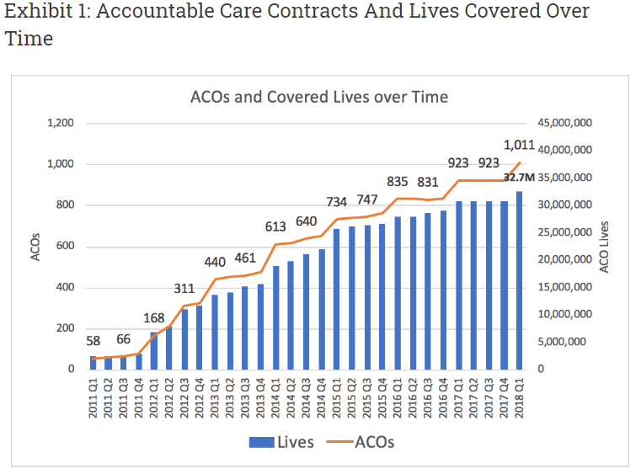
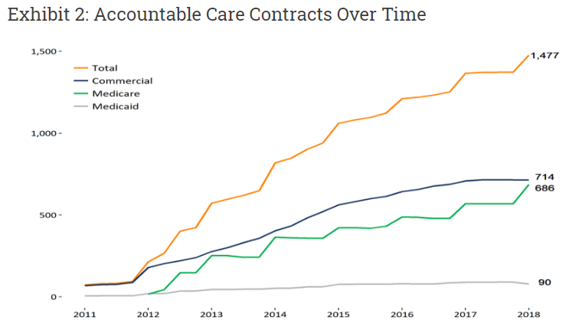
Growth of ACO Contracts
Health Affairs. Recent Progress In the Value Journey: Growth of ACOs and Value-Based Payment Models in 2018. https://www.healthaffairs.org/do/10.1377/hblog20180810.481968/full/. Accessed November 3, 2024.
Notes:
NCQA = National Committee for Quality Assurance
URAC= Utilization Review Accreditation Commission

Slide 14
Challenges to Alternative Payment Models
Only a small portion of providers are signed up for an alternative payment model
Financial risk to providers of changing from their current fee-for-service payment model, having a better understanding on how much incentive they have with a value based payment model
Lack of standardization of systems across providers to make flow of patient data easily obtained to identify gaps in care or coordinate care
Provider lack of knowledge for costs of medical services and medications
Health Affairs. Recent Progress In the Value Journey: Growth of ACOs and Value-Based Payment Models in 2018. https://www.healthaffairs.org/do/10.1377/hblog20180810.481968/full/. Accessed on November 3, 2024.
American Journal of Accountable Care. The Future Success of ACOs Depends on Fixing Current Challenges. https://www.ajmc.com/view/the-future-success-of-acos-depends-on-fixing-current-challenges. Accessed on November 3, 2024.
Notes:
NCQA = National Committee for Quality Assurance
URAC= Utilization Review Accreditation Commission

Slide 15
Resources
Health Affairs. Recent Progress In the Value Journey: Growth of ACOs and Value-Based Payment Models in 2018. https://www.healthaffairs.org/do/10.1377/hblog20180810.481968/full/
https://www.ncqa.org/programs/health-care-providers-practices/patient-centered-medical-home-pcmh/
CMS. Accountable Care Organizations (ACOs): General Information. https://www.cms.gov/priorities/innovation/innovation-models/aco
https://pcmh.ahrq.gov/page/defining-pcmh
OECD (2025), Health at a Glance 2025: OECD Indicators, OECD Publishing, Paris, https://doi.org/10.1787/8f9e3f98-en.
University of California San Francisco. A Team-Based Approach to Primary Care. https://www.ucsf.edu/news/2014/08/116856/team-based-approach-primary-care.
American Journal of Accountable Care. December 10, 2020. The Future Success of ACOs Depends on Fixing Current Challenges. https://www.ajmc.com/view/the-future-success-of-acos-depends-on-fixing-current-challenges.

Slide 16

Mission & Vision
To improve patient health by ensuring access to
high-quality, cost-effective medications and other therapies.
Notes:
Last reviewed and updated by: Thomas Nguyen (November 2024)

