Slide 1
Managed Care Models: Types of Health Plans
Created by the School of Pharmacy Relations Committee for AMCP
Last Reviewed: November 2024

Slide 2
Objectives
Identify types of managed care organizations (MCOs)
Discuss differences between types of MCO Health Plans
Differentiate the level of control and cost per model
Explain the concept of pharmacy networks
Notes:
For a deeper dive into this area, the primary resource: Burns LR. The U.S. Healthcare Ecosystem: Payers, Providers, Producers. 1st ed. McGraw Hill Medical; 2021.

Slide 3
Managed Care Models: Types of Health Plans
Health maintenance organization (HMO)
Preferred provider organization (PPO)
Exclusive provider plan (EPO)
Point-of-service plan (POS)
High-deductible Health Plan (HDHP)
Notes:
For some years going back to the 1980s, HMO and PPO models were the 2 dominant forms of managed care. They are used in commercial, employer sponsored plans & individual coverage, and also Medicare Advantage, as well as managed Medicaid.
Exclusive provider organization (EPO) plans, are like HMO plans in that they have a specific network of providers that members must use, except in the case of an emergency.
This presentation focuses on the employer sponsored plan coverage types.

Slide 4
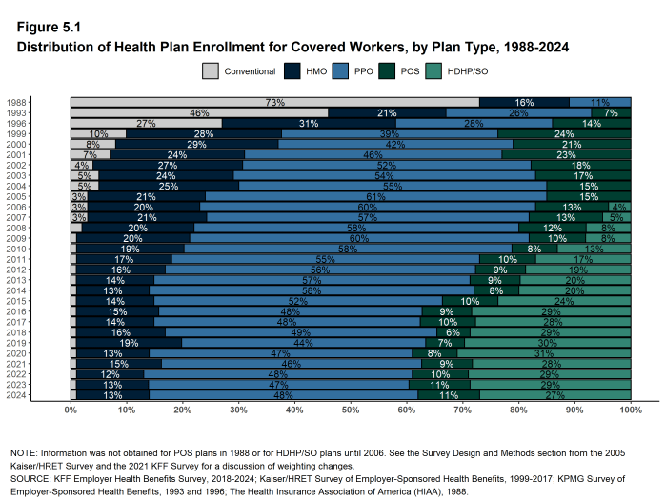
Notes:
https://www.kff.org/report-section/ehbs-2024-section-5-market-shares-of-health-plans/

Slide 5
Characteristics of HMOs
“Gatekeeper” principle
Primary care provider (PCP) serves as a gatekeeper and must authorize all medical services
Services not authorized by the PCP usually not covered
Rationale for gatekeeper is to avoid unnecessary expenses
Preferred networks
Plans will only pay for services provided by healthcare providers that they have contracted with
“In-Network” providers
Plans will not pay for “Out-of-Network” providers
Less choice, but lower premiums

Slide 6
Characteristics of PPOs
No gatekeeper
Patients can choose their own providers without having to use a designated PCP
Preferred networks with some out-of-network coverage
Patient can see any healthcare practitioner they want, but they are financially incentivized to see in-network providers
E.g., Patient pays 10% to see in-network vs. 50% to see out-of-network
More choice, but higher premiums

Slide 7
Characteristics of EPOs
Hybrid of a PPO and HMO
No gatekeeper
Patients can choose their own providers without having to use a designated PCP
Must see a healthcare practitioner that is in-network for coverage
Out-of-network (OON) providers are not covered
Less choice than a PPO, more choice than a HMO
Lower premium than a PPO, higher premium than a HMO

Slide 8
Characteristics of POSs
Hybrid of PPO and HMO
Patients can choose their provider
HMO rates for preferred provider (e.g., gatekeeper PCP)
Costs of out-of-network services determined by providers (NOT contracted rates with health plans)
Providers can collect charges not paid for by the insurance company
Notes:
Costs of out-of-network services determined by providers (NOT contracted rates with health plans)
- for all other plans through this point, the health plan basically sets the price that they will reimburse the provider based on the agreed upon contracted rate. In this case, out-of-network providers set their own rates and patients are responsible for the difference between what is being charged and what the health plan pays.

Slide 9
Characteristics of Models
 | Advantages | Disadvantages
PPO | Most Choice No gatekeeper hassles Most popular model among members | Least popular model among insurers
EPO | Lower cost than a PPO No gatekeeper | Lack of out-of-network coverage
HMO | Low cost Greateast control over cost and quality | Least popular among members Most restrictive
POS | Combines the network contracting characteristics of HMO with the open access of PPO | Administrative complexity Less popular than PPO among members
HDHP | Drives more cost efficiency in the healthcare market | Administrative complexity (eg, savings account)
Table © Steven Kheloussi
Notes:
Adapted from Burns, Healthcare ecosystem, figure 17-5

Slide 10
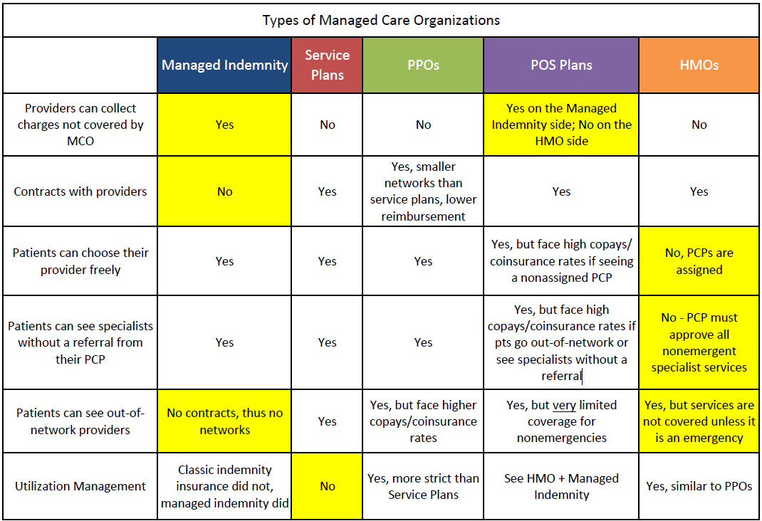
Characteristics of Models
Table © Steven Kheloussi

Slide 11
Characteristics of HDHPs
High-Deductible Health Plans (HDHPs):
Low premiums
High deductibles (usually several thousands of $)
Preventive services covered at $0 cost share
Typically paired with a PPO
All PPO features apply, except that the patient is responsible for a larger portion of the cost upfront

Slide 12
Employer Decision: Benefit Controls vs. Cost
Few Benefit Controls
Higher Cost
Lower Cost
Highly Controlled Benefits
Notes:
Considering all the models of healthcare available, employers must decide on a benefit design for their employees. This involves choosing between offering their employees more choice or lower costs. There is a balance to be achieved. The more patient option, the higher the cost of the plan benefit design.

Slide 13
Benefit Control vs. Cost
Managed Indemnity
Service Plans
PPOs
EPOs
POSs
HMOs
LESS control of medical cost and quality
MORE control of medical cost and quality

Slide 14
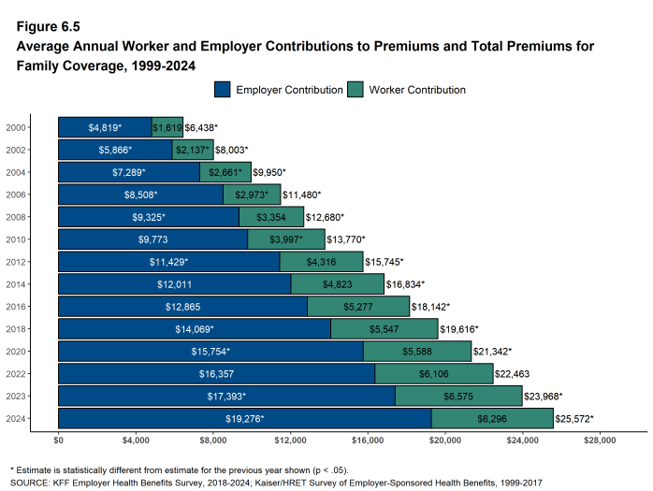
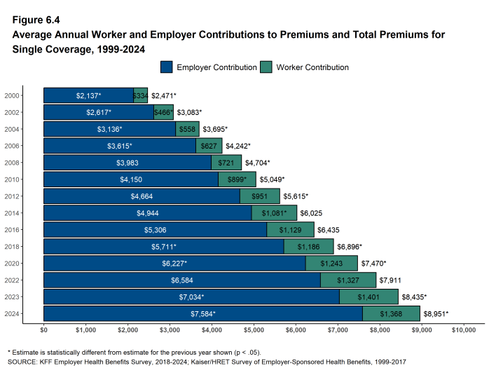
Funding: Employer Coverage
Managed Indemnity
Service Plans
PPOs
HMOs
Notes:
Costs for both employers and members have risen over time, leading to many deliberations and decisions on what type of health plan is selected to offer for employees
https://www.kff.org/report-section/ehbs-2024-section-6-worker-and-employer-contributions-for-premiums/

Slide 15
Pharmacy Networks
Just like with providers, narrow pharmacy networks help control cost
Pharmacies reimbursed less in exchange for more business
Smaller number of pharmacies for patients to go to
Several types of pharmacy networks
Preferred pharmacy networks
Limited pharmacy networks
Specialty pharmacy networks
Neither
Notes:
With preferred pharmacy networks – there are preferred in-network pharmacies, where patients will pay the lowest cost (e.g., $5 copay); non-preferred in-network pharmacies, where patients will pay a slightly higher copay (e.g., $10), and there are out-of-network pharmacies (where patients have no coverage at all).
Being out of network means that the pharmacy cannot process claims through that insurance.
With limited pharmacy networks – there are preferred in-network pharmacies, where patients will have coverage; and there are out-of-network pharmacies, where patients will not.
With “neither” – many, if not all, pharmacies are in-network

Slide 16
Summary
There are many different types of managed care models.
Each model offers a choice to employers who buy these services.
Employers must balance employee choice with cost when choosing.
Plan types are just one way of controlling cost.

Slide 17
References
https://www.metlife.com/stories/benefits/epo-vs-ppo/
https://www.coveredca.com/support/before-you-buy/plan-and-network-types/
https://www.kff.org/health-costs/report/2024-employer-health-benefits-survey/

Slide 18
Mission & Vision
To improve patient health by ensuring access to
high-quality, cost-effective medications and other therapies.
Notes:
Last Reviewed and Updated by Thomas Nguyen (November 2024).

