Slide 1
Consumer-Directed Health Care
Created by the School of Pharmacy Relations Committee for AMCP
Updated: November 2024

Slide 2
What is Consumer-Directed Health Care (CDHC)?
Patients:
Control their own health care spending
Decide what health plan to join
Decide what treatment to receive when
Decide on the provider for their treatment
Notes:
NOTE: in this slide deck – CDHC, CDHP will be used interchangeably
CDHC – consumer directed health care
CDHP – consumer directed health plan

Slide 3
CDHC Features
CDHC consists of health insurance plans that usually have:
A tax-advantaged health savings account (HSA) or health reimbursement account (HRA)
Tools to help make healthcare decisions

Slide 4
How do CDHC Plans Differ from Traditional Health Plans?
Both plans have premiums, but CDHC plans have lower premiums than traditional plans
In CDHC, physicians must work closely with members on evaluating costs as well as risks/benefits

Slide 5
Background of CDHC
With health care costs rising faster than inflation, CDHC is being promoted as a way to combat these costs and still provide quality health care
Shifting costs to patients may empower them to take charge of their own health care
Gives patients incentive to seek out lower-cost providers of care
Patients will likely only use services that they need, as they will be paying more out of pocket (e.g., patients will use a retail clinic for a sore throat vs. a trip to the ER)
Blumenthal D. Employer-sponsored insurance – riding the health care tiger. NEJM. 2006;355(2):195-202.
Notes:
Policymakers, employers, and insurers have a growing interest in an insurance approach named “consumer-directed health care.” This term applies to a broad range of health plan designs such as Health Savings Accounts (HSAs) or Health Reimbursement Accounts (HRAs), but is most commonly used to describe the combination of a high-deductible health insurance plan with a tax-preferred savings account used to pay for routine health care expenses. While HSAs and HRAs are both tax-preferred health accounts, they have different legal requirements and incentives.
https://www.ncbi.nlm.nih.gov/books/NBK44064/

Slide 6
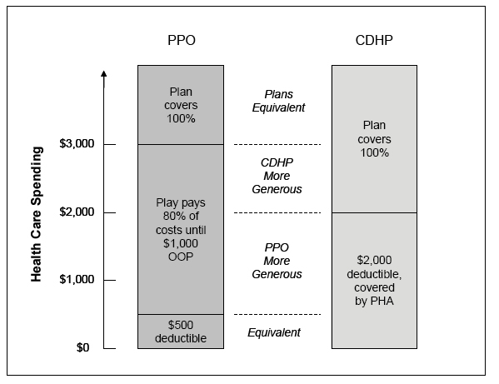
How it works
PHA: Personal Health Account
OOP: Out-of-pocket
CDHP: Consumer Directed Health Plan
PPO: Preferred Provider Organization
Notes:
This slide compares traditional health plans vs CDHP (consumer directed health plans)
As you can see, the deductibles for CDHP plans are much higher. During this time, the patient may use their HRA or HSA dollars to pay for out-of-pocket expenses.
In CDHC with savings option plans, patients pay for health care services with a tax-advantaged or HRA
After the account runs out, the patient pays out of pocket until reaching the deductible and/or out of pocket max
Deductibles in these plans are often more than a traditional plan
It must be noted that, most CDHP plans provide preventive care at little to no cost.

Slide 7
Goals of CDHC Plans with savings options
Reduce costs by discouraging the use of inappropriate services
Encourage patients to compare, shop and request information on cost and quality for services and providers
If patients pay more out of pocket for health care, they may be more prudent in seeking health care services
Providers must then offer higher quality services at affordable rates in order to compete for business
In theory, this will eventually decrease health care costs
Blumenthal D. Employer-sponsored insurance – riding the health care tiger. NEJM. 2006;355(2):195-202.
Haviland A etl al. Do “Consumer-Directed” health plans bend the cost curve over time?. J Health Econ. 2016; 46; 33-51.
Notes:
Implicit in this concept is the theory that requiring patients to take more fiscal responsibility for their healthcare expenditures will make them better educated and more discerning “purchasers” of health care. As in other industries, when consumers become better educated about their choices of goods and services, they demand a higher level of quality and lower costs from suppliers. Providers must compete on the basis of both price and quality to win the business of these consumers. Many experts in the healthcare arena consider CDHC one of the critical market-based forces that will lead to more efficient and cost-effective allocation of scarce healthcare resources.

Slide 8
Health Savings Accounts and Relationship to CDHC plans
Created by the Medicare Modernization Act of 2003
Accounts allow patients enrolled in a HDHP to contribute and withdraw funds tax-free to cover health care costs
Can be contributed by employees and/or employers
Once deposited, the funds belong to the employee, and can travel with them to wherever they work
When the account balance runs out, the patient then pays out of pocket (similar to a regular deductible)
Unused funds can be “rolled over” to the next year
Healthcare.gov (2024) https://www.healthcare.gov/glossary/health-savings-account-hsa/; Accessed November 3, 2024.
Healthcare.gov (2024) https://www.healthcare.gov/high-deductible-health-plan/; Accessed November 3, 2024.
Notes:
In order to have an HSA, individuals must have a high deductible health plan. In a typical CDHC model, individuals with an HSA pay for routine health care expenses out of their savings account. After the accounts are depleted, individuals pay directly out-of-pocket until they have reached the relatively high deductible amount in their health plan. Because the plan has a high deductible, monthly premiums are often lower than traditional health insurance. Consumers may keep any unspent dollars in their account, creating an additional incentive to be cost-conscious when purchasing their health services. Employers or individuals can contribute to the HSAs.

Slide 9
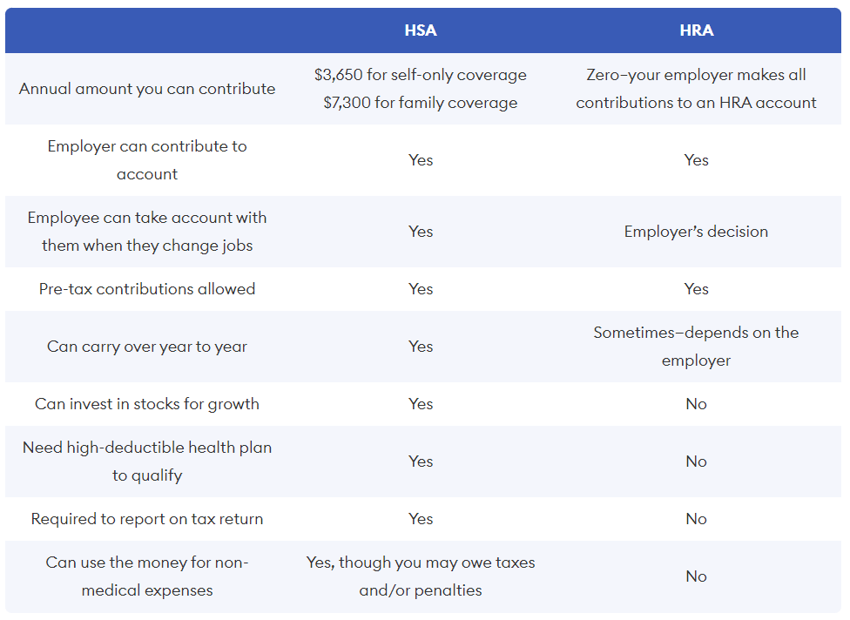
Forbes Advisor. HRA vs. HSA: Which is better for you? https://www.forbes.com/advisor/health-insurance/hra-vs-hsa/ Accessed on November 3, 2024

Slide 10
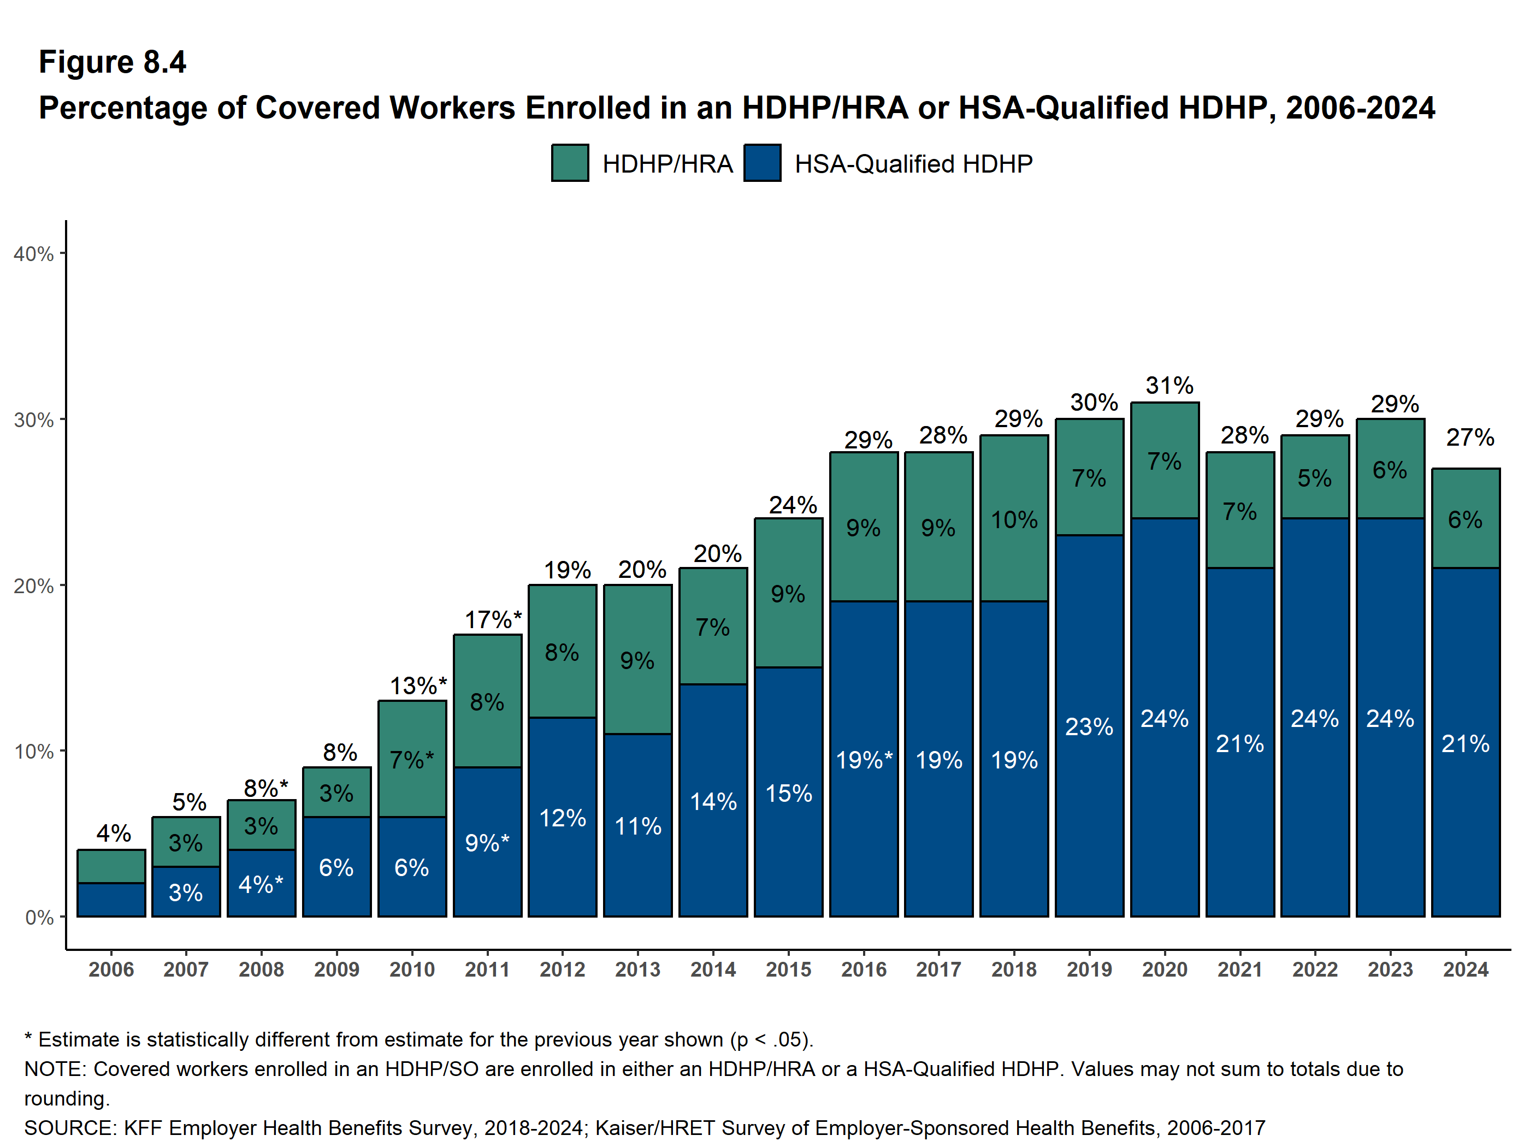
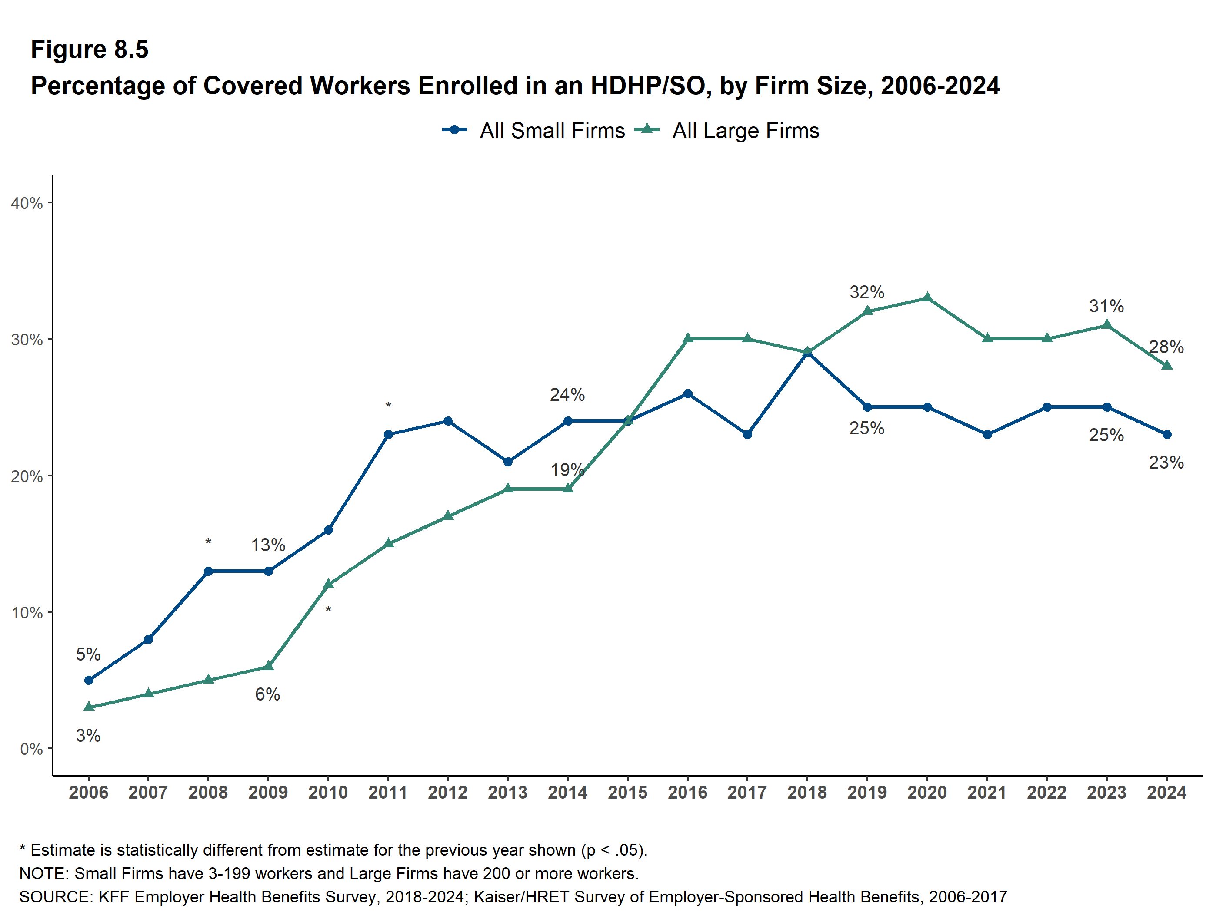
HSA/HRA Adoption
Approximately 30% of employers offer HSA/HRA with their health plan
About 21% of workers are enrolled in a CDHP
2024 Employer Health Benefits Survey. KFF
https://www.kff.org/report-section/ehbs-2024-section-8-high-deductible-health-plans-with-savings-option/
Accessed November 3, 2024
Notes:
https://www.kff.org/report-section/ehbs-2024-section-8-high-deductible-health-plans-with-savings-option/
Please review this source for more charts/graphs and trends.

Slide 11
Other Features of CDHC Plans
Some CDHC plans cover preventive care, routine checkups, lab tests, vaccines, and health screenings
Some have online tools containing medical information for patients (e.g., information on vaccines, hypertension, etc.)
Some offer information on both price and quality of the services and physicians
High-deductible component protects patients against catastrophic medical expenses
Beeuwkes Buntin M. et al, Consumer-directed health care: early evidence about effects on cost and quality. Health Affairs.
2007;25(6):516-530.

Slide 12
The Health Insurance Experiment
The classic, decades-old RAND Health Insurance Experiment confirmed:
Patients used fewer services when they paid more for them out of pocket
Patients reduced the use of necessary and unnecessary services at the same rate
RAND Health. The Health Insurance Experiment: A classic RAND Study Speaks to the Current Reform Debate. Dec 6, 2006. www.rand.org/pubs/research_briefs/RB9174/index1.html
Accessed November 3, 2024.

Slide 13
The Health Insurance Experiment
Patients with CDHC plans generally spent less on health care and used fewer health care services
CDHC plans had mixed effects on quality of care (Patients used more preventive services but some may have forgone care)
Patients had a lower level of satisfaction
Patients lacked adequate information to make informed medical care choices
.
RAND Health. The Health Insurance Experiment: A classic RAND Study Speaks to the Current Reform Debate. Dec 6, 2006. www.rand.org/pubs/research_briefs/RB9174/index1.html
Accessed November 3, 2024.

Slide 14
Pros of CDHC Plans
May lower health care costs
Lowers costs for employers
Patients play a bigger role in managing their health care
May reduce the use of inappropriate health care services
Beeuwkes Buntin M. et al, Consumer-directed health care: early evidence about effects on cost and quality. Health Affairs. 2007;25(6):516-530.
Notes:
Proponents of CDHCs argue that in the current health care system, insured individuals have little perception of the true cost of services because out-of-pocket costs are primarily limited to a share of insurance premium costs, copayments and other cost sharing. Proponents of CDHCs argue that if consumers pay for services directly with funds from an HSA, they will be more cost-conscious of services, and will take initiative to research and make more informed and prudent choices when they purchase services. This would reduce unnecessary health care spending and thus reduce costs. Proponents also argue that CDHCs will reduce the number of uninsured, because the lower premium costs associated with high deductible health plans will be more affordable for the uninsured to purchase. Proponents also posit that the expansion of CDHCs will be an incentive for providers, insurers, and employers to improve health care quality, promote competition, improve consumer knowledge, and make the health system more transparent. To help equip consumers for purchasing decisions, many insurers have developed web-based tools that provide information about common medical treatments as well as basic information about the relative quality and cost of different treatment options and providers. Additionally, health care professionals would also have more incentive to release reports on quality of care and to make quality improvements to attract consumers.

Slide 15
Cons of CDHC Plans
Lack of information on pricing and quality of services and providers
Overall, low health literacy in US
Sicker patients may need to pay more out of pocket and may not be able to afford it
Potential for patients to skip services/care they need
Notes:
Low health literacy is an important point here. If large number of patients have difficulty understanding a prescription label, how will they be able to make good decisions about what type of medical services they need.

Slide 16
Cons of CDHC Plans Continued
May disproportionately attract healthy patients (since premiums are lower in these plans than in traditional plans)
If healthier patients leave traditional plans, then sicker patients left in these plans may drive up costs
This concept is known as adverse selection
Beeuwkes Buntin M. et al, Consumer-directed health care: early evidence about effects on cost and quality. Health Affairs. 2007;25(6):516-530.
Notes:
Some are concerned about whether CDHCs guide health care financing in the proper direction. They warn that CDHCs may adversely affect risk selection and increase out-of-pocket costs for people who are currently insured through traditional insurance. For example, CDHCs may attract a disproportionate share of healthy enrollees with low health spending. This in turn, would leave traditional, comprehensive health plans with a relatively less healthy population who will need to pay more. The potentially high out-of-pocket liability in CDHCs also could deter lower income and chronically ill people from obtaining health services that they need. Furthermore, it is well-documented that a relatively small, disproportionately ill segment of the population accounts for a large share of health care spending. There is little evidence suggesting that this population could reduce expenditures, given their substantial health needs. In fact, individuals with expensive health needs often spend beyond the deductible and out-of-pocket maximum levels. As a result, the incentives in HSA/high deductible health plans may not affect a large share of health care spending. Another area of concern involves how well people can shop for health care services given their health literacy and the state of information technology at this point. Consumer-directed plans presume that people can obtain sufficient information about the price and quality of their health care to make good decisions. However, it is not clear whether the proposed web tools and technologies would be sufficient to help consumers make such complicated decisions. Furthermore, there is little in the way of good information about the costs of different health care services and provider charges.

Slide 17
Considerations
The challenge of a CDHC plan design is to promote cost-consciousness and discourage the use of inappropriate services without deterring patients from seeking needed care
New evidence suggests that CDHC is associated with
Reduction in both appropriate and inappropriate care
Reduction in health services utilization
Consequently, a reduction in health care costs
Beeuwkes Buntin M. et al, Consumer-directed health care: early evidence about effects on cost and quality. Health Affairs. 2007;25(6):516-530.
Agarwal R et al. High-Deductible Health Plans Reduce Health Care Cost and Utilization, Including Us of Needed Preventive Services. Health Affairs. 2017; 36(10)

Slide 18
References
Beeuwkes Buntin M. et al, Consumer-directed health care: early evidence about effects on cost and quality. Health Affairs. 2007;25(6):516-530.
Blumenthal D. Employer-sponsored insurance – riding the health care tiger. NEJM. 2006;355(2):195-202.
2024 Employer Health Benefits Survey. Washington D.C.: Kaiser Family Foundation, Oct 2024. https://www.kff.org/report-section/ehbs-2024-section-8-high-deductible-health-plans-with-savings-option/ Accessed November 3, 2024.
RAND Health. The Health Insurance Experiment: A classic RAND Study Speaks to the Current Reform Debate. Dec 6, 2006. www.rand.org/pubs/research_briefs/RB9174/index1.html Accessed November 3, 2024.
Haviland A etl al. Do “Consumer-Directed” health plans bend the cost curve over time? J Health Econ. 2016; 46; 33-51
Agarwal R et al. High-Deductible Health Plans Reduce Health Care Cost and Utilization, Including Us of Needed Preventive Services. Health Affairs. 2017; 36(10).
Forbes Advisor. HRA vs. HSA: Which is better for you? https://www.forbes.com/advisor/health-insurance/hra-vs-hsa/ Accessed on November 3, 2024.
Healthcare.gov (2024) https://www.healthcare.gov/glossary/health-savings-account-hsa/; Accessed November 3, 2024.
Healthcare.gov (2024) https://www.healthcare.gov/high-deductible-health-plan/; Accessed November 3, 2024.

Slide 19
Mission & Vision
To improve patient health by ensuring access to
high-quality, cost-effective medications and other therapies.
Notes:
Last reviewed and updated by: Thomas Nguyen (November 2024)

