Slide 1
AMCP Format for Formulary Submissions
Created by Steven Kheloussi, PharmD, MBA, FAMCP
Director, Professional Affairs, AMCP
Updated: November 2024

Slide 2
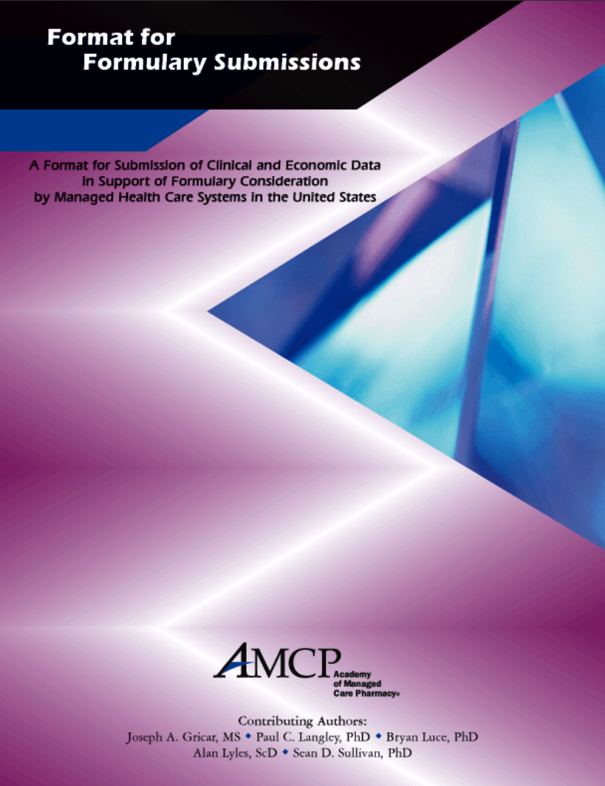
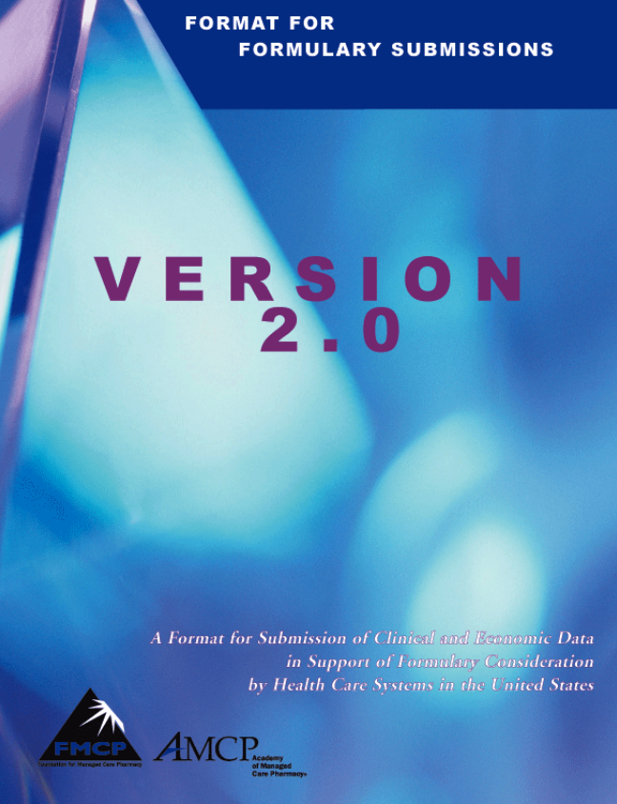
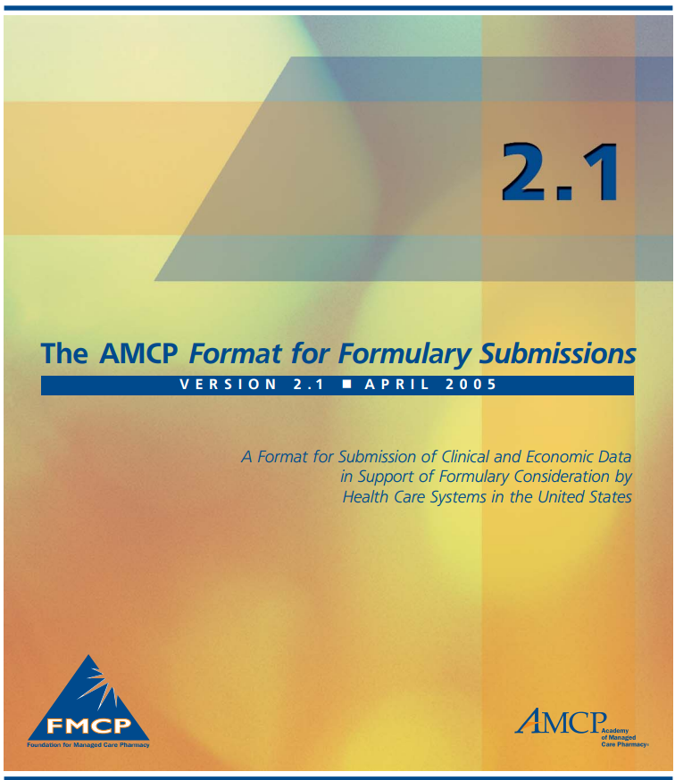
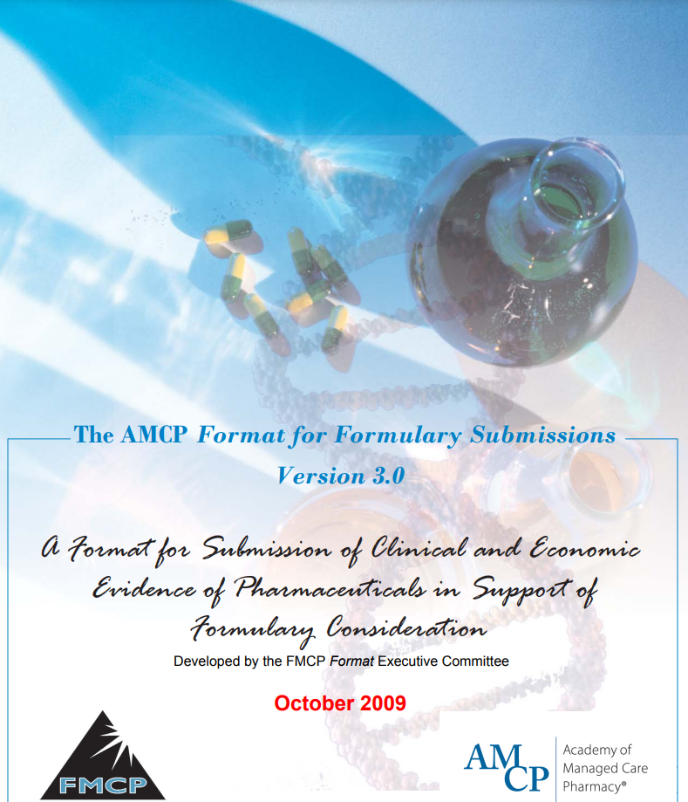
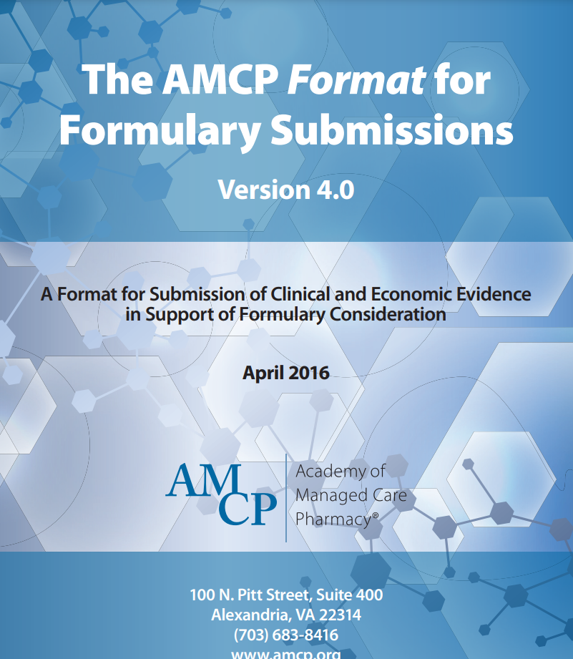
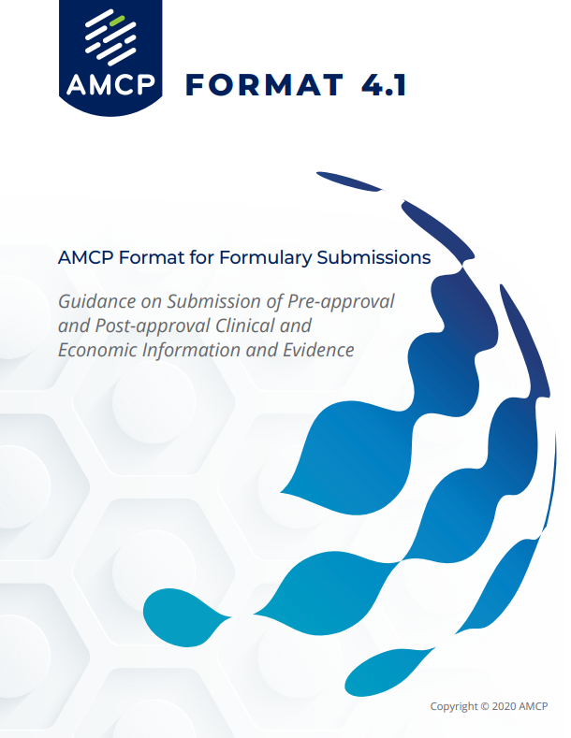
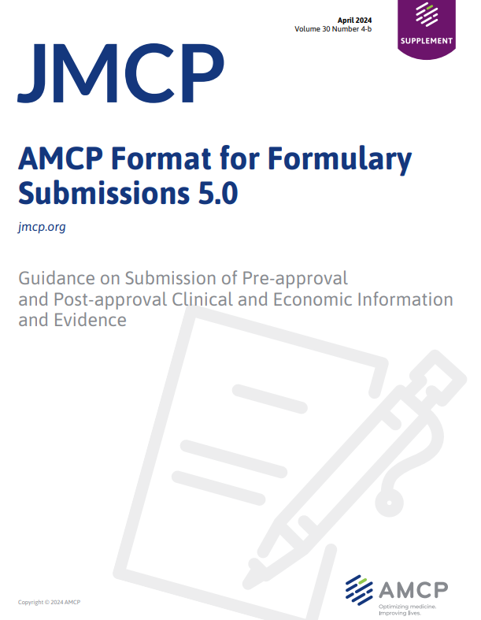
Purpose of the Format
A template and guidance for developing formulary dossiers that:
Supports the informed review, assessment, selection, and payment of medical products
Aims to identify comprehensive evidence and information elements to meet the evidentiary needs of HCDMs
Intended to improve patient care
Notes:
The AMCP Format for Formulary Submissions, also referred to as the AMCP Format, is designed to be a platform for efficient exchange of scientific information about a pharmaceutical product. It is intended to shape the dialogue between pharmaceutical and medical device manufacturers and payer pharmacists and physicians. Pharmaceutical manufacturers develop drug dossiers based on the AMCP Format. The goal is to provide payers with the information they need and the evidence required to allow these healthcare decision-makers to more consistently and efficiently evaluate the product described and support formulary and coverage policy decisions. Within this framework, manufacturers share comprehensive clinical and pharmacoeconomic information including off-label data with healthcare decision makers upon their unsolicited (unprompted) request. The unsolicited portion is important to highlight because it emphasizes that pharmaceutical manufacturers have to be prepared to offer this information if and when it is requested by a payer, so it requires a delicate balance of ensuring adequate, but not excessive, resources are devoted to the creation of a drug or device dossier. As such, the Format helps streamline the development process so that the information is consistently presented in a straightforward way for healthcare decision-makers to follow but also standardized for pharmaceutical manufacturers. Probably the most important part is that the intention is for patient benefit. The Format does so by helping payers and providers make more thorough assessments of emerging products and improve their availability of high value products for the patients that need them.

Slide 3
What is a Dossier?
A detailed overview of a medication (or device) shared by manufacturers to healthcare decision-makers
Three types of dossiers as defined in the Format:
Unapproved Product Dossiers
Approved Product Dossiers
Unapproved Use Dossiers
Notes:
The AMCP Format offers guidance on the development of dossiers for unapproved products, which are those that have yet to gain FDA approval for their use; unapproved uses for approved products, which are products that have received FDA approval for at least one use and are seeking approval for a new indication; and finally, approved products, which are the more traditional dossiers representing products that have gained FDA approval.

Slide 4
Dossier Types
 | Pre-approval Dossiers |  | Approved Product Dossier
 | Unapproved Product Dossier | Unapproved Use Dossier | Approved Product Dossier
What is the purpose? | Communicate information to HCDMs on an unapproved product for which initial FDA approval is being sought | Communicate information to HCDMs on an unapproved use of an approved product for which FDA approval is being sought | Communicate information to an HCDM on an FDA-approved product; can contain off-label information
How long is it? | 30–50 pages | 30–50 pages | 60–90 pages
Can the value proposition be communicated? | No; factual presentation of evidence only; no characterizations or conclusions regarding safety or effectiveness |  | Yes; value story grounded in clinical and economic evidence
What economic content about the product can be included? | Anticipated product price or range | Current or anticipated product price or range if unapproved use(s) are approved | Product price, HEOR, economic models
When should it be available for HCDMs? | Any time before FDA approval (typically, 6 to 12 months prior) | Any time while seeking FDA approval (typically, based on a key milestone) | Any time after FDA approval (typically, soon after)
How is it provided? | At the discretion of the manufacturer |  | Unsolicited request only
Who should provide it? | Personnel with appropriate medical/clinical/scientific credentials, expertise, and responsibilities
Who is the intended audience? | Any healthcare personnel, committee, or organization that uses an evidence-based process for making healthcare coverage and reimbursement decisions for patient populations
Notes:
You’ll see some key differences between these various types of dossiers. Pre-approval dossiers, which are those for unapproved products and unapproved uses for approved products are expected to be shorter than approved product dossiers. And that’s the case for a few reasons, including the third row in this table. When we look at value propositions, unapproved products and unapproved uses for approved products are not meant to demonstrate conclusions regarding safety and effectiveness. They're purely factual information. You should be getting a full value story and robust economic evidence with the approved product dossiers. With unapproved product dossiers, you may get an anticipated price range. For the unapproved use dossier, you may get the price range for the uses that are already approved, and then for the approved product dossier, the price should be communicated, as well as health economics outcomes research, as well as robust economic modeling. You can also see differences in the time ranges for when these dossiers should be provided, and we'll touch again on that shortly. And at the bottom you can see that these are intended for any healthcare personnel, committee, or organization that uses the evidence-based process for making healthcare coverage and reimbursement decisions for their patient populations. These are population-based decision-makers, not individual patient decision-makers.

Slide 5
Format History
1990 | 1999 | 2000 Version 1.0 | 2002‒2009 Versions 2.0 to 3.0
Evidence-based medicine gains traction | Regence BlueShield Guidelines lead to development of AMCP Format | Formalized and standardized information requests, with core requirements for formulary submissions outlined | Further refinements and clarity added to the guidance
2012 Version 3.1 | 2016 Version 4.0 | 2019 Version 4.1 | 2024 Version 5.0
Added guidance on comparative effectiveness research, added evidence requirements for specialty products and CDx | Further refinements and additional considerations, including biosimilars and dossier information before FDA approval | Expanded guidance on pre-approval dossiers, including new terminology for Unapproved Product Dossiers, Unapproved Use Dossiers, and Approved Product Dossiers | Added guidance for Digital therapeutics Health disparities Brevity to streamline dossiers PIE Real-world evidence
Notes:
In the 1990s, there was a growing demand for evidence-based medicine and managed care. It was difficult or impossible for payers to obtain detailed clinical trial reports and outcomes assessments until well after their FDA approval. At that point, this information was still being distributed on paper. The Regence guidelines project back in the late 90s, was based on approaches being developed in Australia, England, and Canada to come up with a framework for sharing information between manufacturers and payers. It was piloted for a couple of years and published in 1999, and then AMCP took up the torch on the work of giving manufacturers guidelines for submitting information to healthcare decision makers. So, AMCP published the first version of the Format for Formulary Submissions in October of 2000. This included several sections from the Regence guidelines project and with the initial versions that were published, AMCP did quite a bit of nationwide education on how to incorporate the Format into practice and continues to do so today, including this webinar! In 2002, so two years after the first version was published, the AMCP Foundation reported that nearly 20 managed care organizations, 35 hospitals, and several Medicaid organizations had incorporated the AMCP Format into their decision-making. Versions 2.0 and 3.0 were published between 2002 and 2009, including the first prototype of the online version that we continue to see today. Additional updates were made from 2012 through 2019 with versions 3.1, 4.0, and 4.1 and most recently, 5.0 in April 2024. And today, the AMCP Format remains the best practice guidance for the transmission of evidence from manufacturers to healthcare decision makers.

Slide 6
Dossier Contents
Pre-approval Dossiers |  | Approved Product Dossier
Unapproved Product Dossier | Unapproved Use Dossier | Approved Product Dossier
Section 1.0 – Highlights and Overview |  | Section 1.0 – Executive Summary
Section 2.0 – Product Information and Disease Description Section 2.1 – Product Information Section 2.2 – Disease Description |  | Section 2.0 – Product Information and Disease Description Section 2.1 – Product Information Section 2.2 – Place of the Product in Therapy Section 2.2.1 – Disease Description Section 2.2.2 – Approaches to Treatment Section 2.3 – Evidence for Companion Diagnostic Tests
Section 3.0 – Clinical Evidence |  | Section 3.0 – Clinical Evidence
Section 4.0 – Economic Information | Section 4.0 – Economic Value & Modeling Report | Section 4.0 – Economic Value & Modeling Report
Section 5.0 – Additional Supporting Evidence Section 5.1 – Clinical Practice Guidelines Section 5.2 – HTAs and Systematic Reviews Section 5.3 – Other Economic or Outcomes Evidence Section 5.4 – Effect on Equity Section 5.5 – Effect on Quality Measures Section 5.6 – Other Evidence or Information | Section 5.0 – Additional Supporting Evidence Section 5.1 – Clinical Practice Guidelines Section 5.2 – HTAs and Systematic Reviews Section 5.3 – Compendia Section 5.4 – Other Economic or Outcomes Evidence Section 5.5 – Effect on Equity Section 5.6 – Effect on Quality Measures Section 5.7 – Other Evidence or Information | Section 5.0 – Additional Supporting Evidence Section 5.1 – Clinical Practice Guidelines Section 5.2 – HTAs and Systematic Reviews Section 5.3 – Compendia Section 5.4 – Other Economic or Outcomes Evidence Section 5.5 – Effect on Equity Section 5.6 – Effect on Quality Measures Section 5.7 – Other Evidence or Information
Section 6.0 – Dossier Appendices
Notes:
Here's a summary of what goes into a dossier and the Format suggests these as the table of contents for each dossier. Section 1 is the Executive Summary. This is where the drug sponsor should summarize the value statement for the medication. You’ll notice this is a bit different between approved product dossiers, which is where that value statement comes in, versus pre-approval dossiers, where section 1 is just the highlights and overview of the product, without making any specific value statements. Section 2 includes the product information and description as well as the disease description. Approved product dossiers will also include information in addition to that, such as place in therapy and any associated companion diagnostics. Section 3 is the clinical evidence from research studies. Section 4 is the economic section, so unapproved dossiers will include projected pricing, while approved product dossiers will include pricing, value assessments, and economic modeling. Section 5 is a great section where the manufacturer can summarize all of the other clinical information that's available outside of research studies. This would include things like guideline recommendations, systematic reviews, compendia, support effects on equity, and so on. And finally, section 6 includes any appendices.

Slide 7
Dossier timing relative to product lifecycle
Unapproved Product Dossier
Approved Product Dossier
Phase 2
Phase 3
NDA Submission
FDA Approval of Product
sNDA Submission
FDA Approval of New Use
Unapproved Use Dossier
Unapproved Use Dossier may coexist with Approved Product Dossier while FDA approval is being sought
Notes:
This slide walks through the timing of when the different types of dossiers are appropriate to develop and share. I think this paints a nice picture of the life cycle of where they're used with regard to NDAs and FDA approval. Although NDA is used in this case, you can easily substitute 510k or other approval pathway. So, you’ll see as products progress through the pre-approval stages, Phase 2 and 3 studies and NDA approval, an unapproved product dossier should be available upon request and may also be proactively shared with health care decision-makers. Once the product is approved, the approved product dossier should be available. Finally, as supplemental NDAs are submitted, unapproved use dossiers should be developed and may coexist with approved product dossiers. Once the new use is approved, the new indication should be built into the approved product dossier.

Slide 8
Conclusion
Gold standard for information exchange between manufacturers and payers
Offers guidance on different types of dossiers
Updated by AMCP approximately every 3 years
Format v5.0 published April 2024

Slide 9
Helpful Resources
AMCP Format 5.0: https://amcp.org/resource/amcp-format-5-formulary-submissions-guidance

Slide 10
Mission & Vision
To improve patient health by ensuring access to
high-quality, cost-effective medications and other therapies.

