Slide 1
Specialty Pharmacy and Biosimilars
Created by the School of Pharmacy Relations Committee for AMCP
Updated: February 2025

Slide 2
Part 1: Specialty Pharmacy

Slide 3
Objectives
Obtain an understanding of specialty pharmaceuticals
Understand the challenges of specialty pharmaceuticals for managed care companies
Describe the value that specialty products bring to the market

Slide 4
Definition of Specialty Pharmaceuticals
Lack of universal definition
“Biologic, biological, biopharmaceutical, biotech”
Can include high cost injectable, infused product, oral agent or inhaled medication
May require close supervision, monitoring and handling requirements
Medicare’s Part D definition for specialty: any drug for which the negotiated monthly price is $670 or more
Can be administered at home, MD office, infusion center or outpatient hospital
Notes:
https://www.hhs.gov/guidance/sites/default/files/hhs-guidance-documents/2021%20mtm%20and%20specialty%20thresholds%20final%20part%20d%20bidding%2005.22.2020_8.pdf
-URAC’s definition is a “product requiring special handling, administration, unique inventory management, a high level of patient monitoring and more intense support than conventional therapies.”
-Each channel by which a patient accesses a drug or treatment has different components/criteria, i.e., specialty vendor, clinicians billing med, benefit design determinations, patient advocates discussing the challenges of access

Slide 5
Impact of Specialty Products
Specialty drugs have been the fastest growing segment of drug spend under the pharmacy benefit.
Specialty pharmacy accounts for more than a third of total healthcare costs, with specialty drugs making up 55% of drug spend - and predicted 65% by 2025 due to a pipeline that's two-thirds specialty drugs.
There were 5,995 drugs in the R&D pipeline in 2001. In January 2024, there were approximately 22,825 drugs in the pipeline.
Notes:
Many of the pipeline drugs are innovative and are aimed to target unique patient populations, new classes of medications allowing for new treatment pathways, or allow for new testing capabilities to ensure more targeted therapies
1 Pharmaceutical Strategies Group, LLC. (2022). 2022 Artemetrx state of specialty spend and trend report. https://www.psgconsults.com/specialtyreport2022
2 IQVIA Institute for Human Data Science. (2022, April). The use of medicines in the U.S. 2022. https://www.iqvia.com/insights/the-iqvia-institute/reports/the-use-of-medicines-in-the-us-2022“
3. https://www.statista.com/statistics/791263/total-r-and-d-pipeline-size-timeline-worldwide/#:~:text=This%20statistic%20shows%20the%20total,the%20pipeline%20in%20January%202023.

Slide 6
Specialty Pharmacy Programs
May include prior authorizations to ensure clinically appropriate and cost-effective use of treatments when certain criteria is met
Incorporate evidence-based guidelines, dosing and discontinuation guidance, and monitoring
Many specialty pharmacy providers have disease state management programs specific for conditions that are commonly treated with specialty pharmaceuticals

Slide 7
Specialty Pharmacy Providers
Specialty pharmacy is often a subset of retail pharmacy in managed care
Payers often contract specifically with specialty pharmacies to provide specialty pharmaceutical services to their members
Many payers own their own specialty pharmacy
Cigna / Express Scripts – Accredo
Humana – CenterWell
Caremark / Aetna – CVS Specialty Pharmacy
Notes:
Specialty pharmacy providers often “specialize” in specialty pharmaceuticals. Since the cost of these drugs is so high, but the populations they treat are relatively small. Centralizing the dispensing of these medications is a common strategy for payers who wish to manage their specialty pharmacy spend effectively.
A robust pipeline in specialty pharmaceuticals has caused many payers to enter the specialty pharmacy industry as payers see the potential for specialty pharmacy to be a larger part of their overall pharmacy spend.

Slide 8
Components of Specialty Programs
Refill reminders
Delivery coordination
Insurance verification
Clinical interventions
Patient education
Adherence counseling
Psychosocial assessment
Patient assistance programs
Integrated nursing staff
Notes:
Specialty pharmacies often offer these components to provide more value to patients and payers. Payers often look for these services from their specialty pharmacy providers as they help increase the efficacy and access to these expensive drugs.

Slide 9
Commonly Targeted Disease States
Blood disorders
Cystic fibrosis
Crohn’s disease
Ulcerative Colitis
Growth hormone deficiency
Hemophilia
HIV/AIDS
Infertility
Pulmonary arterial hypertension
Multiple sclerosis
Hepatitis C
Rheumatoid arthritis
Psoriasis
RSV
Oncology

Slide 10
Challenges in MCOs
Billing systems- integration of medical and pharmacy claims
Utilization management
Drug coding- NDC vs. J code
Benefit design and patient cost share
Debbie Stern and Debi Reissman, “Specialty Pharmacy Cost Management Strategies of Private Health Care Payers,” Journal of Managed Care Pharmacy, November/December 2006. http://www.amcp.org/data/jmcp/Nov-Dec06JMCP1.pdf
Accessed February 3, 2010
Notes:
-Typically medical claims and pharmacy claims are in separate shops, separate systems and formats, etc. So a physician office could bill for a drug that the patient also picks up from the pharmacy. This would result in double billing.
-Utilization management requires coordination. Sometimes the pharmacy department handles the UM but the criteria includes information from the medical claims system or the criteria being developed has to be implemented on the medical side but previous drugs tried may be in the pharmacy system
-J codes can be used to represent several NDC numbers for multiple drug products. For example, J7192 represents all recombinant Factor VIII products (Recombinant, Kogenate FS, Bioclate, Helixate) and does not differentiate among the various products. Determining the cost of the product is also complicated by the lack of reliable values in the quantity field on medical claims for J codes. A quantity of “1” is common for a J code medical claim, not the actual quantity of the drug administered in metric units.
- Also a J code specific to a drug is assigned anywhere from 6 to 18 months after a drug enters the market. Until a specific J code for a new drug is assigned, a nonspecific code such as J3590 (Unclassified Biologics) or J3490 (Unclassified Drugs) is used for billing, which does not identify
the drug being billed. Even 12 to 18 months after initial market introduction and assignment of a specific J code, medical offices may continue to use the nonspecific code (e.g., J3490 or J3590) for a drug with a J code because auditing medical claims for accurate and precise use of J codes requires commitment of administrative resources by the payer.
-Therefore it’s hard to compare one for one an NDC to a Jcode without cross-walking the two

Slide 11
Benefit Designs
Cause of much confusion
Medical benefit vs. pharmacy benefit
Each MCO can design and deliver their own product and services
Has led to additional formulary tiers
Tier 4, Tier 5 and Tier 6 for example
Traditionally associated with higher co-pays or co-insurances
Many plans are moving towards new benefit designs for specialty drugs and therapies, including a “specialty formulary”
Notes:
-Can discuss the advantages and disadvantages of migrating from medical benefit to pharmacy benefit, i.e., better, real-time data but increased out of pocket costs
-Medical benefit discussions have included the current lucrative financial incentives for “buy-and-bill” practices and concerns about ethics in medical practice sites have risen due to this issue; currently physician revenues are tied in large part to specialty pharmacy treatments administered under their care or the care of their practice settings.
-A specialty formulary allows MCO’s to prefer certain drugs in a class and obtain rebates from the manufacturer; a practice common with non-specialty products

Slide 12
Impact on Patients
The cost of specialty drugs has continued to grow, totaling $301 billion in 2021, an increase of 43% since 2016.
Potential impact of shifting costs to patients with specialty drugs:
Inability or refusal to pay for medications leading to decreased compliance
Compliance issues may impact medical expenses and hospital costs
Notes:
-There’s a greater shift of expenditures to members with an added tier that is associated with higher OOP costs
https://aspe.hhs.gov/sites/default/files/documents/88c547c976e915fc31fe2c6903ac0bc9/sdp-trends-prescription-drug-spending.pdf

Slide 13
Monitoring for Adverse Reactions
Prescription drug safety is key with specialty pharmaceuticals
Problems arise when a drug offers significant therapeutic benefits but also carries challenging health or safety risks
FDA Mandated Risk Evaluation and Mitigation Strategy (REMS)
Many biologics and new therapies are subject to REMS
Includes patient registries, ongoing patient monitoring, and certification for prescribers and pharmacies
Specialty pharmacies have a high level of patient and physician interaction and specially trained therapy teams to assist with meeting these requirements

Slide 14
Summary
Specialty pharmacy is a growing part of the pharmacy industry
Specialty pharmacy providers continue to develop programs and value-added services to better manage patients
Payers continue to develop new strategies to manage the high costs of these drugs
Patients are often affected by the variance in coverage and cost shares

Slide 15
References
Prime Therapeutics LLC. 2011 drug trend insights. 8/11. Available at: http://www.primetherapeutics.com/PDF/2011PrimeDrugTrendInsights.pdf. Accessed September 14,2011.
Debbie Stern and Debi Reissman, “Specialty Pharmacy Cost Management Strategies of Private Health Care Payers,” Journal of Managed Care Pharmacy, November/December 2006. http://www.amcp.org/data/jmcp/Nov-Dec06JMCP1.pdf. Accessed February 3, 2010.
Gleason PP, Starner CI, Gunderson BW, Schafer JA, Sarran HS. Association of Prescription Abandonment with Cost Share for High-Cost Specialty Pharmacy Medications. Journal of Managed Care Pharmacy 2009;15(8)648-58. Specialty pharmacy's role in REMS, FDA's new drug safety program. Formulary. 2009;44:300–308.
FMCP Specialty Pharmacy Initiative: Phase I Discovery & U.S. Environmental Scan. October 2009. www.fmcpnet.org. Accessed February 1, 2010.
The Biopharmaceutical Industry: Creating Research, Progress and Hope. http://www.phrma.org/about/biopharmaceutical_sector. Accessed February 1, 2015.

Slide 16
Part 2: Biosimilars

Slide 17
Biologics Price Competition and Innovation Act (BPCIA)
Established in 2009 to create an abbreviated licensure pathway for biological products that are demonstrated to be “biosimilar” to or “interchangeable” with an FDA-licensed biological product.

Slide 18
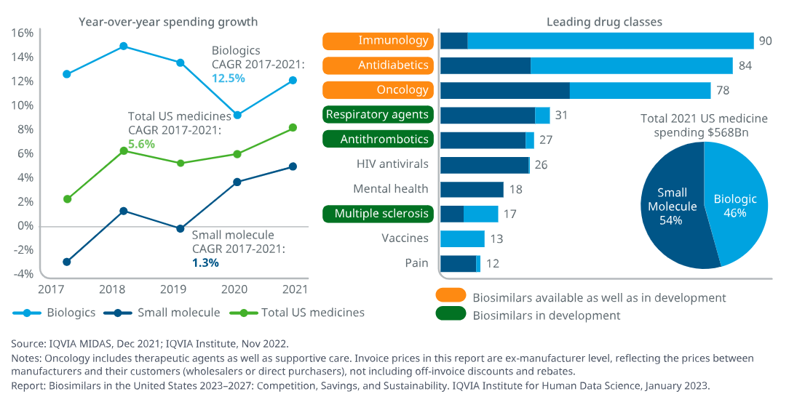
Biologic Marketplace
Notes:
https://www.iqvia.com/insights/the-iqvia-institute/reports-and-publications/reports/biosimilars-in-the-united-states-2023-2027

Slide 19
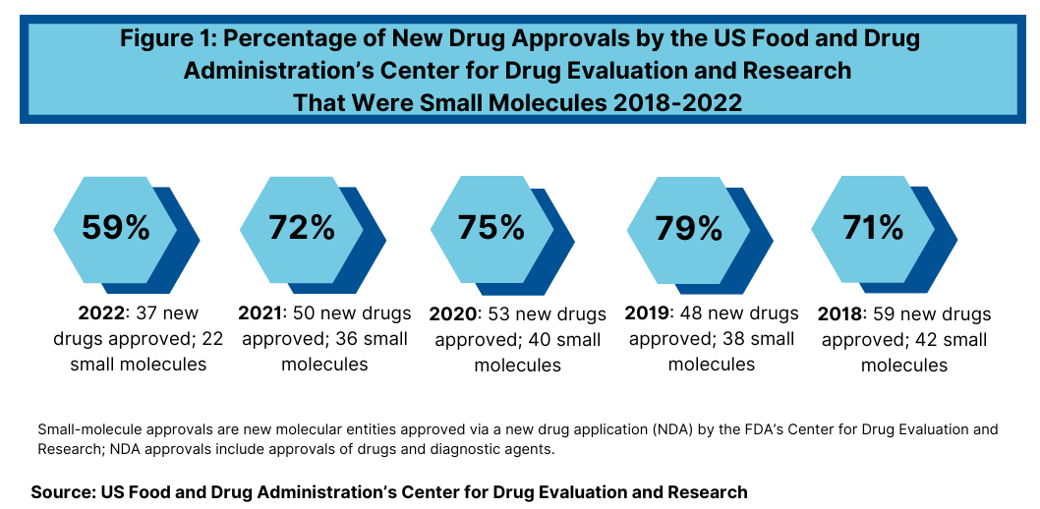
Trend Towards Biologics
Notes:
https://www.dcatvci.org/features/top-10-key-trends-in-new-drug-approvals-small-molecules-biologics/

Slide 20
Biologic
Biologic: Therapeutic product derived from a biological source
Vaccines
Antitoxins
Blood products
Proteins
Monoclonal antibodies
www.fda.gov

Slide 21
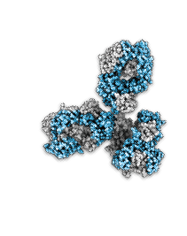
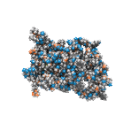
Biologics Vs. Small Molecules
Biologics, including biosimilars are much more complex than small molecule drugs
Large biologic
Small biologic
Small molecule drug
COMPLEXITY

Slide 22
Biosimilar
Biosimilar
Highly similar to the U.S. licensed reference biological product notwithstanding minor differences in clinically inactive components
No clinically meaningful differences from the reverence product in terms of safety, purity, and potency
www.fda.gov

Slide 23
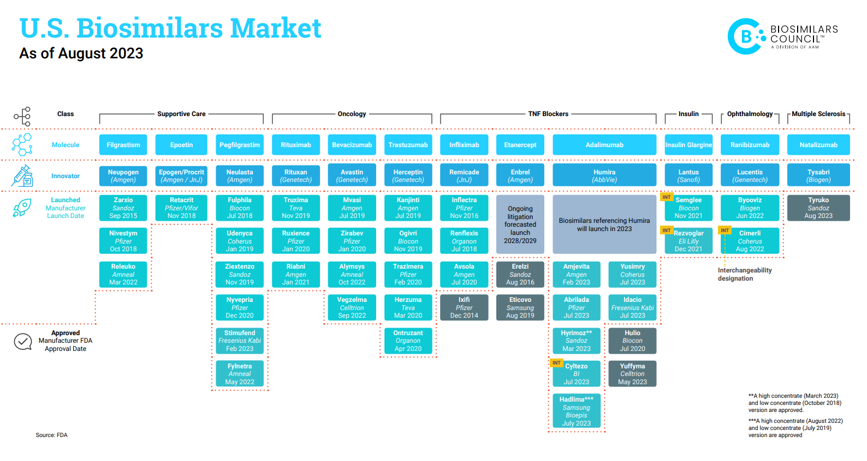
Notes:
https://biosimilarscouncil.org/wp-content/uploads/2021/09/US-biosimilars-market-2023-08-1.pdf

Slide 24
Interchangeable
Interchangeable
Biosimilar to the U.S. licensed reference product
Expected to produce the same clinical result to the reference product in any given patient
If a product is indicated for multiple administrations, then the product must be able to be alternated with the reference product without any loss of efficacy or change in risk of adverse events
May be substituted at the pharmacy level without the intervention of a healthcare provider
www.fda.gov

Slide 25
Biosimilar 351(k) Application
In order to be granted biosimilar status by the FDA, the biological product must show clinical data derived from:
Analytical studies that demonstrate that the biological product is highly similar to the reference product notwithstanding minor differences in clinically inactive components;
Animal studies (including the assessment of toxicity); and
A clinical study or studies (including the assessment of immunogenicity and pharmacokinetics or pharmacodynamics) that are sufficient to demonstrate safety, purity, and potency in one or more appropriate conditions of use for which the reference product is licensed and intended to be used and for which licensure is sought for the biological product.
http://www.fda.gov/downloads/Drugs/GuidanceComplianceRegulatoryInformation/Guidances/UCM291128.pdf

Slide 26
Biosimilar 351(k) Application
Stepwise Approach:
Extensive structural and functional characterization of both products
Animal data if contains pertinent information not able to be obtained from humans (e.g. toxicity)
Human Pharmacokinetic studies
Human Pharmacodynamic studies
Compare clinical immunogenicity
If inconsistencies exist, consider clinical trial with appropriate safety and efficacy measures
http://www.fda.gov/downloads/Drugs/GuidanceComplianceRegulatoryInformation/Guidances/UCM291128.pdf

Slide 27
FDA Purple Book
First published September 9, 2014
Lists biological products, including any biosimilar and interchangeable biological products licensed by the FDA under the Public Health Service Act (PHS Act)
Includes the date a biological product was licensed under 351(a) of the PHS Act and whether the FDA evaluated the biological product for reference product exclusivity under section 351(k)(7)
Shows if the FDA has determined a product to be biosimilar or interchangeable with an already licensed FDA reference biological product
Biosimilar and interchangeable products are listed under the reference product

Slide 28
Biosimilar: Filgrastim
First application under the new biosimilar pathway brought to an FDA advisory committee
On January 7th, 2015, the FDA Oncologic Drugs Advisory Committee unanimously voted that Sandoz’s EP2006 (Zarxio) should be licensed as biosimilar to the reference product, Neupogen
Includes all 5 indications for which Neupogen is approved
Zarxio (filgrastim-sndz) was approved March 6, 2015 as a biosimilar, not an interchangeable
Route of administration, indications and side effects are the same as Neupogen
Launched September 3, 2015
15 percent wholesale list price discount

Slide 29
Biosimilar Naming
Nonproprietary Naming of Biological Products Guidance finalized January, 2017
Per FDA Guidance biosimilars receive a nonproprietary name consisting of a common core plus a unique FDA-approved suffix composed of four lowercase letters
For example, for products sharing the core name replicamab, those proper names may be displayed as:
-replicamab-cznm
-replicamab-hixf
The proposed suffix should:
Be unique
Be devoid of meaning
Be four lowercase letters of which at least three are distinct
Be nonproprietary
Be attached to the core name with a hyphen
Be free of legal barriers that would restrict its usage
www.fda.gov

Slide 30
Outstanding Questions
How much will the addition of biosimilars lower costs to the health care system?
Will increased access to biologics lead to better health outcomes overall?
How will managed care organizations manage these agents?

Slide 31
References
Information for Healthcare Professionals (Biosimilars). https://www.fda.gov/drugs/biosimilars/overview-health-care-professionals. Accessed 13 February 2025.
"Biosimilars," Health Affairs, October 10, 2013. Accessed 13 February 2025.
Purple Book. https://www.fda.gov/drugs/therapeutic-biologics-applications-bla/purple-book-lists-licensed-biological-products-reference-product-exclusivity-and-biosimilarity-or. Accessed 13 February 2025.

Slide 32
Mission & Vision
To improve patient health by ensuring access to
high-quality, cost-effective medications and other therapies.

