Slide 1

THE MISSING PUZZLE PIECE
to your E-Board’s Success

Slide 2
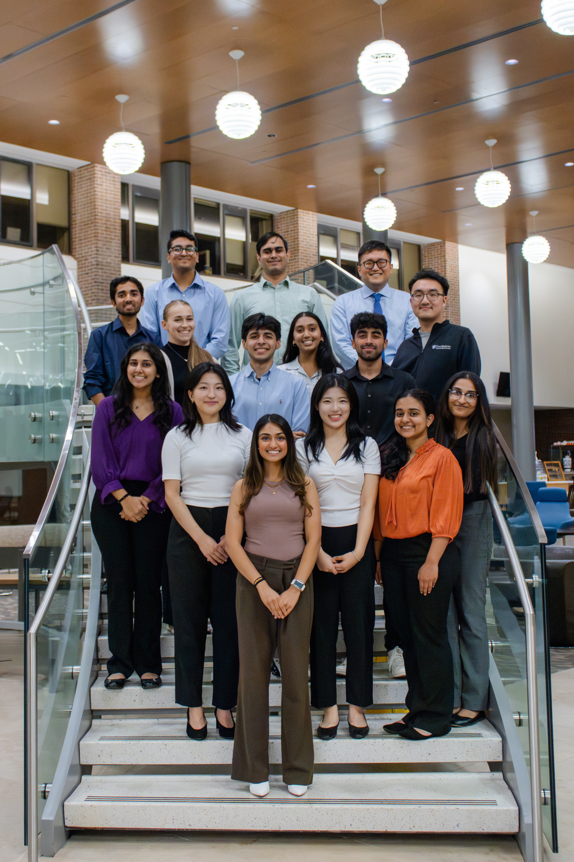
Overview
  Rutgers University - Who Are We?
  Speed Networking Event
  Medicare Education Series
  Managed Care Speaker Series
  E-Board’s Success

Slide 3

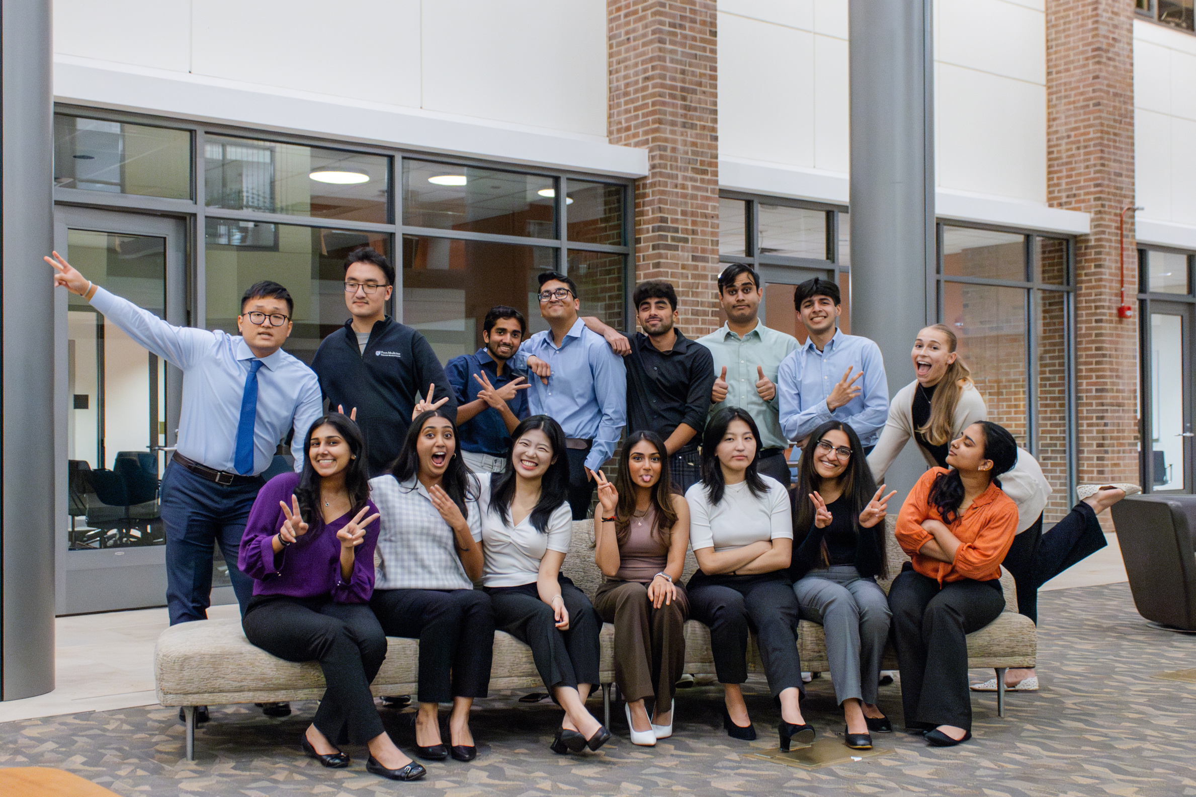
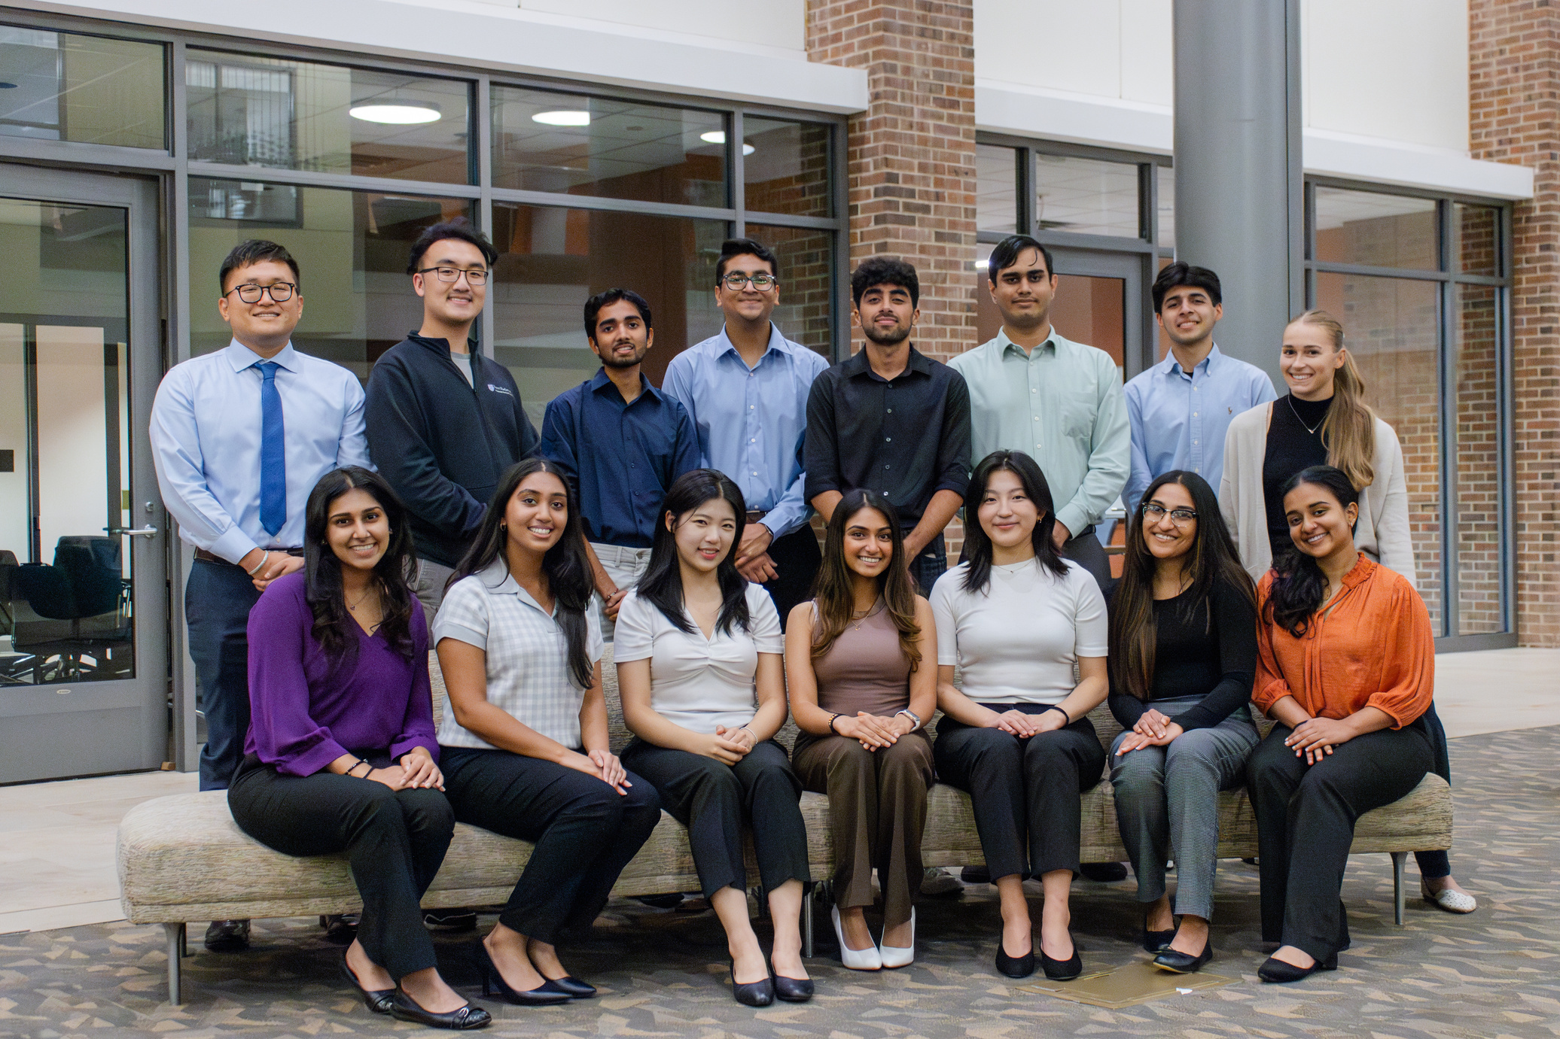
Who Are We?

Slide 4
Our Committees
President
President-Elect
Vice Presidents (2)
Treasurer
Secretary
SNE Committee
P&T Committee
Marketing Committee
Fundraising Committee
Patient Care Committee
Let’s Talk Numbers!
17 E-Board Members
22 Committee Chairs
115+ General Members
Healthcare Literacy Committee

Slide 5
SPEED
NETWORKING EVENT

Slide 6

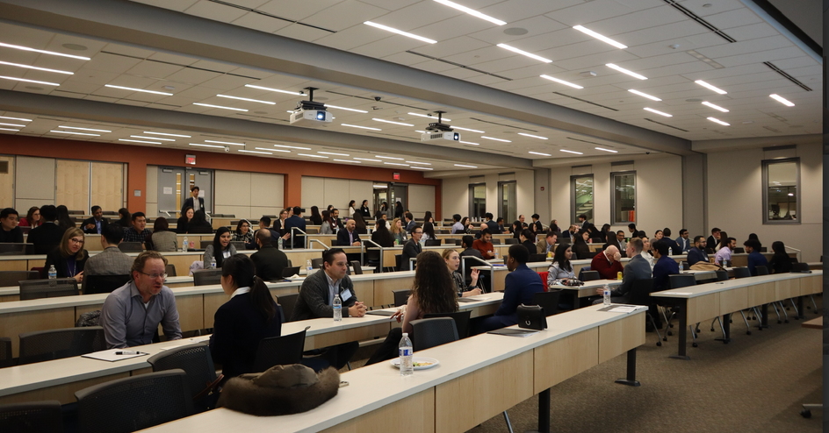
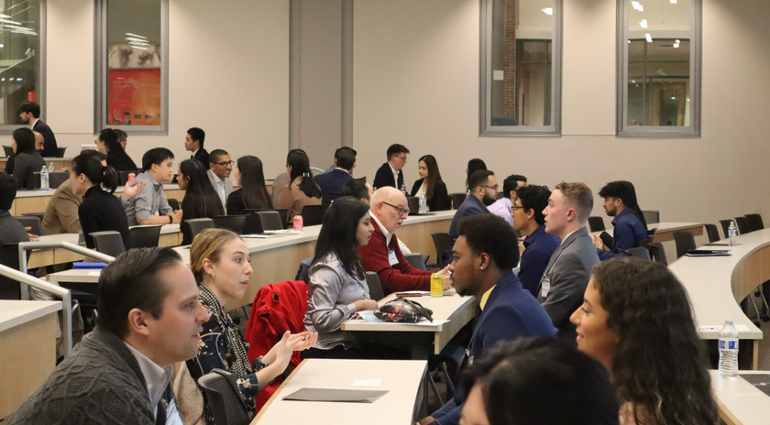


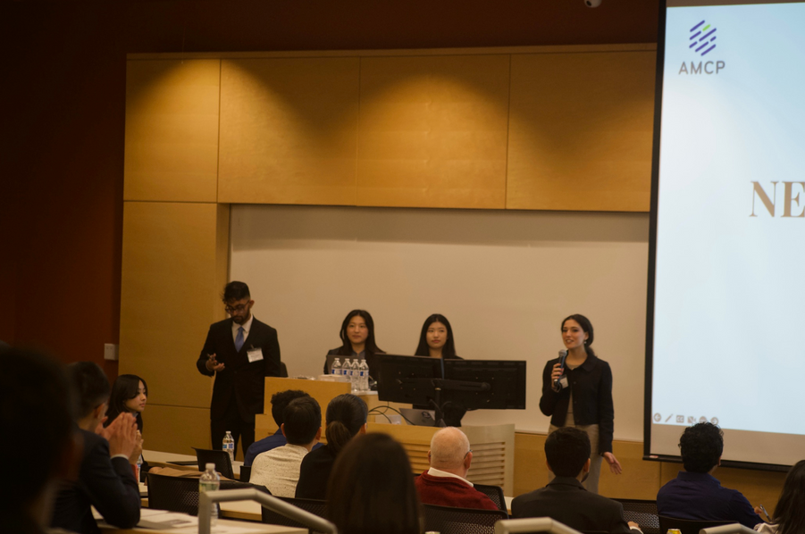

Speed Networking Event
Celebrating its 15th anniversary, the Speed Networking Event features keynote presentations and diverse networking opportunities across pharmacy domains. It includes interactive sessions connecting students with experts and exclusive invitations for managed care professionals in a casual, speed-dating style format.
Speakers and Sponsors
  We collaborate with Drug Information Association and feature speakers from various fields and companies before networking. This year, our speakers include our dean, and reps from Horizon NJ and Walgreens.
Enhancing Networking Quality
  We organized two workshops beforehand, SNE 101 & 102 offering tips on resume improvement, effective self-presentation, crafting elevator pitches, and mastering follow-up techniques.
Organization
  For this event, we use a master Google Sheet to coordinate tasks and deadlines for directors, chairs, and volunteers. We also keep students updated via Instagram with event details and required materials. This ensures a seamless experience for everyone involved.

Slide 7


Slide 8
MEDICARE EDUCATION SERIES

Slide 9

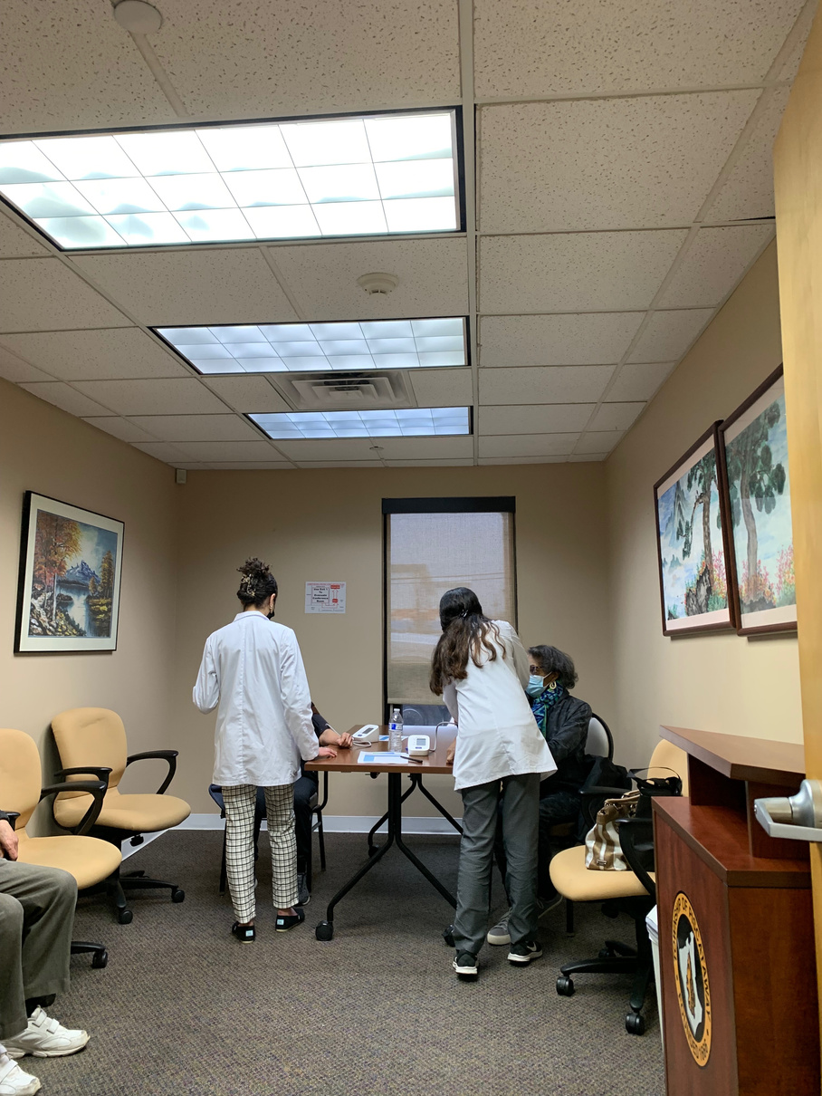
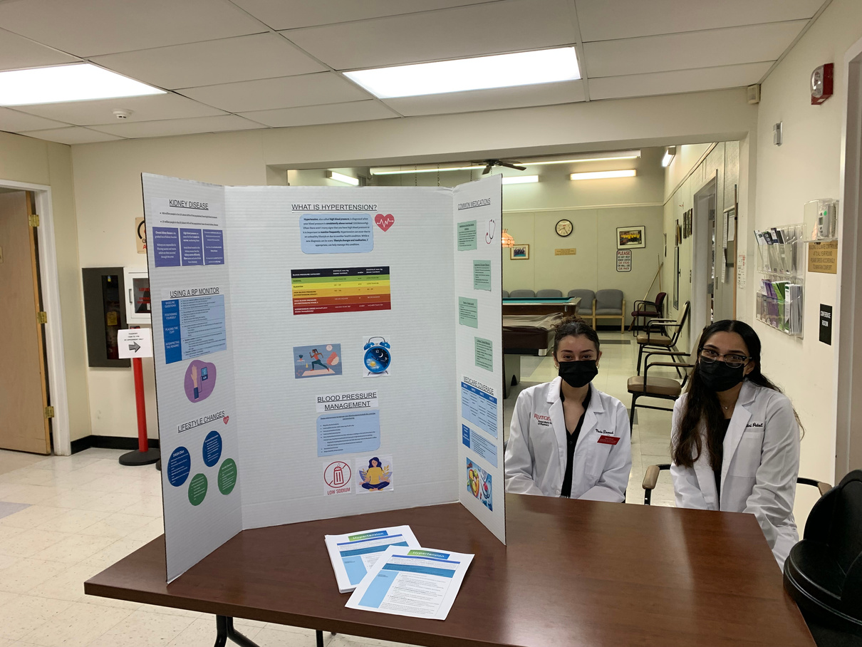
Medicare Education Series
This was a two-part event series focused on providing Medicare information to local senior citizens.
The first part involved creating and disseminating a brochure to local libraries. The second portion, included counseling at a local senior center.
Collaboration
  We collaborated with the Rutgers chapter of the Student National Pharmacist Association to provide in-person counseling on blood pressure management.
Managed Care Focus
  We worked with an intention to teach managed care basics to our target audience. This was accomplished by explaining formularies and value based care to participants.
Student Pharmacist Engagement
  Creating an opportunity for student pharmacists to employ lessons they learn in class in real situations helped to increase engagement.

Slide 10
MANAGED CARE SPEAKER SERIES

Slide 11
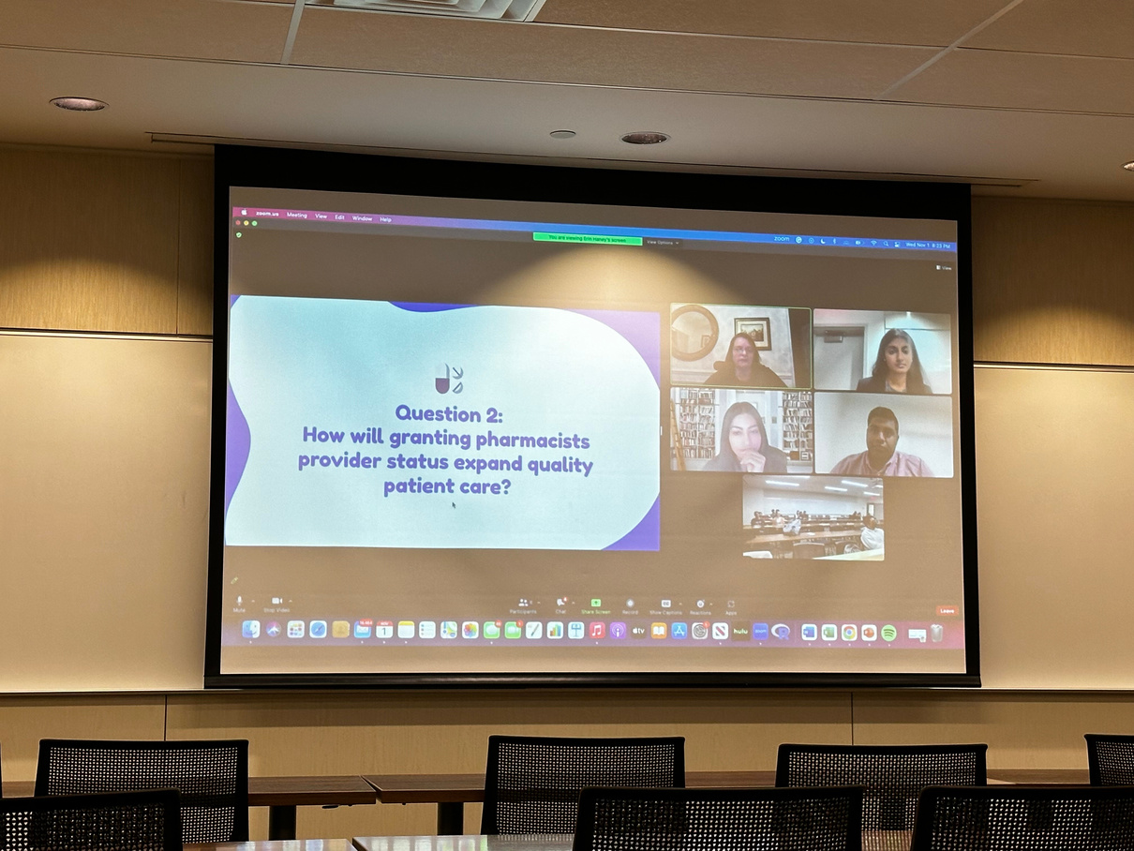
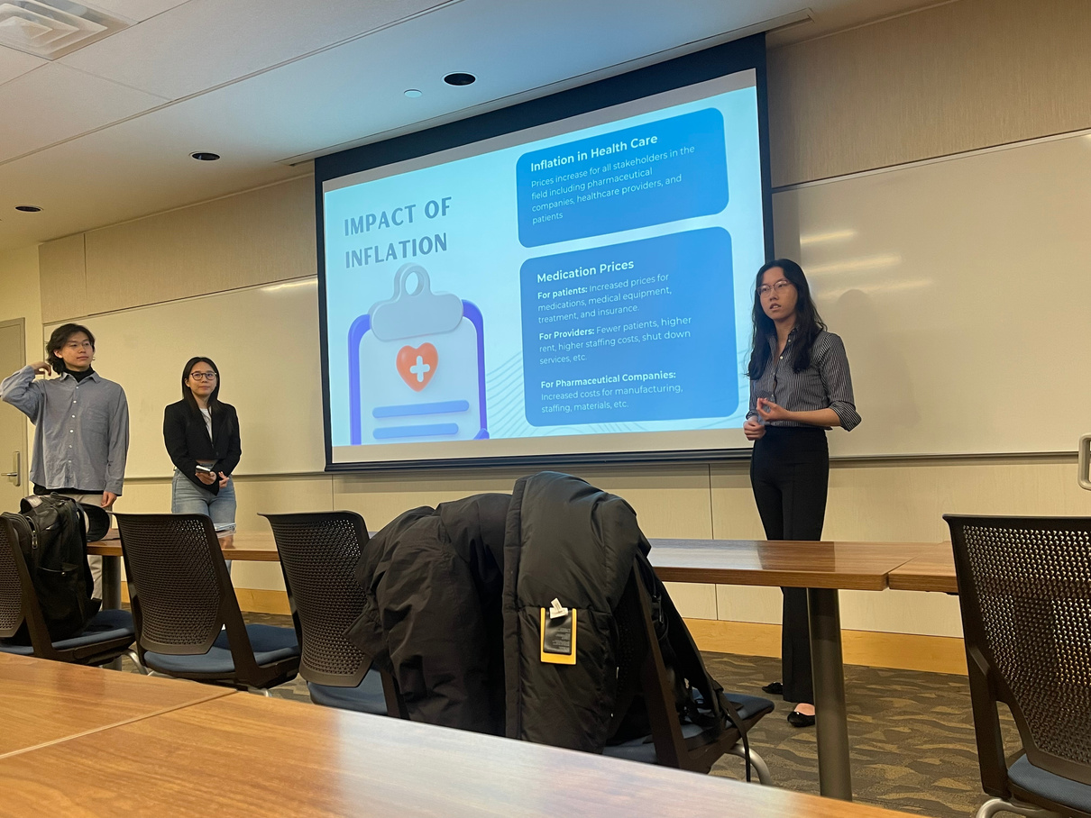
Managed Care Speaker Series
The Speaker Series events were organized with the aim of educating the student body about emerging topics in the managed care space.
Leadership Opportunities
  Students had the opportunity to gain leadership experience by participating in the Patient Care Committee to plan and host events.
Emerging Topics
  Men’s Mental Health
  Cost and Barriers of Fertility Treatments
  HIV/AIDS Awareness and Education
  ECAPS & Pharmacy and Medically Underserved Communities Enhancement Act
  Inflation Reduction Act
  Medicaid Best Price & Value-Based Purchasing
Student Pharmacist Engagement
  Students had the opportunity to connect with professionals specializing in managed care topics and learn about emerging managed care topics.

Slide 12
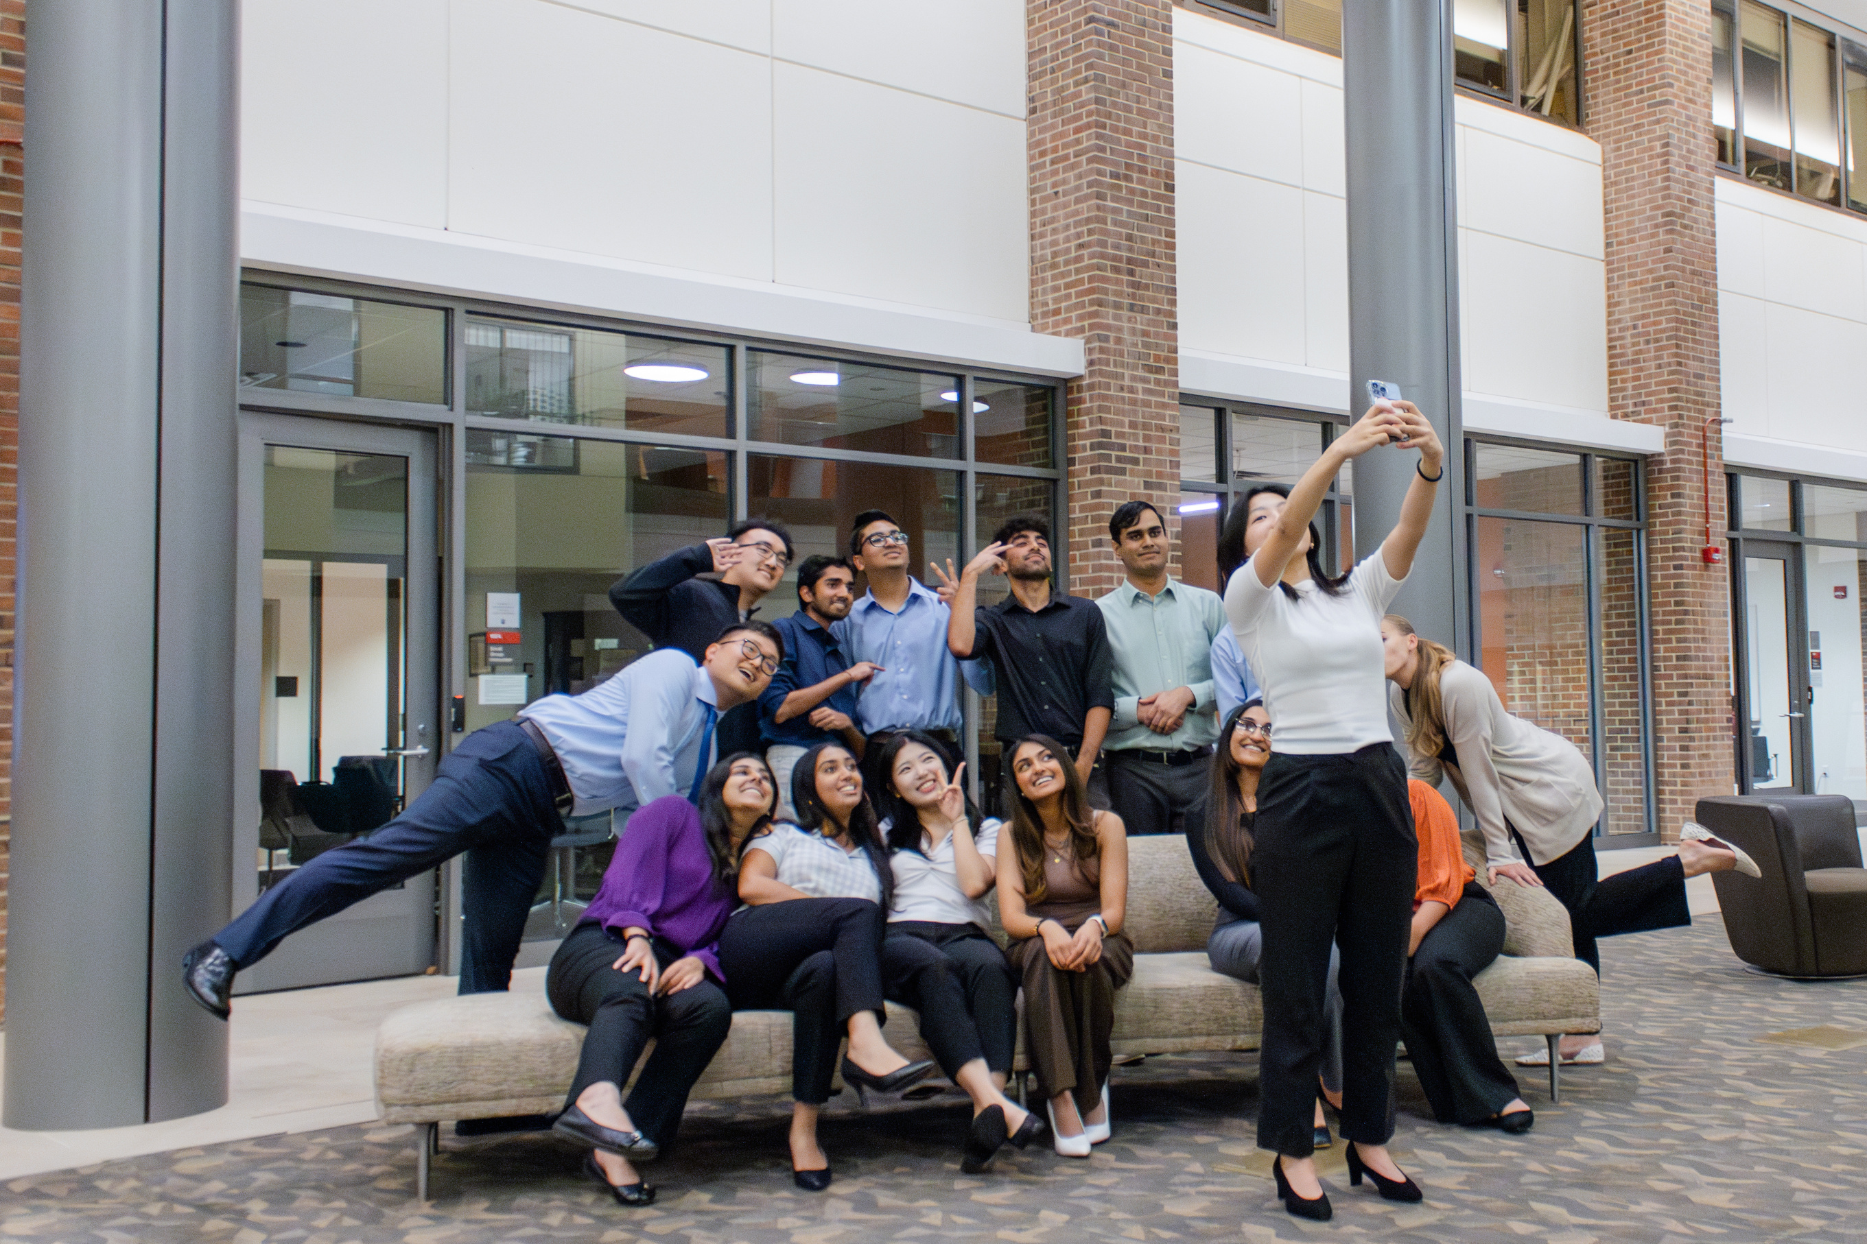
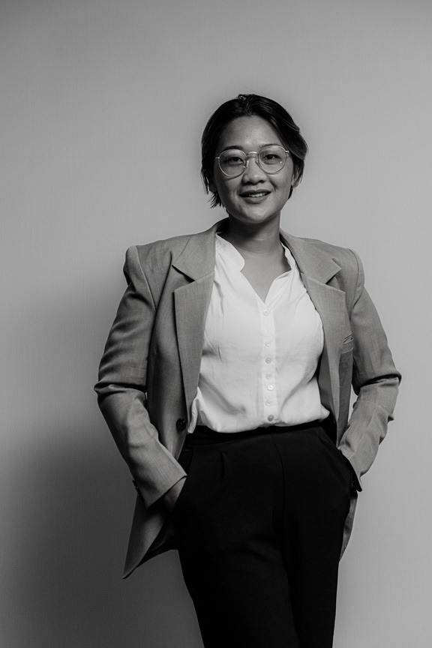
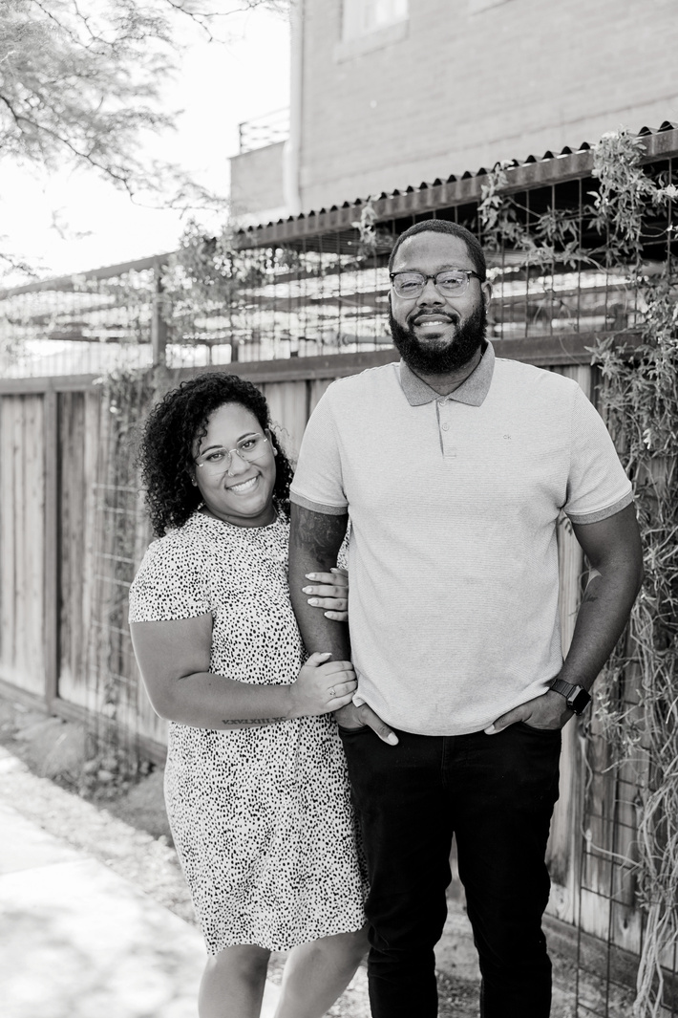

Slide 13


WHAT’S THE MISSING PIECE FOR SUCCESS?

Slide 14
The Missing Piece - One Big Happy Family
  The success of our events and continuous E-Board engagement stemmed from connecting on a personal level.
  Here are 4 key steps for personal development with your board:
01
  Reach out to each E-Board member to check-in on how they are doing - for AMCP, school, other organizations, work, and life!
02
  Make meetings fun - we like to bring food and play games/activities in addition to the monthly E-Board meetings.
03
  Host outings for the E-Board to do something fun/hang out outside of school - helps people bond in a setting besides school.
04
  Appreciate their hard work, reward them with treats and gifts - we started annual care packages and thank you gifts to keep E-board motivated.

Slide 15

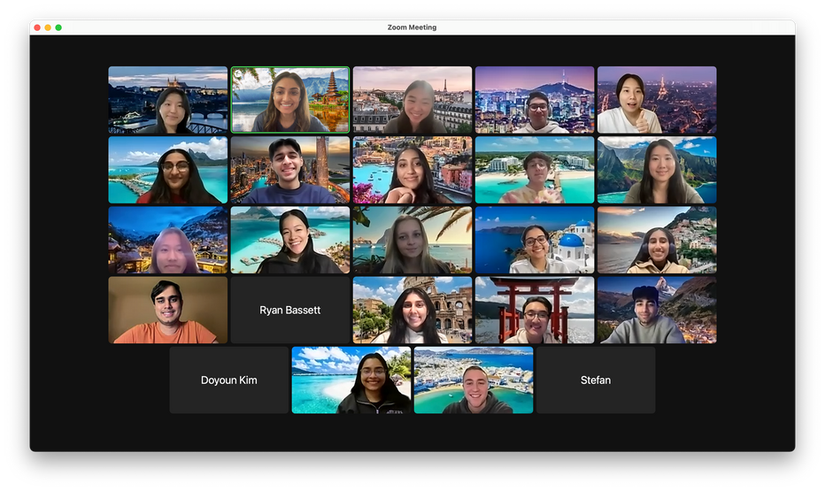
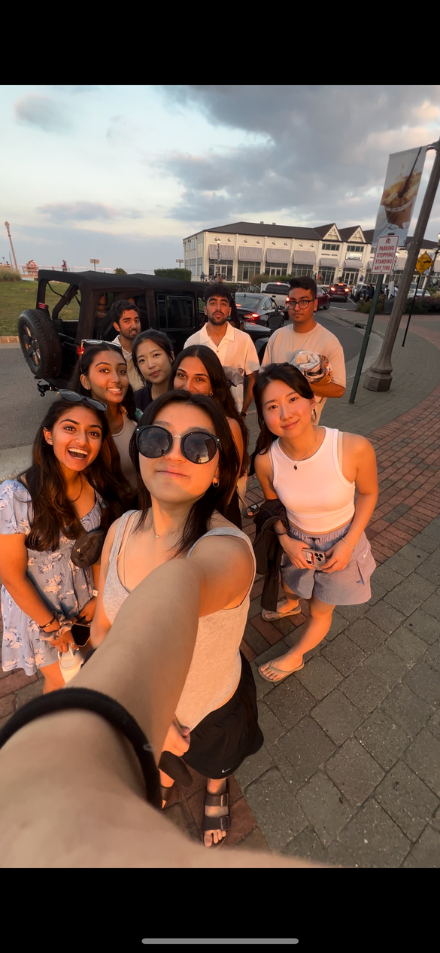
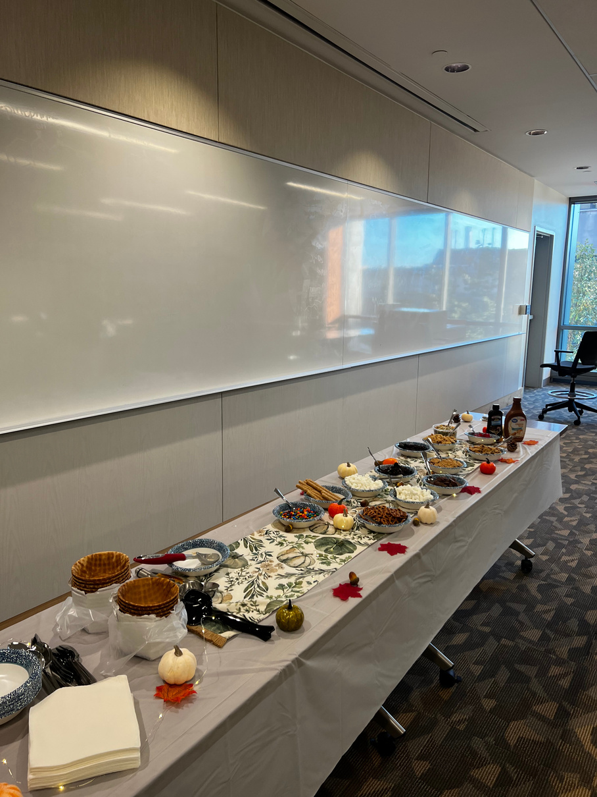
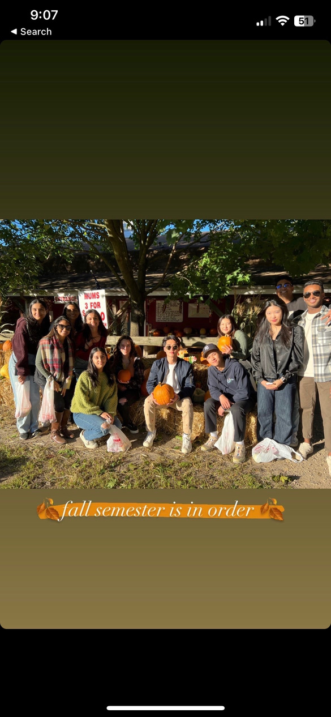
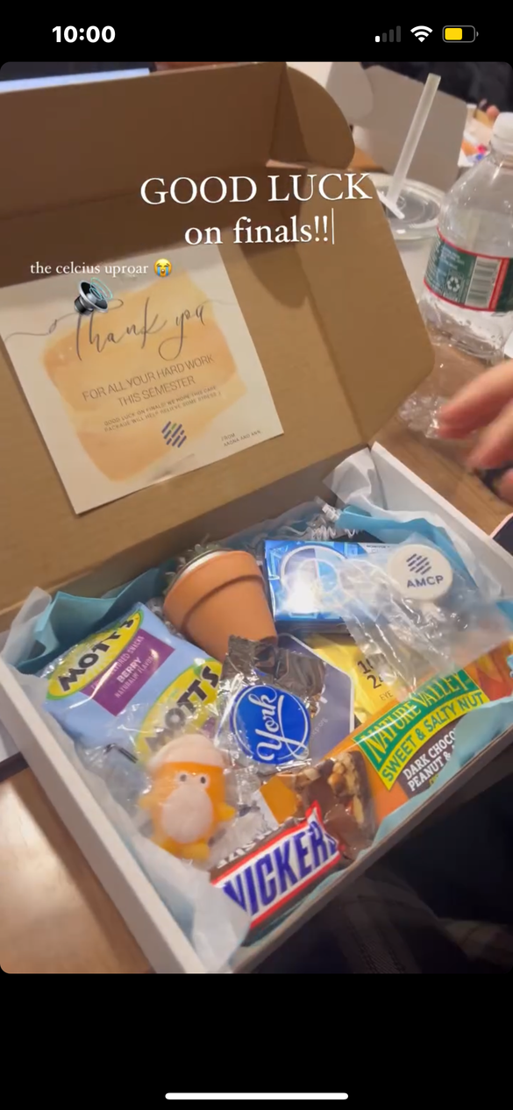
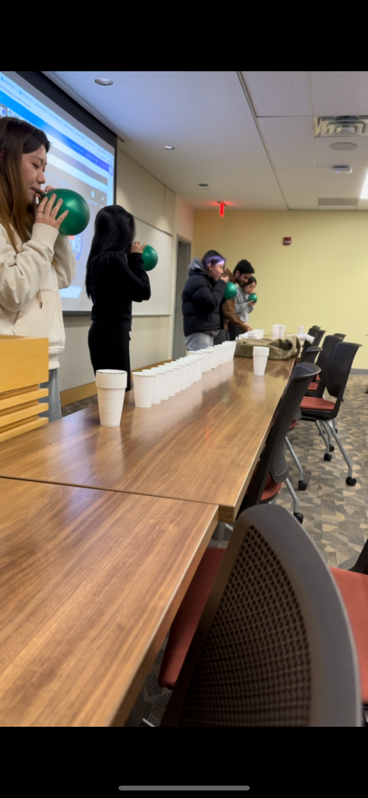

Slide 16
THE MISSING PUZZLE PIECE
to your E-Board’s Success

Slide 17

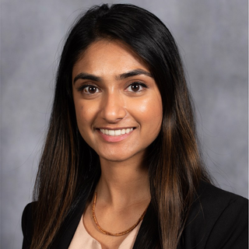
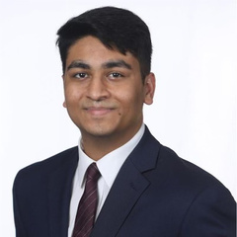

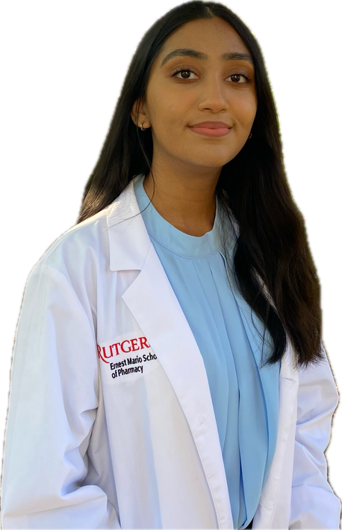
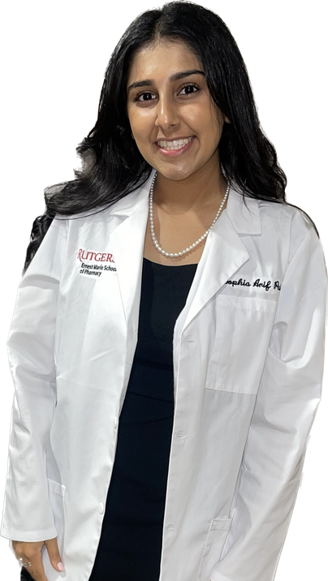
Reach out to us for questions!
@rutgersamcp
Aagna Patel
Raj Patel
avp99@scarletmail.rutgers.edu
rjp294@scarletmail.rutgers.edu
Avisha Patel
Sophia Patel
amp529@scarletmail.rutgers.edu
sap393@scarletmail.rutgers.edu

