Slide 1
USC Chapter
AMCP Annual 2024
University of Southern California
Alfred E. Mann School of Pharmacy and Pharmaceutical Sciences
Notes:
layout: title slide, chapter introduction, 2021-2022 events timeline, main events in order (managed care 101, medicare part d, kaiser night), special programs (PMCP, mentorship, collabs with other orgs, ???), idk what else to put

Slide 2
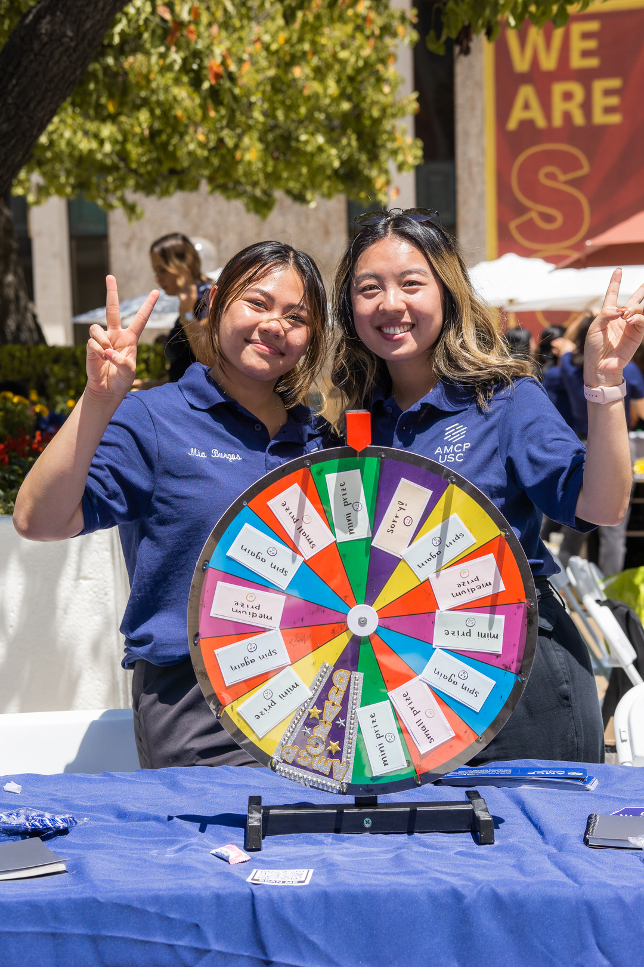
CHAPTER INTRODUCTION
The USC School of Pharmacy's Chapter of Academy of Managed Care Pharmacy is dedicated to providing students professional experiences that enrich learning and networking within the managed care profession. With this, we hope to continue to promote AMCP's core values of medication safety, efficacy, and cost-effective drug therapy.
Notes:
layout: title slide, chapter introduction, 2021-2022 events timeline, main events in order (managed care 101, medicare part d, kaiser night), special programs (PMCP, mentorship, collabs with other orgs, ???), idk what else to put

Slide 3
MEET OUR TEAM
Kavan Chau
Anh Duong
President-Elect
Director of Interschool Relations

Slide 4
2023-2024 HIGHLIGHTS
Managed Care 101
Medicare Part D Week
01
02
The event offered students the opportunity to learn about Managed Care through the experiences of working professionals in the field.
Through Medicare Part D, students were able to participate in offering consultations to USC retirees to help reduce their Medicare Plan costs.
Kaiser Night
Building Bridges
03
04
Partnering with Kaiser Permanente, USC AMCP offered students to learn more about residency programs and potential job offers.
USC AMCP collaborates with SIA-IPhO to host a night of networking and education for student members.

Slide 5
EVENT PREPARTION
Professional Invites
Funding
Advertising
Event Day
Speaker invitations sent 4-6 weeks prior to event
Google Form RSVP
Confirmation email sent the week of event
Utilization of school funds
Paperwork and invoices submitted 8 weeks prior to event (catering, parking, speaker gifts, etc.)
Receipts are kept for reimbursement
Advertising material posted on social media 2 weeks prior
School newsletter and in class advertisements
CA AMCP Linkedin for larger scale events
Program and event slides are completed 1 week prior
All hands on deck
Speaker gifts are sent out.
Thank you emails to students/professionals

Slide 6
Managed Care 101
Our first look at managed care pharmacy
Introductory event to managed care pharmacy meant to give a BIG PICTURE overview of the managed care space to students with little to no exposure to careers in managed care.
Keynote speeches from professionals in managed care
Round table networking and dinner
Planning Time: 1 month
Targeted Audience: P1 students Attendance: 35 members

Slide 7
Medicare Part D Week
Medicare consultations led by students
Under the guidance of our faculty professor Dr. Patrick Tabon and preceptors, students are given the opportunity to aid USC retirees in optimizing their Medicare Plan. Our students helped save over $20,000 for our retirees
Lecture from Center for Health Care Rights about Medicare Part D
1:1 Student and Retiree consultations under guidance of preceptor
Will eventually expand to geriatric clinic follow-ups
Planning Time: 1 month
Targeted Audience: all students Attendance: 30-40 students

Slide 8
Kaiser Night
A look into a managed care organization
In collaboration with Kaiser Permanente, students are able to network with a multitude of Kaiser professionals from various specialties and gain insight as to how a managed care organization operates.
Keynote speeches from Kaiser leadership and pharmacy residents
Round table networking with pharmacists
Insight into internship opportunities
Planning Time: 2 months
Targeted Audience: P1 students Attendance: 22 students

Slide 9
20th Annual Building Bridges
Annual industry/managed care networking event
Dinner event tailored for students to engage with professionals on a night of networking and education. Held in collaboration with SIA-IPhO, Building Bridges is our largest networking showcaseof the year.
Keynote speeches from managed care/industry professionals
Open networking for students to meet with professionals
Planning Time: 2-3 months
Targeted Audience: all students
Attendance: 40 students + 13 professionals

Slide 10
Chapter Remarks
As we begin to look ahead to next year, the USC Chapter aims to continue to garner student interest in managed care through the innovation of new programs and the continued expansion of our managed care network at USC.

Slide 11
ON BEHALF OF USC AMCP
THANK YOU
Instagram: @uscamcp
uscamcpchapter@gmail.com

