Slide 1
Chapter Resources Webinar
Hosted by: AMCP’s Student Pharmacist Committee

Slide 2
Welcome &
Introductions
Vignesh Pernati, University of Maryland, Class of 2024
Emily Diep, University at Buffalo, Class of 2025
Allen Yousif, Western University of Health Sciences, Class of 2024
Nikhil Bhatia, University of Georgia, Class of 2024
Nikolas Norman, Wilkes University, Class of 2025
Notes:
Vignesh, Emily, Allen, Nikhil, Nik Norman

Slide 3
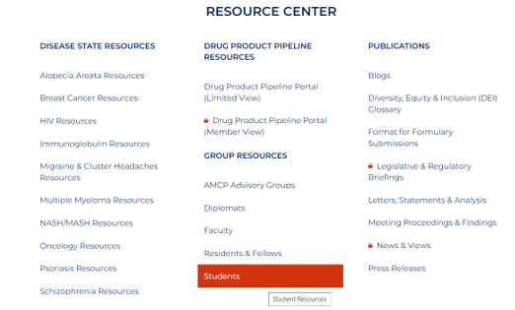
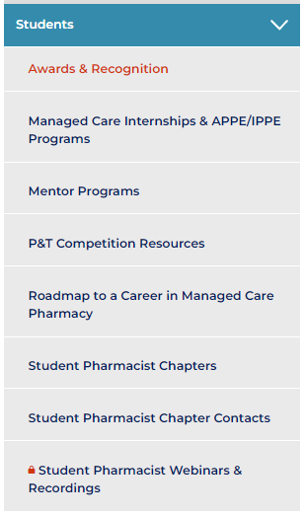
Student Resource Center
Student Resource Center
Accessible Student Group Resources
Vignesh Pernati, University of Maryland

Slide 4
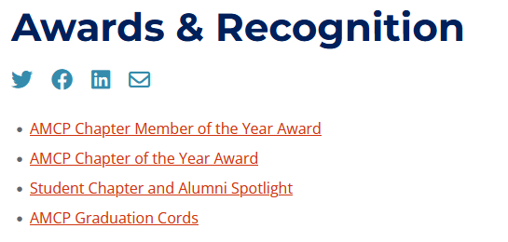
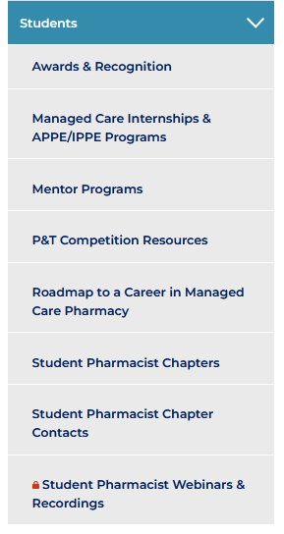
Awards and Recognitions
Emily Diep, University at Buffalo

Slide 5
AMCP Chapter Member of the Year
Annual award where each chapter may highlight an outstanding member for their contributions
Each chapter creates their own scoring guide
Notify AMCP Headquarters and the recipient will be awarded locally
Emily Diep, University at Buffalo

Slide 6
AMCP Chapter of the Year Award
Aimed to recognize top chapters for innovative efforts in managed care
Chapters must complete the application packet and submit it to the designated submission portal to be considered
Top 3 chapters will be awarded
1st place: $1,000 Chapter Grant & Personalized Plaque
2nd place: $600 Chapter Grant & Personalized Plaque
3rd place: $300 Chapter Grant & Personalized Plaque
Emily Diep, University at Buffalo

Slide 7
Chapter of the Year Award Tips
Follow the rubric!
What makes your events unique and innovative
In your essay, discuss initiatives beyond the events submitted. Showcase your efforts as a chapter!
Collaborate with other chapters
Engage with multiple audiences (e.g. pre-pharmacy students, Medicare age population)
Emily Diep, University at Buffalo

Slide 8
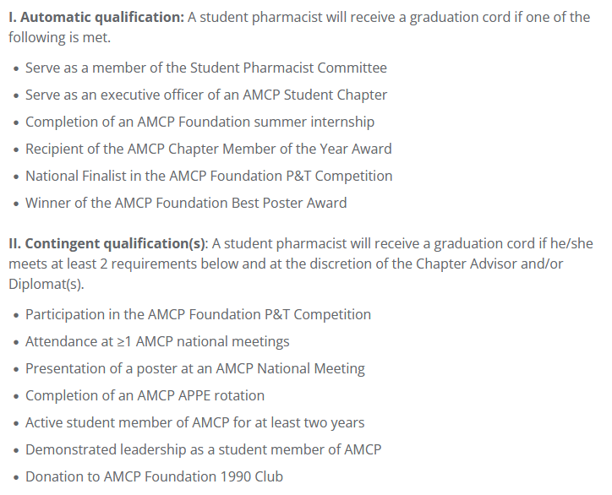
AMCP Graduation Cords
Eligible students may request a graduation cord on the website if they meet any of the requirements shown here (also listed on the resources page):
Emily Diep, University at Buffalo

Slide 9
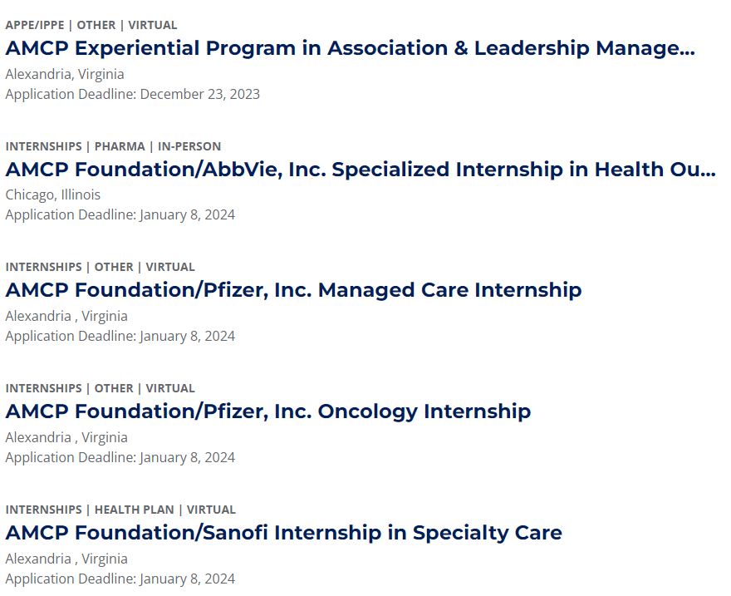
Managed Care Internships & APPE/IPPE Program
AMCP Foundation Internships
Foundation Internships offer great benefits for students including the opportunity to present capstone research projects at AMCP Nexus
Internship Requirements:
Doctor of Pharmacy degree students in an ACPE-accredited school or college of pharmacy during the 2023–2024 school year with anticipated graduation in 2025 or 2026.
Application Requirements:
Submission of online application.
Two letters of recommendation
A letter of good academic standing, including current cumulative GPA
Vignesh Pernati, University of Maryland

Slide 10
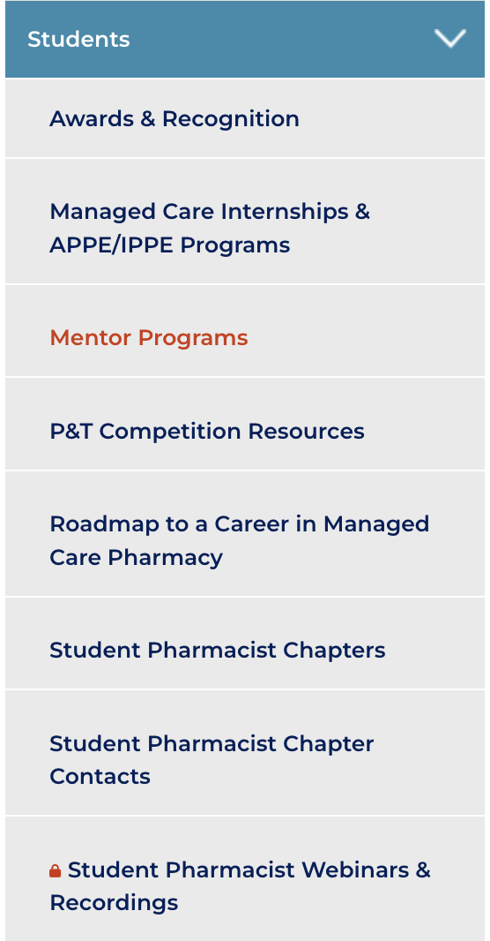
Mentor Programs
AMCP and the AMCP Foundation have numerous mentor programs at AMCP meetings and throughout the year.
Conference Buddy Program
AMCP Foundation Poster Development Mentor Program
AMCP Foundation Poster Presentation Mentor Program
Mock Fellowship Interview Program
Mock Residency Interview Program
Allen Yousif, Western University of Health Sciences
Notes:
Use an example of when this was used to help him.

Slide 11
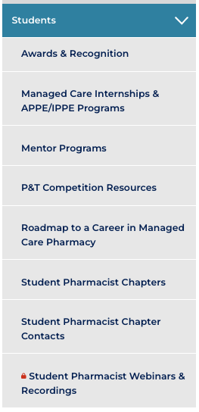
P&T Competition Resources
Three main links:
AMCP Foundation Annual P&T Competition
How to Conduct a Local Pharmacy & Therapeutics Competition
One-Day P&T Competition Kit
Vignesh Pernati, University of Maryland

Slide 12
Roadmap to a Career in Managed Care Pharmacy
This resource provides a step-by-step process for:
Evaluating managed care pharmacy career opportunities
Leveraging student pharmacist opportunities
Becoming a strong candidate for a managed care career
Vignesh Pernati, University of Maryland

Slide 13
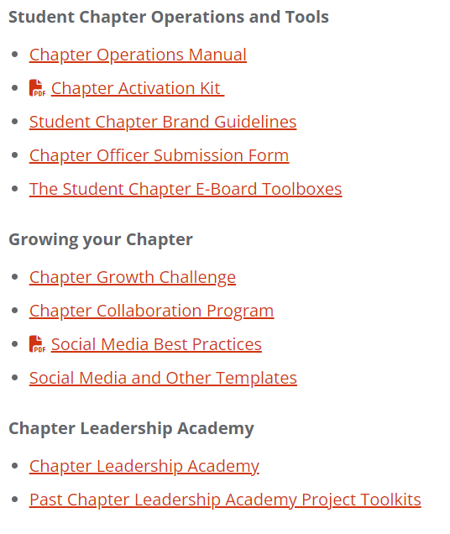
Student Pharmacist Chapters
Provides access to the various chapter resources available
Notable resources include the following:
Chapter Operations Manual
Chapter Activation Manual
Chapter Leadership Academy
Nikhil Bhatia, University of Georgia
Notes:
Briefly describe each resource

Slide 14
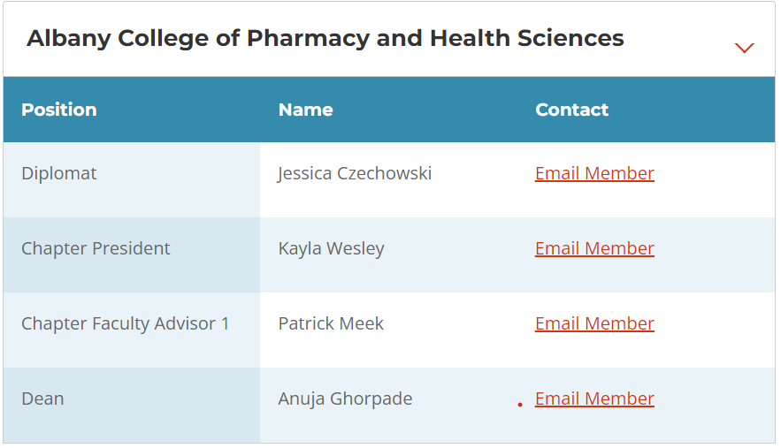
Student Pharmacist Chapter Contacts
Includes all AMCP Student Chapters
Timeline for 2022
P&T Competition
Filter by school and access direct contacts
Increased possibility for collaboration
Nikhil Bhatia, University of Georgia

Slide 15
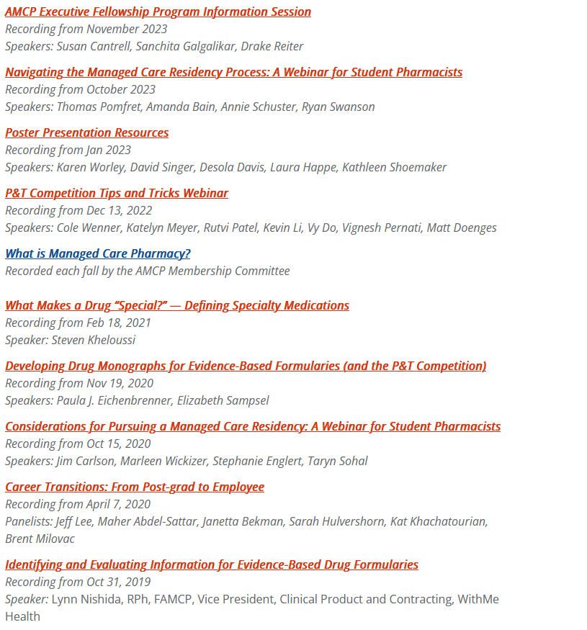
Student Pharmacist Webinars & Recordings
Timeline for 2022
P&T Competition
Gain access to webinars you missed!
Many webinars with great information to help prepare you for different opportunities like the P&T competition
Emily Diep, University at Buffalo

Slide 16
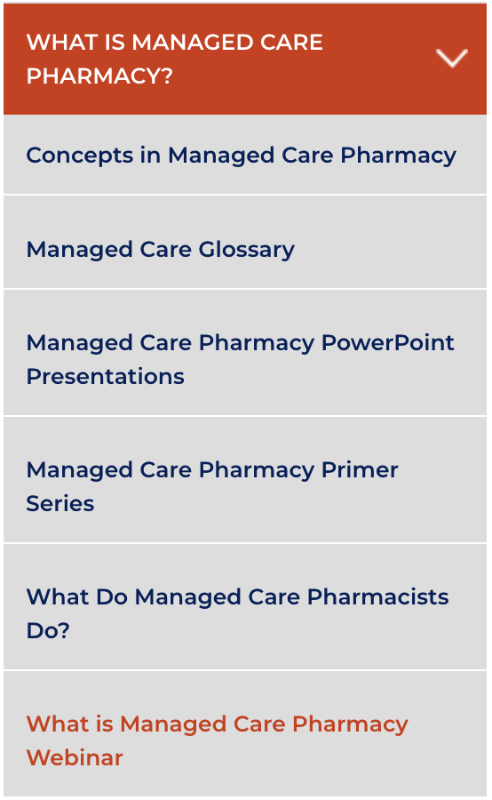
What is Managed Care Pharmacy Webinar
The AMCP Membership Committee provides an overview of managed care pharmacy, typically recorded each fall season.
Allen Yousif, Western University of Health Sciences

Slide 17
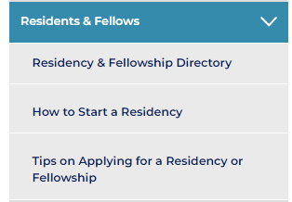
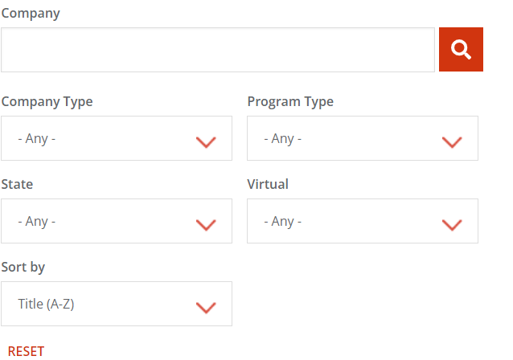
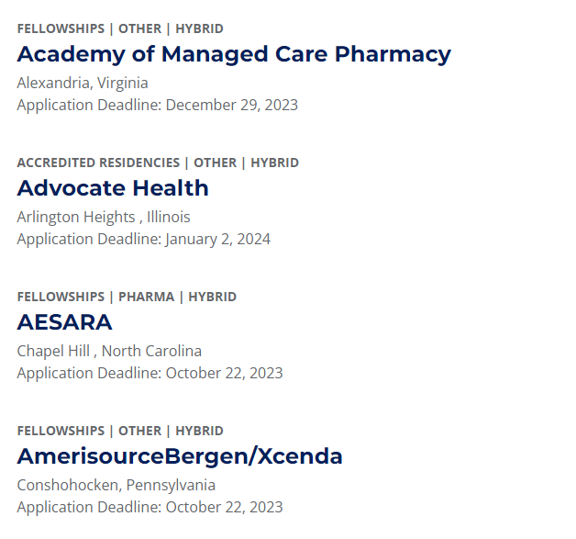
Residency and Fellowship Directory
Timeline for 2022
P&T Competition
Access Residents and Fellows section under the resource center
Redirected to a directory of fellowship and residency programs
Programs are listed alphabetically
Residencies and fellowships can be filtered by criteria that allows for ease of application
Tips on applying for a residency page, provides guidance on interactions after the residency and fellowship showcase as well as sign up process for the PhORCAS/Match, PPS as well as the interviewing process
Vignesh Pernati, University of Maryland

Slide 18
Chapter Officer Succession Best Practices
Vignesh Pernati, University of Maryland
Notes:
We started off presentation discussing awards and recognition

Slide 19
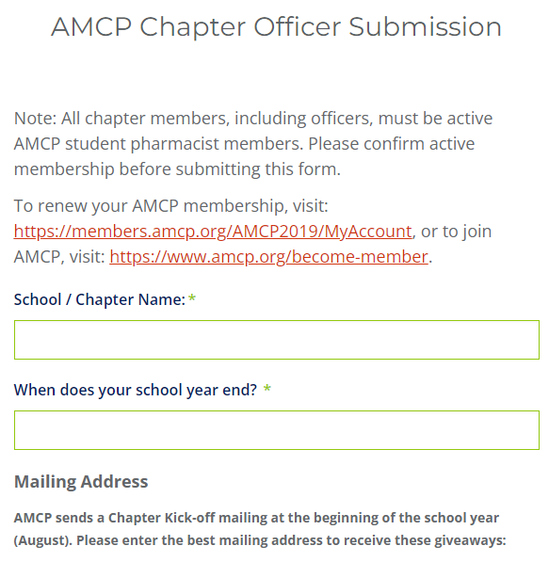
Chapter Officer Submission Form
This form allows chapters transitioning into office to receive important updates from AMCP
Required Criteria:
Mailing Address
Chapter Advisor
AMCP Diplomat
Officer Information:
President
President-Elect
Vice President
Secretary
Treasurer
This form is sent out in April during the officer transition period
* Active membership required for officers and chapter members
Timeline for 2022
P&T Competition
Vignesh Pernati, University of Maryland

Slide 20
Election Timeline Recommendations
Pre-Election Period
Ensure Election process is as outlined in chapter bylaws.
Finalize Election event details at least 4 weeks in advance.
Distribute information on the roles and responsibilities of each available position to all students.
Schedule sufficient time before Election to allow for prospective Board members to individually reach out.
Annual Election
Schedule sufficient time following Election to properly allow for determination of results.
Inform each candidate not selected of the result, ahead of the announcement of new Board.
Transition Period
Schedule sufficient time following Election results to allow for transition from outgoing Board members to incoming Board members.
Submit new officer forms through school and AMCP.
Allen Yousif, Western University of Health Sciences
Notes:
Highlight this after webinar

Slide 21
Officer Transitions Tips
Schedule Transition Meeting
Officer Timelines
Review Events and Activities
Timeline for 2022
P&T Competition
Coordinate a time and place to discuss what tasks and duties each officer is responsible for and what is expected of them.
Create a timeline/agenda for new chapter officers to visualize when planning and implementation of tasks and events should take place.
Discuss events and activities that have previously occurred to give new chapter officers ideas of which programs will be most successful for their local chapter.
Nik Norman, Wilkes University

Slide 22
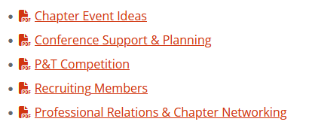
E-Board Toolbox
If your e-board runs into any obstacles or needs ideas:
Difficulty Getting Chapter Members to Come to Conferences?
Trouble Recruiting Members?
Nikhil Bhatia, University of Georgia
Notes:
A case scenario where anyone used the toolboxes for their chapter

Slide 23
Questions
Vignesh Pernati, University of Maryland

Slide 24
Feedback on resources?
Please let us know!
Zack Riley
zriley@amcp.org
Vignesh Pernati, University of Maryland

