Slide 1
LinkedIn Present Yourself Like A Pro!
Presented to NEXUS 2023
Student Leadership Academy
October 18, 2023

Slide 2
My Background
Facilitating and leading the North Dallas / Plano Career Focus Group since 2007
Created www.CareerDFW.org in 2008
Wrote a book called “Your Job Search”
Invited to the White House Forum Job Clubs and Career Ministries in 2012
Created www.CareerUSA.org in 2012
Since March 2020, have conducted over 760 free online career workshops (LinkedIn, Interviewing, Effective Resume & Networking)

Slide 3
What I am going to talk about today
What I could talk about if we had a week or more.

Slide 4
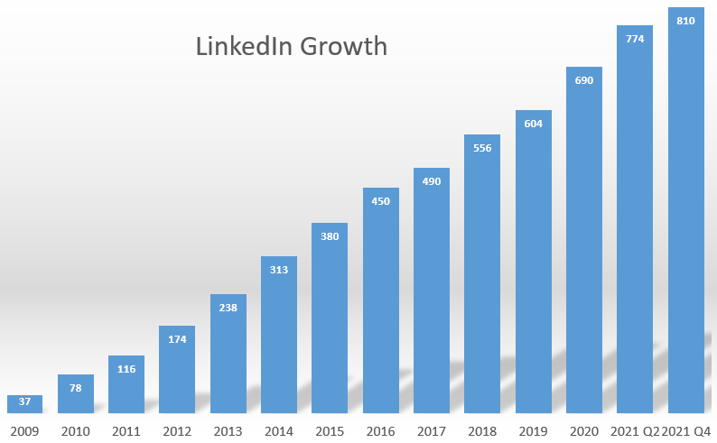
LinkedIn Growth

Slide 5
What we will cover today
How to build a good profile
Strategies to optimize their LinkedIn presence.
Tips on expanding their professional network
How to leverage LinkedIn for job search

Slide 6
What we will cover today
How to build a good profile
Strategies to optimize their LinkedIn presence
Tips on expanding their professional network
How to leverage LinkedIn for job search

Slide 7
LinkedIn Goals
1) Set up a welcoming LinkedIn profile for recruiters:
Easy to read
Picture
Background
Possibly some personal information
2) Optimize your profile so the LinkedIn search engine can find you

Slide 8
LinkedIn Calculates Your Score
Your profile score is calculated each day
Score is based on content and activity
You cannot see your score
LinkedIn will not divulge the point value for any feature or activity

Slide 9
What the Search Engine Looks For
Mutual interest between the recruiter and the candidate
Likely to respond
Connected to employees in the company
Follows the company on LinkedIn
Open to Work
Relevance to the Job being searched
Title
Key Skills
Pass the Skill Assessment Test
Notes:
To increase your discoverability:
Complete the Open to Work and include 5 titles
Respond to all messages that you receive
Have a professional headshot
Include both titles and skills in Headline
Add employees of targeted companies to your network
Add targeted companies to your Interest section

Slide 10
Be an All Star
Current Position
Location
Industry
Summary
Skills (at least 5)
Education
Headshot

Slide 11
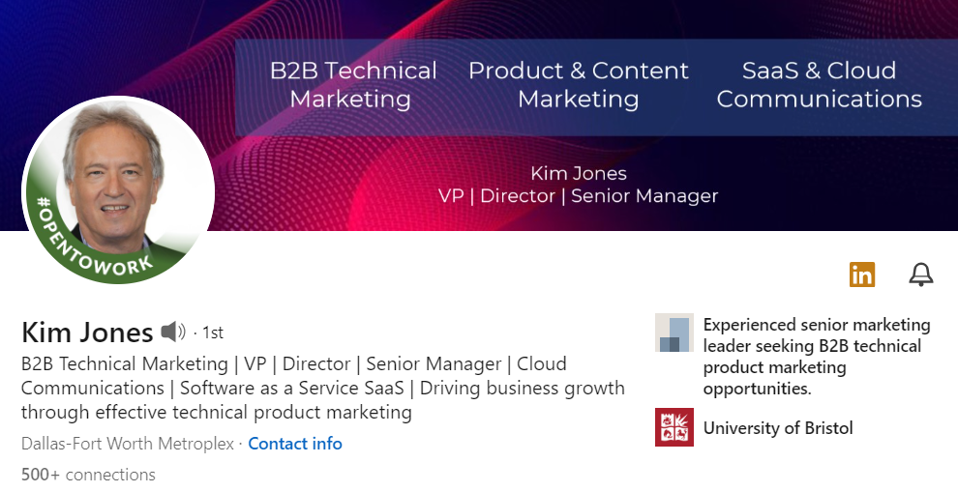
Current Position
Notes:
30% of viewers won’t scroll down
97% of viewers won’t tap ‘see more’ on About section

Slide 12
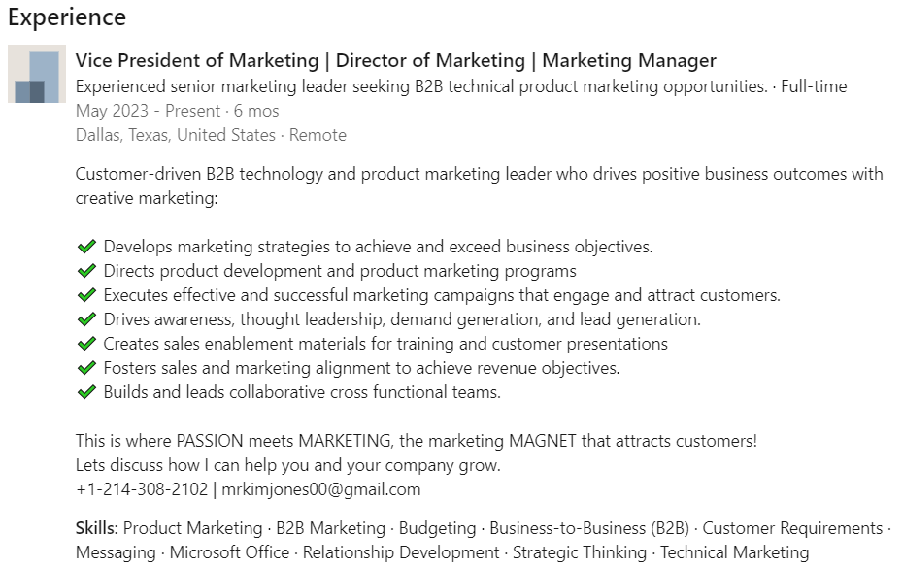
Current Position
For company…enter your phone and email address

Slide 13
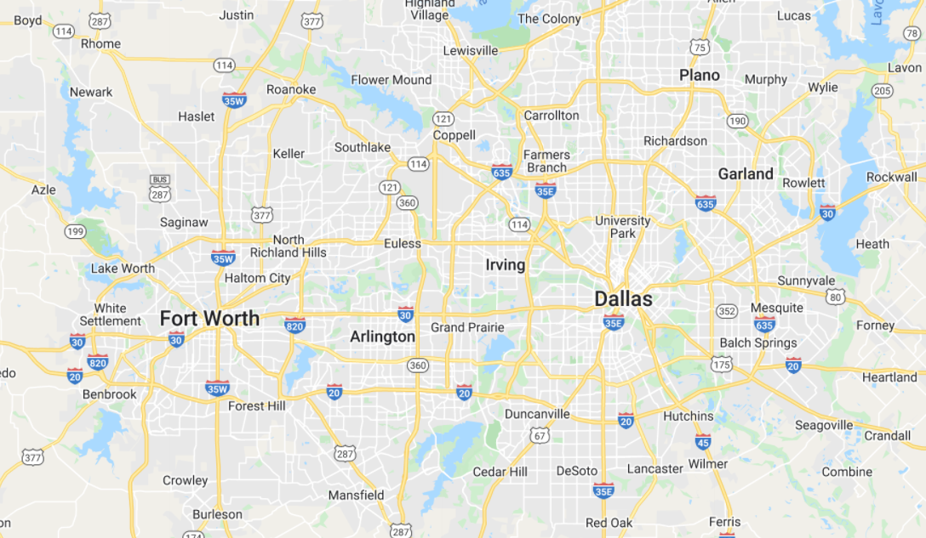
Location
Select the closest large city metro area

Slide 14
Maximizing Titles
Use titles that LinkedIn has standardized:
(Look at the “Open to Work” section)
Add multiple titles to “Headline” and “Open to Work”
Add additional titles to the “Experience” section

Slide 15
Headline Title Generator
Start with An Adjective
Add Several Titles
Add What Value You Bring
Specializing in…
Focused on…
Bringing… to…
Experienced in….
Building…
Developing…
Example:
Accomplished, Award Winning, Certified, Engaging, Experienced, Energetic, Flexible, Tenacious, Transformational, Dynamic, Skilled
Use titles that can be found on LinkedIn’s list of titles
Dynamic Program Manager driving brand awareness through integrated marketing
These can be found on “Jobs” tab when typing in a search title

Slide 16
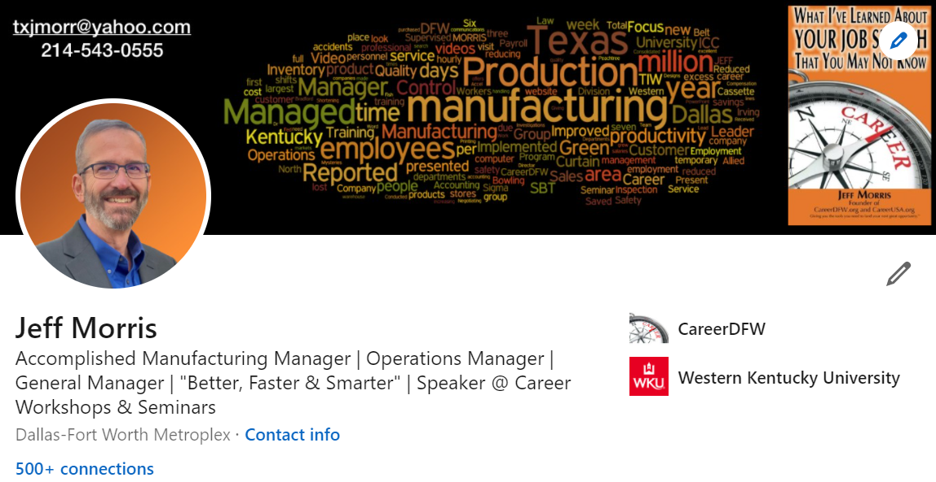
Your Branding Headline Matters

Slide 17
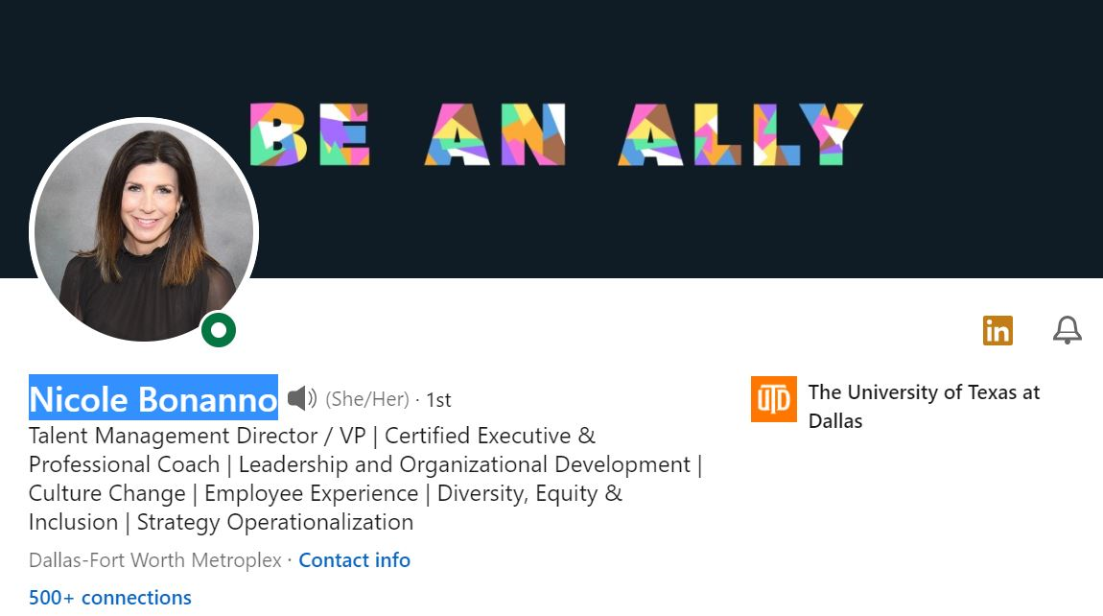
Hard to pronounce name?

Slide 18
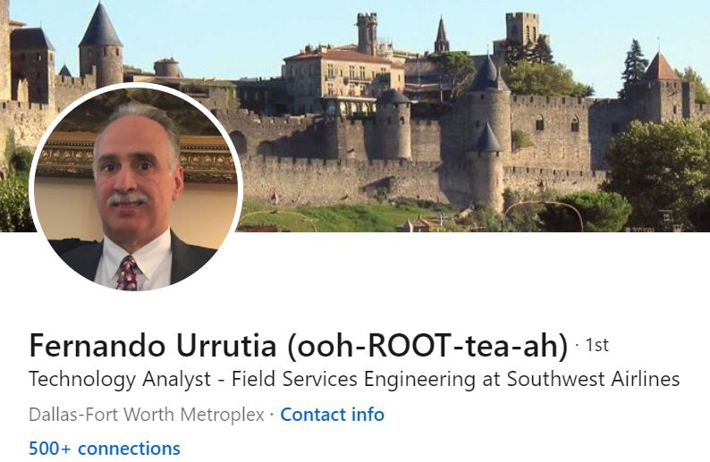
Hard to pronounce name?

Slide 19
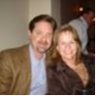
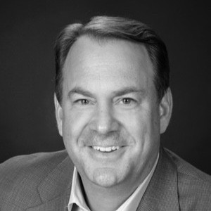
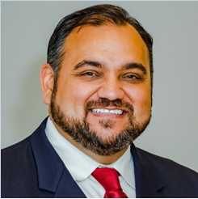
Your Picture

Slide 20
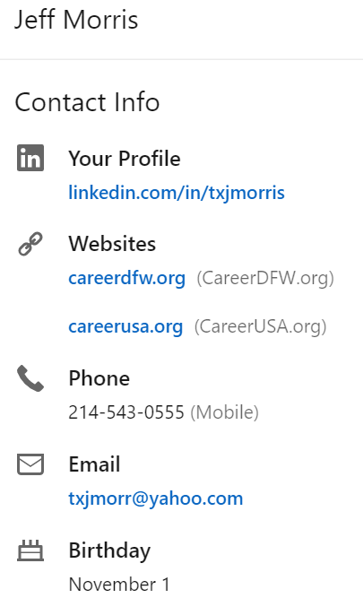
Optimize Your Contact Information Section
Have a professional email
Remember…ONLY 1st degree connections can see this information.
MOST IMPORTANT: Include it in the “About” section.

Slide 21
Create a Banner Image that Tells a Story

Slide 22
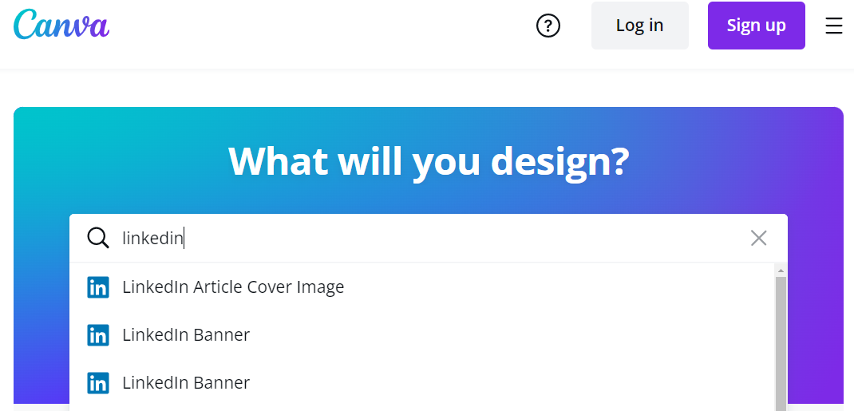
Create a Banner Image that Tells a Story
Use the FREE program Canva.com

Slide 23
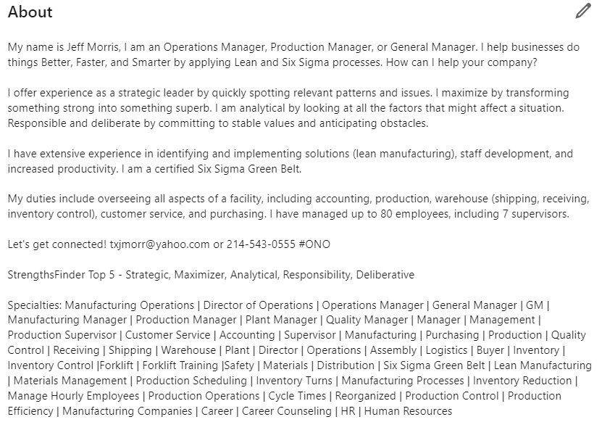
“About” Section – Tell People Who You Are, What You Can Do, and How You Can Help
Up to 2600 characters
Written in 1st person
Keep paragraphs to no more than 3 lines
Add contact info
Add keywords

Slide 24
Maximizing Skills
Use Key Words pertaining to your job in “About” and “Experience” sections
Top 10 skills employers want to see on your resume in 2023 (LinkedIn)
1. Industry-specific tools
2. Data analytics
3. Creativity
4. Communication
5. Collaboration
6. Digital literacy
7. Self-motivation
8. Time management
9. Adaptability
10. Problem-solving
https://www.linkedin.com/pulse/top-10-skills-employers-want-see-your-resume-2023-resumemansion/

Slide 25
Skills and Endorsement Section
Maximum skills allowed is 50; recommend 45-50
Two skills are showcased on the profile
Skills should include both technical and managerial (soft) skills
You should alphabetize them for easier reading
LinkedIn categorizes the skills into sections, cannot be moved
You want three current (2021-2023) recommendations

Slide 26
Skill Assessments
LinkedIn Skill Quiz is a feature that allows members to take assessments on various skills to test and showcase their proficiency in those skills
Assessments are categorized as:
Technical (C++, Python, JavaScript)
Business (QuickBooks, Microsoft Excel, Word, and PowerPoint)
Design (iMovie, Adobe Illustrator, Photoshop, InDesign)
Results show candidates who pass LinkedIn Skill Assessments are significantly more likely (~30%) to get hired

Slide 27
Skill Assessments Test
Generally 15 to 20 multiple choice questions. The questions are timed and must be completed in one session
Must score in the 70th percentile or above, to be awarded a "badge". The badge will be displayed on the “Skills and Assessment” section
Is only valid for 12 months and will expire after that
Able to retake the assessment one more time after three months, then will no longer be available

Slide 28
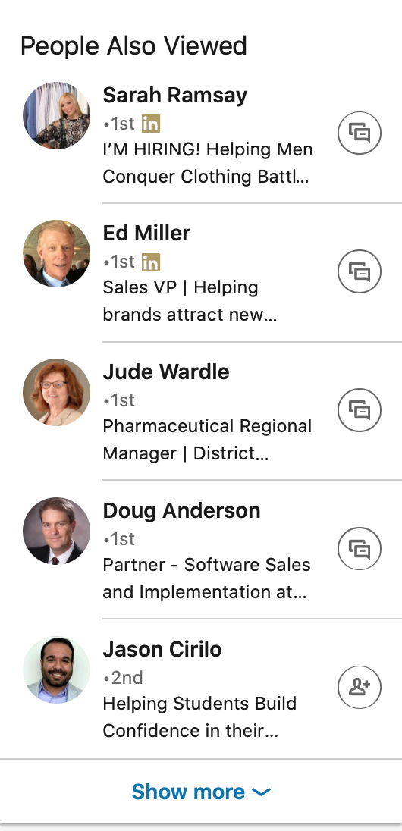
LinkedIn Settings to adjust
Privacy Settings

Slide 29
LinkedIn Settings to adjust
Privacy Settings

Slide 30
Develop a Daily Routine – 15-30 Minutes a Day
Clear the red

Slide 31
What we will cover today
How to build a good profile
Strategies to optimize their LinkedIn presence.
Tips on expanding their professional network
How to leverage LinkedIn for job search

Slide 32
Connections
Recommended: over 500
Most should be people in similar industry of job function to your search goals
Add recruiters who work in targeted companies
Add people with titles that could denote hiring manager status in targeted companies

Slide 33
How to Find Key Contacts and Prospects
AND Both are required
OR Either will qualify
NOT Eliminates records from results
“ “ Requires exact string match
( ) Clarifies like topics
Boolean Modifiers

Slide 34
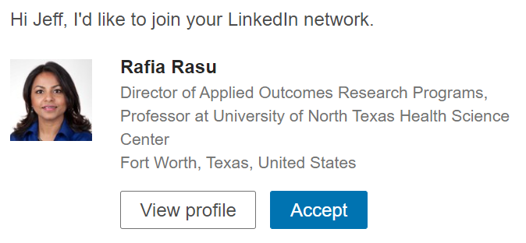
Always send a personal note

Slide 35
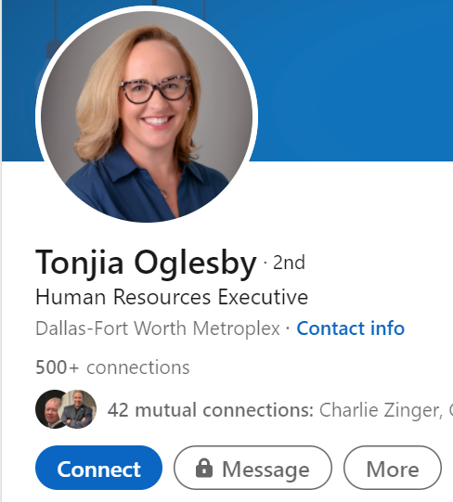
Always send a personal note
Look for the Blue connect button

Slide 36
The LinkedIn Promise
The LinkedIn Promise
I (insert your name here) promise to always send a personal note when ever I send a LinkedIn request to connect with anyone.
This includes when I use my cell phone or my computer.

Slide 37
Always send a personal note
As of October 1st, 2023
LinkedIn only allows 10 personal notes per month with the free version.

Slide 38
Follow Companies
Be sure to “Follow” any company you are interested in or have applied to

Slide 39
Be Active on LinkedIn
Post, Share and Like: Post – once a week (www.Feedly.com)
Share - with a comment daily (more than 12 words)
Share - with no comment
Like – 3-5 times daily

Slide 40
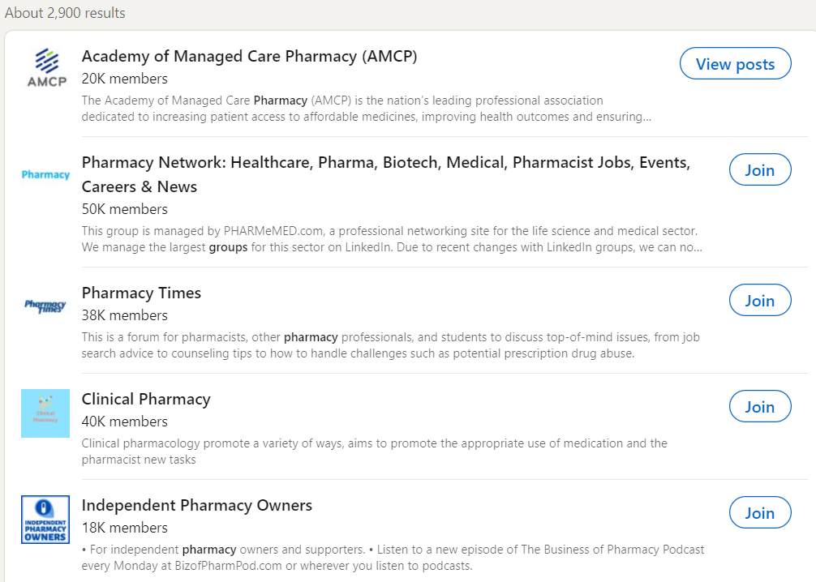
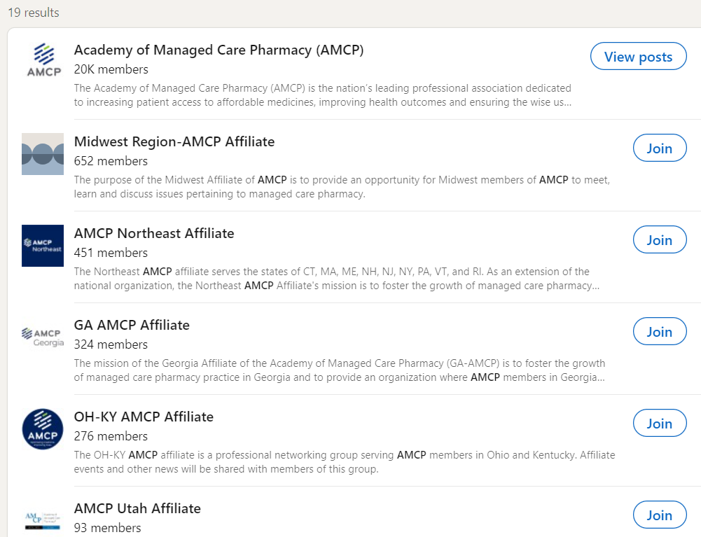
Join Groups

Slide 41
What we will cover today
How to build a good profile
Strategies to optimize their LinkedIn presence.
Tips on expanding their professional network
How to leverage LinkedIn for job search

Slide 42
Three Types of Recruiters
1) In House Recruiter
Could be handling 30 - 40 job descriptions at a time
Very Very busy…may rely on Applicant Tracking Systems
2) Outside Contingent Recruiting Firms
3 - 5 firms may be trying to fill the same job
Only the firm that makes the placement gets paid
3) Outside Retained Search Consultant
Only one firm is trying to fill a role
Gets paid an up front fee and balance on placement
Will have a good relationship with the employer

Slide 43
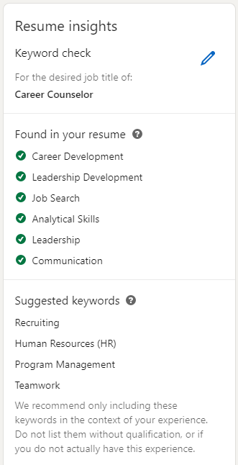
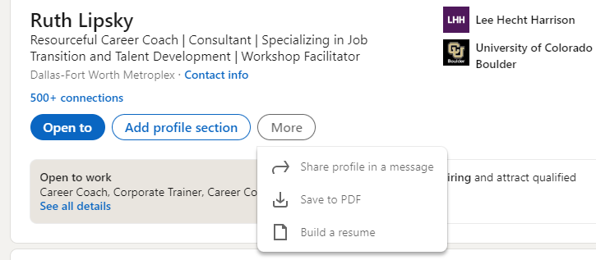
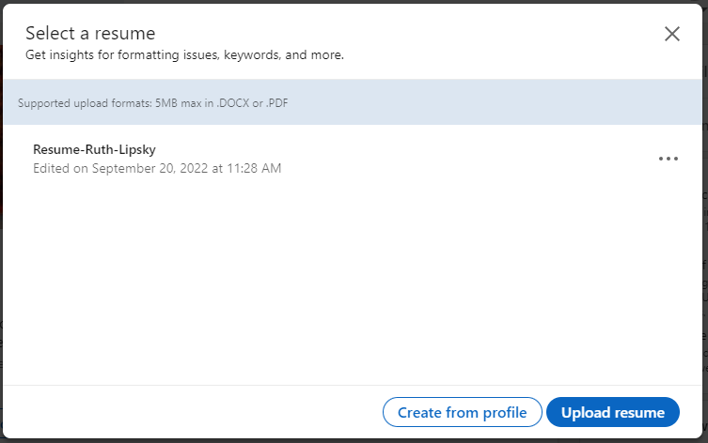
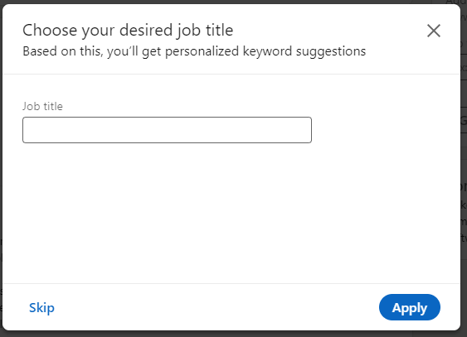
Check Your Key Skills

Slide 44
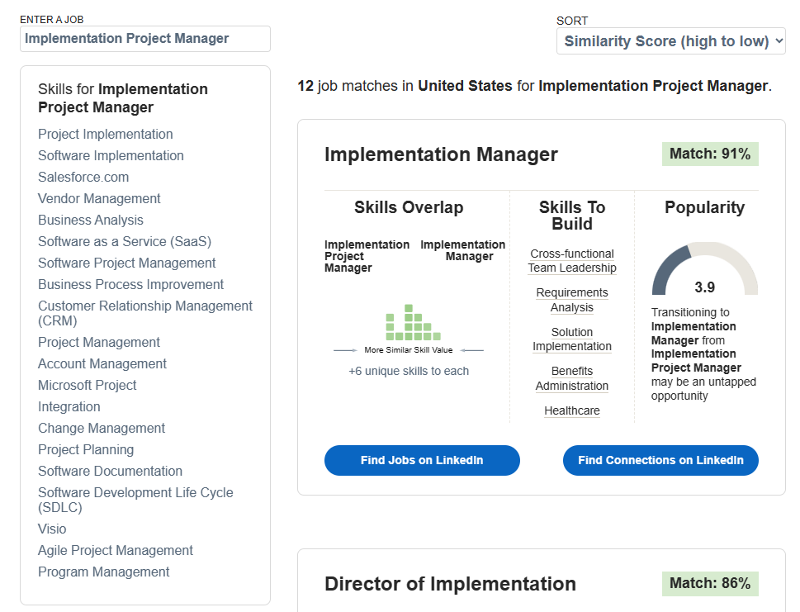
Career Explorer: LinkedIn’s List of Skills
linkedin.github.io/career-explorer/

Slide 45
#OpenToWork
LinkedIn indicates that profiles with a public #OpenToWork are likely to receive 20% -50% more InMails from recruiters.
Needs to be refreshed by turning off, then on, every two months.
Most frequently used filter in LinkedIn Recruiter software.

Slide 46
Reply to Recruiter Messages
Reply to every message from a recruiter, even if you are not interested in that role.
LinkedIn tracks the percent of recruiter messages that you reply to and creates a ‘likely to respond’ score as part of your profile.
You do not need to reply to messages that are solicitations.

Slide 47
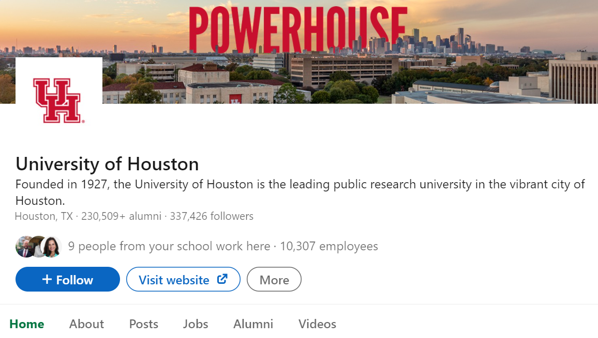
Networking
Use your college network
Type in a college name in the “Search” bar
Select the appropriate school
Click on “Alumni”

Slide 48
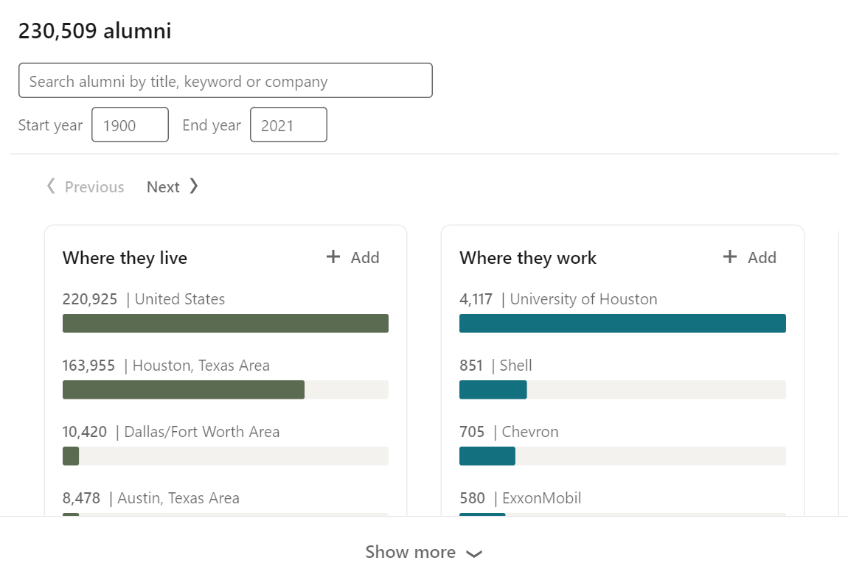
University of Houston Alumni Option

Slide 49
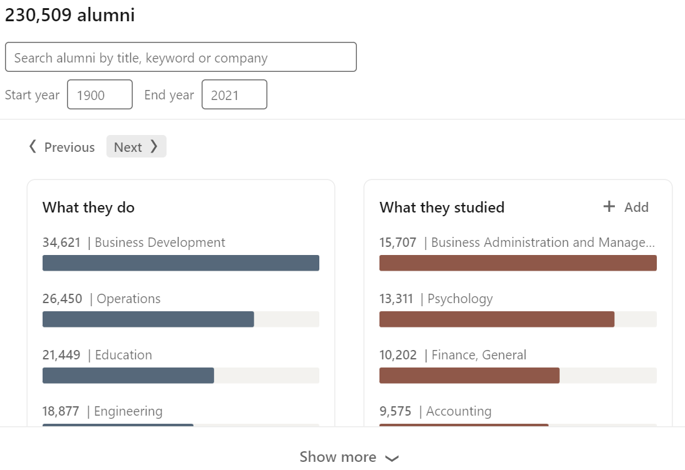
University of Houston Alumni “Next”

Slide 50
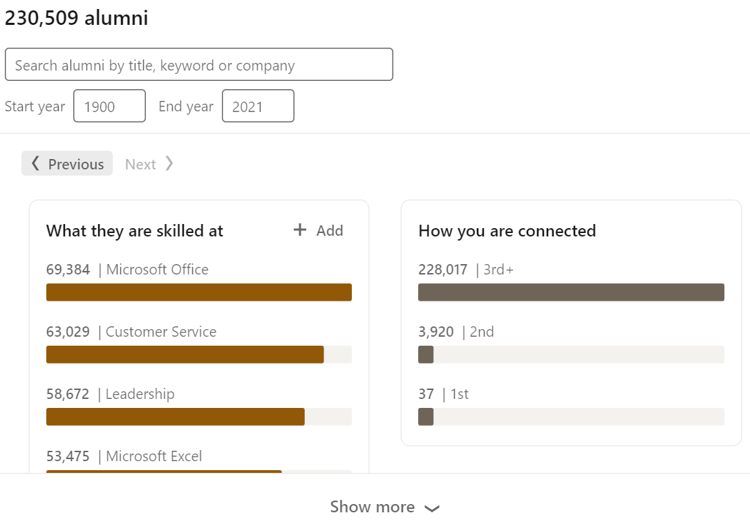
University of Houston Alumni “Next”

Slide 51
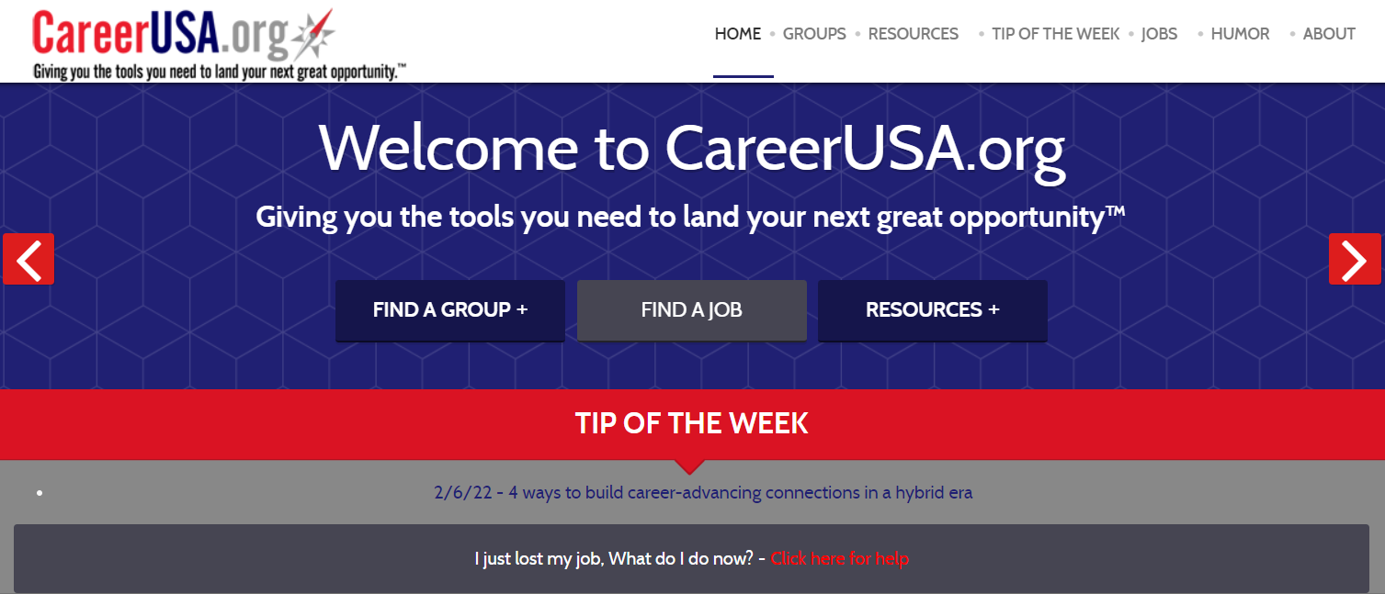
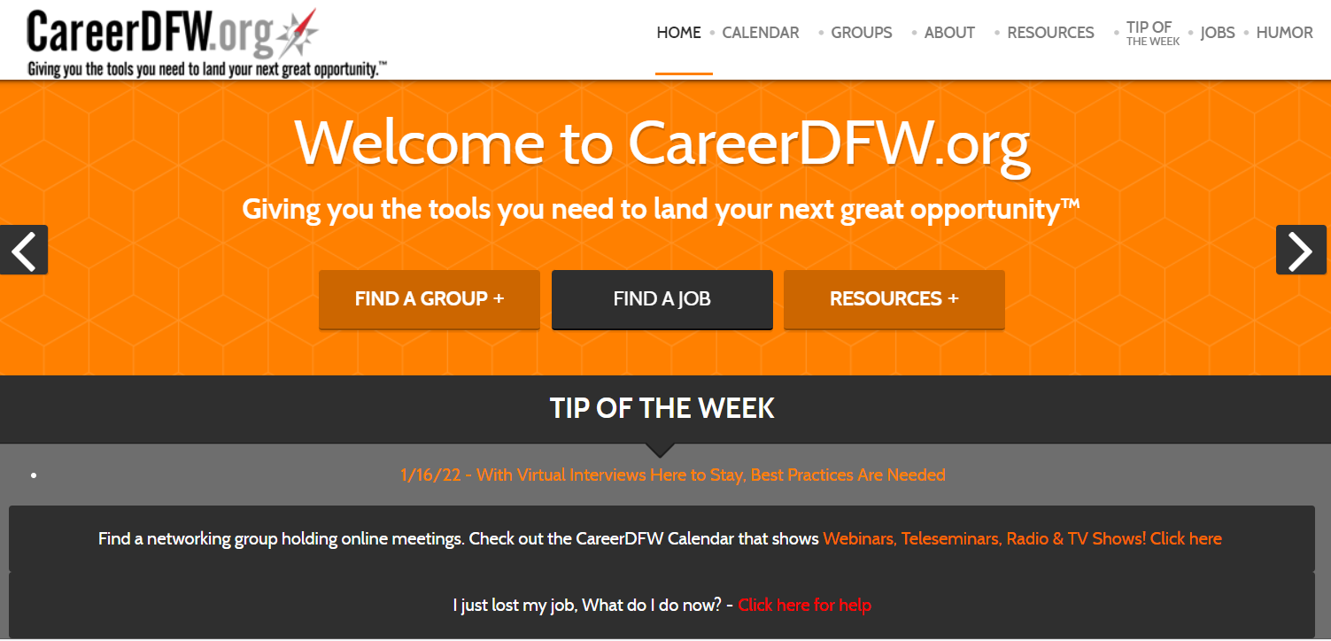
Check out CareerDFW.org or CareerUSA.org

Slide 52
Join CareerDFW & CareerUSA.org for free online training
Tuesdays – LinkedIn – 1pm Central
Wednesdays – Interviewing – 1pm Central
Thursday (1st & 3rd) – Effective Resumes - 1pm Central
Thursday (2nd & 4th) – Networking - 1pm Central
Fridays – North Dallas / Plano Career Focus Group – 9:30am Central
Check out the Career YouTube channel for over 420 workshops
Join the CareerUSA mailing list, send an email to CareerUSA+subscribe@groups.io

Slide 53
Subscribe to the CareerUSA YouTube channel

Slide 54
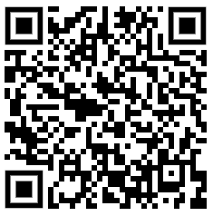
Join our email distribution list
Join the CareerUSA mailing list
Scan the QR code or send an email to
CareerUSA+subscribe@groups.io

Slide 55
Upcoming sessions at NEXUS 2023
Wednesday’s sessions
Wednesday at 11:30am – “Focus on these Four Areas for the Most Successful Job Searches”
Wednesday at 1pm Central – “Living a Mindful Life: Tools, Techniques and Practices to Keep you Staying Present and Living in the NOW”
The LinkedIn Lounge

Slide 56
Let’s Connect
Looking for a speaker?
Contact me!
Jeff Morris
webmaster@CareerDFW.org
http://www.linkedin.com/in/txjmorris
Join the CareerUSA mailing list, send an email to
CareerUSA+subscribe@groups.io
Buy it on Amazon $15

