Slide 1
Presented by the
AMCP Membership Committee
Tuesday, Sep. 26, 2023

Slide 2
Today’s Agenda
Managed Care History
What is Managed Care Pharmacy
Understanding the Players
Health Care Trends, & Challenges
Addressing the Rising Costs of Pharmaceuticals​
AMCP Student and Professional Memberships

Slide 3
Managed Care History

Slide 4
1940s
1950s
Companies offer health insurance to compete for labor.
Health plans proliferate.
1960s
Rise of employer-based health insurance.
Unemployed, poor, and older adults left out.
1970s
Pressure to control health care costs.
1968: Pharmaceutical Card System – first PBM
1973: President Nixon signs Health Maintenance Organization Act
History
Notes:
To understand the managed care pharmacy field, let me share a quick history lesson about the evolution of health insurance.
During WWII, employers had a hard time attracting employees due to labor shortages. To attract workers, employers started offering sick leave and health insurance.
This practice caught on, and in the 50s and early 60s, more employers began offering health coverage. However, unemployed, poor, and older adults were left out of these health insurance markets. At the same time health care costs increased, and pressure built to control health care costs.
Two new models to control costs emerged. First, in 1968: Pharmaceutical Card System – first PBM to address pharmaceutical costs. Then in 1973: President Nixon signs Health Maintenance Organization Act which established a new model for health care delivery as a way to curb medical cost inflation.

Slide 5
1980s
1990s
HMOs hire more pharmacists
Managed care pharmacy is a growing profession
1988: AMCP founded
2000s
Managed care pharmacy field matures quickly
2003: President Bush signs Medicare Prescription Drug, Improvement, and Modernization Act (MMA)
CMS taps AMCP leaders to establish Medicare Part D systems and regulations
History (cont’d)
Notes:
In the 1980s drug prices continued to increase. HMOs, hospital systems, and PBMs began hiring pharmacists to work in the evolving pharmacy benefit field…which led to the emergence of the managed care pharmacy practice.
Late in the 80s, PBMs become a major force to help address escalation in prescription costs.
A group of hospital pharmacists connected at a national hospital conference. They realized that they were all part of this new field and
needed a professional society to represent the interests and challenges of the ambulatory portion of pharmaceutical care delivery…particularly how to optimize the outcomes for patients.
And that’s how AMCP was founded in 1988 and incorporated in 1989.
A key example of the utility of managed care pharmacy practice in action is Medicare Part D.
After President Bush signs Medicare Prescription Drug, Improvement, and Modernization Act (MMA) in 2003, CMS taped AMCP leaders to help establish Medicare Part D systems and regulations.
Today, we see elements of managed care pharmacy in all insurance plans – from formularies to utilization management tools.
Let’s start with the definition.

Slide 6
2010s
Affordable Care Act Specialty Drug cost escalation
Rise of Value-Based Care Models
2015: BBCIC Founded
2020 & Beyond
COVID and Care Delivery Reforms
Increase in digital health
Passage of IRA
PBM Reform
History (cont’d)
Notes:
Affordable Car Act – establishment of the health insurance marketplace, Medicaid expansion, drug rebate rform
Consider including the care delivery reforms resulting from Covid, as so many of them involve health plans/PBMs/pharmacists, such as telehealth, expansion of pharmacist’s role, tools/strategies to combat the opioid crisis, etc. Many provisions are ongoing with efforts to make them permanent.

Slide 7
Where Managed Care
Pharmacists Work
Health Plans
Pharmacy Benefit Managers (PBMs)
Integrated Delivery Networks (IDNs)
Pharmaceutical Manufacturers

Slide 8
What Is Managed Care Pharmacy?
Angelica Asadi, PharmD

Slide 9
The Practice of Managed Care Pharmacy
Applies clinical and scientific evidence.
Supports the appropriate use of medications.
Enhances patient and population health outcomes.
Optimizes the use of limited health care resources.
Notes:
Managed Care pharmacy is a collaborative approach through which health care professionals apply clinical and scientific evidence to support the appropriate use of medications and enhance patient and population health while optimizing the use of limited health care resources.

Slide 10
Managed Care Pharmacy Professionals are Vital in Optimizing Patient Care
They Develop Strategies
for
Patients, Health Plans & Providers
across 5 Key Areas
Notes:
Managed care pharmacy professionals develop strategies for patients, health plans, and providers across 5 key areas.

Slide 11
Notes:
We will be discussing each of these areas in detail.

Slide 12
Ensuring access by defining where care is available.
Determining which treatments are covered based on individual and population needs.
Notes:
Pharmacy benefit design and implementation ensures access by defining where care is available. Care availability includes which pharmacies, provider groups, or other medication delivery organizations a patient can use for their healthcare needs. Appropriate benefit design also includes the decision as to which treatments should be covered based on the individual and populations that the organization is serving. This leads us to the next area of focus: Formulary.

Slide 13
Identifying which medications to include on the formulary.
Applying drug management strategies and tools.
Tracking new and developing medications.
Notes:
Formulary and medication utilization management utilizes clinical evidence and guidelines, product safety information, pharmacoeconomics, and population health needs to determine which medications to include on the formulary and what strategies and utilization tools need to be implemented. Formulary and medication utilization management require the tracking of new products, monitoring of pipeline information, analysis of clinical studies, and an understanding of the latest or upcoming clinical guideline changes. For those of you interested in putting yourself in the shoes of a pharmacist who partakes in these activities, you can use AMCP as a resources for drug product pipeline information, a resource available to members, and pay close attention to regulatory and market updates provided via our regular emails.

Slide 14
​
What is a Formulary?​
A continually updated list of medications and related products supported by evidence-based medicine, and experts on the diagnosis and treatment of disease and preservation of health. ​
Open Formulary:
Reimbursement is generally provided for most or all formulary and non-formulary drugs. Patients may or may not incur additional out-of-pocket expenses for using non-formulary drugs. Some drug classes may be excluded by plan design.​
Closed Formulary:
Non-formulary drugs are not reimbursed (unless authorized by formulary exception policies).​
Notes:
A formulary is list of drugs approved for use in a given setting. This list is continually updated based on the development of new products, updates to FDA approvals, and changes to clinical practice and guidelines.
The formulary determines which prescription drugs or classes will be covered, their level of patient and health plan cost responsibility, and any requirements that may be associated.
There are broadly two types of formularies:
An open formulary allows for most or all FDA-approved drugs to be covered by an organization, such as a health plan, but patients may pay more out-of-pocket for non-preferred products. This type of formulary provides more options to patients, but incurs more cost on both patients and the organization.
A closed formulary includes a specific list of covered products which are provided by the plan. If medically necessary, patients may be able to ask for exceptions beyond the formulary, but will have to pay extra and prove clinical necessity. This provides more limited options for patients, but reduces overall healthcare cost. Closed formularies are designed to cover an appropriate number of medications per therapeutic category and based on clinical practice to limit the need for exception requests. These decisions are made by the pharmacy and therapeutics or P&T Committee.

Slide 15
Pharmacy & Therapeutics (P&T) Committee
A committee is responsible for developing, managing, updating, and administering the drug formulary system.
Generic Formulary Drugs
Brand-Name Formulary Drugs
Specialty Formulary Drugs
Non-Formulary Drugs
Excluded Drug List
Widely available
Lowest out-of-pocket cost
Generally available
Moderate out-of-pocket costs
Includes infusion drugs
Higher out-of-pocket
Pay full cost
Go towards out-of-pocket limits
Pay full cost
Do not go towards out-of-pocket limits
Notes:
The P&T Committee is comprised of pharmacists, primary care and specialty physicians, and other health care professionals (e.g. nurses) that are responsible for developing, managing, updating, and administering the drug formulary system.​ Decisions often include the cost-share placement of the product on the formulary. This slide shows some examples of these cost-placement strategies, these may differ based on the organization. Medications may be added to the formulary, considered non-formulary, or may be completely excluded from coverage based on the organization's specific policies. ​
Annually, we provide the opportunity for student pharmacists to compete in a P&T competition that allows for you to mimic a real P&T setting, we will discuss this and other student opportunities later in this presentation.

Slide 16
P&T Committee: Decision Considerations
Notes:
P&T committee members utilize clinical efficacy and safety information, guidelines and standards of practice, review of similar therapies on the market, therapeutic need of the patient population, pipeline information, and pharmacoeconomic and value assessment information to make their decisions. All this information can be gathered neatly in the AMCP format for formulary submissions to assist P&T committees to make these decisions.
​

Slide 17
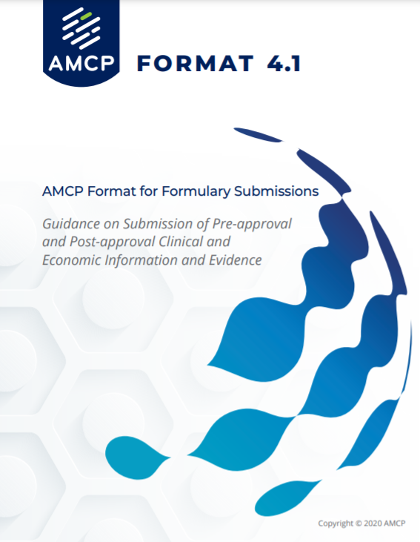
For more than two decades, the AMCP Format has defined the gold standard for evaluating evidence to support formulary and coverage decisions.
https://www.amcp.org/Resource-Center/format-formulary-submissions/AMCP-Format-for-Formulary-Submissions-4.1
Notes:
AMCP Format 4.1 is not a mandate but for more than two decades, it has defined the gold standard for evaluating evidence to support formulary and coverage decisions.
. Development and use of dossiers is at the discretion of the manufacturer and is subject to their individual legal and regulatory compliance policies. The Format is reviewed and updated as need by an AMCP committee dedicated to this work.

Slide 18
Managing coordinated care programs​.
Conducting drug utilization reviews​.
​Implementing initiatives to address health disparities.
​Completing medication therapy management​.
Notes:
Pharmacists largely contribute to the design and conduction of clinical programs. These programs are designed to manage and coordinate medication-use among a patient's various care providers. These programs include completing drug utilization reviews, medication therapy management reviews, addressing health disparities, optimizing medications use based on clinical guidelines for specific disease states, and other interventions designed to improve care, reduce waste, and ensure quality outcomes.

Slide 19
Assessing and reporting on quality measures​.
Reporting Medicare Part-D Star ratings.​
Managing drug shortages & safety programs​.
Notes:
The clinical programs and similar initiatives or interventions are designed to ensure quality outcomes in which patients receive optimal care to appropriately manage disease states. Many organizations utilize quality endpoints such as blood pressure results, A1C levels, medication adherence or other measures that are associated with healthier patients to ensure organizations do the best they can in their care delivery. For instance, Medicare Part D utilizes various quality measures to rate Medicare Advantage health plans on a scaled of 1 to 5. The higher the rating, the more appealing these plans become to patients, ensuring that quality care is provided to Medicare beneficiaries. Quality measures are often linked with healthier patients, leading to reduced overall healthcare costs. Managing drug shortages and having safety programs in place will also ensure improved patient outcomes. Proactive approaches to providing alternatives or monitoring high-risk disease states closely for safety, will improve patient care and reduce overall costs.

Slide 20
Reducing risk for individuals, employers, and other public payers by managing overall costs​.
Protecting against misuse, overuse, and fraud​.
Promoting value-based care.
Notes:
Finally, one of the unique aspects of managed care is its consideration for overall costs. It is important to take affordability into consideration, as regardless of the clinical efficacy and superiority of a product, if a patient cannot afford it, it is not the best choice for them. Managed care principles and practices are in place to reduce the cost for everyone, patients, employers, health plans, government programs, and other health care organizations. Affordability considerations are a part of formulary decisions, creation of clinical, quality and safety programs, government health plan requirements, and most other decisions made in the health care market. Through these decisions, managed care professionals promote value-based care.
It is also important to ensure the right resources are used at the right time, for the right patients. Therefore, organizations need to have processes in place to combat fraud, misuse or overuse.

Slide 21
Understanding the Players:
How Payment Works
Vi Huynh, PharmD, MS, MPH
Centene
Notes:
Let’s go through how payments work so you can better understand the players in managed care pharmacy​

Slide 22
What is a Plan Sponsor / Payer?
A purchaser of health care insurance, including private employers, Medicare, Medicaid, government programs (e.g., TRICARE), and health insurance marketplaces.

Slide 23
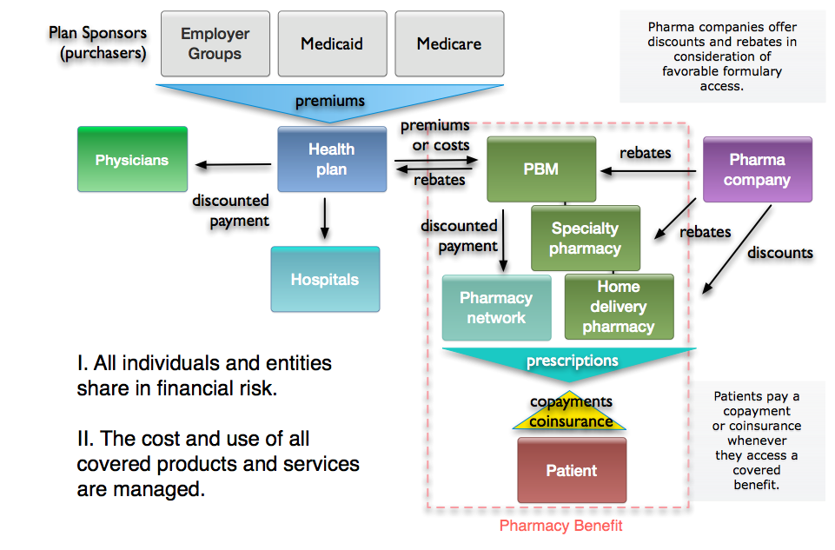
Commercial Partners & Money Flow
Patient
Notes:
Focus on Plan Sponsors
This diagram shows the contractual relationships with the trading partners and the flow of money. We will start on the top just to illustrate what we mentioned in the previous slide. We have employer groups, Medicaid, and Medicare, which are the three largest insurance programs. We call these books of business.
So, the employer groups, Medicaid, or Medicare, we will call them plan sponsors because these are the entities that are purchasing the insurance. These are the entities that determine what insurance benefits are authorized and what they are willing to buy. There is a trade of money that is either a premium or actual claims are passed through, as determined by the contract with a healthcare plan or insurance company.
For example, in this slide, the healthcare plan is contracting with one of the employer groups. They want to buy health insurance and so they contact a health plan, they may contact several health plans to get competing bids and they will finally select a health plan to provide medical and pharmacy benefits and for the comprehensive benefits, the employer group will pay the premiums. Part of the premiums is paid by the individual employee. The healthcare plan then has a network of physicians, hospitals, and other providers that the covered individuals can use for their health care needs as we showed in the previous slide. These are called a provider network to provide the healthcare services that are contracted by the employer group. So, the healthcare plan contracts with community-based providers in exchange for the privilege of the providers being paid to see the health plan's patients.

Slide 24
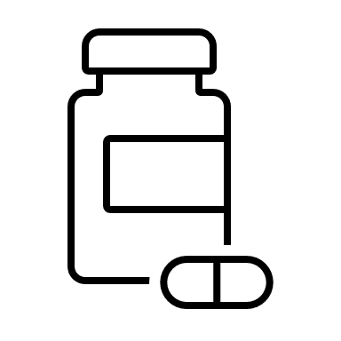
What is a Pharmacy Benefit Manager (PBM)?
Organizations that manage pharmacy benefits for managed care organizations, other medical providers, ​or employers.

Slide 25
Commercial Partners & Money Flow
Patient
Notes:
​Focus on Inside the Red Dash Box – Pharmacy Benefit​
​
So, let us look inside the red dash block on the right side of the slide. This represents the pharmacy benefit. The left side of the box or outside on the box on the left is the medical benefit. Sometimes, a health plan will contract or subcontract with a PBM, or a Pharmacy Benefit Manager, to develop and manage the prescription drug benefits. So, the healthcare plan may pass on some administrative fees that are paid by the employer group to administer the pharmacy benefit. The PBM then sends the actual cost of the prescriptions used back to the healthcare plan. ​
​
The PBM has a network of community pharmacies where patients can pick up their medications. . However, PBMs will set up many different types of pharmacy networks based on the needs of a specific employer group. ​
​
For example, if there is an employer group that only has people living in the state of Florida, they do not need all US pharmacies in their pharmacy network, so they can save money if they have a reduced pharmacy network, perhaps including some national chains in case their employees in Florida go on vacation or travel on business, but most of the pharmacies in the network are in Florida because that is where the employees and their families live. ​
​
In addition to the community pharmacy network, the PBM will also have the specialty pharmacy contract or may have its own specialty pharmacy for high-cost biologicals. The PBM may also contract with a home delivery pharmacy or mail service pharmacy, or it may have its own mail service pharmacy, so there are three primary distribution chains. It is important to realize that 80 percent of the prescriptions go through community pharmacies. ​
​
About 5 percent of prescriptions are filled at specialty pharmacies, and then we have home delivery, which is about 15- percent of all prescriptions. All these pharmacies dispense prescriptions that are covered underneath the formulary. The formulary was determined by the PBM and healthcare plan, and then the patient, pays a cost share, that is a fixed dollar copayment or a percentage coinsurance whenever the patient gets a covered prescription filled at the pharmacy. ​
​

Slide 26
Commercial Partners & Money Flow
Patient
Notes:
Focus on Pharmaceutical Companies
On the upper right, we have the pharmaceutical companies. They are also involved in the financial risk because they offer rebates or discounts, which are price concessions paid to the PBM or paid directly to the health plan or pharmacy, depending upon who is purchasing the drug and taking possession of the drug, but these are price concessions that reduce the net cost of their drug. So, the lower net cost as the result of the pharmaceutical company price concessions are then passed on back to the healthcare plan and the plan sponsor. The pharmaceutical company discounts reduce the net cost on contracted products and reduce the cost of the system, but not usually the cost to the patient.

Slide 27
Health Care
Today

Slide 28
U.S. Health Care Insurance Overview
Notes:
​The U.S. health care system is unique and unlike any other system in the world. It is a complex system that has both state and federal programs and oversight. ​
​
This slide depicts this system. Let us illustrate this with Medicaid. Medicaid is a program that was established in 1965 by the Social Security Act. It was a federally enacted program, but it is state organized and managed, so each state has its own Medicaid program. ​
​
Managed Medicaid or Medicaid programs are administered by individual states, possessions, and territories and so there are 54 different Medicaid programs in total. They are similar in that they are all developed for low-income individuals. So, there is state administration, state determination of the formulary and drugs that are covered in the benefits, but there is a lot of consistencies because there is federal oversight. ​
​
Health insurance exchanges, authorized through the Healthcare Reform Act of 2010, allow individuals and small companies to buy health insurance in state and/or federal exchanges. Again, every state has its own type of exchange and insurance program, but there is a great deal of consistency because they are all must include the Essential Health Benefits, as required by the ACA (which include pharmacy benefits). ​
​
These are 156 million individuals covered by some sort of an employer-based program. And again, some are under the state program, the state authorization, and some under federal authority. The very large, self-funded programs are typically under federal ERISA programs. ​
​
Medicare insurance programs operate under the same national Centers for Medicare and Medicaid Service’s oversight. Medicare covers about 63 million recipients over age 65, and about 10 million who have severe disabilities, and some under 65 years, who are also eligible for state Medicaid benefits. ​
​
The bottom row illustrates how care is delivered. Integrated delivery systems such as Kaiser Permanente, Group Health Cooperative of Puget Sound, Henry Ford Health System, and others usually own their own health facilities, employ health care professionals, and also contract with other insurance programs. IDS may have lower costs due to control over health delivery costs, and may have higher quality and better outcomes due to coordination of care and use of Electronic Health Records (EHRs). IDS represent a minority of insured individuals in the US.​
​
Outside of an integrated care system, patients can choose medical providers under their insurance plan based on preferred networks and facilities. ​
​
Pharmacy benefit managers are organizations that manage pharmacy benefits for managed care organizations, other medical providers, or employers. PBM activities may include some or all of the following: benefit plan design; creation/administration of retail and mail service networks; claims processing; and managed prescription drug care services such as drug utilization review, formulary management, generic dispensing, prior authorization, and disease management.​
​
Let’s now explore how this overview relates to the players in the health care system. ​
​
​

Slide 29
Health Care
GDP 2021
$4.3 trillion
$12,914 per person
Prescription drug spending increased 7.8% over previous year to $378 billion
18.3% of GDP
URL: https://www.cms.gov/Research-Statistics-Data-and-Systems/Statistics-Trends-and-Reports/NationalHealthExpendData/NHE-Fact-Sheet
Notes:
In 2021, US health care was 18.3% of the GDP at $4.3 trillion dollars and almost $13K per person.
Of note, prescription drug spending was $378 billion, an increase of 7.8% over the previous year. (This is not surprising since COVID was in 2020.)
The largest shares of total health spending were sponsored by the federal government (34 percent) and the households (27 percent). The private business share of health spending accounted for 17 percent of total health care spending, state and local governments accounted for 15 percent, and other private revenues accounted for 7 percent.
Over 2022-2031, an increase in the health spending share of GDP is anticipated to increase from 18.3 percent in 2021 to 19.6 percent in 2031.
The insured share of the population is projected to have been 92.3 percent in 2022 (an historic high) related to high Medicaid enrollment and gains in Marketplace enrollment and remain at that rate through 2023.
The Inflation Reduction Act is projected to result in lower Medicare beneficiary OOP spending on prescription drugs for 2024, to include $2,000 annual OOP spending cap and lower gross prices resulting from negotiations with manufacturers.
----------------------
NHE Fact Sheet
Historical NHE, 2021:
NHE grew 2.7% to $4.3 trillion in 2021, or $12,914 per person, and accounted for 18.3% of Gross Domestic Product (GDP).
Medicare spending grew 8.4% to $900.8 billion in 2021, or 21 percent of total NHE.
Medicaid spending grew 9.2% to $734.0 billion in 2021, or 17 percent of total NHE.
Private health insurance spending grew 5.8% to $1,211.4 billion in 2021, or 28 percent of total NHE.
Out-of-pocket spending grew 10.4% to $433.2 billion in 2021, or 10 percent of total NHE.
Other Third-Party Payers and Programs and Public Health Activity spending declined 20.7% in 2021 to $596.6 billion, or 14 percent of total NHE.
Hospital expenditures grew 4.4% to $1,323.9 billion in 2021, slower than the 6.2% growth in 2020.
Physician and clinical services expenditures grew 5.6% to $864.6 billion in 2021, slower growth than the 6.6% in 2020.
Prescription drug spending increased 7.8% to $378.0 billion in 2021, faster than the 3.7% growth in 2020.
The largest shares of total health spending were sponsored by the federal government (34 percent) and the households (27 percent). The private business share of health spending accounted for 17 percent of total health care spending, state and local governments accounted for 15 percent, and other private revenues accounted for 7 percent.
Projected NHE, 2022-2031:
Over 2022-2031 average growth in NHE (5.4 percent) is projected to outpace that of average GDP growth (4.6 percent) resulting in an increase in the health spending share of GDP from 18.3 percent in 2021 to 19.6 percent in 2031.
The insured share of the population is projected to have been 92.3 percent in 2022 (an historic high) related to high Medicaid enrollment and gains in Marketplace enrollment and remain at that rate through 2023.
Medicaid enrollment is projected to decline from its 2022 peak of 90.4M to 81.1M by 2025 as states disenroll beneficiaries no longer eligible for coverage. By 2031 the insured share of the population is projected to be 90.5%.
The Inflation Reduction Act is projected to result in lower OOP spending on prescription drugs for 2024 and beyond as Medicare beneficiaries incur savings associated with several provisions from the legislation including the $2,000 annual OOP spending cap and lower gross prices resulting from negotiations with manufacturers.

Slide 30
Challenges
In America's complex health care system, patient needs can get lost.
When patients can't access medication due to cost or other barriers, their condition worsens.
This increase the burden on individuals and the entire health care system.
Innovative therapies change, and even save lives, but are associated with higher costs.

Slide 31
Managed Care Pharmacy is Part of the Solution…
Professionals dedicated to getting patients the medications they need at a cost they can afford.

Slide 32
Promising Therapies, Higher Prices
Innovative therapies may improve quality of life, increase longevity, or even cure disease.
Eight of 13 drugs launched in 2022 - priced over $200,000 per year 1.
Median annual price for new U.S. drugs in 2022 was $257,0001.

Slide 33
Addressing
the
Rising Costs of Pharmaceuticals
Justin Bioc, PharmD
Devoted Health
Notes:
Including so they can see some of the issues that managed care pharmacy is addressing

Slide 34
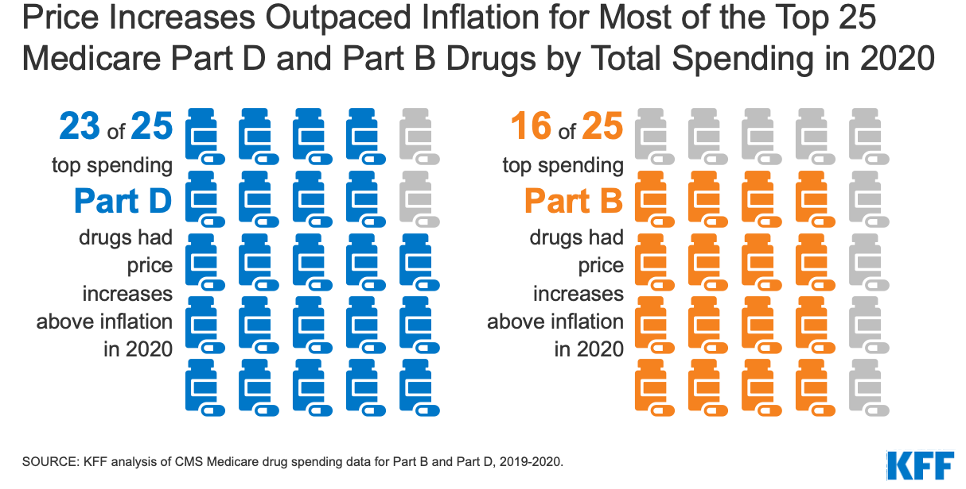

Slide 35
Shared Beliefs & Principles to Address Rising Costs
Clinical decision-making must be driven by evidence.
Payers, manufacturers, and the health care system want to see therapies used appropriately.
Need to put resources behind interventions that demonstrate value.
Dialogue among stakeholders is essential.

Slide 36
Proposed Solutions to Address the Rising Cost of Pharmaceuticals
Value based outcomes
Enhanced approach to coverage decisions
Competition to lower costs
HEOR
Population Health

Slide 37
Online training program on the basics of managed care pharmacy
Accredited for 9.5 hours for pharmacists and pharm technicians
Discounted pricing for AMCP members and bulk sales
Learn more at amcplearn.org

Slide 38
Keeping the Patient Needs Front & Center
That’s the Vision we Share as Managed Care Pharmacy Professionals
Notes:
What is important always in managed care pharmacy

Slide 39
About AMCP & Student and Professional Memberships
Teresa Roane, PharmD, MBA, BCACP
University of Florida
Notes:
Including so they can see some of the issues that managed care pharmacy is addressing

Slide 40
Notes:
And since our founding, AMCP continues to be the hub for health plans, manufacturers, PBMs, and other health care decision makers to catalyze meaningful conversation and create actionable solutions to get patients the medications they need at a cost they can afford.
This is an important niche health care profession.
AMCP’s diverse membership of pharmacists, physicians, nurses, biopharmaceutical professionals, and other stakeholders leverage their specialized expertise in clinical evidence and economics to optimize benefit of medicines, population health management, and patient access to cost-effective, safe medications.
And student pharmacists are in important part of our membership as we build the pipeline for the next generation. AMCP offers many opportunities for you to learn more about managed care pharmacy as well as how to launch your career.
AMCP supports university chapters across the country for you to join, network, and learn

Slide 41
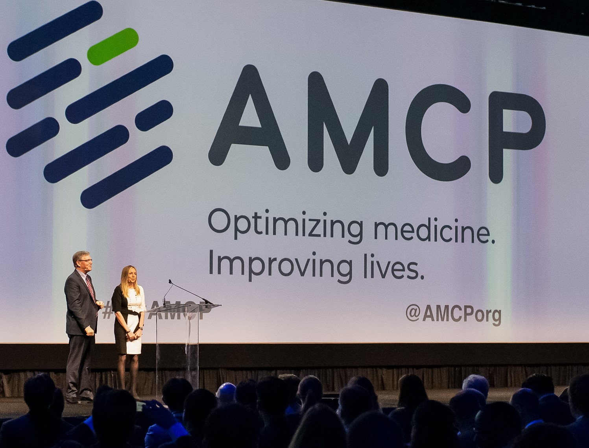
AMCP members manage medication therapies for 300 million Americans
8,000 members
80+ AMCP Student Chapters
Education, Networking, Advocacy, & More

Slide 42
AMCP Strategic
INITIATIVES
Optimize Value & Access
Address Disparities in Medication Use and Access
Enhance Member Value
Improve formulary decision-making and tools to help patients obtain the medications and other therapies they need
Address barriers to access and the effective use of medications and other therapies
Grow our membership and make AMCP essential to those involved in managed care pharmacy
Notes:
AMCP has 3 strategic initiatives to guide its work. It convenes industry leaders and develops guidelines and tools for members on these key issues.
Focus areas for each one (You do not need to go into these – just in case you are asked)
Optimize Value & Access:
Provide resources to help payers evaluate digital therapeutics
Promote the adoption of biosimilars
Incorporate the patient voice into formulary decision making
Address Disparities in Medication Use and Access
Create awareness and identify opportunities to mitigate disparities in medication use from a managed care perspective
Seek partnerships to assist AMCP with addressing health disparities
Expand research opportunities to support managed care professionals regarding disparities in medication use
Enhance Member Value
Evaluate emerging sectors for incorporation into AMCP member growth strategy
Define and enhance value proposition for key stakeholder groups
Grow corporate membership and involvement
Build an organization that is #Member1st

Slide 43
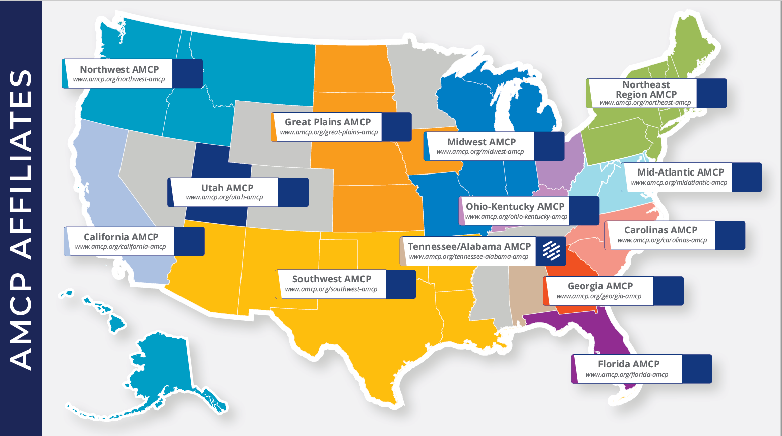

Slide 44
AMCP Student Pharmacist Membership

Slide 45
Notes:
As a student member of AMCP there are so many great resources grow your career and innovate the future of managed care.
From student pharmacist-specific programming at national meetings (including the popular conference buddy program!) to an exclusive student online community to discounts on national meetings and other learning opportunities, AMCP offers a range of meaningful resources for you.
We even have a special online resource center designed for students.

Slide 46
Student Member Opportunities
Network
At events hosted by AMCP Regional Affiliates
Serve
As a Chapter Leader
Participate
In the prestigious National P&T competition
Notes:
Plenty of opportunities to get involved at a local, student chapter level. In particular, the national AMCP Foundation P&T competition offers students a great opportunity to learn how to apply the P&T committee decision-making process and create a monograph.
If your university don’t have a chapter – contact AMCP about forming one.
There are even more opportunities.

Slide 47
Get Involved!
Attend | Find | Apply
A National Meeting: Spring Annual Meeting & Fall AMCP Nexus NEXUS: Managed Care Pharmacy Residency & Fellowship Showcase to find post-graduate training opportunities. | A Mentor: Through our Conference Buddy Program or Mock Interview program A volunteer opportunity through your local affiliate | For an AMCP: Foundation Internship National AMCP Committee Affiliate travel grant
Notes:
Best way to take advantage of your membership

Slide 48
Networking
Notes:
Of course, one of the best ways to take advantage of your membership is to network!
AMCP Collaborate is the exclusive online community where you can connect with students from around the country
Relationships with conference buddies, school diplomats, and other professionals
Mock interview programs give you feedback from professionals to polish your brand

Slide 49
Notes:
Highlight that there is a Student Open Forum that is exclusively for AMCP student pharmacist members!

Slide 50
Managed Care Residencies & Fellowships

Slide 51
Managed Care Residencies & Fellowships
Residency
Fellowship
Year long post-PharmD intensive learning and skills-building experience in a managed care pharmacy environment.
To be accredited by ASHP, the program must meet standards that are developed by the Commission on Credentialing with input from AMCP members.
Typically, research-based and typically two years in length.
Sometimes completed after a PGY1 and/or PGY2 residency (or instead of one).
amcp.org/residents-fellows
Notes:
You're approaching the end of pharmacy school and made the decision to pursue a career in managed care pharmacy - what's next? Many choose to pursue a managed care residency or fellowship. AMCP has the tools you need to explore your options and find the best fit for you. ​
Accredited Residencies​
Non-Accredited Residencies​
Fellowships​
How to Start a Residency​
Tips on Applying for a Residency or Fellowship​
​
It’s important to understand some key differences between the two types of post graduate training as their timelines vary. ​
​

Slide 52
Student Education Sessions (Oct 17 &18)
Practice Based Research: What, Why, and How? (Oct 17)
Student Leadership Academy (Oct 18)
Reception (Oct 17)
AMCP Managed Care Pharmacy Residency & Fellowship Showcase (Oct 18)
amcpnexus.org
Notes:
We’re excited to host a live meeting this fall.
Encourage students to register –
Discount for student members.

Slide 53
Notes:
Encourage to belong and to connect with us via social media.

Slide 54
Questions
Additional Resources:
www.amcp.org/What_is_MCP?

Slide 55
Not an AMCP member yet?
……………………..
Join today at amcp.org/Join

