Slide 1
About AMCP & Student and Professional Memberships
Teresa Roane, PharmD, MBA, BCACP
University of Florida
Notes:
Including so they can see some of the issues that managed care pharmacy is addressing

Slide 2
Notes:
And since our founding, AMCP continues to be the hub for health plans, manufacturers, PBMs, and other health care decision makers to catalyze meaningful conversation and create actionable solutions to get patients the medications they need at a cost they can afford.
This is an important niche health care profession.
AMCP’s diverse membership of pharmacists, physicians, nurses, biopharmaceutical professionals, and other stakeholders leverage their specialized expertise in clinical evidence and economics to optimize benefit of medicines, population health management, and patient access to cost-effective, safe medications.
And student pharmacists are in important part of our membership as we build the pipeline for the next generation. AMCP offers many opportunities for you to learn more about managed care pharmacy as well as how to launch your career.
AMCP supports university chapters across the country for you to join, network, and learn

Slide 3
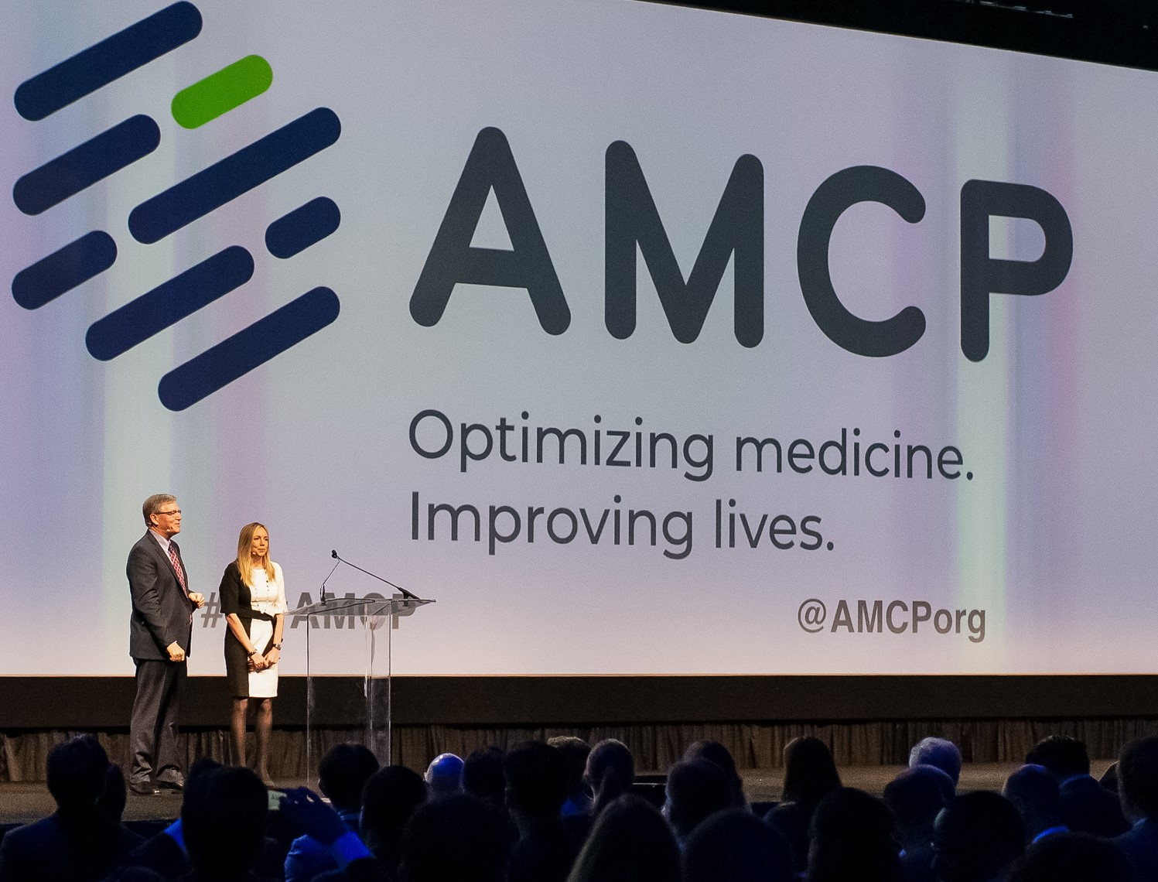
AMCP members manage medication therapies for 300 million Americans
8,000 members
80+ AMCP Student Chapters
Education, Networking, Advocacy, & More

Slide 4
AMCP Strategic
INITIATIVES
Optimize Value & Access
Address Disparities in Medication Use and Access
Enhance Member Value
Improve formulary decision-making and tools to help patients obtain the medications and other therapies they need
Address barriers to access and the effective use of medications and other therapies
Grow our membership and make AMCP essential to those involved in managed care pharmacy
Notes:
AMCP has 3 strategic initiatives to guide its work. It convenes industry leaders and develops guidelines and tools for members on these key issues.
Focus areas for each one (You do not need to go into these – just in case you are asked)
Optimize Value & Access:
Provide resources to help payers evaluate digital therapeutics
Promote the adoption of biosimilars
Incorporate the patient voice into formulary decision making
Address Disparities in Medication Use and Access
Create awareness and identify opportunities to mitigate disparities in medication use from a managed care perspective
Seek partnerships to assist AMCP with addressing health disparities
Expand research opportunities to support managed care professionals regarding disparities in medication use
Enhance Member Value
Evaluate emerging sectors for incorporation into AMCP member growth strategy
Define and enhance value proposition for key stakeholder groups
Grow corporate membership and involvement
Build an organization that is #Member1st

Slide 5
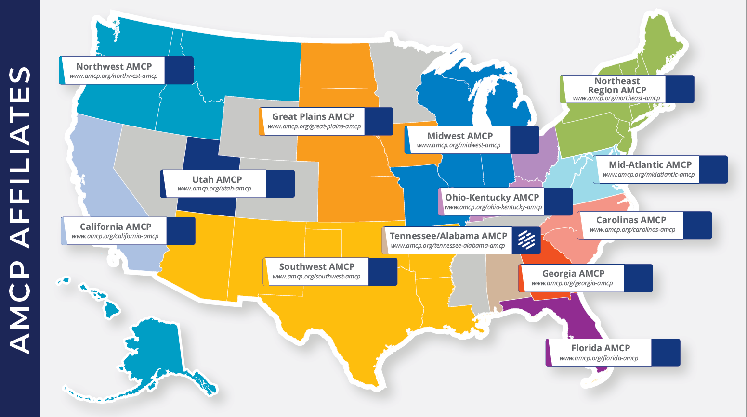

Slide 6
AMCP Student Pharmacist Membership

Slide 7
Notes:
As a student member of AMCP there are so many great resources grow your career and innovate the future of managed care.
From student pharmacist-specific programming at national meetings (including the popular conference buddy program!) to an exclusive student online community to discounts on national meetings and other learning opportunities, AMCP offers a range of meaningful resources for you.
We even have a special online resource center designed for students.

Slide 8
Student Member Opportunities
Network
At events hosted by AMCP Regional Affiliates
Serve
As a Chapter Leader
Participate
In the prestigious National P&T competition
Notes:
Plenty of opportunities to get involved at a local, student chapter level. In particular, the national AMCP Foundation P&T competition offers students a great opportunity to learn how to apply the P&T committee decision-making process and create a monograph.
If your university don’t have a chapter – contact AMCP about forming one.
There are even more opportunities.

Slide 9
Get Involved!
Attend | Find | Apply
A National Meeting: Spring Annual Meeting & Fall AMCP Nexus NEXUS: Managed Care Pharmacy Residency & Fellowship Showcase to find post-graduate training opportunities. | A Mentor: Through our Conference Buddy Program or Mock Interview program A volunteer opportunity through your local affiliate | For an AMCP: Foundation Internship National AMCP Committee Affiliate travel grant
Notes:
Best way to take advantage of your membership

Slide 10
Networking
Notes:
Of course, one of the best ways to take advantage of your membership is to network!
AMCP Collaborate is the exclusive online community where you can connect with students from around the country
Relationships with conference buddies, school diplomats, and other professionals
Mock interview programs give you feedback from professionals to polish your brand

Slide 11
Notes:
Highlight that there is a Student Open Forum that is exclusively for AMCP student pharmacist members!

Slide 12
Managed Care Residencies & Fellowships

Slide 13
Managed Care Residencies & Fellowships
Residency
Fellowship
Year long post-PharmD intensive learning and skills-building experience in a managed care pharmacy environment.
To be accredited by ASHP, the program must meet standards that are developed by the Commission on Credentialing with input from AMCP members.
Typically, research-based and typically two years in length.
Sometimes completed after a PGY1 and/or PGY2 residency (or instead of one).
amcp.org/residents-fellows
Notes:
You're approaching the end of pharmacy school and made the decision to pursue a career in managed care pharmacy - what's next? Many choose to pursue a managed care residency or fellowship. AMCP has the tools you need to explore your options and find the best fit for you. ​
Accredited Residencies​
Non-Accredited Residencies​
Fellowships​
How to Start a Residency​
Tips on Applying for a Residency or Fellowship​
​
It’s important to understand some key differences between the two types of post graduate training as their timelines vary. ​
​

Slide 14
Student Education Sessions (Oct 17 &18)
Practice Based Research: What, Why, and How? (Oct 17)
Student Leadership Academy (Oct 18)
Reception (Oct 17)
AMCP Managed Care Pharmacy Residency & Fellowship Showcase (Oct 18)
amcpnexus.org
Notes:
We’re excited to host a live meeting this fall.
Encourage students to register –
Discount for student members.

Slide 15
Notes:
Encourage to belong and to connect with us via social media.

Slide 16
Not an AMCP member yet?
……………………..
Join today at amcp.org/Join

