Slide 1
AMCP Diplomat
Webinar
August 24, 2023

Slide 2
AGENDA
Welcome, Introductions, & Antitrust Statement Review
Diplomat Program Overview
Diplomat Resources
A Look at Student Pharmacist Membership
Diplomat Sharing – Diplomat Tips for Success
Diplomat Survey Result Highlights
Update on Fundamentals of Managed Care Pharmacy Certificate
Q&A/Open Discussion

Slide 3
Welcome
Introductions
Antitrust
Tom Walters, PharmD, MBA, MS
SOPRC Vice-Chair

Slide 4
INTRODUCTIONS
Kheelan Gopal – Chair, Schools of Pharmacy Relations Committee
Tom Walters – Vice Chair, Schools of Pharmacy Relations Committee
Heather Wind – Diplomat Task Lead, Schools of Pharmacy Relations Committee
Amanda Bain – Diplomat Regional Director, Midwest
Shobna Butler – Diplomat Regional Director, South
Christine Dube – Diplomat Regional Director, East
Michael Pazirandeh – Diplomat Regional Director, West
Brad Stevens – Task Member, Schools of Pharmacy Relations Committee
Ethan Heidorn – Diplomat, University of Minnesota
Ruby Singh - VP Education & Publications
Zack Riley – AMCP Manager Student Pharmacist & New Practitioner Programs
Betty Whitaker – AMCP VP Membership & Volunteer Experience

Slide 5
AMCP ANTITRUST STATEMENT
AMCP's policy is to comply fully and strictly with all federal and state antitrust laws. Meetings held under the auspices of the Academy must be conducted in a manner that avoids the fact or appearance of conduct that may violate the antitrust laws. Participants are not to discuss industry-wide or individual company prices (current or projected) or matters relating to pricing such as costs, profits, contractual terms and conductions (e.g., discounts, credit terms), wages/salaries, market allocation, market shares/sales or clients/customers.
Please see www.amcp.org/antitrust for full statement.

Slide 6
Diplomat Program Overview
Tom Walters, PharmD, MBA, MS
SOPRC Vice-Chair

Slide 7
Diplomat Program Overview
Current AMCP members who volunteer to serve as a Managed Care resource for student pharmacists and faculty
At least one Diplomat for each School/College of Pharmacy
SOPRC oversees the AMCP Diplomat Program
Four Diplomat Regional Coordinators

Slide 8
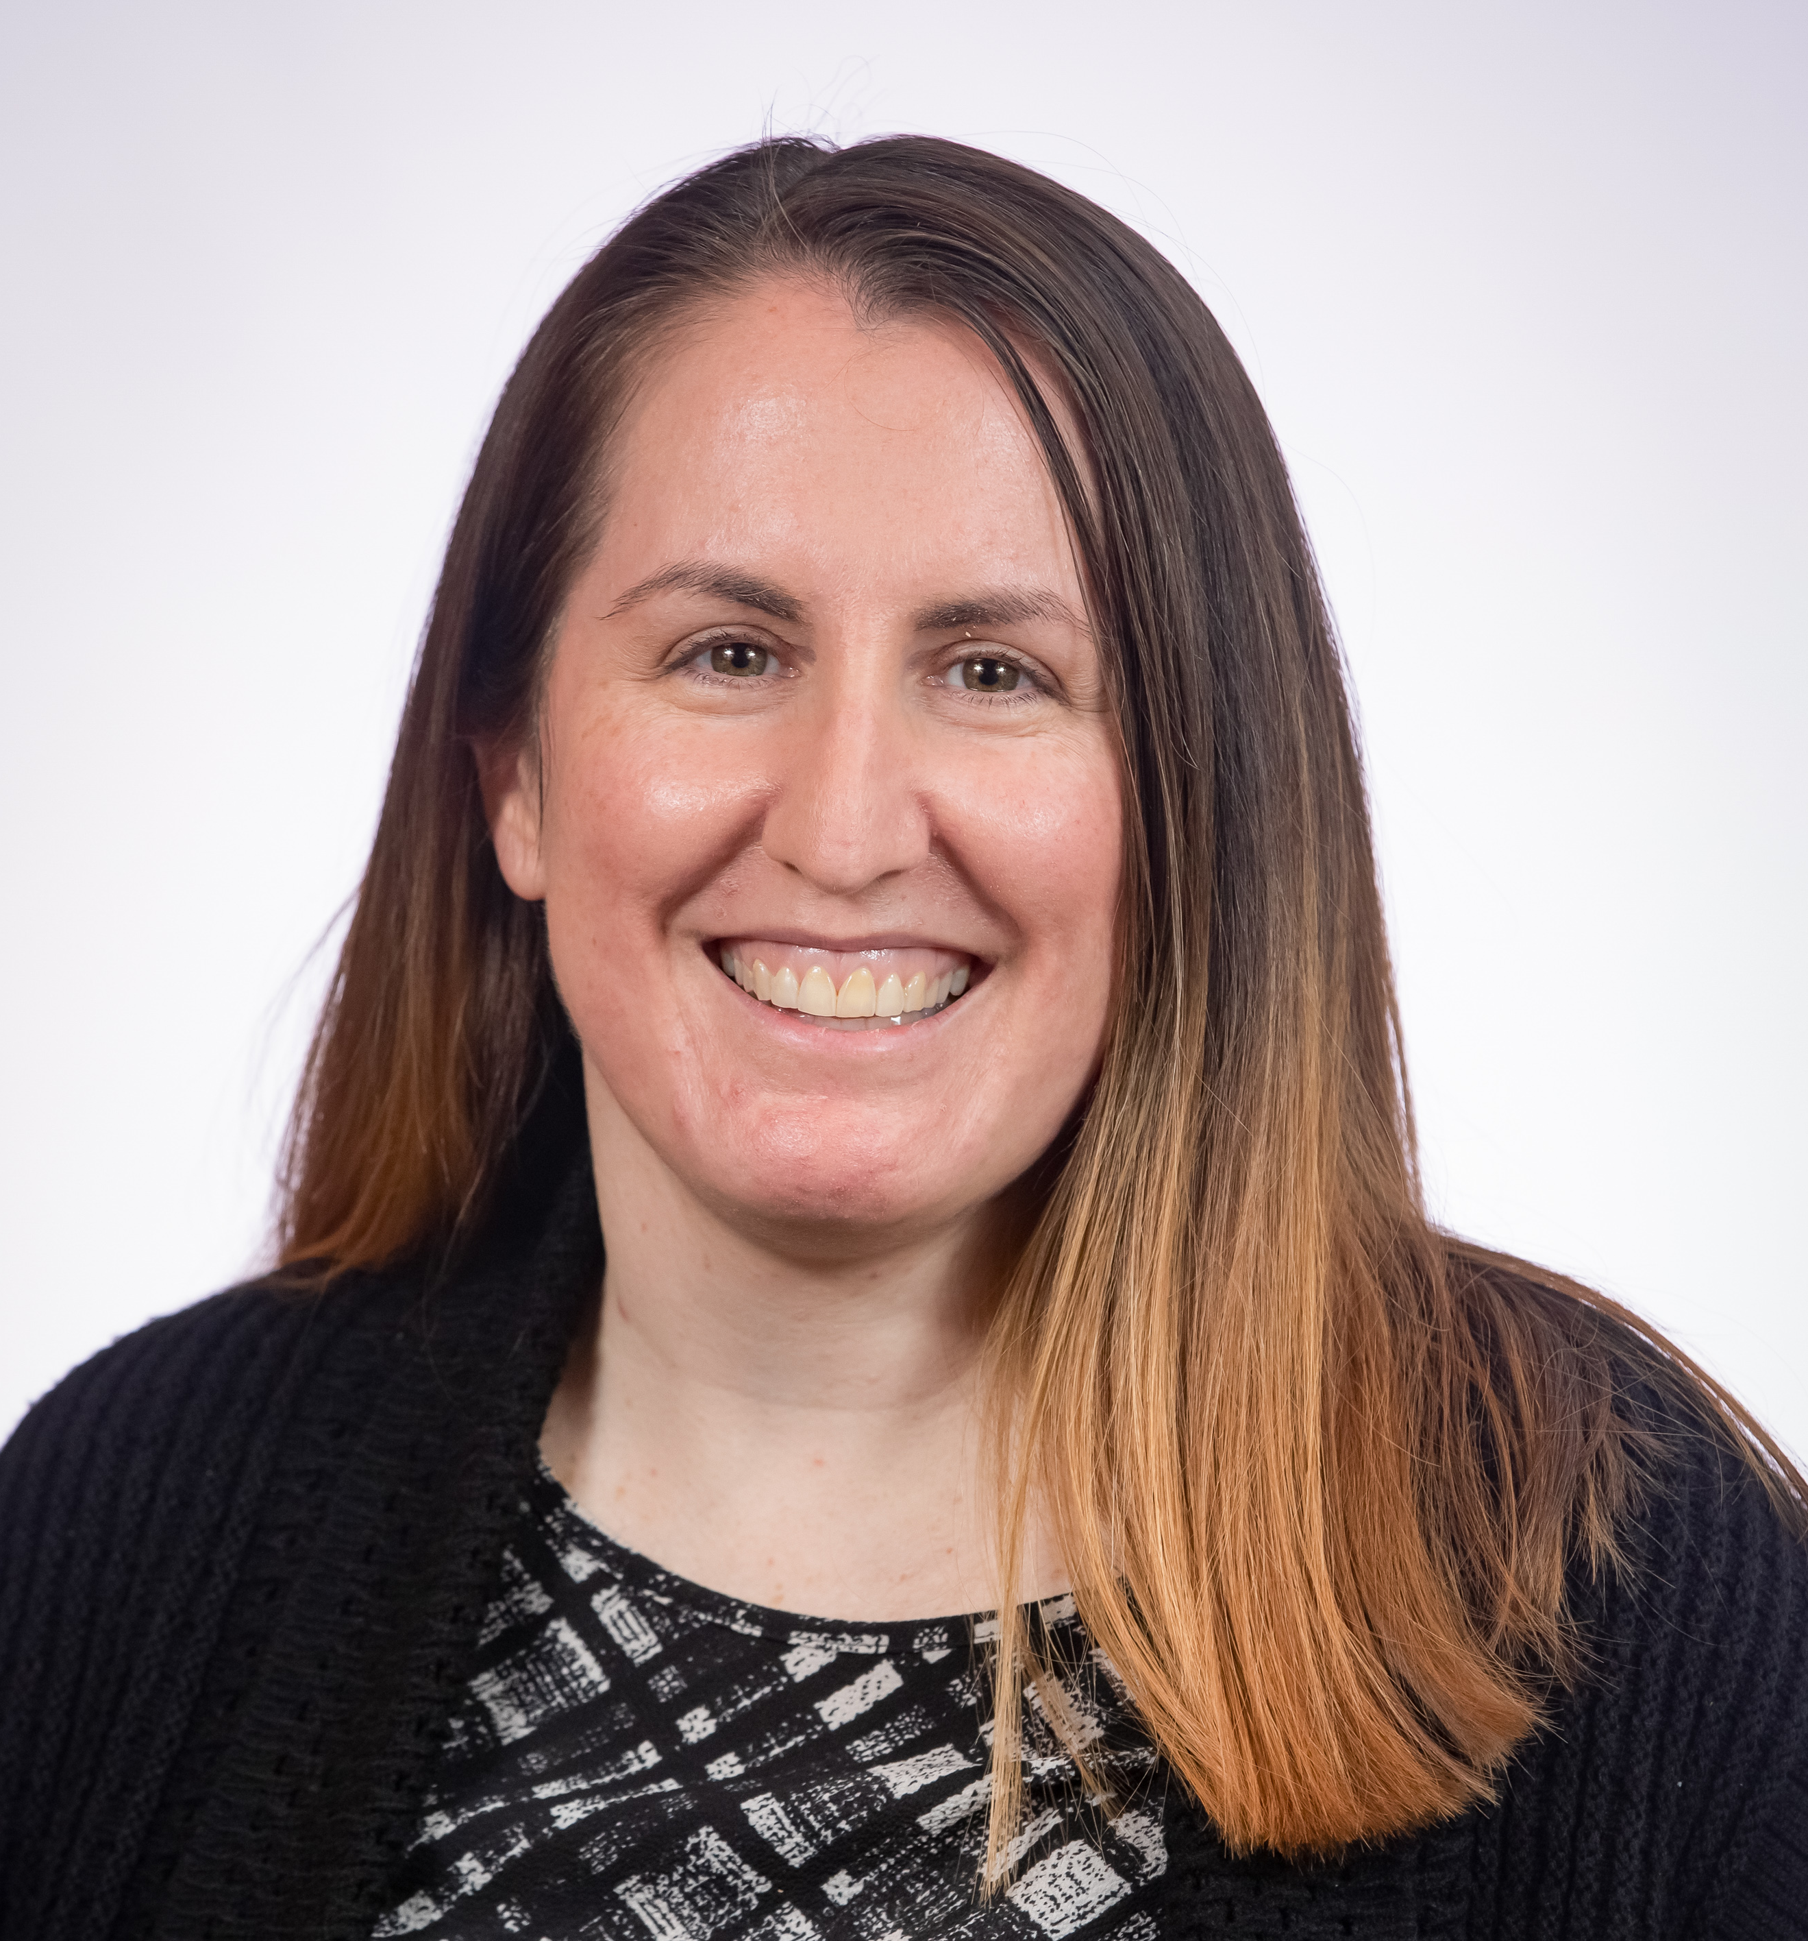
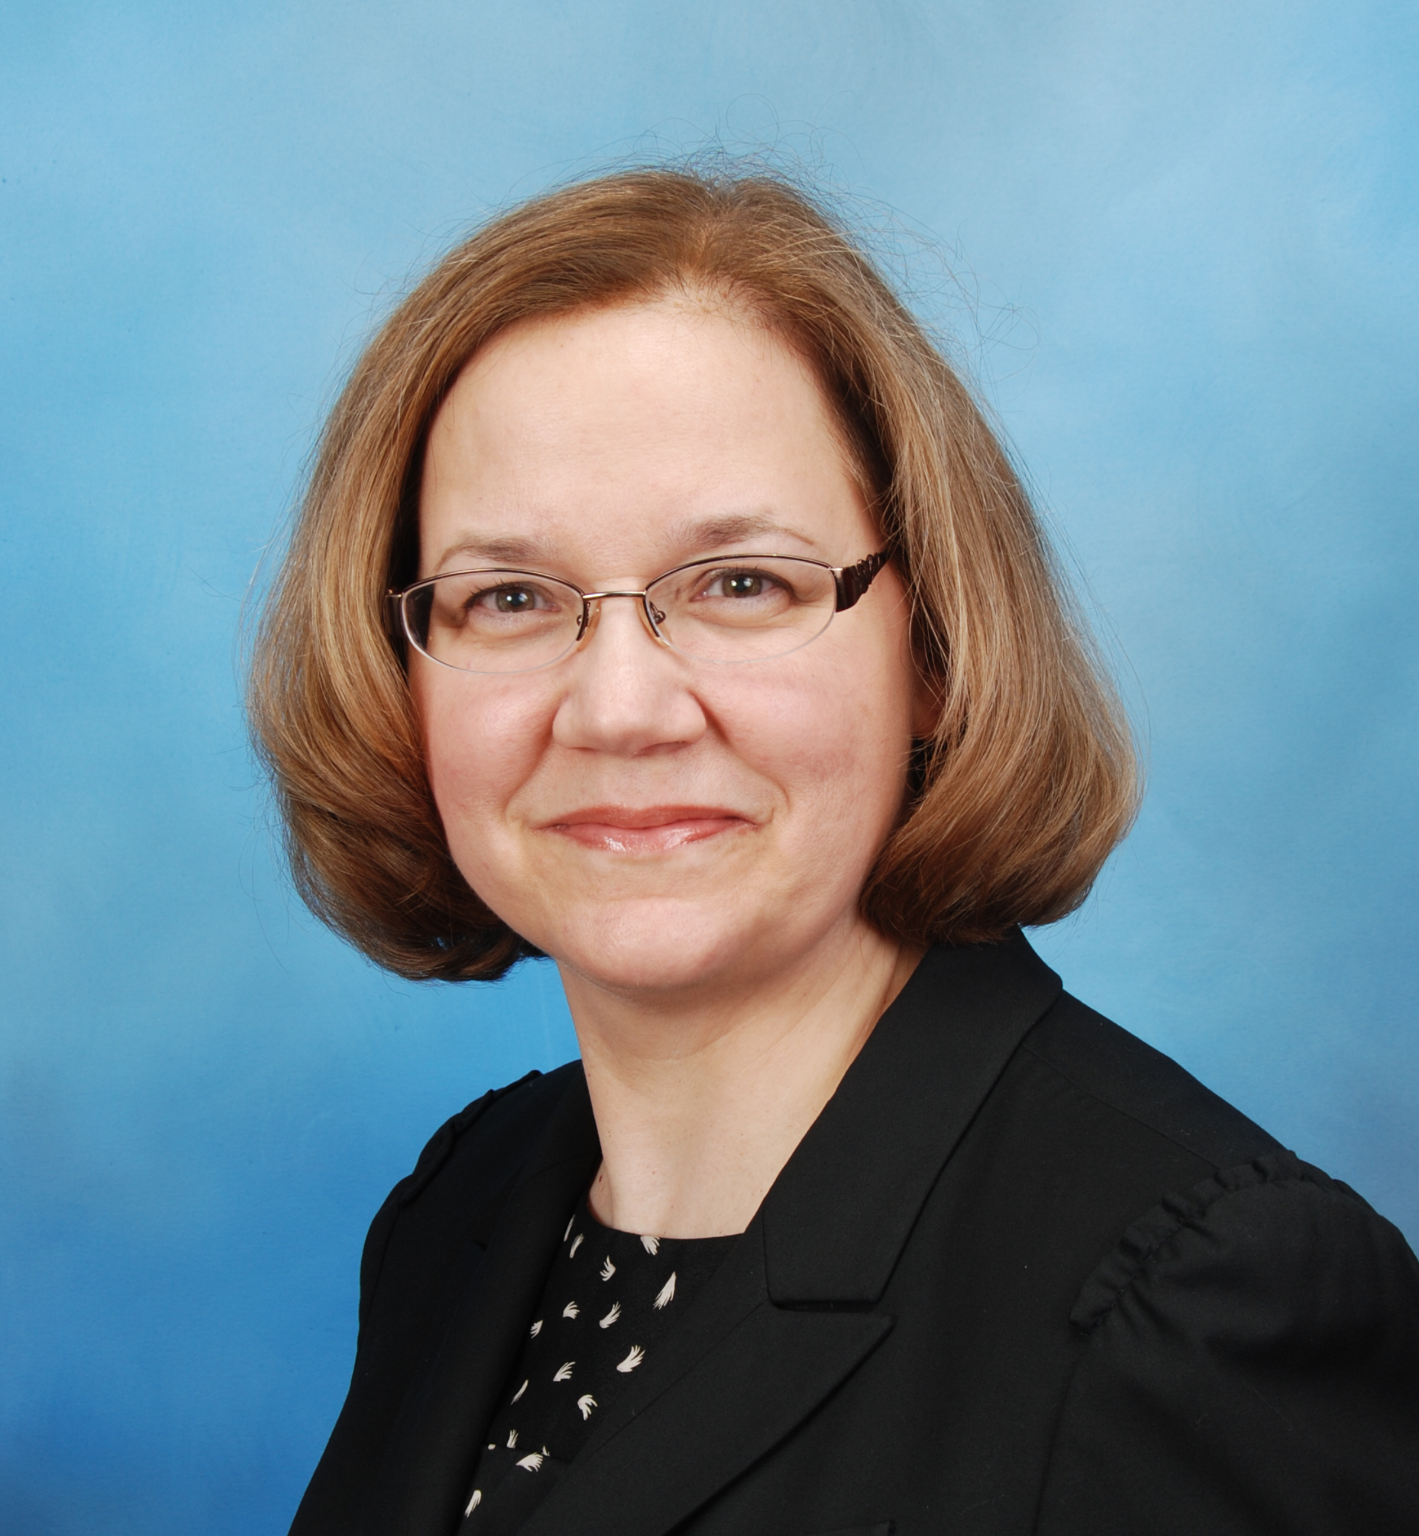
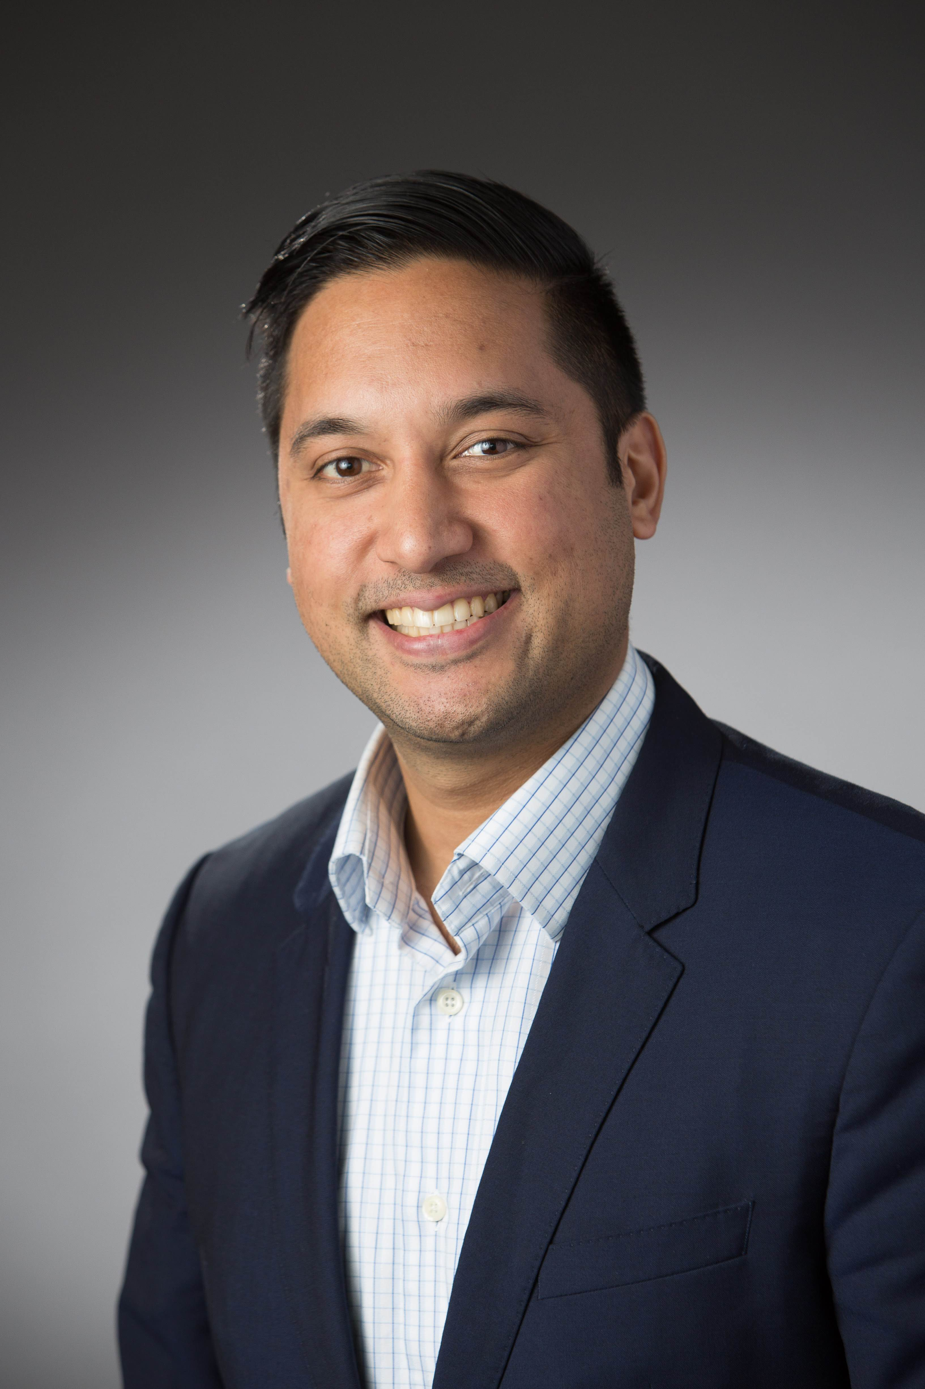
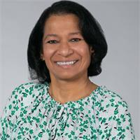
Diplomat Regional Directors
Midwest – Amanda Bain
WA
ID
MT
ME
OR
ND
MN
WI
NY
WY
SD
MI
East – Christine Dube
CA
NV
IA
PA
UT
NE
IL
OH
CO
IN
WV
KS
MO
VA
KY
West – Michael Pazirandeh
AZ
NM
NC
OK
TN
TX
AR
SC
MS
AL
GA
LA
AK
FL
South – Shobna Butler
HI

Slide 9
Diplomat Program Overview
At a minimum:
Complete Year-End Diplomat Program Evaluation (email in late spring)
On-going communication with faculty contact and/or AMCP Chapter Advisor
Visit School/College of Pharmacy and meet with student pharmacists, AMCP chapter, faculty contacts
If the School/College has Co-Diplomats, coordinate activities/reporting
Stay up to date by reviewing Diplomat E-Link
Notes:
Very quick section
Betty/Zack will provide an update on vacancies and strategy to filling those

Slide 10
Diplomat Resources
Brad Stevens, PharmD, MBA
SOPRC Diplomat Task Member
Notes:
Need to finalize who is speaking in this section

Slide 11
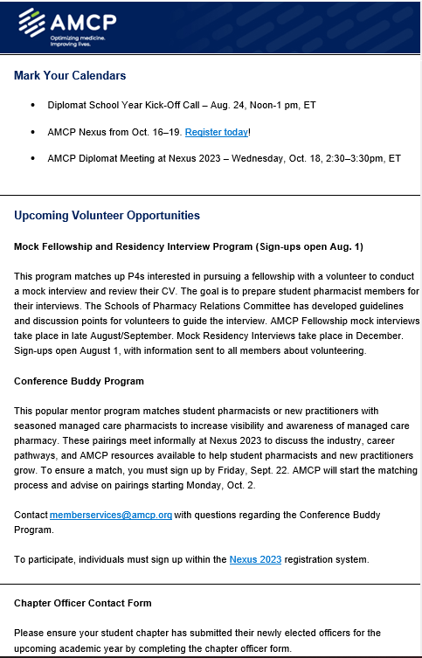
Diplomat E-Link
Sent every other month via email
  Updates and reminders
  Diplomat Spotlight
Notes:
BRAD
- Diplomat E-Links sent Sep, Nov, Jan, Mar, May, & Jul

Slide 12
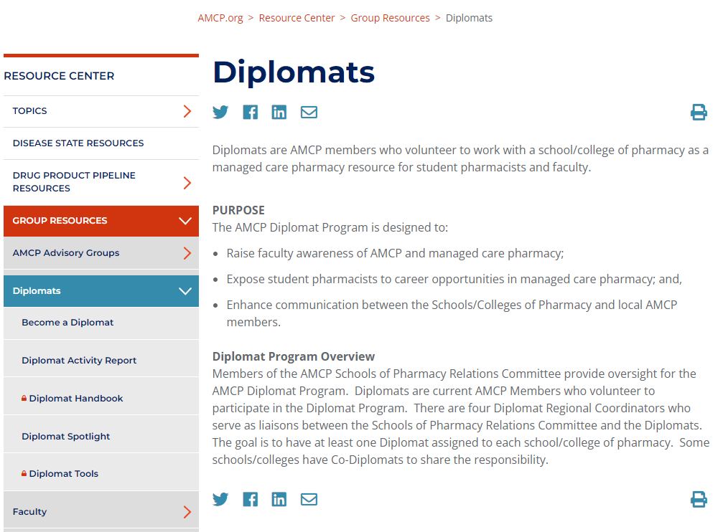
Diplomat Center: Diplomat Tools
https://www.amcp.org/resource-center/group-resources/diplomats-resources
Notes:
BRAD

Slide 13
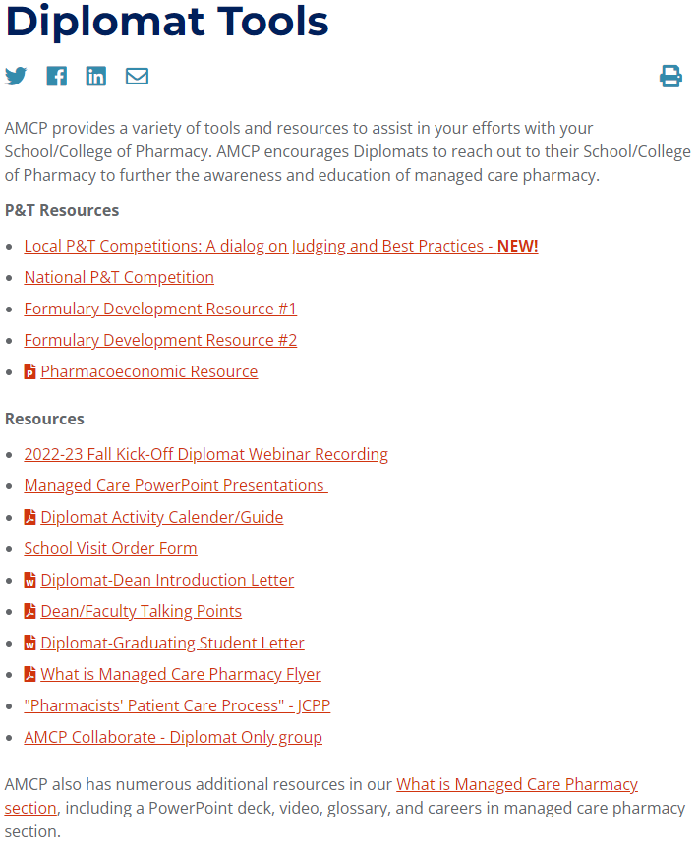
Diplomat Tools
NOTE: Updates in progress
Notes:
TOM

Slide 14
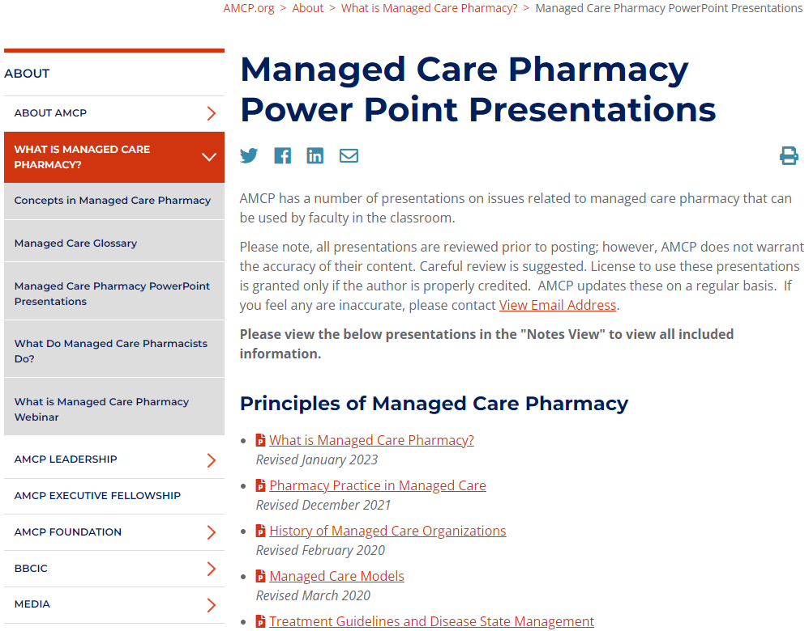
Managed Care Presentations
https://www.amcp.org/about/managed-care-pharmacy-101/managed-care-pharmacy-power-point-presentations
Notes:
BRAD

Slide 15
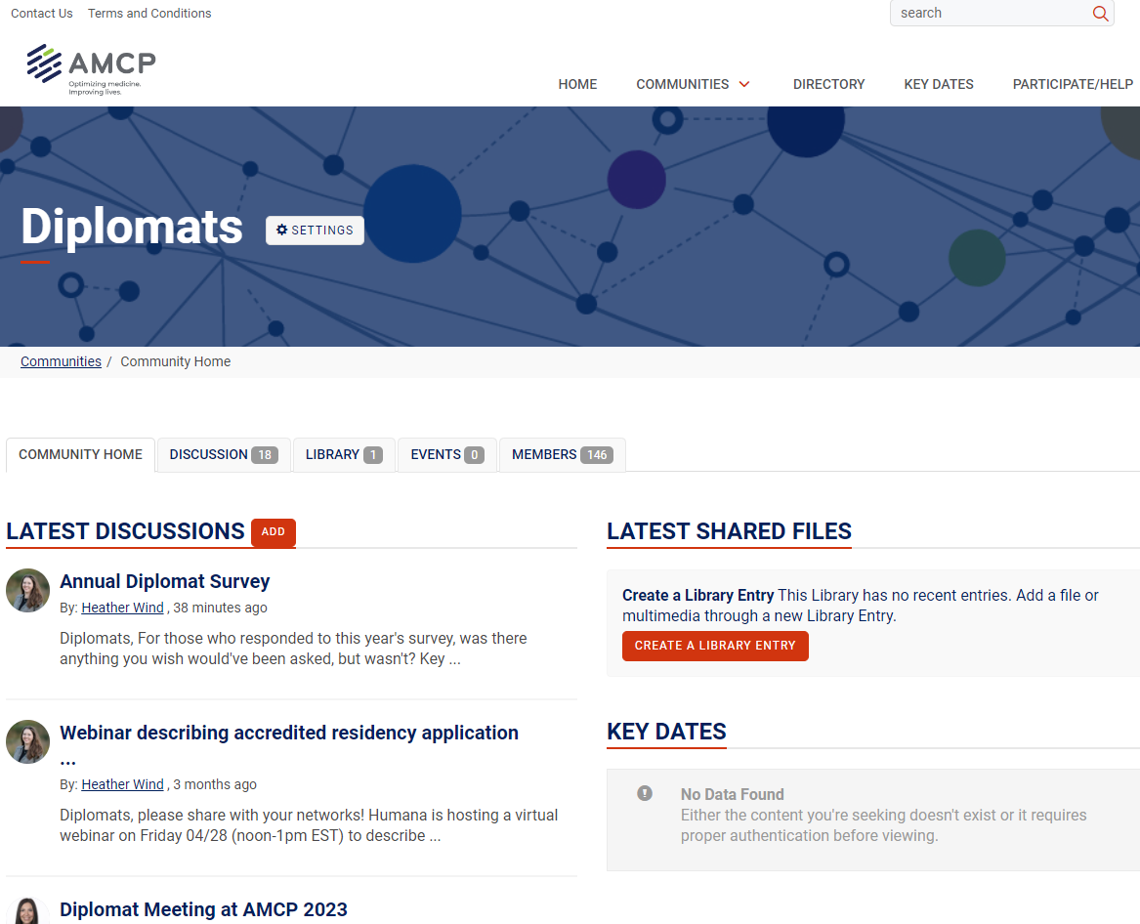
AMCP Collaborate: Communities
Active participation in relevant communities is highly encouraged.
Ask questions
Offer suggestions
Share best practices
Coordinate
Network
https://collaborate.amcp.org/
Notes:
BRAD

Slide 16
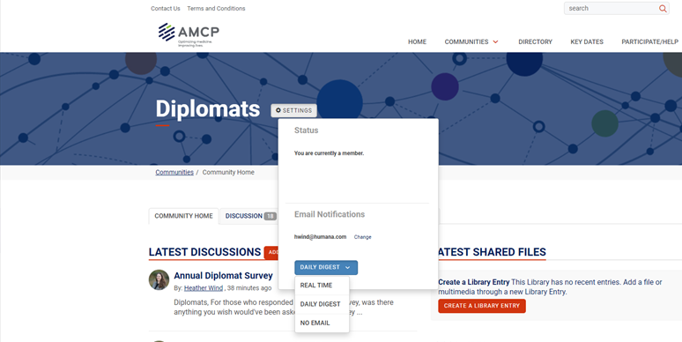
AMCP Collaborate: Email Notifications
Notes:
BRAD

Slide 17
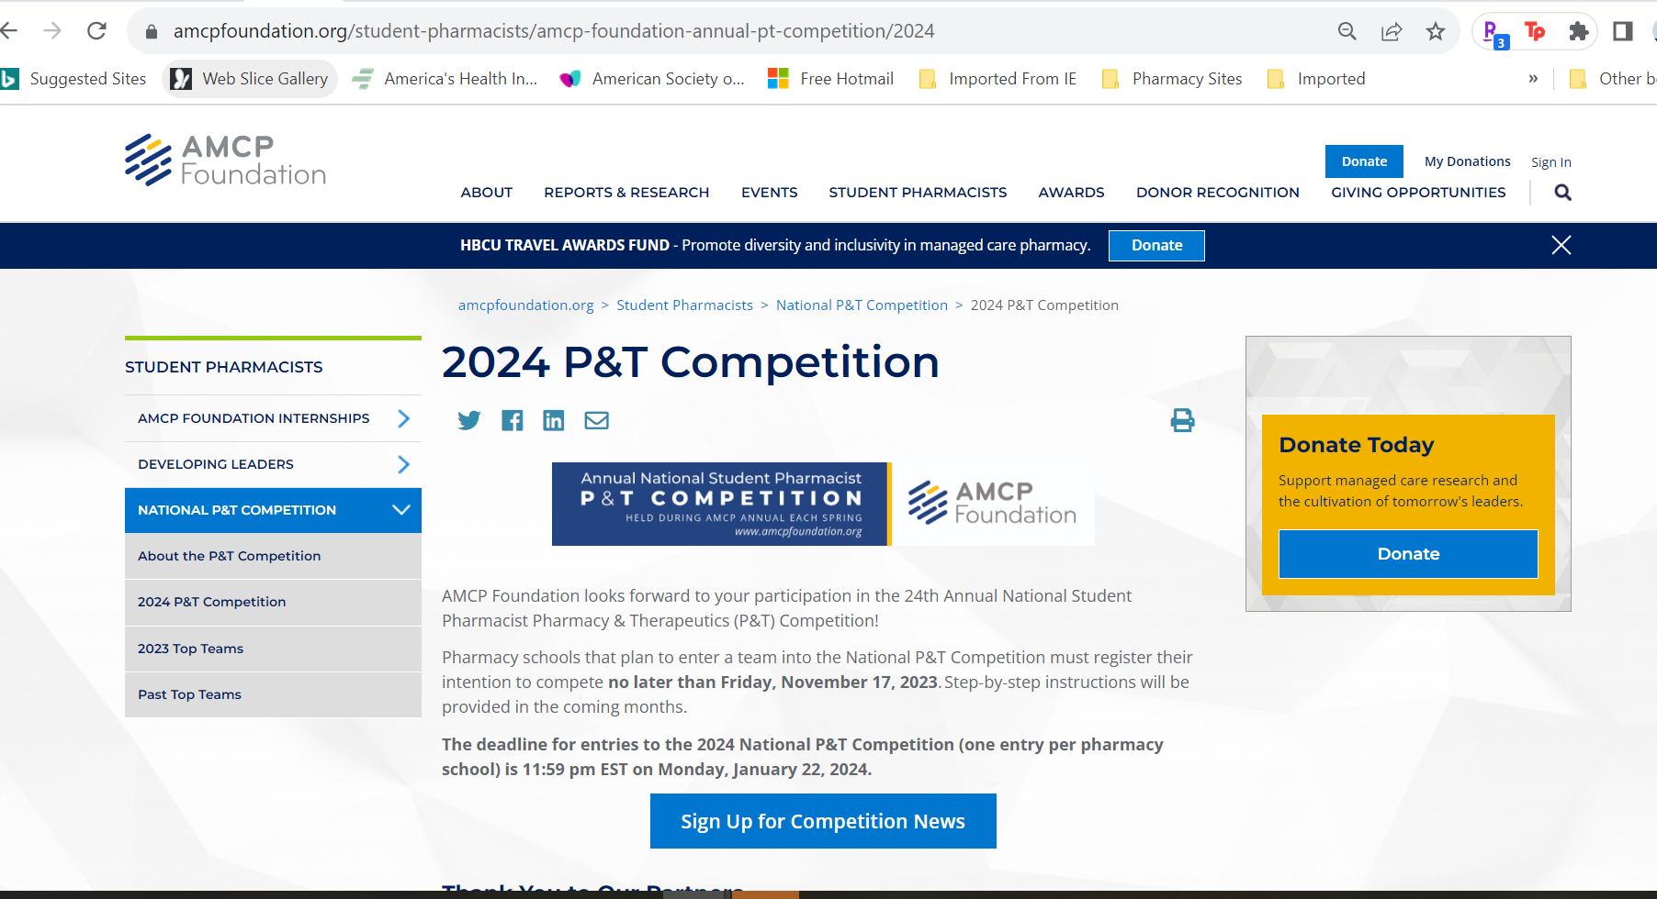
P&T Competition
https://amcpfoundation.org/PT
Sign up for Competition News if you are involved in P&T
Notes:
BRAD
Highlight that we will subscribe all diplomats and faculty advisers to competition news

Slide 18
A Look at Student Pharmacist Membership
Betty Whitaker
VP Membership & Meetings
Notes:
Add a description to the chapter collab program
Encourage more cross school collaboration for events

Slide 19
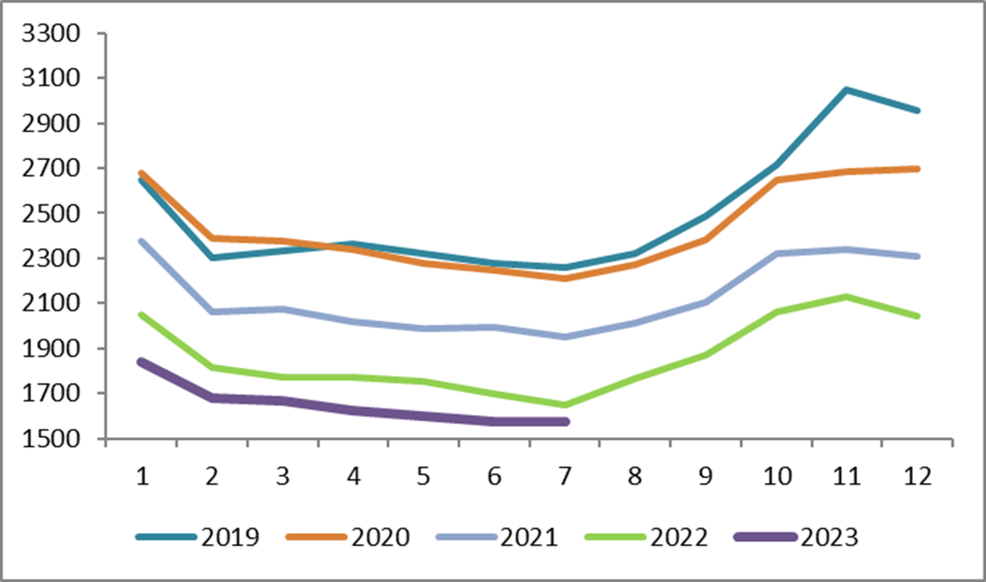
Student Membership
School year starts & membership surges.
Grace period for students not renewing ends and membership drops.
Notes:
Betty or Zack

Slide 20
Student Pharmacist Chapters
81 chapters
  Average members: 17
  Range: 1-77
28 schools of pharmacy with no chapter but members
Member Count | # of Chapters
<9 | 29
10-19 | 22
20-29 | 15
30-39 | 6
40-49 | 1
50-75 | 5
Notes:
Betty or zack

Slide 21
Diplomat Sharing
Diplomat Tips for Success
Ethan Heidorn, PharmD
Director of Market Research for Formulary Insights
Diplomat, University of Minnesota
College of Pharmacy

Slide 22
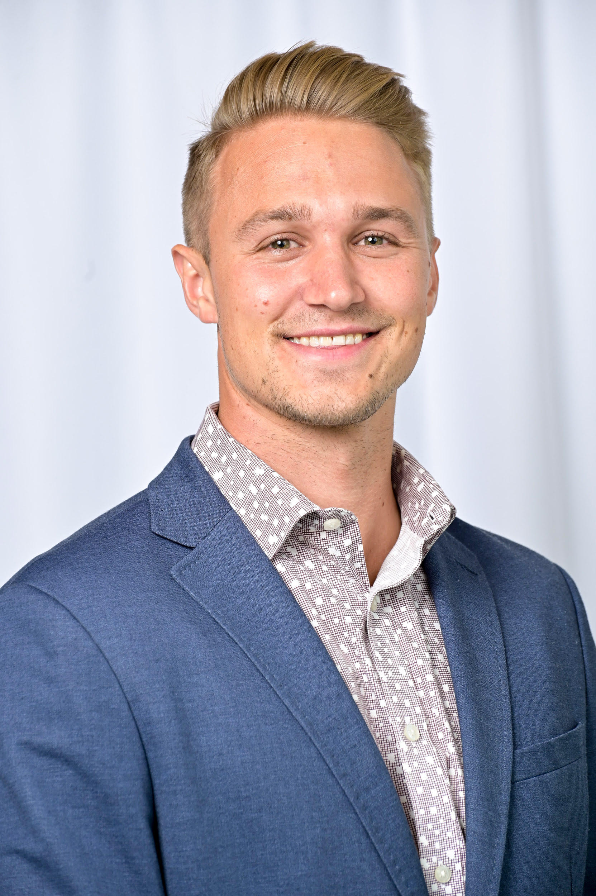
2023 DIPLOMAT OF THE YEAR AWARD RECIPIENT
Dr. Heidorn is always ready to participate in student events, serve as a model of excitement for managed care pharmacy and support students through both AMCP involvement and career planning. He regularly supports chapter event planning and provides educational topics for students to expand their understanding of managed care.
Ethan Heidorn, PharmD
Diplomat for University of Minnesota
College of Pharmacy
Director of Market Research for Formulary Insights

Slide 23
Diplomat Tips for Success
Find your champion; initiate engagement if needed
Engage dean/professor
Recommend/support year-long planning
Involve co-workers/network in school events, speakers, etc
Schedule 15 minute 1-on-1s

Slide 24
Diplomat Survey Result Highlights
Heather M. Wind, PharmD, SSGB
SOPRC Diplomat Team Lead
Notes:
•Thank you to the 49 Diplomats who responded to our 2023 survey!
- Notable improvement over 2022 survey, which had 38 responses
•Survey results help AMCP and SOPRC better understand your needs and find ways to better support you as Diplomats
- Discussion on AMCP Collaborate Diplomat community if you have additional feedback to share
•Please note that results are qualitative in nature and are not necessarily generalizable to all Diplomats

Slide 25
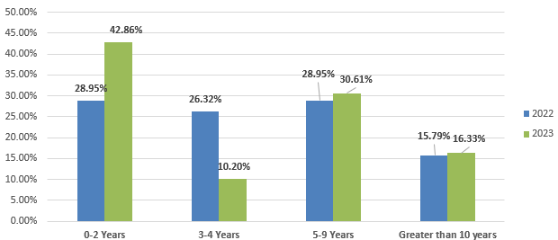
DIPLOMAT DEMOGRAPHICS
- 14%
57% of respondents have served as Diplomats
for 3 years or more
52% of Diplomats showed interest in being featured in an eLink Diplomat Spotlight
54% of Diplomats work at organizations that offer a rotation (IPPE/ APPE) at their practice site
+ 15%
- 10%
Notes:
57% of respondents reported they have served as diplomats for at least 3 years. This is a significant decrease from last year (71%).
Almost half (43%) of respondents have served as a diplomat for 0-2 years (was 29% in 2022).
Respondents who have served as a diplomat >10 years remained stable.
52% showed interest in being featured in diplomat spotlight. This is a significant increase from last year (37%).
Thank you for all of you who showed interest. You may receive an email from a member of the SOPRC asking for you to complete the information needed for the Spotlight.
54% reported that they work for an organization offering IPPE/APPE rotations (vs 64% in 2022).

Slide 26
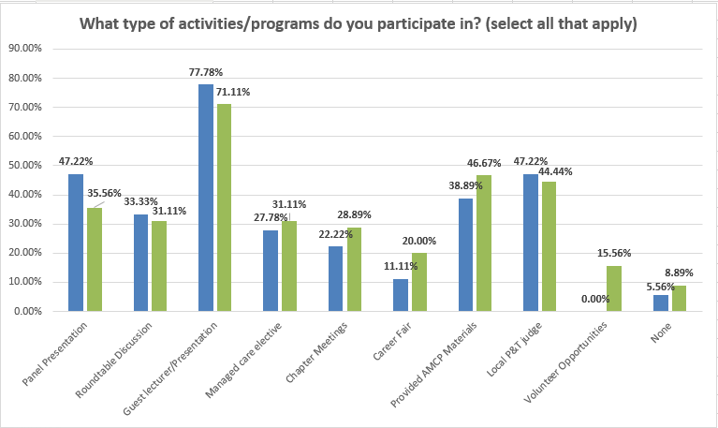
DIPLOMAT ENGAGEMENT
40% use slide decks or other materials prepared by AMCP (down from 58% in 2022), but all diplomats were aware of the resources.
Common topics include:
Guest lectures
Managed care pharmacist career opportunities
What is managed care
AMCP Foundation national P&T competition
Residencies / Fellowships
AMCP affiliate &/or national events / webinars / conferences
General AMCP information
Added in 2023
Notes:
Diplomats continue to participate in a variety of activities
Most common activity remains guest lecturers / presentations, though decreased from 2022
47% provided AMCP materials (up from 2022)
44% served as local P&T judge (down from 2022)
36% participated in panel presentation (down from 2022)
31% managed care elective (up from 2022)
31% roundtable discussion (down from 2022)
29% participated in chapter meetings (up from 2022)

Slide 27
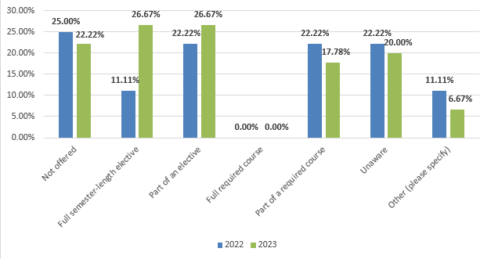
INCORPORATION OF MANAGED CARE INTO THE CURRICULUM
Fewer respondents indicated no managed care in the curriculum
Significant increase in full semester-length elective offerings
Fewer respondents indicated including managed care in required curriculum
- 3%
+ 16%
- 4%

Slide 28

COLLABORATION OPPORTUNITIES FOR DIPLOMATS & AFFILIATES
Regional events
Mentoring programs
Coordinate communication
Opportunity for affiliates to offer student chapters support
  Scholarships (e.g., conference, membership)
  Networking opportunities
  Guest speakers
  Recommend providing affiliates with list of schools & diplomats

Slide 29
Update on Fundamentals of Managed Care Pharmacy Certificate
Ruby Singh, PharmD
Senior Vice President, Education & Publications
Notes:
Add a description to the chapter collab program
Encourage more cross school collaboration for events

Slide 30
Have you heard of Fundamentals of Managed Care Pharmacy?
Yes, and I have taken it.
Yes, and we encourage our students/peers to take it.
Yes, I am sort of familiar with it but could use a refresher.
What the heck is Fundamentals?

Slide 31

What is Fundamentals of Managed Care Pharmacy Training Program?
Launched as a pre-conference program at Nexus 2014
Launched as an online program in 2016, 3rd edition launched August 2023
Comprehensive introduction to basic concepts in managed care pharmacy
13 interactive modules
Upon completion, receive digital badge, certificate of completion, and 9.5 hours continuing pharmacy education (for accredited versions)
Notes:
Key aspects and terminology covered in 13 interactive modules

Slide 32
Why is this Training Program Important?
Impact to AMCP, members and future members
  Over 1800 individuals have taken the program
  Top seller on AMCP Learn
Understand the roles of managed care professionals
Better understanding of managed care pharmacy
Used as managed care electives at schools/colleges of pharmacy
Training opportunities for APPE students or residents

Slide 33
Target Audiences
Professionals
Pharmacists
Pharmacy Technicians
Student Pharmacists
Managed care professionals working in health plans, PBMs, etc.

Slide 34
3rd Edition:
What’s New?
Added module - HEOR
Increased interactivity
New look, feel, and voice
Accredited for pharmacy technicians

Slide 35
The Modules
Evolution and Principles of Managed Care
Behind the Scenes: Getting Medications to Patients Through the Pharmacy Benefit
Developing and Managing the Drug Formulary
Trading Partners and Flow of Money in Managed Care Pharmacy
Understanding Pharmaceutical Manufacturer Discounts and Rebates
Pharmacy Benefit Management Tools
Managed Care Pharmacy Clinical and Educational Programs
Medication Therapy Management
Introduction to Specialty Pharmacy
Medicare and Managed Care Pharmacy
Medicaid and Managed Care Pharmacy
The ABCs and Stars of Quality Measures
HEOR and Value

Slide 36
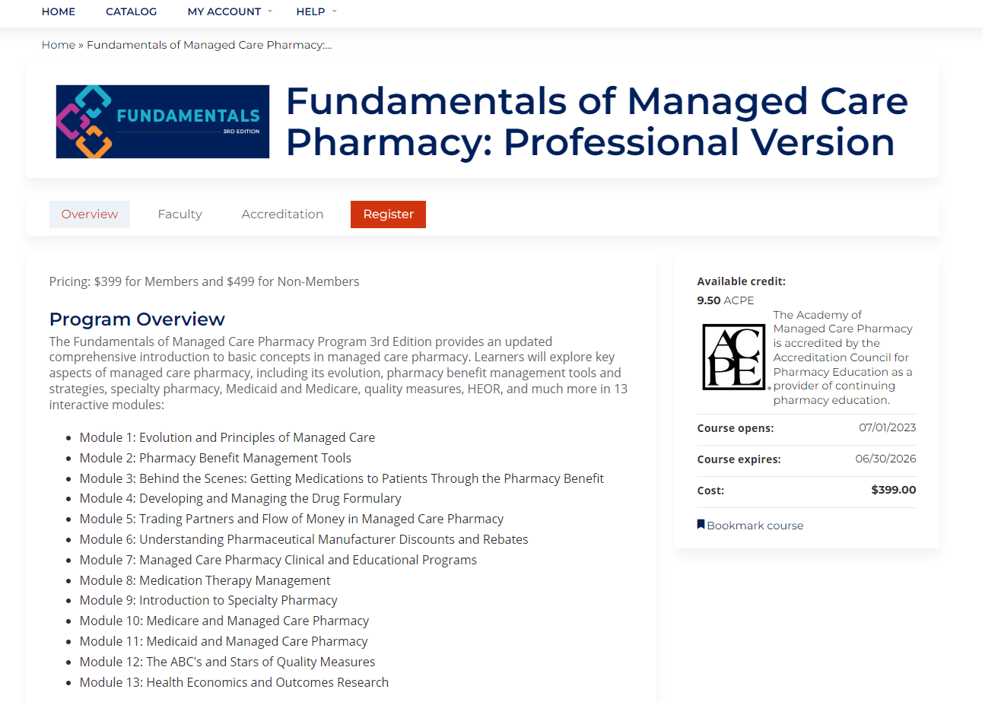
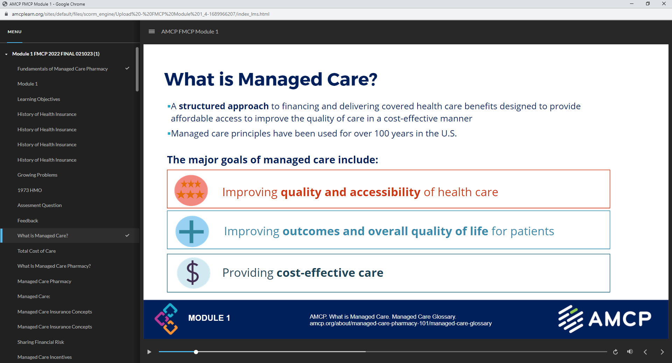
Screen Shots
Landing Page on AMCP Learn
Navigation Bar, Slides, and Audio

Slide 37
Top 5 Things to Know
Student and Corporate bulk sales discounts available
Appropriate for student pharmacists, pharmacy technicians, and managed care professionals
Available through amcplearn.org
Direct email inquiries to amcplearn@amcp.org

Slide 38
Questions?
Contact Info:
Email: rsingh@amcp.org
www.amcplearn.org

Slide 39
Q&A

Slide 40
Announcements
Diplomat Meeting at Nexus – Wed, October 18, 2:30-3:30
Mock Fellowship Interviews – Interviews actively taking place

Slide 41
Thank you!!
Any questions, contact Zack Riley, zriley@amcp.org
Notes:
Confirm Ethan is in and what to cover
Determine if we want to reach out to CT
Update slides – send link out to the group for further updates
Determine how to handle the survey
Decide who is presenting what
Kheelan will kick off and close
Regroup the week of the webinar for quick touch base

