Slide 1
AMCP Faculty Advisor Webinar
Wednesday, August 23rd, 2023

Slide 2
AMCP Antitrust Statement
AMCP's policy is to comply fully and strictly with all federal and state antitrust laws. Meetings held under the auspices of the Academy must be conducted in a manner that avoids the fact or appearance of conduct that may violate the antitrust laws. Participants are not to discuss industry- wide or individual company prices (current or projected) or matters relating to pricing such as costs, profits, contractual terms and conductions (e.g., discounts, credit terms), wages/salaries, market allocation, market shares/sales or clients/customers. Please see www.amcp.org/antitrust for full statement.

Slide 3
Agenda
Welcome and Introductions
Schools of Pharmacy Relations Committee (SOPRC) Role
Membership Overview/Statistics
Member Benefits and Resources
Fundamentals of MC
AMCP Diplomat Program
Pharmacy & Therapeutics (P&T) Competition
Faculty Advisor Best Practices
Open Discussion

Slide 4
Introductions
Kheelan Gopal, PharmD – Chair, Schools of Pharmacy Relations Committee
Tom Walters, PharmD, MBA, MS – Vice Chair, Schools of Pharmacy Relations Committee
Janetta Bekman, PharmD, MBA – Task Lead, Schools of Pharmacy Relations Committee
Nasir Kaker, PharmD – School of Pharmacy Relations Committee
Sarah McLarty, PharmD, MBA – School of Pharmacy Relations Committee
Zack Riley, AMCP Manager Student Pharmacist & New Practitioner Programs
Betty Whitaker, AMCP VP Membership & Volunteer Experience
John Watkins, PharmD, MPH, BCPS – Faculty Advisor, University of Washington
Jonathan Luong, PharmD Candidate – Chapter President, University of Washington

Slide 5
School of Pharmacy Relations Committee (SOPRC)
Committee Mission: To raise faculty and student awareness of both AMCP and managed care pharmacy consistent with the mission of AMCP.
The Schools of Pharmacy Relations Committee provides guidance and expertise on the importance of managed care pharmacy to schools and colleges of pharmacy and oversees the AMCP Diplomat program.

Slide 6
Membership Overview
Betty Whitaker
AMCP VP Membership & Volunteer Experience

Slide 7
Membership Statistics
82 chapters
Average members: 17
Range: 1-77
28 schools of pharmacy with no chapter but members

Slide 8
Benefits and Resources
Nasir Kaker, PharmD
School of Pharmacy Relations Committee

Slide 9
Membership Benefits for Students
National Meetings (AMCP Nexus and AMCP Annual)
AMCP Conference Buddy program
Residency Showcase
Student-targeted presentations/networking
P&T Competition for finalists
National leadership positions (AMCP’s Student Pharmacist Committee)
Mentor Programs - Mock residency/fellowship interviews
Fundamentals of Managed Care Pharmacy Certificate (discounted price for students)
Member-only webinars (variety of topics)
Residency/Fellowship Database
Managed Care Internships and APPE/IPPE Intern Database
APPE rotations (Association and Leadership Management)
P&T Competition resources and support
Notes:
APPE rotation: Chance for students to see how a national pharmacy organization is managed with experiences in many different departments.

Slide 10
Chapter Recognition
Chapter Collaborate Program – matches up chapters with each other
Chapter of the Year Award – recognized at Nexus each year
Chapter Member of the Year Award – selected by each chapter
Graduation Cords – available for all AMCP members who meet the leadership criteria
Notes:
-Chapter of the year award: requires an online submission by the student chapter. Deadline for 2022 was at the end of July, so keep it on the radar for next year
-Chapter member of the year award: Presented to the recipient in the spring of every year. To the member that has made outstanding contributions to their AMCP Student Pharmacist Chapter. There is an online nomination form that needs to be filled out. There is still time for this.

Slide 11
Explaining Managed Care Pharmacy Tools
“What is Managed Care Pharmacy”
Short overview video
“What is Managed Care Pharmacy?” Webinar (Sept 26) and slides
Managed Care Glossary
Managed Care PowerPoints
Managed Care Pharmacy Careers
Fundamentals of Managed Care Pharmacy Certificate Course
Managed Care Pharmacy Curriculum
Notes:
We have several schools using Fundamentals of Managed Care Pharmacy in their programs – bulk discounts are available
Managed Care Pharmacy Curriculmn is being updated. Pdf

Slide 12
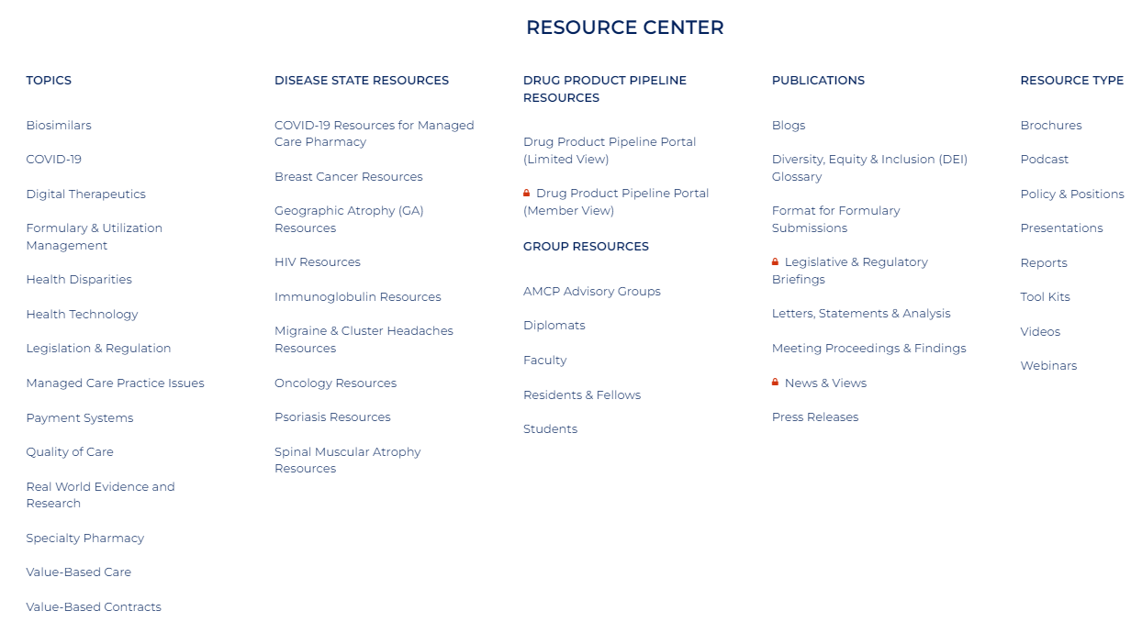
AMCP Resource Center

Slide 13
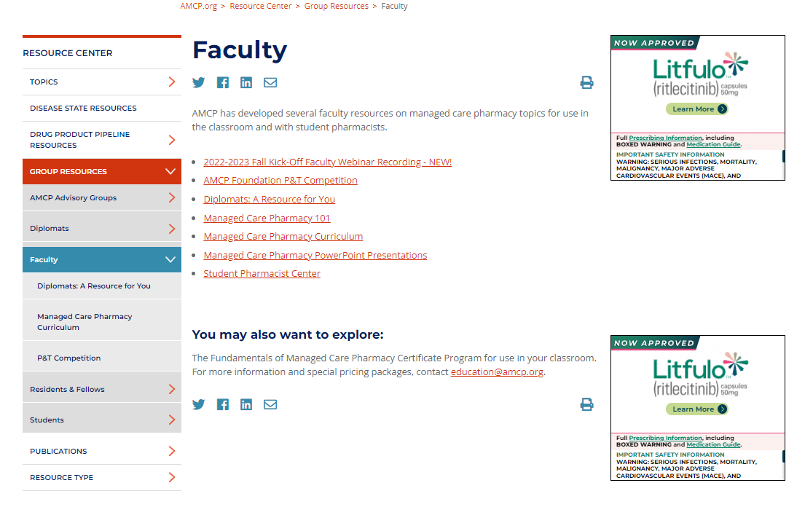
Faculty Resources
Notes:
-You can find your chapters diplomat
-Learn more about the managed care pharmacy curriculum course that was developed to assist faculty
-Resources for the P&T competition
-Managed Care Pharmacy 101: Provides a broad overview of what managed care pharmacy is and the tools we use
-PPT Presentations: MC career paths, what is MC pharmacy, MTM, MC models, etc
-All faculty advisors should have access to members-only areas on the AMCP website.

Slide 14
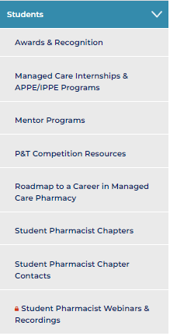
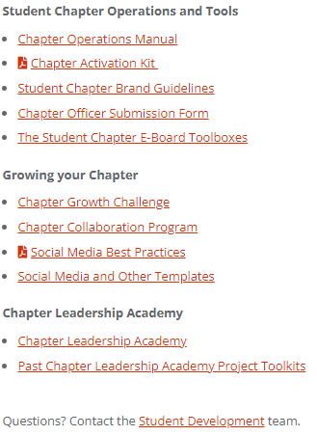
Student Pharmacist Center
Notes:
-Chapter operations manual: useful information on how to manage and grow your student-chapters
-Toolboxes: Toolboxes are intended to guide AMCP Student Chapter E-Boards on certain key topics that all Chapter leaders face
-Social media and other templates: provides many different types of AMCP logo templates

Slide 15
Fundamentals of Managed Care Pharmacy
Ruby Singh, PharmD
Senior Vice President, Education & Publications

Slide 16
Have you heard of Fundamentals of Managed Care Pharmacy?
Yes, and I have taken it.
Yes, and we encourage our students/peers to take it.
Yes, I am sort of familiar with it but could use a refresher.
What the heck is Fundamentals?

Slide 17
What is Fundamentals of Managed Care Pharmacy Training Program?
Launched as a pre-conference program at Nexus 2014
Launched as an online program in 2016, 3rd edition launched August 2023
Comprehensive introduction to basic concepts in managed care pharmacy
13 interactive modules
Upon completion, receive digital badge, certificate of completion, and 9.5 hours continuing pharmacy education (for accredited versions)
Notes:
Key aspects and terminology covered in 13 interactive modules

Slide 18
Why is this Training Program Important?
Impact to AMCP, members and future members
Over 1800 individuals have taken the program
Top seller on AMCP Learn
Understand the roles of managed care professionals
Better understanding of managed care pharmacy
Used as managed care electives at schools/colleges of pharmacy
Training opportunities for APPE students or residents

Slide 19
Target Audiences
Professionals
Pharmacists
Pharmacy Technicians
Student Pharmacists
Managed care professionals working in health plans, PBMs, etc.

Slide 20
3rd Edition: What’s New?
Added module - HEOR
Increased interactivity
New look, feel, and voice
Accredited for pharmacy technicians

Slide 21
The Modules
Evolution and Principles of Managed Care
Behind the Scenes: Getting Medications to Patients Through the Pharmacy Benefit
Developing and Managing the Drug Formulary
Trading Partners and Flow of Money in Managed Care Pharmacy
Understanding Pharmaceutical Manufacturer Discounts and Rebates
Pharmacy Benefit Management Tools
Managed Care Pharmacy Clinical and Educational Programs
Medication Therapy Management
Introduction to Specialty Pharmacy
Medicare and Managed Care Pharmacy
Medicaid and Managed Care Pharmacy
The ABCs and Stars of Quality Measures
HEOR and Value

Slide 22
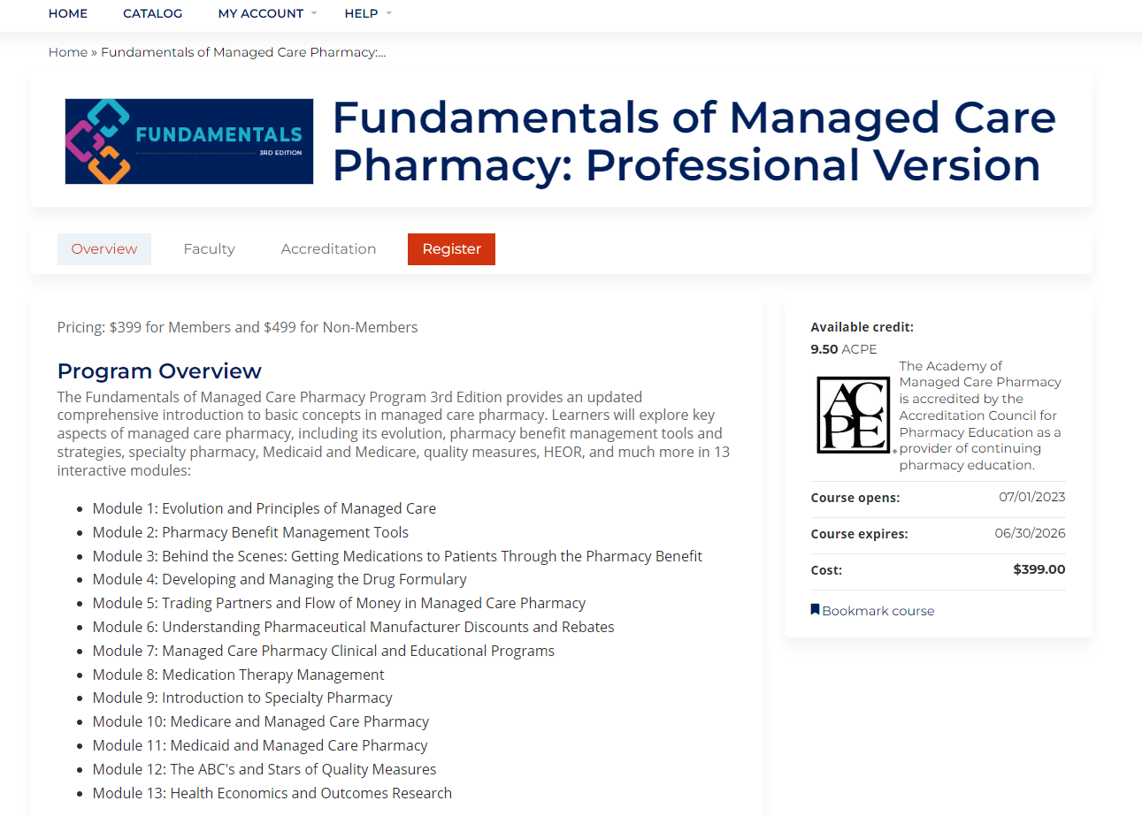
Screen Shots
Landing Page on AMCP Learn
Navigation Bar, Slides, and Audio

Slide 23
Top 5 Things to Know
Student and Corporate bulk sales discounts available
Appropriate for student pharmacists, pharmacy technicians, and managed care professionals
Available through amcplearn.org
Direct email inquiries to amcplearn@amcp.org

Slide 24
Questions?
Contact Info:
Email: rsingh@amcp.org
www.amcplearn.org

Slide 25
AMCP Diplomat Program
Breyanne Bannister, PharmD
School of Pharmacy Relations Committee
Lumanity

Slide 26
What is an AMCP Diplomat?
Diplomats are volunteer AMCP members who volunteer to work with a school/college of pharmacy as a managed care pharmacy resource for student pharmacists and faculty.
Raise faculty awareness of AMCP and managed care pharmacy
Expose student pharmacists to career opportunities in managed care pharmacy
Enhance communication between the Schools/Colleges of Pharmacy and local AMCP members
Notes:
Work with the school of pharmacy and student chapters - speak, participate in career fairs, etc.

Slide 27
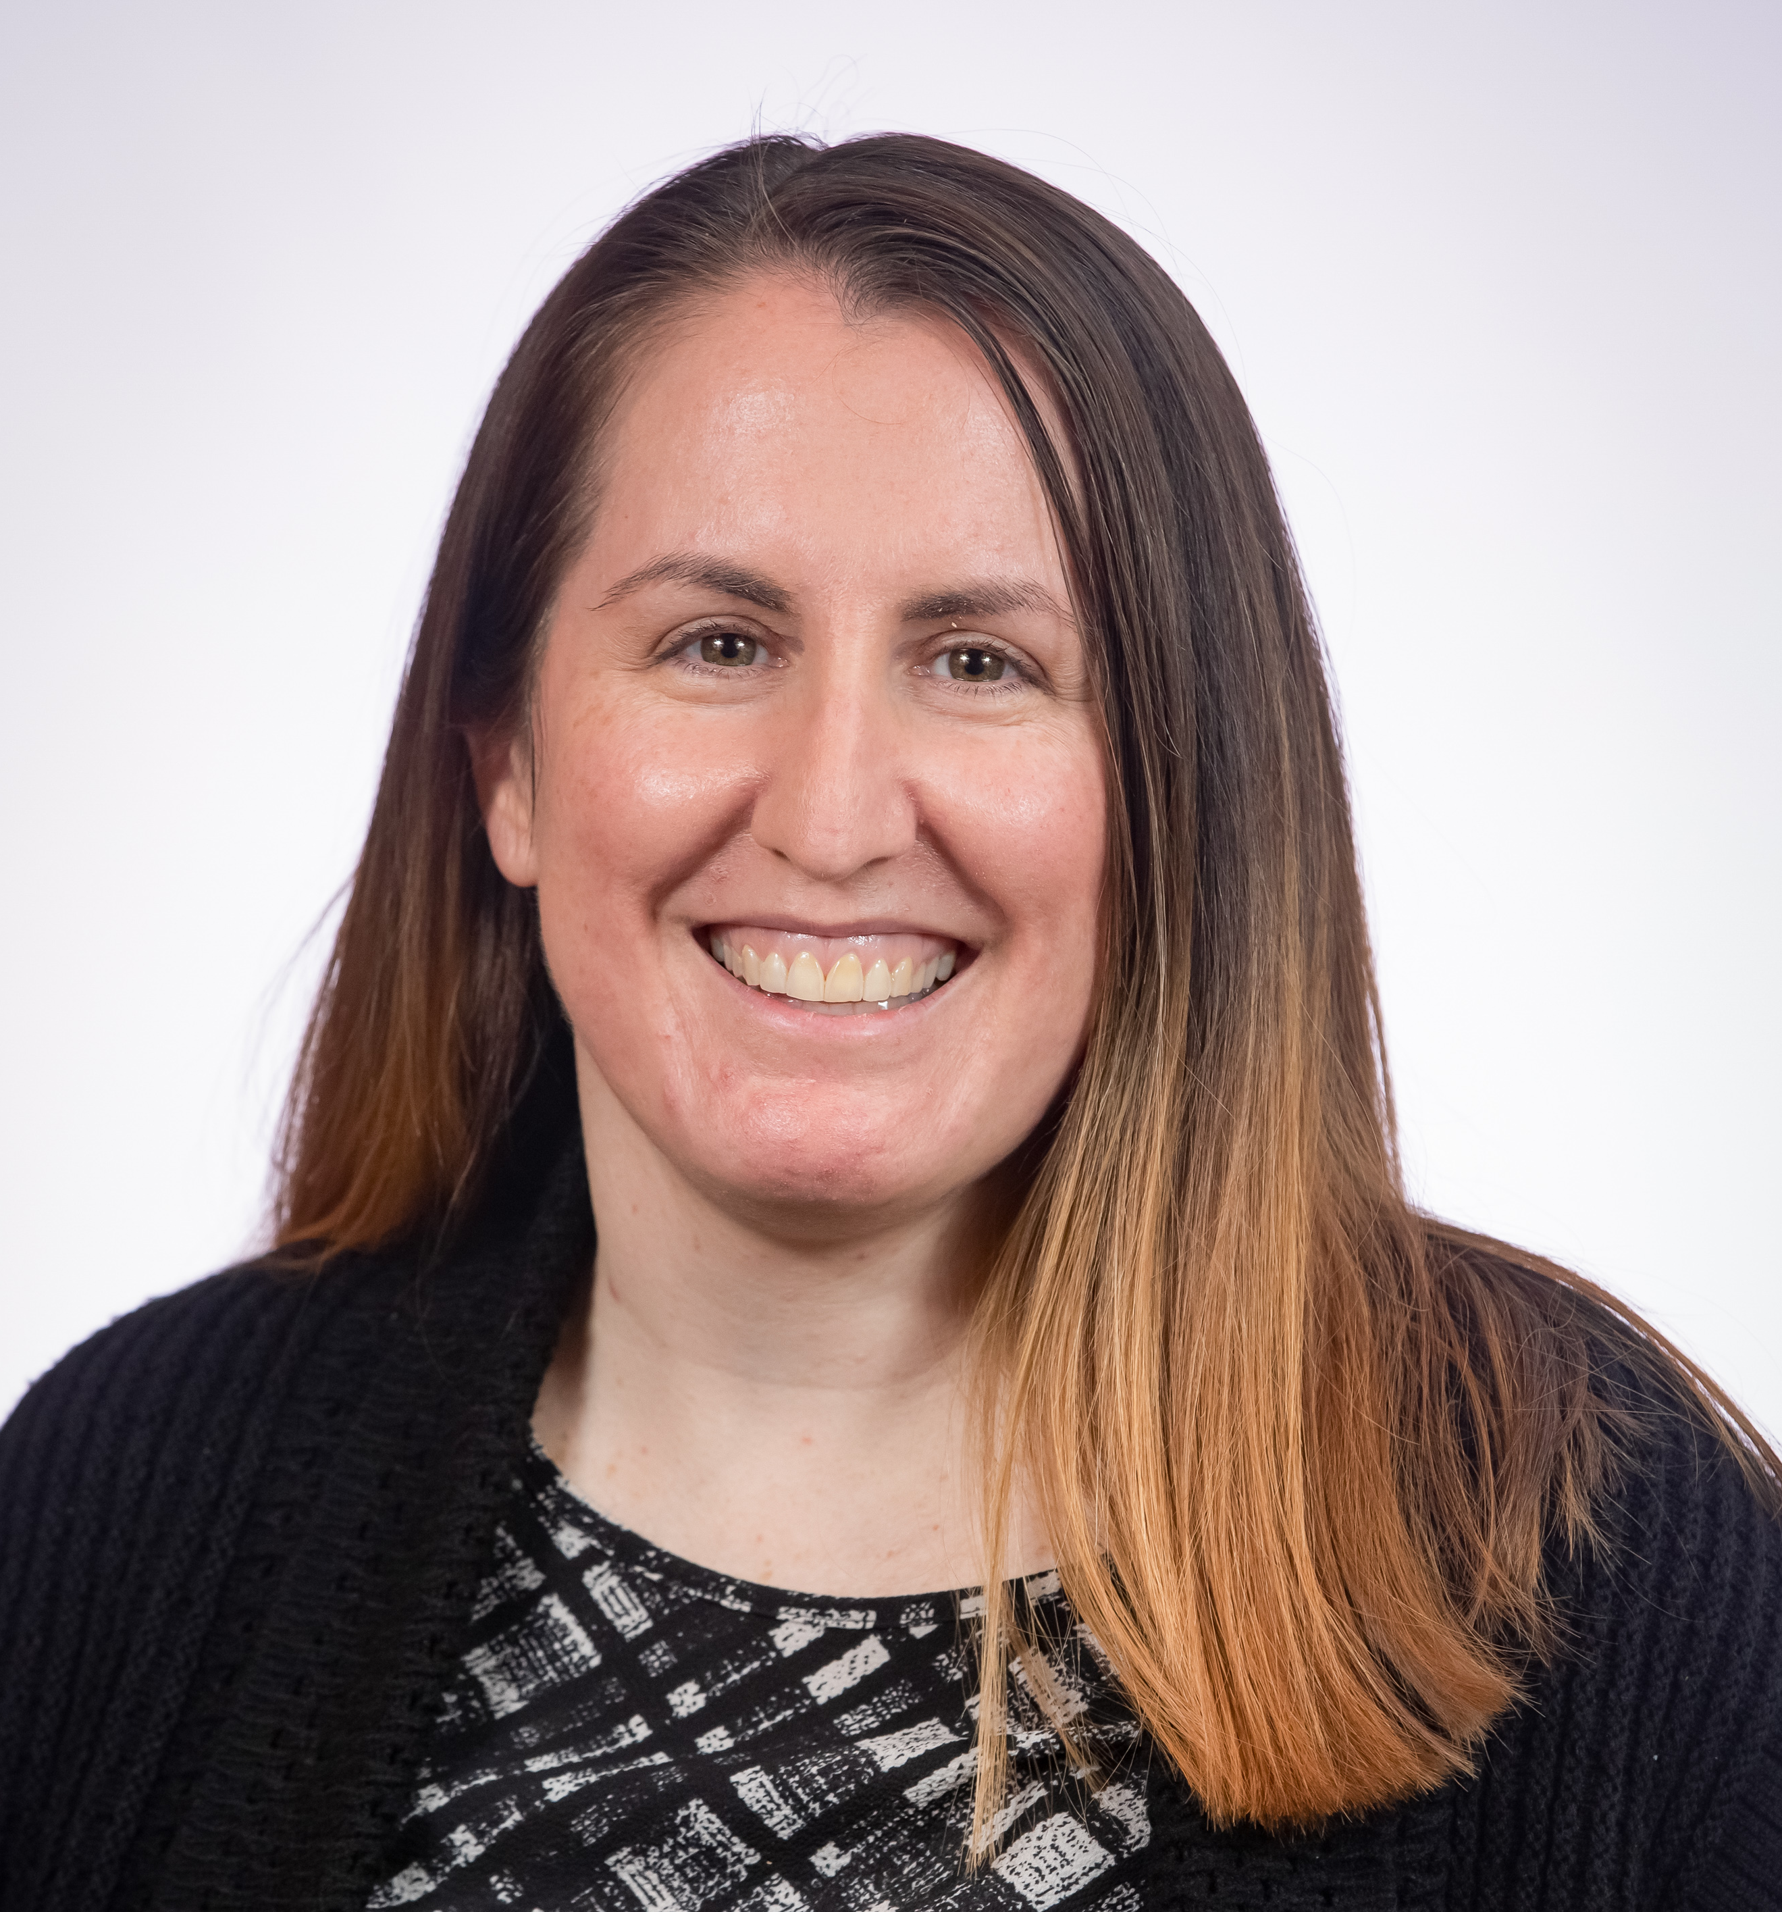
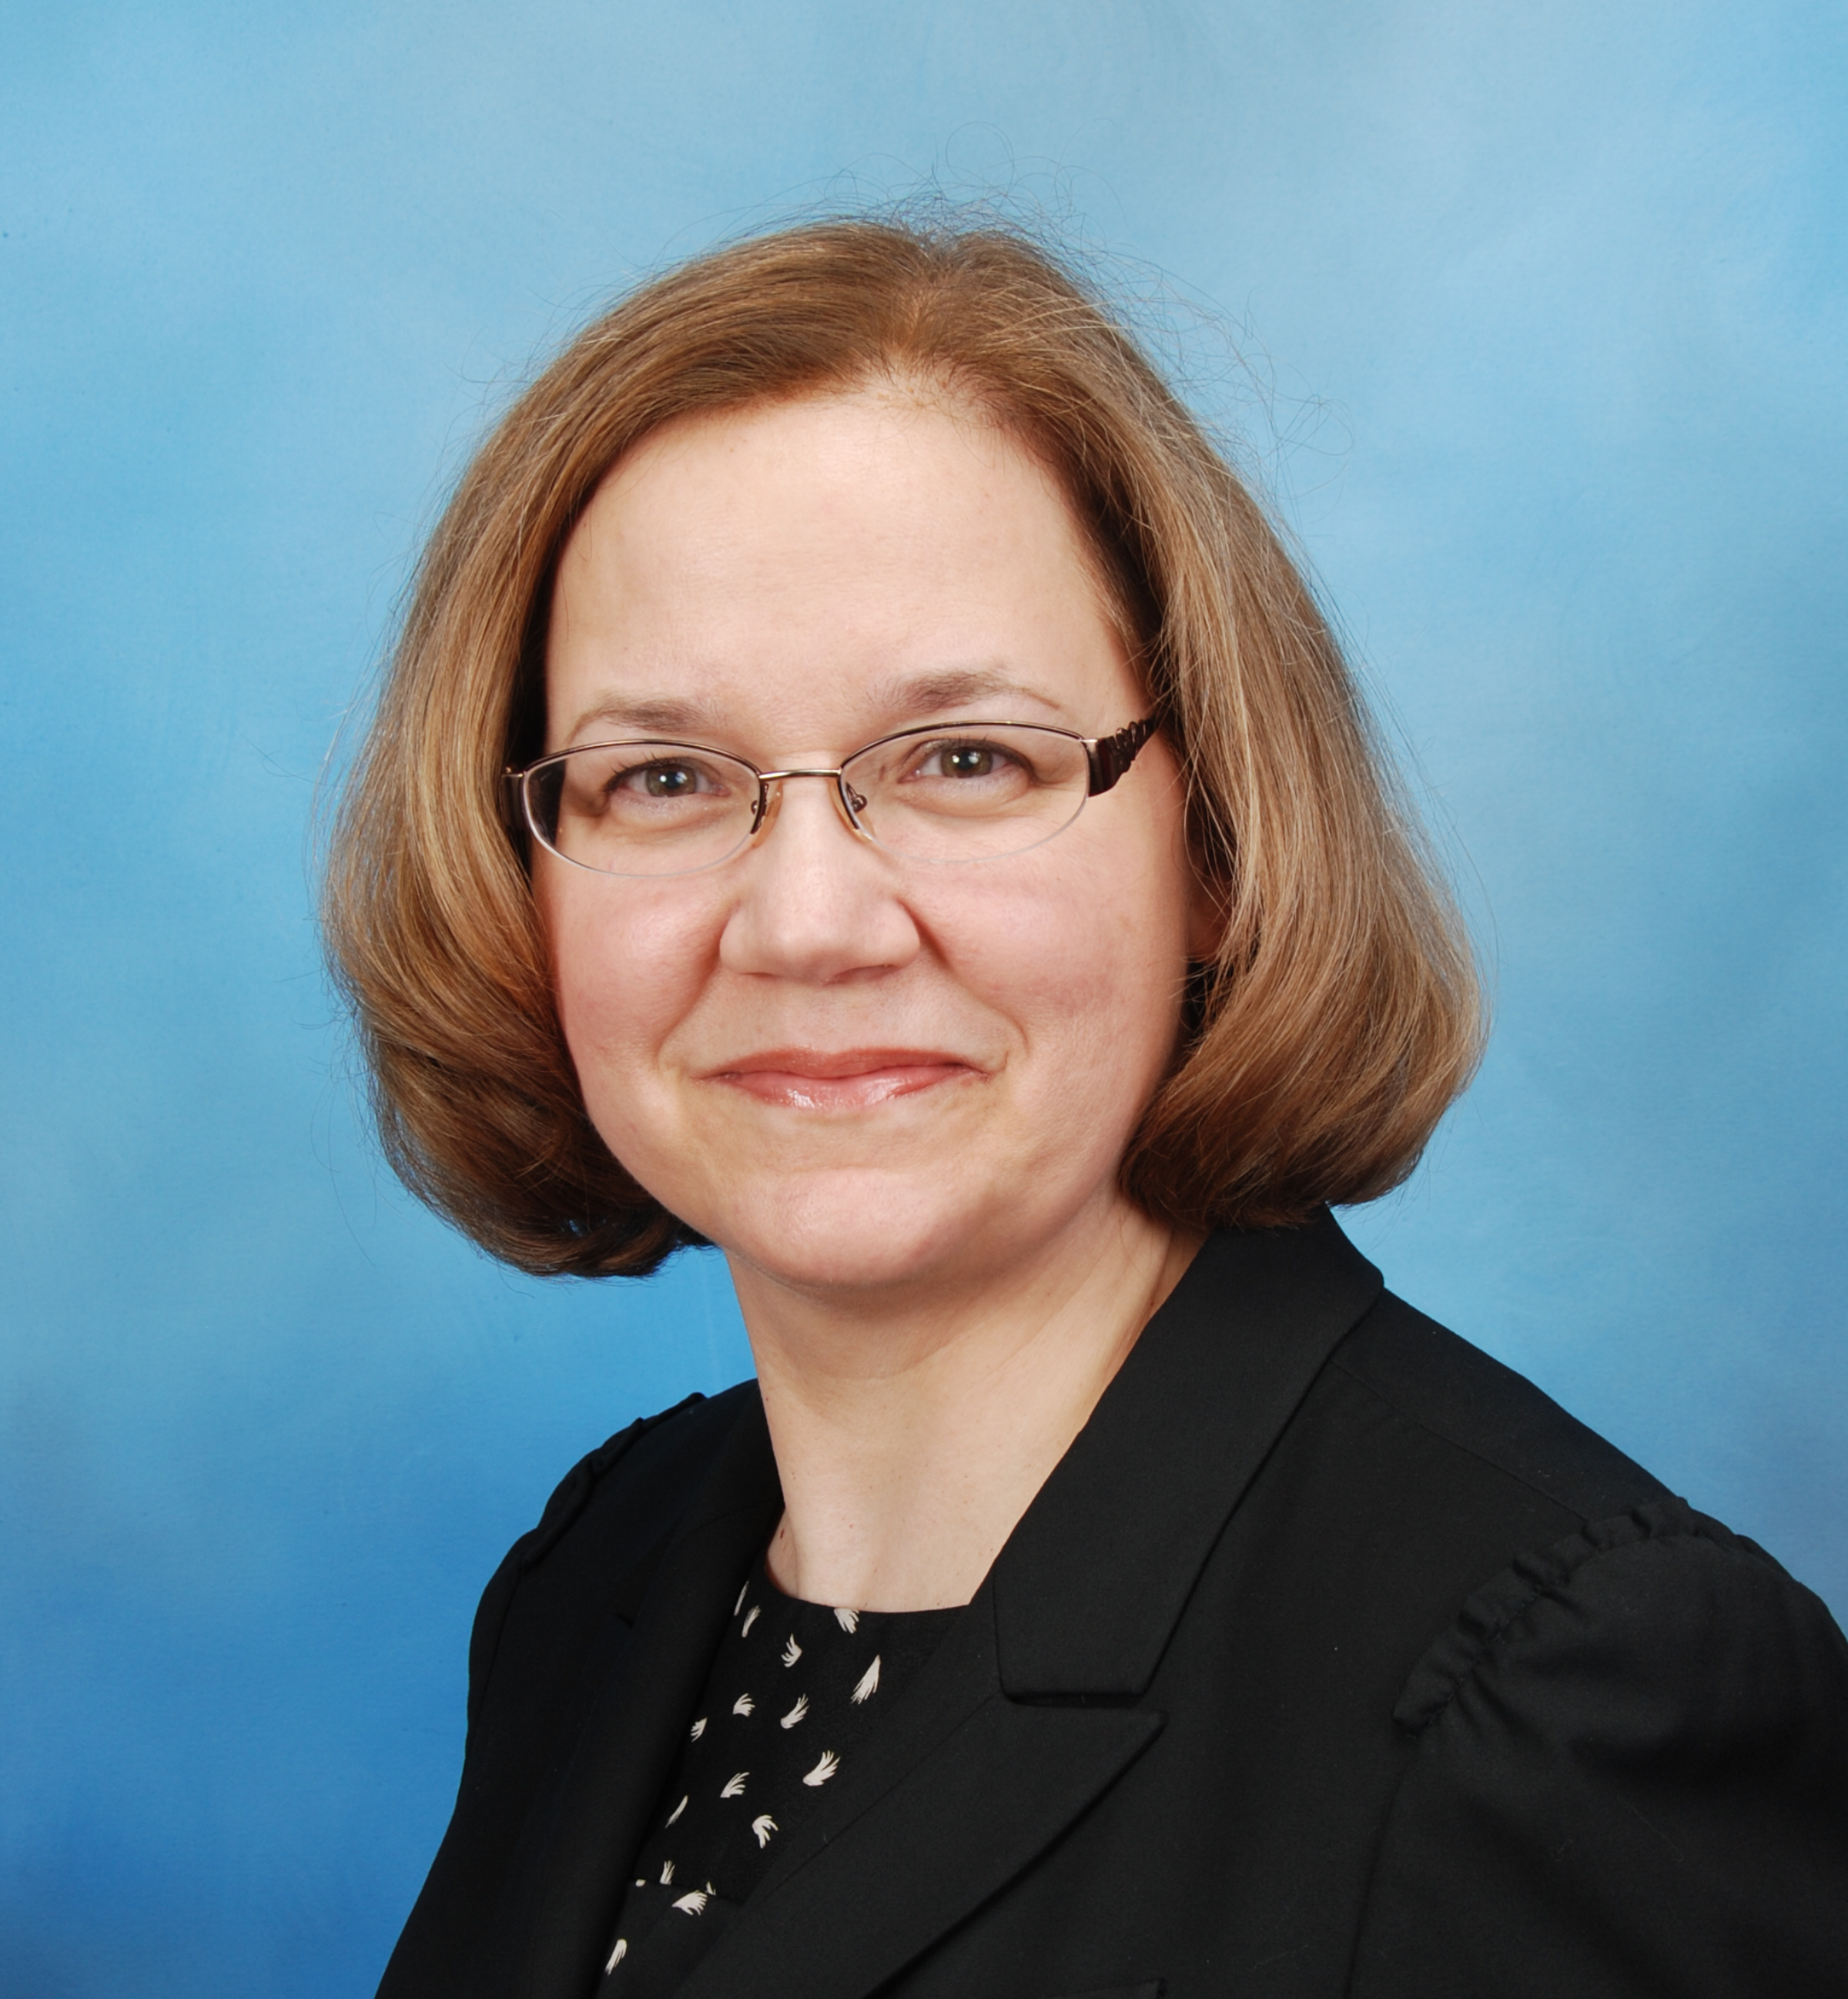
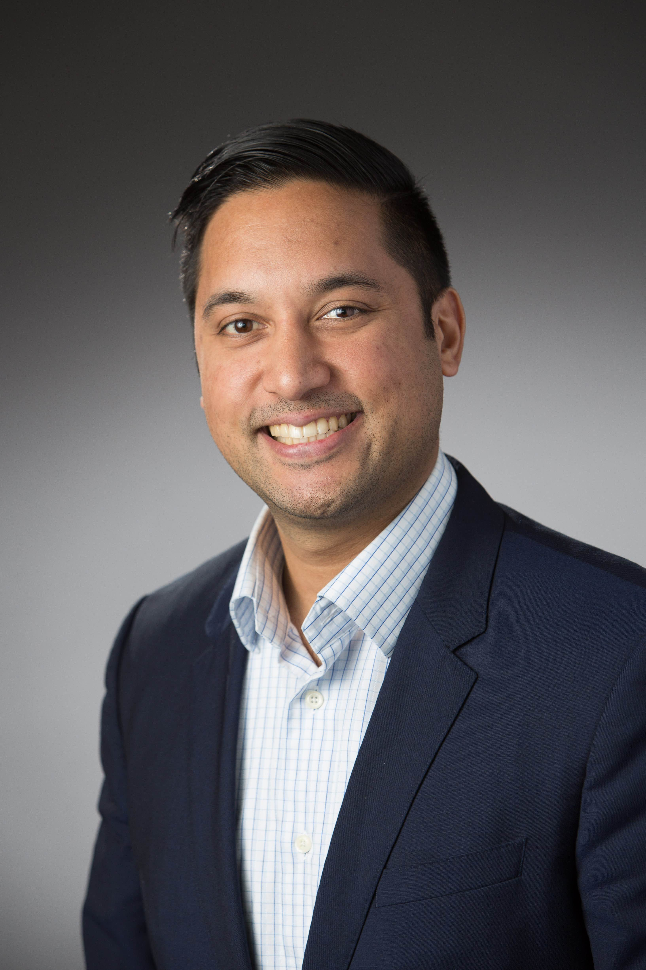
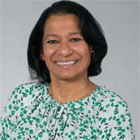
Diplomat Regional Directors
Midwest – Amanda Bain
WA
ID
MT
ME
OR
ND
MN
WI
NY
WY
SD
MI
East – Christine Dube
CA
NV
IA
PA
UT
NE
IL
OH
CO
IN
WV
KS
MO
VA
KY
West – Michael Pazirandeh
AZ
NM
NC
OK
TN
TX
AR
SC
MS
AL
GA
LA
AK
FL
South – Shobna Butler
HI

Slide 28
AMCP Diplomat Program
Refer to AMCP website for list of Diplomats for each school
Reach out to Zack Riley, zriley@amcp.org, for Diplomat related questions
AMCP Diplomat Roster on the website (for members)

Slide 29
P&T Competition
Sarah McLarty, PharmD, MBA
School of Pharmacy Relations Committee
CVS Health

Slide 30
Key dates for 2024:
Intent to compete due Nov 17, 2023
Deadline for entries to the 2024 National P&T Competition is January 22, 2024
Resources:
AMCP Foundation 2024 Competition webpage
P&T Competition Resources on the Student Pharmacist Center webpage
Sign up for Competition Newsletter

Slide 31
How to Conduct a Local Competition
How to Conduct a Local P&T Competition Guide

Slide 32
AMCP Faculty Advisor Best Practices
John Watkins, PharmD, MPH, BCPS
Jonathan Luong, PharmD Candidate (2025)
University of Washington School of Pharmacy

Slide 33
Launching and maintaining a chapter
Getting it off the ground is the hardest part
Recruit student members at entry level (P1)
Promote the P&T Competition
Offer a managed care pharmacy elective course
Get support from your regional AMCP Affiliate
Use former chapter leaders, residents, local payer pharmacists, MSLs and AMs as mentors for current chapter leaders
Notes:
Talking points: Some schools had to "reboot" their chapters post-COVID. We didn't. I think these are some of the reasons why.
It's like flying a kite—the first effort is the hardest. Energetic leaders with great people skills are critical during the first year. We struggled before that because our health plan APPE students would get all excited about managed care, but they had already lost contact with the lower classes, so the enthusiasm didn't get passed on.
Once you get going, recruiting P1 and P2 members is the key to continuity, so they are ready for leadership by the third year.
Develop a robust plan for generating interest in the local P&T Competition. (Jonathan can talk about what's worked for us in the past.) It's a lot of work and sacrifice of vacation time to prepare, but worth it for the experience and definitely career-enhancing. As an RPD, I expect to see this. Almost all our candidates have done it.
Getting a class started is a critical step. We only had 5 students the first year, but it grew steadily from there.
We use a lot of guest presenters from local payers and industry.
If you don't have an AMCP Affiliate, start one! Ours offers a limited number of scholarships for student to attend AMCP Annual and Nexus. They invite student chapter members to all the activities, and we usually have at least 10 or 15 show up.
Getting a robust mentorship program going is also critical to long-term success. I tell all my students and residents: You've been given a great deal by your school and the profession. Pay it forward! Be a mentor, preceptor, and volunteer.
We are happy to help and encourage other schools. Feel free to contact our chapter leadership, Pete Fullerton, or me.

Slide 34
Thoughts from a Student Pharmacist
First few events of the school year are essential for student recruitment
Provide support in multiple ways for P&T Competition teams for them to perform to their full potential
Encourage and promote attendance of AMCP conferences
Build a culture of mentorship and support between older and younger students
Notes:
First few events of the school year are essential for student recruitment
Take advantage of the opportunities that are present to promote the organization. Our school of pharmacy hosts a student activity fair each year, and we use this as an opportunity not necessarily to educate incoming students on what managed care is, but to make them aware of our presence and how active and involved we are (P&T competition, attending conferences, mentorship opportunities, etc.)
Our first event of the year is always an informational session that is followed by a happy hour-the social aspect of the event helps us connect with students and opens the door for them to learn more about managed care, AMCP, and pique their interest to get involved
Provide support in multiple ways for P&T Competition in order for teams to perform to their full potential
Our chapter provides many resources for competing teams
Team mentor that is usually a PY3 or PY4 that had previously competed or managed care resident that is a UW alum or with a local health plan (ex. Premera)
Workshops from previous competitor on project management, monograph writing, creating a budget impact model
Presentation from a specialty provider on the relevant disease state
Managed care course that provides fundamentals on MC and skills for competition (ex. Monograph writing, evidence evaluation)
Encourage and promote attendance of AMCP conferences
Our school has built a culture of attending conferences to network and reconnect, support P&T competing teams, present research, bond socially
Very grateful to have support of affiliate (NW-AMCP) to provide travel grants to students interested in attending
Build a culture of mentorship and support between older and younger students
Most important, as it helps with expanding the chapter’s network and available resources
Older students help serving in mentorship roles, providing feedback, offering networking and internship opportunities
Develops a strong sense of community amongst the students and encourages them to pay it forward!

Slide 35
We are happy to help other schools
Jonathan Luong, Chapter President: jluong27@uw.edu
Kevin Li, Chapter President Emeritus kli13@uw.edu
Faculty Advisors:
Pete Fullerton: peteful@msn.com
John Watkins: jwatkins@uw.edu
Pay it forward!

Slide 36
Open Discussion

Slide 37
Challenges?
What challenge(s) has your AMCP chapter faced in the recent years with membership, engagement, etc.?
How did your AMCP chapter overcome these challenges?
Example: APhA/other larger pharmacy orgs lure in students, leaving little room for AMCP/other orgs
Example: Challenges with COVID-19 for students who haven’t had to put on in-person events in the past
Notes:
Fatima or Task 4 Member

Slide 38
Successes
What positive outcomes has your AMCP chapter seen in the recent years? (e.g., increase in membership, P&T competition involvement, etc.)
How does your AMCP chapter plan to continue achieving positive outcomes?
Example: more collaboration between schools of pharmacy due to COVID-19 especially on virtual platforms
Notes:
Fatima or Task 4 Member

Slide 39
Advice
What advice would you give to someone starting a new AMCP chapter?
What do you wish you had known at the time?
Example: knowing your AMCP resources
Notes:
Fatima or Task 4 Member

Slide 40
Questions?

Slide 41
Announcements
Faculty Advisor In-Person Meeting at Nexus (Wed. October 18, 1-2PM)
New Faculty Advisor AMCP Collaborate Community (collaborate.amcp.org)
All faculty advisors have access to member-only content on the AMCP website
Notes:
Fatima or Task 4 Member

Slide 42
Thank you!

