Slide 1
USC Chapter
AMCP Annual 2023
USC Alfred E. Mann School of Pharmacy and Pharmaceutical Sciences
Notes:
layout: title slide, chapter introduction, 2021-2022 events timeline, main events in order (managed care 101, medicare part d, kaiser night), special programs (PMCP, mentorship, collabs with other orgs, ???), idk what else to put

Slide 2
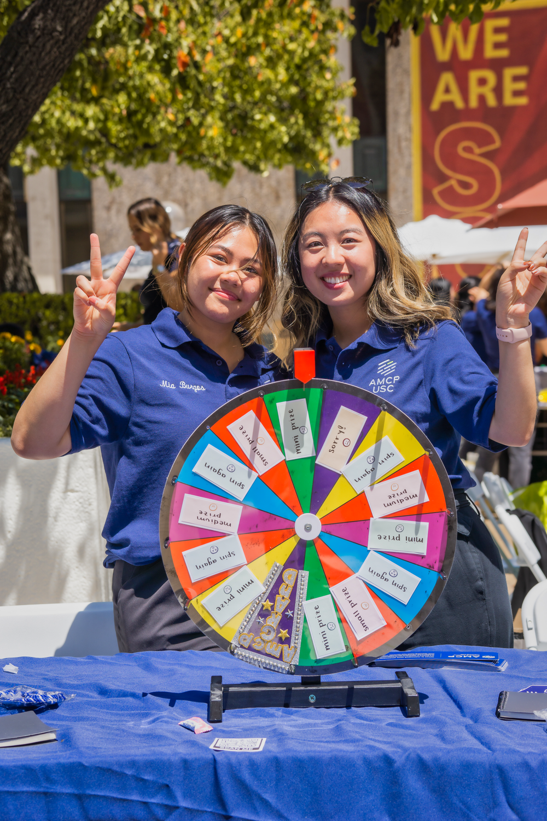
CHAPTER INTRODUCTION
The USC School of Pharmacy's Chapter of Academy of Managed Care Pharmacy is dedicated to providing students professional experiences that enrich learning and networking within the managed care profession. With this, we hope to continue to promote AMCP's core values of medication safety, efficacy, and cost-effective drug therapy.
Notes:
layout: title slide, chapter introduction, 2021-2022 events timeline, main events in order (managed care 101, medicare part d, kaiser night), special programs (PMCP, mentorship, collabs with other orgs, ???), idk what else to put

Slide 3
MEET OUR TEAM
Mia Burgos
Beverly Fuerte
Eugenia Kwon
President-Elect
Director of Finance
Director of Medicare

Slide 4
2021-2022 HIGHLIGHTS
Managed Care 101
Medicare Part D
01
02
The event offered students the opportunity to learn about Managed Care through the experiences of working professionals in the field.
Through Medicare Part D, students were able to participate in offering consultations to USC retirees to help reduce their Medicare Plan costs.
Kaiser Night
Special Programs
03
04
Partnering with Kaiser Permanente, USC AMCP offered students to learn more about residency programs and potential job offers.
USC AMCP offers programs such as the Pre-Managed Care Program and the Mentorship Program to expand interest and networking in the field.

Slide 5
Managed Care 101
Our first look at managed care pharmacy
Introductory event to managed care pharmacy meant to give a BIG PICTURE overview of the managed care space to students with little to no exposure to careers in managed care.
Keynote speeches from professionals in managed care
Round table networking and dinner

Slide 6
Medicare Part D
Medicare consultations led by students
Under the guidance of our faculty professor Dr. Patrick Tabon and preceptors, students are given the opportunity to aid USC retirees to optimize their Medicare Plan.
Lecture from Center for Health Care Rights about Medicare Part D
Learning to navigate medicare.gov
1:1 Student and Retiree consultations under guidance of preceptor

Slide 7
Kaiser Night
A look into a managed care organization
In collaboration with Kaiser Permanente, students are able to network with a multitude of Kaiser professionals from various specialties and gain insight as to how a managed care organization operates.
Keynote speeches from Kaiser leadership and pharmacy residents
Round table networking with pharmacists
Insight into internship opportunities

Slide 8
Pre-Managed Care Program
Undergraduate Opportunities
Outreach program which serves to educate pre-pharmacy societies on undergraduate campuses on the field of pharmacy of managed care pharmacy as well as connect them to Pharm.D. candidates for mentorship and guidance.
Pre-pharmacy society campus visits
Mentorship pairings between undergraduates and Pharm.D. candidates
Resume/CV reviews & mock interviews for pharmacy school

Slide 9
Mentorship Program
Exploring career options
By matching students 1:1 with working professionals in different fields, the program offers students to network with individuals with their career of interest.
Matching students to professionals with career preferences
Hosting mentorship mixers for students and professionals to connect

Slide 10
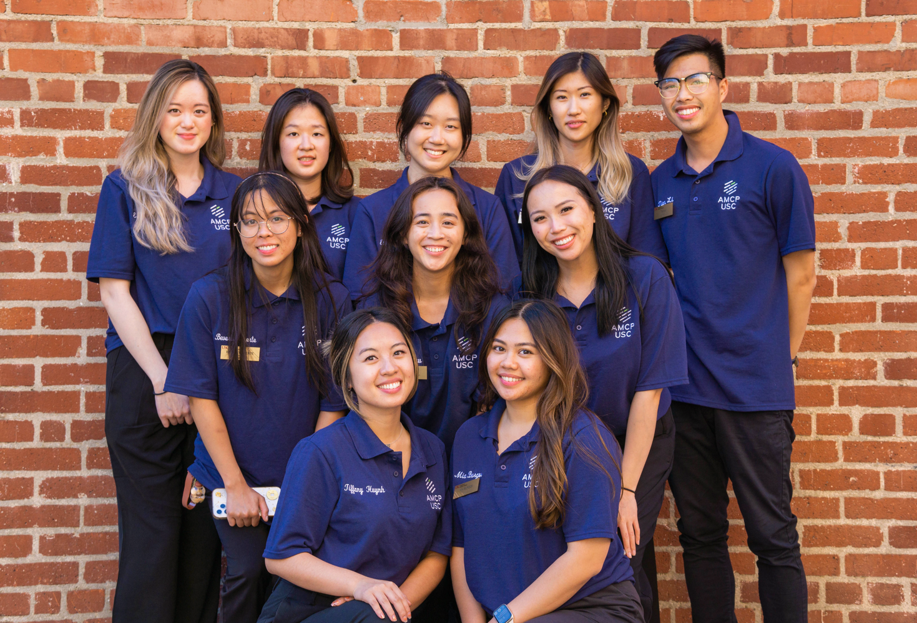
Chapter Remarks
With the ongoing tradition of the different events and programs, the USC Chapter aims to continue to garner student interest in managed care and retain the strong network of managed care professionals at USC.

Slide 11
ON BEHALF OF USC AMCP
THANK YOU

