Slide 1
Managed Care Models
Created by the School of Pharmacy Relations Committee for AMCP
Updated: March 2020

Slide 2
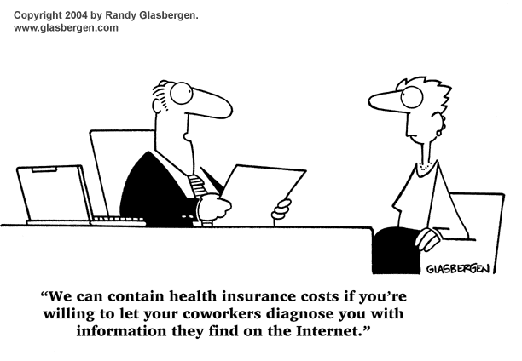

Slide 3
Objectives
Identify the types of managed care models
Discuss differences between model types
Differentiate the level of control and cost per model
Explain the concept of pharmacy networks

Slide 4
Managed Care Model Types
Health maintenance organization (HMO)
Preferred provider organization (PPO)
Point-of-service plan (POS)
High-deductible Health Plans (HDHPs)

Slide 5
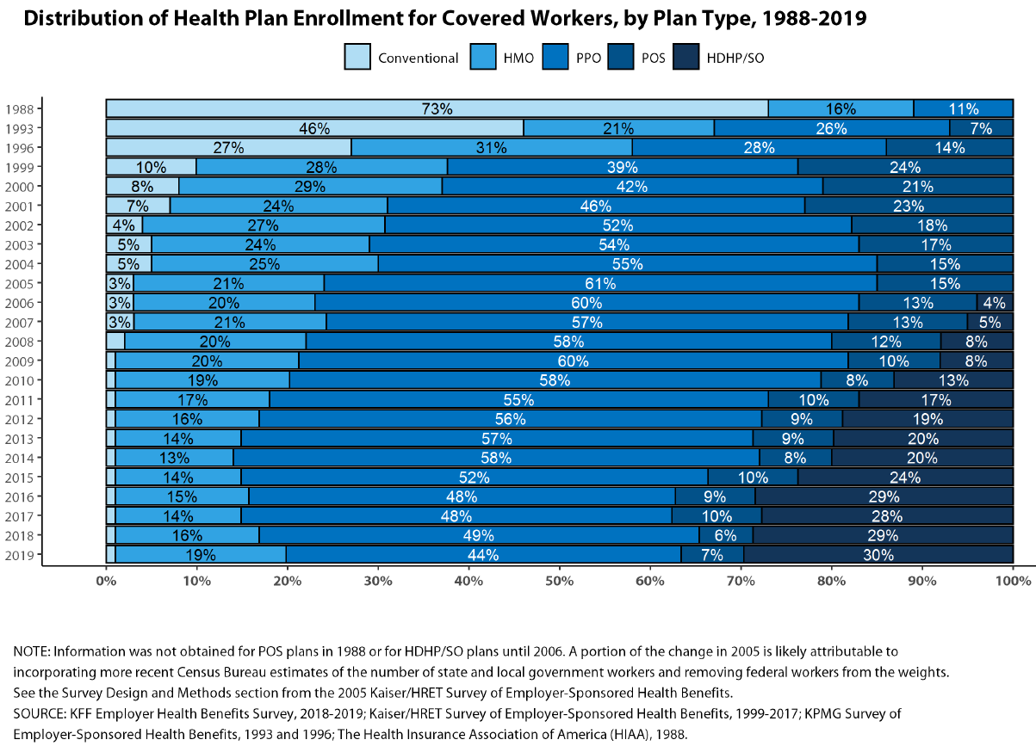
Notes:
Note increase in HDHPs
Conventional plans are ones in which the health plan does not contract with providers. Patients could choose their providers freely and the provider could charge whatever they wanted. If the insurance didn’t pay, the patient would be responsible for whatever was leftover. These plans were referred to as “indemnity insurance” and when health plans started limiting services (e.g., which services they would pay for), it became known as managed indemnity.

Slide 6
Characteristics of HMOs
“Gatekeeper” principle
Primary care provider (PCP) serves as a gatekeeper and must authorize all medical services
Services not authorized by the PCP usually not covered
Rationale for gatekeeper is to avoid unnecessary expenses
Preferred networks
Plans will only pay for services provided by healthcare providers that they have contracted with
“In-Network” providers
Plans will not pay for “Out-of-Network” providers
Less choice, but lower premiums

Slide 7
Characteristics of PPOs
No gatekeeper
Patients can choose their own providers without having to use a designated PCP
Preferred networks with some out-of-network coverage
Patient can see any healthcare practitioner they want, but they are financially incentivized to see in-network providers
E.g., Patient pays 10% to see in-network vs. 50% to see out-of-network
More choice, but higher premiums

Slide 8
Characteristics of POSs
Hybrid of PPO and HMO
Patients can choose their provider
HMO rates for preferred provider (e.g., gatekeeper PCP)
Costs of out-of-network services determined by providers (NOT contracted rates with health plans)
Providers can collect charges not paid for by the insurance company
Notes:
Costs of out-of-network services determined by providers (NOT contracted rates with health plans)
- for all other plans through this point, the health plan basically sets the price that they will reimburse the provider based on the agreed upon contracted rate. In this case, out-of-network providers set their own rates and patients are responsible for the difference between what is being charged and what the health plan pays.

Slide 9
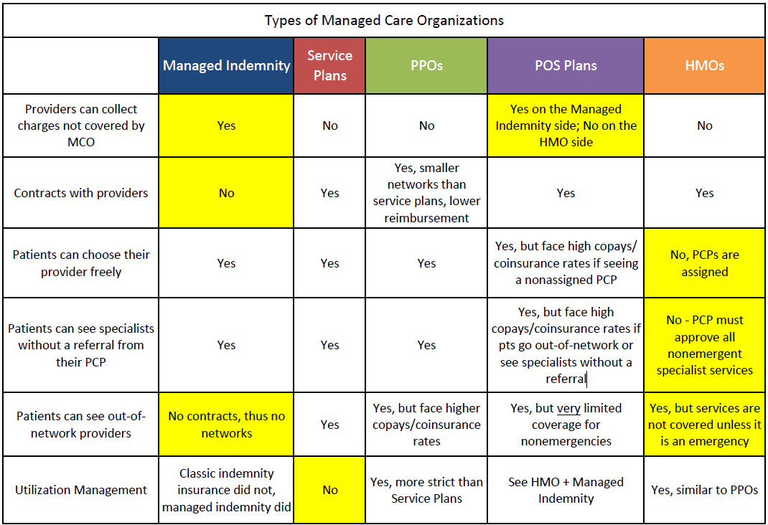
Characteristics of Other Models
Table © Steven Kheloussi

Slide 10
Characteristics of HDHPs
High-Deductible Health Plans (HDHPs):
Low premiums
High deductibles (usually several thousands of $)
Typically paired with a PPO
All PPO features apply, except that the patient is responsible for a larger portion of the cost upfront

Slide 11
Employer Decision: Benefit Controls vs. Cost
Few Benefit Controls
Higher Cost
Lower Cost
Highly Controlled Benefits
Notes:
Considering all the models of healthcare available, employers must decide on a benefit design for their employees. This involves choosing between offering their employees more choice or lower costs. There is a balance to be achieved. The more patient option, the higher the cost of the plan benefit design.

Slide 12
Benefit Control vs. Cost
Managed Indemnity
Service Plans
PPOs
POSs
HMOs
LESS control of medical cost and quality
MORE control of medical cost and quality

Slide 13
Pharmacy Networks
Just like with providers, narrow pharmacy networks help control cost
Pharmacies reimbursed less in exchange for more business
Smaller number of pharmacies for patients to go to
Three types of pharmacy networks
Preferred pharmacy networks
Limited pharmacy networks
Neither
Notes:
With preferred pharmacy networks – there are preferred in-network pharmacies, where patients will pay the lowest cost (e.g., $5 copay); non-preferred in-network pharmacies, where patients will pay a slightly higher copay (e.g., $10), and there are out-of-network pharmacies (where patients have no coverage at all).
Being out of network means that the pharmacy cannot process claims through that insurance.
With limited pharmacy networks – there are preferred in-network pharmacies, where patients will have coverage; and there are out-of-network pharmacies, where patients will not.
With “neither” – many, if not all, pharmacies are in-network

Slide 14
Summary
There are many different types of managed care models.
Each model offers a choice to employers who buy these services.
Employers must balance employee choice with cost when choosing.
Plan types are just one way of controlling cost.

Slide 15
Mission & Vision
To improve patient health by ensuring access to
high-quality, cost-effective medications and other therapies.

