Slide 1
AFFILIATE MEETING
AMCP Annual Meeting
San Antonio, Texas
March 21, 2023

Slide 2
AGENDA
ANTITRUST STATEMENT
MISSION STATEMENT
BOARD INTRODUCTIONS
​UPDATE ON EDUCATIONAL OPPORTUNITIES
SCHOOLS OF PHARMACY LIAISON VOLUNTEERS
VOLUNTEER OPPORTUNITIES AND NEEDED ROLES​

Slide 3
ANTITRUST STATEMENT for meetings
AMCP follows strict antitrust guidelines. Meeting attendees are to review the following statement:
AMCP's policy is to comply fully and strictly with all federal and state antitrust laws. Meetings held under the auspices of AMCP must be conducted in a manner that avoids the fact or appearance of conduct that may violate the antitrust laws. Participants are not to discuss industry-wide or individual company prices (current or projected) or matters relating to pricing such as costs, profits, contractual terms and conductions (e.g., discounts, credit terms), wages/salaries, market allocation, market shares/sales or clients/customers.
AMCP Antitrust Guidelines may be viewed at http://www.amcp.org/antitrust/

Slide 4
MISSION STATEMENT
The Great Plains AMCP Affiliate seeks to serve the AMCP membership in the states of Iowa, Kansas, Missouri, Nebraska, North Dakota, and South Dakota in three primary areas: networking, advocacy, and education programming.

Slide 5
Thanks to our Past Board
Treasurer: Casey Reed
Secretary: Kavitha Makayee
Immediate Past President: Jeff Huether
Educational Chairs: Courtney Spezia & Elaine Ogden
Schools of Pharmacy/Student Liaisons: Christin Henrich
Great Plains State Delegates:
Iowa: Maggie Murphy
Kansas: Mark Gruenhaupt
Missouri: Rick Kegler
Nebraska: Terry Ahlers
North Dakota: Gary Parenteau
South Dakota: Erica Bukovich

Slide 6
Board Introductions
Newly Elected Officers for 2023- 2024
Casey Reed, President-Elect
Elaine Ogden, Treasurer
Jeff Green, Secretary
Matt Grewe, Education Co-Chair
Jim Baumann, Education Co-Chair

Slide 7
Board Introductions
The below individuals are also recognized for their continued leadership service on the Great Plains AMCP Board of Directors:
Deb Minich, President
Kimberly Rinard, Immediate Past President
Courtney Spezia, Education Co-Chair
Christin Henrich, Schools of Pharmacy/ Student Liaisons
Jeffrey Osmundson, Education Committee
State Delegates:
Iowa, Jim Hoffman
Kansas, Mark Gruenhaupt
Missouri, Rick Kegler
Nebraska, Kurt Hendrickson
North Dakota, Gary Parenteau
South Dakota, Erica Bukovich

Slide 8
Education update
Day of Education (DoE) Summary 2022
64 Attendees in Kansas City on September 16, 2022
40 in attendance for the networking event the prior evening
6 talks, 5.75 Hours of CPE credit
Good Mix of Attendees
Great Fun!

Slide 9
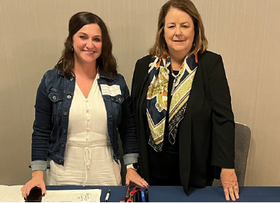
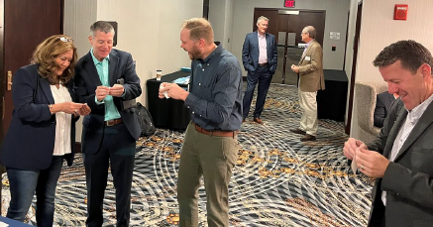
Day of Education

Slide 10
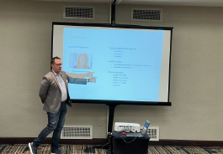
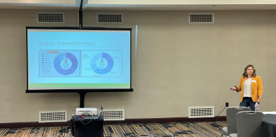
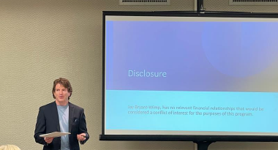
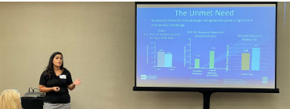
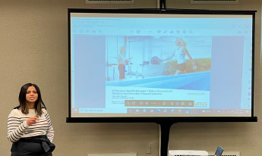
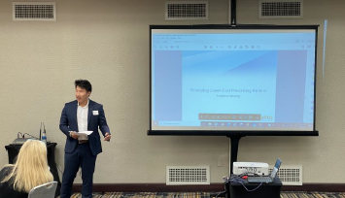
Day of Education

Slide 11
DoE 2023 Planning
Planning has begun:
Mark your calendars: Friday in September 2023 in Kansas City
Expect 5.5 to 6.0 hours of CE provided by the Nebraska Pharmacists Association
Networking event will take place Thursday before the event

Slide 12
Opportunities to Support DoE
Anyone who would like to help is welcome!
There are opportunities to sponsor the event (either one of the meals on the day of the event or the networking event the night before)
Please request information if you would like to sponsor
Please reach out to :
Courtney Spezia Courtney.Spezia@mnk.com
Matt Grewe at magre@leo-pharm.com
Jim Baumann at jabaumann1213@gmail.com

Slide 13
Schools of pharmacy liaisons
The primary responsibility of the pharmacy school liaison is to provide information that is relevant to the pharmacy schools and students related to AMCP and managed care pharmacy.
A couple of examples are a mentorship program and scholarship funds to attend AMCP meetings.
Mentorship program
Paperwork and webinar for mentors to complete
Considering ‘networking’ sessions
Pharmacy Liaison(s)
Pharmacy school liaison could be responsible for matching interested students with mentors to simplify the process

Slide 14
Schools of pharmacy liaisons (Iowa)
Drake University
University of Iowa
AMCP Student Chapter
AMCP Student Chapter
AMCP Diplomat
Contact: Jill Guetersloh
AMCP Diplomats
Ryan Flugge
Ami Gopalan
Amelia Damlo

Slide 15
Schools of pharmacy liaisons (Missouri)
St. Louis College of Pharmacy
University of Missouri, Kansas City (UMKC)
AMCP Student Chapter
AMCP Student Chapter
AMCP Diplomat
Faculty advisor: Mark Patterson, pattersonmar@umkc.edu
AMCP Diplomat
Robert Kilo
Contact: Carli Luebbert, c116g8@umsystem.edu
Katelyn Strauch

Slide 16
Schools of pharmacy liaisons (Nebraska)
Creighton University
University of Nebraska
AMCP Student Chapter, faculty advisor- Donald Klepser, dklepser@unmc.edu
AMCP Student Chapter
AMCP Diplomat
AMCP Diplomats
Contact: Natalia Kunze, NataliaKunze@creighton.edu
Shellie Schoening
Jeff Huether jeff.huether@nebraskablue.com
Sarah Hulvershorn

Slide 17
Schools of pharmacy liaisons (Kansas, ND, SD)
University of Kansas
No AMCP student chapter
Faculty contact- Jessica Bates, batesjv@ku.edu
AMCP Diplomat – Arlene Price
North Dakota State University
No AMCP student chapter
AMCP Diplomats
Jeff Larson
Zachary Jones
South Dakota State University
No AMCP student chapter, No Diplomat

Slide 18
Volunteer Opportunities
Schools of Pharmacy
Mentors
State Social Event Coordinators
Social Coordinator
State Board of Pharmacy Liaison

Slide 19
We want your feedback / Suggestions
CE ideas,
Networking ideas,
Other activities to grow interest in the Affiliate

Slide 20
Great Plains AMCP Advocates for You
You can count on Great Plains AMCP to represent your professional interests when and where it matters most. Your voice is heard by those who make policy decisions about managed care pharmacy with the communities you serve.

Slide 21
THANK YOU
Find us and Follow us
AMCP Great Plains Chapter
www.amcp.org/great-plains-amcp
greatplainsamcp@gmail.com

