Slide 1


AMCP Foundation
P&T Competition
Tips & Tricks
Hosted by the AMCP Student Pharmacist Committee
Genentech, a member of the Roche Group, is the Executive Sponsor
of the National Student Pharmacist P&T Competition

Slide 2
Questions
5 pre-made questions will be answered first
There will be time for any other questions towards the end
  Please use the chat box to send in your questions, and an SPC member will then ask the panelists
  If you see someone has asked a question you also want to ask, please like their message so we see it has more interest

Slide 3
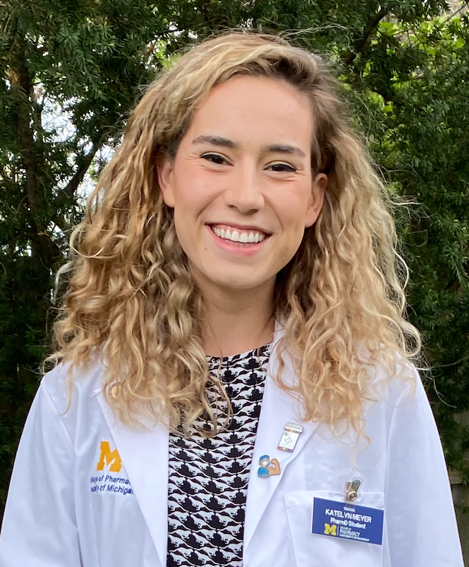
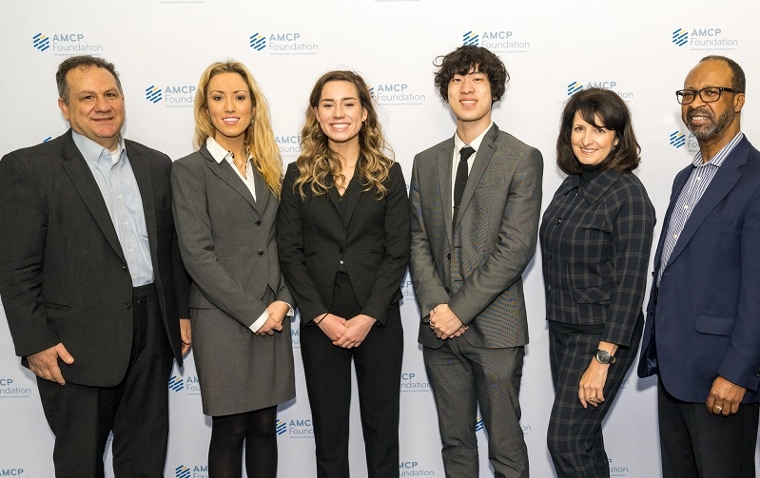
Meet our Panelists
Katelyn Meyer (2022 1st Place Winner)
University Of Michigan
Class of 2024
Areas of Interest: Managed Care & HEOR
Email: kbmeyer@umich.edu

Slide 4
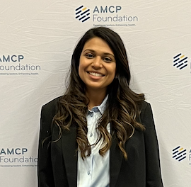
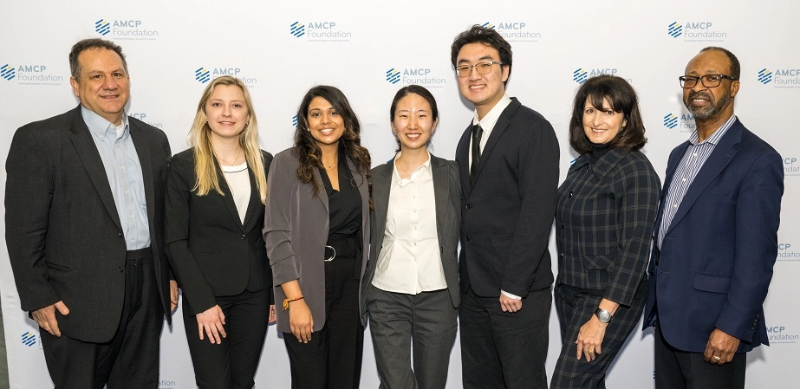
Meet our Panelists
Rutvi Patel (2022 2nd Place Winner)
Rutgers University
Class of 2023
Areas of Interest: Managed care, Market Access, HEOR
Email: patel.rutvi@rutgers.edu

Slide 5
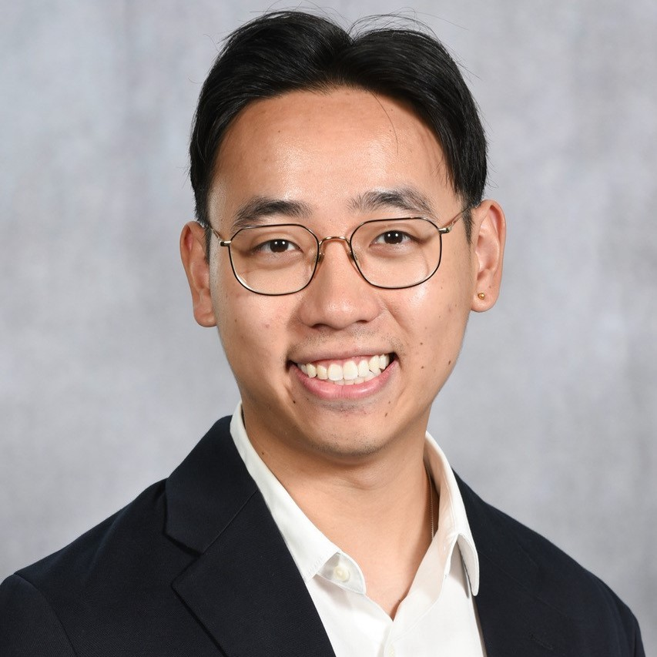
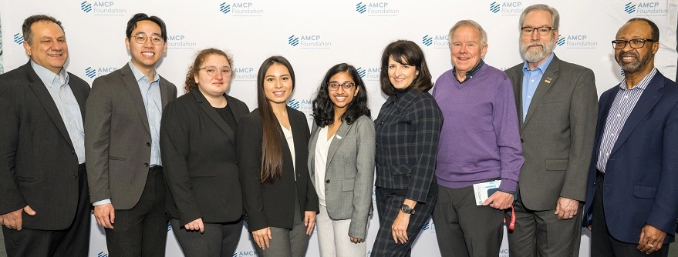
Meet our Panelists
Kevin Li (2022 3rd place winner)
University of Washington
Class of 2023
Areas of Interest: HEOR and Market Access
Email: kli13@uw.edu

Slide 6
2023 National
P&T Competition
Timeline
Moderator: Vy Do

Slide 7
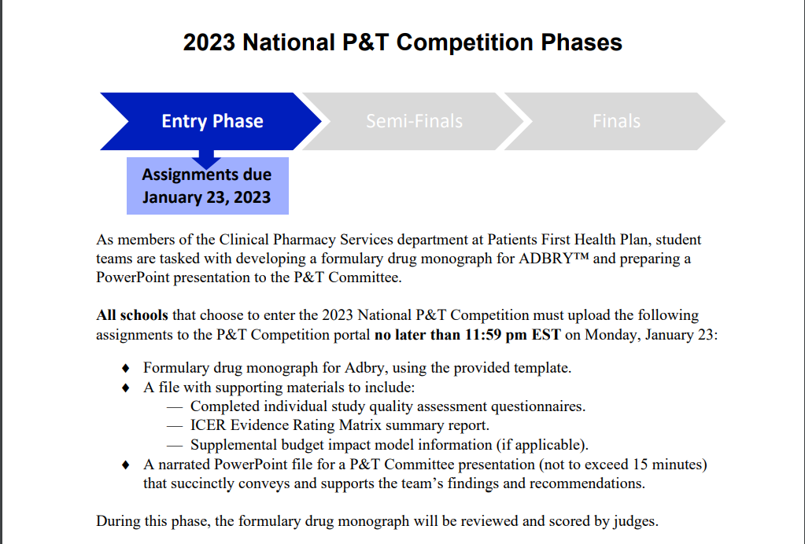
2023 P&T Competition
Moderator: Vy Do

Slide 8
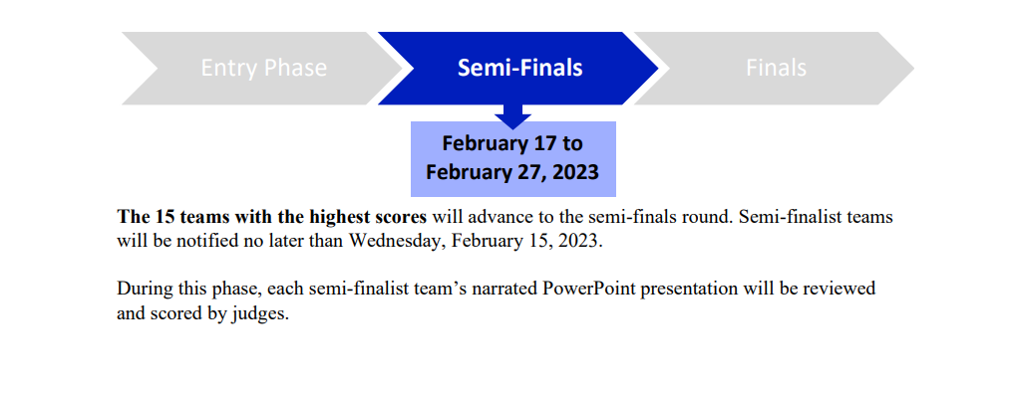
2023 P&T Competition
Moderator: Vy Do

Slide 9
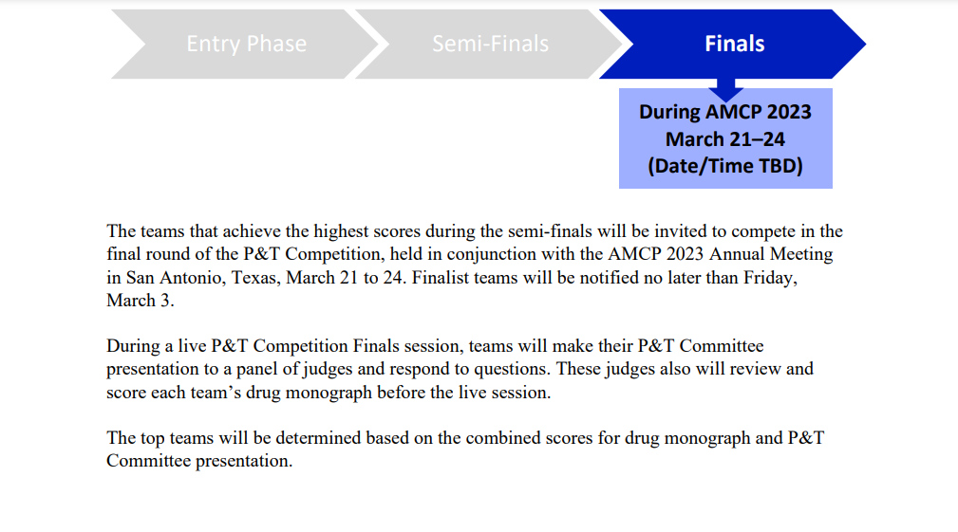
2023 P&T Competition
Moderator: Vy Do

Slide 10
Question 1:
Figuring out where to start can be challenging for competitors — how did your teams approach tackling the P&T Competition?
Moderator: Vignesh Pernati

Slide 11
Question 2: What were some biggest challenges that you and your team encountered?
Moderator: Vignesh Pernati

Slide 12
Question 3:
What did you include in your submissions that you felt made your team stand out?
Moderator: Vignesh Pernati

Slide 13
Question 4:
What are some tips/tricks you would recommend for students?
Moderator: Vignesh Pernati

Slide 14
Question 5: How did the P&T Competition help you shape your future? What is the biggest thing that you took away from it?
Moderator: Vignesh Pernati

Slide 15
Opportunity for other questions…
Moderator: Matt Doenges

