Slide 1
Local P&T Competitions Webinar

Slide 2
Introductions
Sarah Hulvershorn, Chair, School of Pharmacy Relations Committee (SOPRC)
Cynthia Knapp Dlugosz, National P&T Competition Director
Soham Shukla, Task Lead, School of Pharmacy Relations Committee (SOPRC)
Michael Pazirandeh, Regional Diplomat Director
Sunny Hirpara, University of Illinois at Chicago Diplomat

Slide 3
Cynthia Knapp Dlugosz, National P&T Competition Director
2023 National
P&T Competition
Timeline and Phases

Slide 4
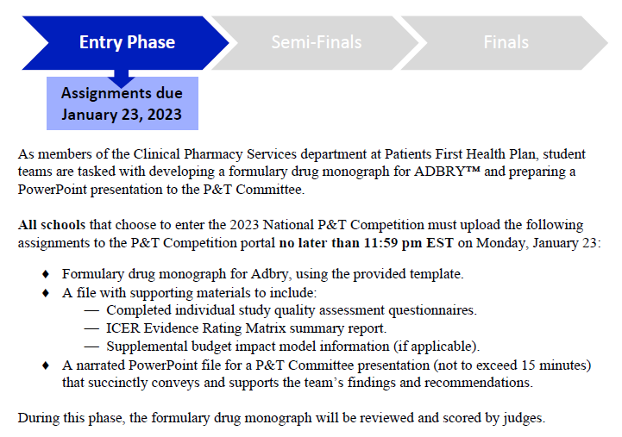
2023 P&T Competition

Slide 5
2023 P&T Competition

Slide 6
2023 P&T Competition

Slide 7
P&T Judging Best Practices

Slide 8
Soham Shukla, Task Lead, SOPRC
Delivering presentation with poise and confidence
Good slide principles, word pronunciation, speaking volume
Handling tough questions from judges, and delivering clear, concise answers
Showing judges the team collaborates well and has good chemistry

Slide 9
Michael Pazirandeh, Diplomat Regional Director
Getting students to sign up
P&T set up and student success
Grading the dossier
Q&As

Slide 10
Sunny Hirpara, University of Illinois at Chicago Diplomat
Support from faculty – an overview of the disease state for a refresher
Your Q&A with the students should reflect the quality of their work
Find support through other diplomats
Praising students after the presentation

Slide 11
Questions

