Slide 1
Strategic Priorities - Title

Slide 2
Today’s Agenda
Managed Care History
What is Managed Care Pharmacy
Understanding the Players
Health Care Trends, & Challenges
Addressing the Rising Costs of Pharmaceuticals​
AMCP Student Membership

Slide 3
Managed Care History

Slide 4

1940s
1950s
Companies offer health insurance to compete for labor.
Health plans proliferate.
1960s
Rise of employer-based health insurance.
Unemployed, poor, and older adults left out.
1970s
Pressure to control health care costs.
1968: Pharmaceutical Card System – first PBM
1973: President Nixon signs Health Maintenance Organization Act
History
Notes:
To understand the managed care pharmacy field, let me share a quick history lesson about the evolution of health insurance.
During WWII, employers had a hard time attracting employees due to labor shortages. To attract workers, employers started offering sick leave and health insurance.
This practice caught on, and in the 50s and early 60s, more employers began offering health coverage. However, unemployed, poor, and older adults were left out of these health insurance markets. At the same time health care costs increased, and pressure built to control health care costs.
Two new models to control costs emerged. First, in 1968: Pharmaceutical Card System – first PBM to address pharmaceutical costs. Then in 1973: President Nixon signs Health Maintenance Organization Act which established a new model for health care delivery as a way to curb medical cost inflation.

Slide 5
1980s
1990s
HMOs hire more pharmacists
Managed care pharmacy is a growing profession
1988: AMCP founded
2000s
Managed care pharmacy field matures quickly
2003: President Bush signs Medicare Prescription Drug, Improvement, and Modernization Act (MMA)
CMS taps AMCP leaders to establish Medicare Part D systems and regulations
History (cont’d)
Notes:
In the 1980s drug prices continued to increase. HMOs, hospital systems, and PBMs began hiring pharmacists to work in the evolving pharmacy benefit field…which led to the emergence of the managed care pharmacy practice.
Late in the 80s, PBMs become a major force to help address escalation in prescription costs.
A group of hospital pharmacists connected at a national hospital conference. They realized that they were all part of this new field and
needed a professional society to represent the interests and challenges of the ambulatory portion of pharmaceutical care delivery…particularly how to optimize the outcomes for patients.
And that’s how AMCP was founded in 1988 and incorporated in 1989.
A key example of the utility of managed care pharmacy practice in action is Medicare Part D.
After President Bush signs Medicare Prescription Drug, Improvement, and Modernization Act (MMA) in 2003, CMS taped AMCP leaders to help establish Medicare Part D systems and regulations.
Today, we see elements of managed care pharmacy in all insurance plans – from formularies to utilization management tools.
Let’s start with the definition.

Slide 6
Managed Care Organizations
Health Maintenance Organization (HMO) – independent practice association, staff, group, network
Preferred Provider Organization (PPO)
Exclusive Provider Organization (EPO)
Point of Service (POS) – hybrid PPO & HMO

Slide 7
What Is Managed Care Pharmacy?

Slide 8
The Practice of Managed Care Pharmacy
Applies clinical and scientific evidence.
Supports the appropriate use of medications.
Enhances patient and population health outcomes.
Optimizes the use of limited health care resources.

Slide 9
Managed Care Pharmacy Professionals
Develop Strategies
for
Patients, Health Plans & Providers
across
5 Key Areas
Notes:
Next slide lists the 5 key areas

Slide 11
Ensuring access by defining where care is available.
Determining which treatments are covered based on individual and population needs.

Slide 12
Identifying which medications to include on the formulary.
Applying drug management strategies and tools.
Tracking new and developing medications.

Slide 13
​
What is a Formulary?​
A continually updated list of medications and related products supported by evidence-based medicine, and experts on the diagnosis and treatment of disease and preservation of health. ​
Open Formulary:
Reimbursement is generally provided for most or all formulary and non-formulary drugs. Patients may or may not incur additional out-of-pocket expenses for using non-formulary drugs. Some drug classes may be excluded by plan design.​
Closed Formulary:
Non-formulary drugs are not reimbursed (unless authorized by formulary exception policies).​

Slide 14
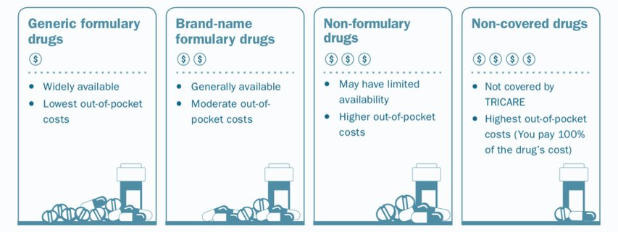
Pharmacy & Therapeutics (P&T) Committee
An advisory committee is responsible for developing, managing, updating, and administering the drug formulary system.
Notes:
What is a pharmacy and & therapeutics (P&T) committee​
An advisory committee made comprised of primary care and specialty physicians, pharmacists, and other health care professionals (e.g. nurses) that is responsible for developing, managing, updating, and administering the drug formulary system.​
​
Committees consider a range of evidence-based data when making benefit determinations. ​
​
Later, you’ll hear how AMCP student members can participate in a national P&T competition through AMCP Foundation. ​
​
​

Slide 15
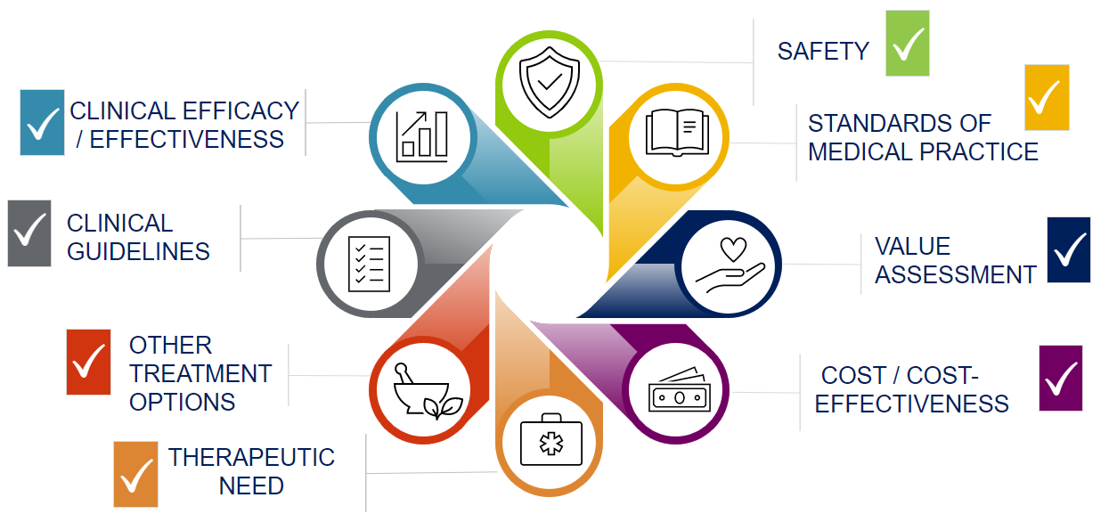
P&T Committee: Decision Considerations
Notes:
PRESENTER NOTE – please provide real-world examples to help illustrate the decision points. - ​
​
Clinical efficacy / effectiveness​
Safety​
Clinical guidelines​
Standards of medical practice ​
Other treatment options​
Value assessment​
Therapeutic need​
Cols / cost-effectiveness ​
​
This is a lot of information to digest. Imagine how the decision-makers feel digesting the data. ​
Could you imagine a case where different drug manufacturers might present information on a new drug to make it looks the best possible so that a payer includes it on the formulary? ​
​
Imagine having 10 new drugs with their clinical trial data presented in 10 different ways. It’d be very difficult to make effective comparisons. ​
​
To level the playing field, AMCP created “the format for formulary submissions.”

Slide 16
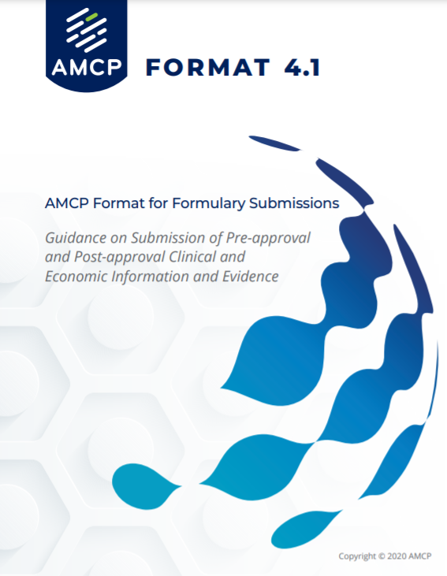
For more than two decades, the AMCP Format has defined the gold standard for evaluating evidence to support formulary and coverage decisions.
https://www.amcp.org/Resource-Center/format-formulary-submissions/AMCP-Format-for-Formulary-Submissions-4.1
Notes:
AMCP Format 4.1 is not a mandate and instead serves as guidance to describe information needs of health care decision makers. Development and use of dossiers is at the discretion of the manufacturer and is subject to their individual legal and regulatory compliance policies.
There are other decisions that a P&T committee need to consider.
The Format is reviewed and updated as need by an AMCP committee dedicated to this work. A new revision to address digital therapeutics, real world evidence, and factors that influence drug outcomes in specific subpopulations is expected soon!

Slide 17
Managing coordinated care programs​.
Conducting drug utilization reviews​.
​Implementing initiatives to address health disparities.
​Completing medication therapy management​.

Slide 18
Assessing and reporting on quality measures​.
Reporting Medicare Part-D Star ratings.​
Managing drug shortages & safety programs​.

Slide 19
Reducing risk for individuals, employers, and other public payers by managing overall costs​.
Protecting against misuse, overuse, and fraud​.
Promoting value-based care.

Slide 20
Understanding the Players:
How Payment Works
Notes:
Let’s go through how payments work so you can better understand the players in managed care pharmacy​

Slide 21

What is a Plan Sponsor / Payer?
A purchaser of health care insurance, including private employers, Medicare, Medicaid, government programs (e.g., TRICARE), and health insurance marketplaces.

Slide 22

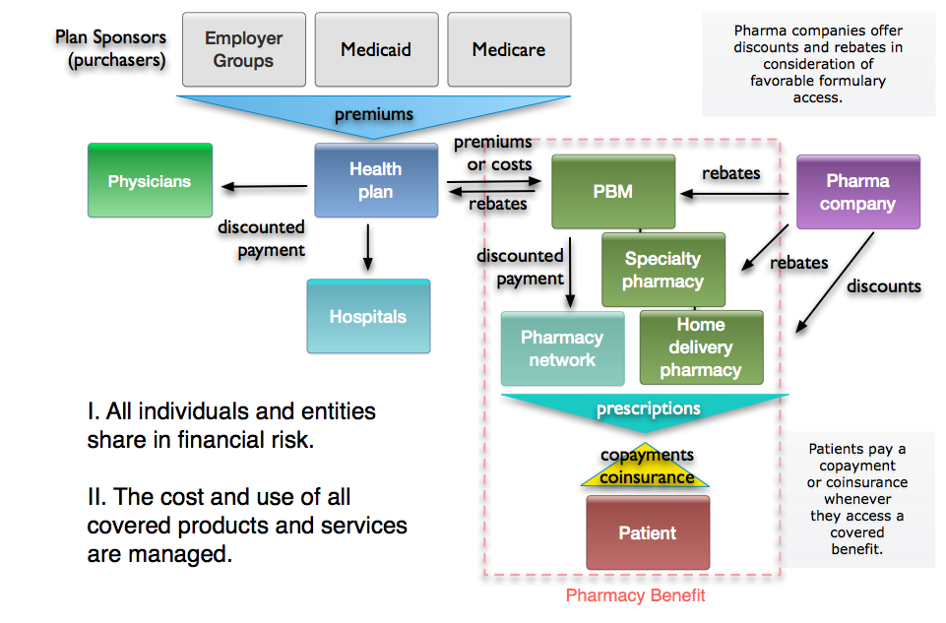
Commercial Partners & Money Flow
Patient
Notes:
ADD PATIENT BAR ABOVE PLAN SPONSORS
Focus on Plan Sponsors
This diagram shows the contractual relationships with the trading partners and the flow of money. We will start on the top just to illustrate what we mentioned in the previous slide. We have employer groups, Medicaid, and Medicare, which are the three largest insurance programs. We call these books of business.
So, the employer groups, Medicaid, or Medicare, we will call them plan sponsors because these are the entities that are purchasing the insurance. These are the entities that determine what insurance benefits are authorized and what they are willing to buy. There is a trade of money that is either a premium or actual claims are passed through, as determined by the contract with a healthcare plan or insurance company.
For example, in this slide, the healthcare plan is contracting with one of the employer groups. They want to buy health insurance and so they contact a health plan, they may contact several health plans to get competing bids and they will finally select a health plan to provide medical and pharmacy benefits and for the comprehensive benefits, the employer group will pay the premiums. Part of the premiums is paid by the individual employee. The healthcare plan then has a network of physicians, hospitals, and other providers that the covered individuals can use for their health care needs as we showed in the previous slide. These are called a provider network to provide the healthcare services that are contracted by the employer group. So, the healthcare plan contracts with community-based providers in exchange for the privilege of the providers being paid to see the health plan's patients.

Slide 23
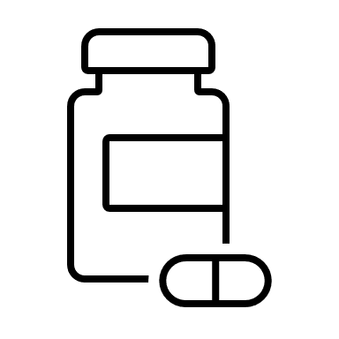
What is a Pharmacy Benefit Manager (PBM)?
Organizations that manage pharmacy benefits for managed care organizations, other medical providers, ​or employers.

Slide 24
Commercial Partners & Money Flow
Patient
Notes:
​Focus on Inside the Red Dash Box – Pharmacy Benefit​
​
So, let us look inside the red dash block on the right side of the slide. This represents the pharmacy benefit. The left side of the box or outside on the box on the left is the medical benefit. Sometimes, a health plan will contract or subcontract with a PBM, or a Pharmacy Benefit Manager, to develop and manage the prescription drug benefits. So, the healthcare plan may pass on some administrative fees that are paid by the employer group to administer the pharmacy benefit. The PBM then sends the actual cost of the prescriptions used back to the healthcare plan. ​
​
The PBM has a network of community pharmacies where patients can pick up their medications. . However, PBMs will set up many different types of pharmacy networks based on the needs of a specific employer group. ​
​
For example, if there is an employer group that only has people living in the state of Florida, they do not need all US pharmacies in their pharmacy network, so they can save money if they have a reduced pharmacy network, perhaps including some national chains in case their employees in Florida go on vacation or travel on business, but most of the pharmacies in the network are in Florida because that is where the employees and their families live. ​
​
In addition to the community pharmacy network, the PBM will also have the specialty pharmacy contract or may have its own specialty pharmacy for high-cost biologicals. The PBM may also contract with a home delivery pharmacy or mail service pharmacy, or it may have its own mail service pharmacy, so there are three primary distribution chains. It is important to realize that 80 percent of the prescriptions go through community pharmacies. ​
​
About 5 percent of prescriptions are filled at specialty pharmacies, and then we have home delivery, which is about 15- percent of all prescriptions. All these pharmacies dispense prescriptions that are covered underneath the formulary. The formulary was determined by the PBM and healthcare plan, and then the patient, pays a cost share, that is a fixed dollar copayment or a percentage coinsurance whenever the patient gets a covered prescription filled at the pharmacy. ​
​

Slide 25
Commercial Partners & Money Flow
Patient
Notes:
Focus on Pharmaceutical Companies
On the upper right, we have the pharmaceutical companies. They are also involved in the financial risk because they offer rebates or discounts, which are price concessions paid to the PBM or paid directly to the health plan or pharmacy, depending upon who is purchasing the drug and taking possession of the drug, but these are price concessions that reduce the net cost of their drug. So, the lower net cost as the result of the pharmaceutical company price concessions are then passed on back to the healthcare plan and the plan sponsor. The pharmaceutical company discounts reduce the net cost on contracted products and reduce the cost of the system, but not usually the cost to the patient.

Slide 26
Health Care
Today

Slide 27
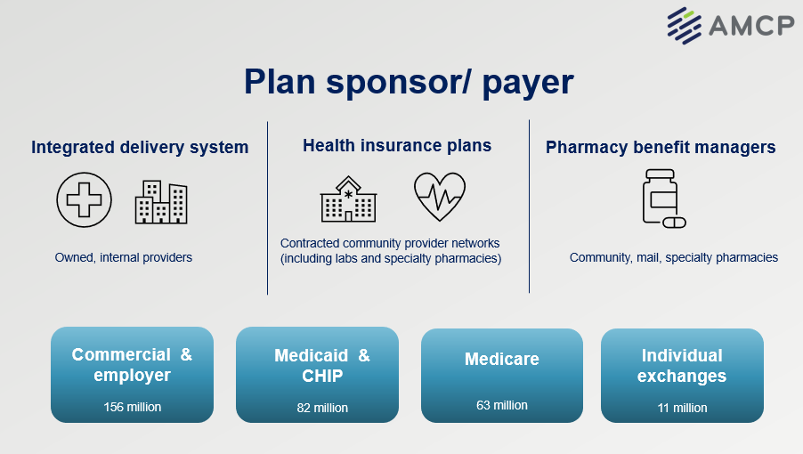
U.S. Health Care Insurance Overview
Notes:
​The U.S. health care system is unique and unlike any other system in the world. It is a complex system that has both state and federal programs and oversight. ​
​
This slide depicts this system. Let us illustrate this with Medicaid. Medicaid is a program that was established in 1965 by the Social Security Act. It was a federally enacted program, but it is state organized and managed, so each state has its own Medicaid program. ​
​
Managed Medicaid or Medicaid programs are administered by individual states, possessions, and territories and so there are 54 different Medicaid programs in total. They are similar in that they are all developed for low-income individuals. So, there is state administration, state determination of the formulary and drugs that are covered in the benefits, but there is a lot of consistencies because there is federal oversight. ​
​
Health insurance exchanges, authorized through the Healthcare Reform Act of 2010, allow individuals and small companies to buy health insurance in state and/or federal exchanges. Again, every state has its own type of exchange and insurance program, but there is a great deal of consistency because they are all must include the Essential Health Benefits, as required by the ACA (which include pharmacy benefits). ​
​
These are 156 million individuals covered by some sort of an employer-based program. And again, some are under the state program, the state authorization, and some under federal authority. The very large, self-funded programs are typically under federal ERISA programs. ​
​
Medicare insurance programs operate under the same national Centers for Medicare and Medicaid Service’s oversight. Medicare covers about 63 million recipients over age 65, and about 10 million who have severe disabilities, and some under 65 years, who are also eligible for state Medicaid benefits. ​
​
The bottom row illustrates how care is delivered. Integrated delivery systems such as Kaiser Permanente, Group Health Cooperative of Puget Sound, Henry Ford Health System, and others usually own their own health facilities, employ health care professionals, and also contract with other insurance programs. IDS may have lower costs due to control over health delivery costs, and may have higher quality and better outcomes due to coordination of care and use of Electronic Health Records (EHRs). IDS represent a minority of insured individuals in the US.​
​
Outside of an integrated care system, patients can choose medical providers under their insurance plan based on preferred networks and facilities. ​
​
Pharmacy benefit managers are organizations that manage pharmacy benefits for managed care organizations, other medical providers, or employers. PBM activities may include some or all of the following: benefit plan design; creation/administration of retail and mail service networks; claims processing; and managed prescription drug care services such as drug utilization review, formulary management, generic dispensing, prior authorization, and disease management.​
​
Let’s now explore how this overview relates to the players in the health care system. ​
​
​

Slide 28

Health Care
GDP 2020
$4.1 trillion
$12,530 per person
Prescription drug spending increased 3% over previous year to 348.4 billion
20% of GDP
Source: https://www.cms.gov/Research-Statistics-Data-and-Systems/Statistics-Trends-and-Reports/NationalHealthExpendData/NHE-Fact-Sheet
Notes:
Historical NHE, 2020: Note: spending went down or increased less than anticipated. This is largely the impact of COVID and decreased use of health care services during early points of pandemic
NHE grew 9.7% to $4.1 trillion in 2020, or $12,530 per person, and accounted for 19.7% of Gross Domestic Product (GDP).
Medicare spending grew 3.5% to $829.5 billion in 2020, or 20 percent of total NHE.
Medicaid spending grew 9.2% to $671.2 billion in 2020, or 16 percent of total NHE.
Private health insurance spending declined 1.2% to $1,151.4 billion in 2020, or 28 percent of total NHE.
Out of pocket spending declined 3.7% to $388.6 billion in 2020, or 9 percent of total NHE.
Federal government spending for health care grew 36.0% in 2020, significantly faster than the 5.9% growth in 2019. This faster growth was largely in response to the COVID-19 pandemic.
Hospital expenditures grew 6.4% to $1,270.1 billion in 2020, slightly faster than the 6.3% growth in 2019.
Physician and clinical services expenditures grew 5.4% to $809.5 billion in 2020, faster growth than the 4.2% in 2019.
Prescription drug spending increased 3.0% to $348.4 billion in 2020, slower than the 4.3% growth in 2019.
The largest shares of total health spending were sponsored by the federal government (36.3 percent) and the households (26.1 percent). The private business share of health spending accounted for 16.7 percent of total health care spending, state and local governments accounted for 14.3 percent, and other private revenues accounted for 6.5 percent.

Slide 29
Challenges
In America's complex health care system, patient needs can get lost.
When patients can't access medication due to cost or other barriers, their condition worsens.
This increase the burden on individuals and the entire health care system.
Innovative therapies change, and even save lives, but are associated with higher costs.

Slide 30
Managed Care Pharmacy is Part of the Solution…
Professionals dedicated to getting patients the medications they need at a cost they can afford.

Slide 31
Addressing
the Rising Costs of
Pharmaceuticals
Notes:
Including so they can see some of the issues that managed care pharmacy is addressing

Slide 32
Promising Therapies, Higher Prices
Innovative therapies may improve quality of life, increase longevity, or even cure disease.
Eight of 13 drugs launched in 2022 - priced over $200,000 per year1.
Median annual price for new U.S. drugs in 2022 was $257,0001.

Slide 33
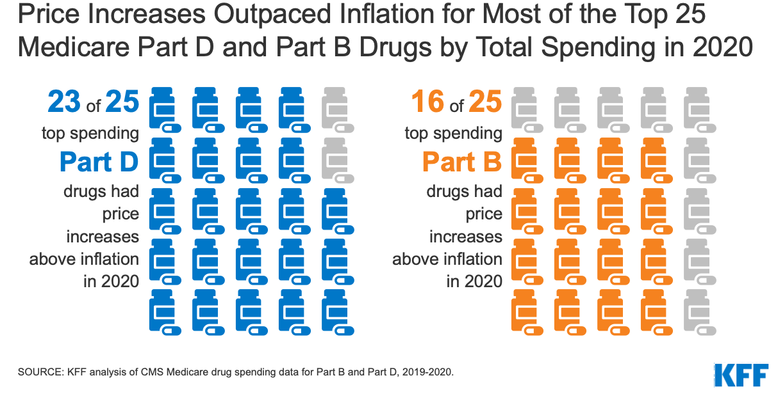

Slide 34
Shared Beliefs & Principles to Address Rising Costs
Clinical decision-making must be driven by evidence.
Payers, manufacturers, and the health care system want to see therapies used appropriately.
Need to put resources behind interventions that demonstrate value.
Dialogue among stakeholders is essential.

Slide 35
Proposed Solutions to Address the Rising Cost of Pharmaceuticals
Value for outcomes
Enhanced approach to coverage decisions
Competition to lower costs

Slide 36
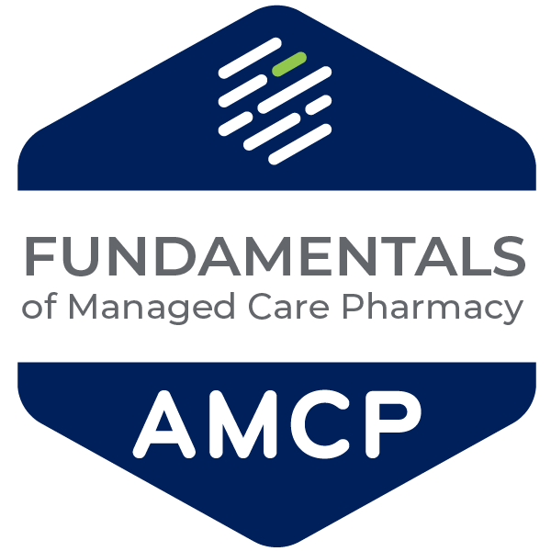
Want To Learn More?
Go to AMCPlearn.org

Slide 37


Keeping the Patient Needs Front & Center
That’s the Vision we Share as Managed Care Pharmacy Professionals
Notes:
What is important always in managed care pharmacy

Slide 38
About AMCP
Notes:
Including so they can see some of the issues that managed care pharmacy is addressing

Slide 39
Notes:
And since our founding, AMCP continues to be the hub for health plans, manufacturers, PBMs, and other health care decision makers to catalyze meaningful conversation and create actionable solutions to get patients the medications they need at a cost they can afford.
This is an important niche health care profession.
AMCP’s diverse membership of pharmacists, physicians, nurses, biopharmaceutical professionals, and other stakeholders leverage their specialized expertise in clinical evidence and economics to optimize benefit of medicines, population health management, and patient access to cost-effective, safe medications.
And student pharmacists are in important part of our membership as we build the pipeline for the next generation. AMCP offers many opportunities for you to learn more about managed care pharmacy as well as how to launch your career.
AMCP supports university chapters across the country for you to join, network, and learn

Slide 40
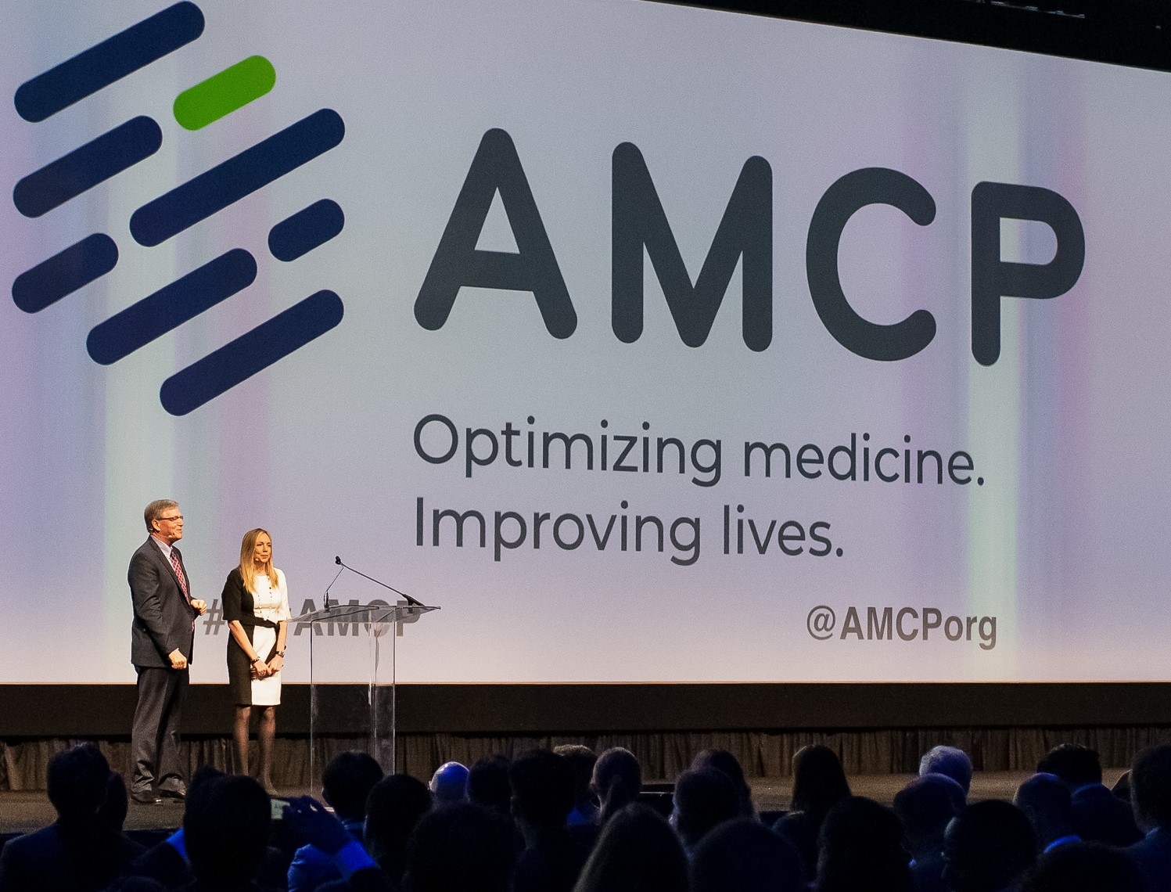
AMCP members manage medication therapies for 300 million Americans
  8,000 members
  80+ AMCP Student Chapters
Education, Networking, Advocacy, & More

Slide 41

Strategic Priorities
Notes:
As a student member of AMCP there are so many great resources grow your career and innovate the future of managed care.
From student pharmacist-specific programming at national meetings (including the popular conference buddy program!) to an exclusive student online community to discounts on national meetings and other learning opportunities, AMCP offers a range of meaningful resources for you.
We even have a special online resource center designed for students.

Slide 42
AMCP Student Pharmacist Membership

Slide 43

Notes:
As a student member of AMCP there are so many great resources grow your career and innovate the future of managed care.
From student pharmacist-specific programming at national meetings (including the popular conference buddy program!) to an exclusive student online community to discounts on national meetings and other learning opportunities, AMCP offers a range of meaningful resources for you.
We even have a special online resource center designed for students.

Slide 44

Student Member Opportunities
Network
At events hosted by AMCP Regional Affiliates
Serve
As a Chapter Leader
Participate
In the prestigious National P&T competition
Notes:
Plenty of opportunities to get involved at a local, student chapter level. In particular, the national AMCP Foundation P&T competition offers students a great opportunity to learn how to apply the P&T committee decision-making process and create a monograph.
If your university don’t have a chapter – contact AMCP about forming one.
There are even more opportunities.

Slide 45
Get Involved!
Attend | Find | Apply
A National Meeting: Spring Annual Meeting & Fall AMCP Nexus NEXUS2022: Managed Care Pharmacy Residency & Fellowship Showcase to find post-graduate training opportunities. | A Mentor: Through our Conference Buddy Program or Mock Interview program | For an AMCP: Foundation Internship National AMPC Committee
Notes:
Best way to take advantage of your membership

Slide 46

Networking
Notes:
Of course, one of the best ways to take advantage of your membership is to network!
AMCP Collaborate is the exclusive online community where you can connect with students from around the country
Relationships with conference buddies, school diplomats, and other professionals
Mock interview programs give you feedback from professionals to polish your brand

Slide 47
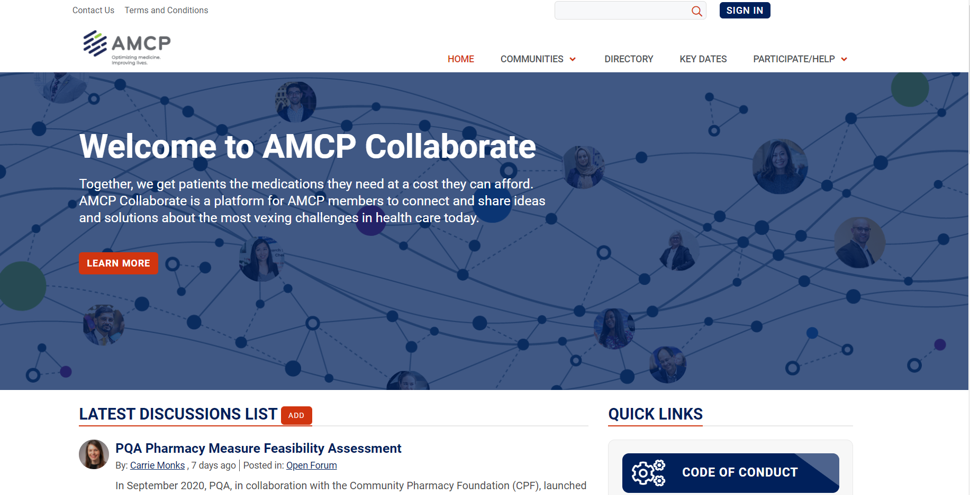
Notes:
Highlight that there is a Student Open Forum that is exclusively for AMCP student pharmacist members!

Slide 48
Managed Care Residencies & Fellowships
Residency
Fellowship
Year long post-PharmD intensive learning and skills-building experience in a managed care pharmacy environment.
To be accredited by ASHP, the program must meet standards that are developed by the Commission on Credentialing with input from AMCP members.
Typically, research-based and typically two years in length.
Sometimes completed after a PGY1 and/or PGY2 residency (or instead of one).
amcp.org/residents-fellows
Notes:
You're approaching the end of pharmacy school and made the decision to pursue a career in managed care pharmacy - what's next? Many choose to pursue a managed care residency or fellowship. AMCP has the tools you need to explore your options and find the best fit for you. ​
Accredited Residencies​
Non-Accredited Residencies​
Fellowships​
How to Start a Residency​
Tips on Applying for a Residency or Fellowship​
​
It’s important to understand some key differences between the two types of post graduate training as their timelines vary. ​
​

Slide 49


amcpmeetings.org
Notes:
AMCP hosts two meetings each year – both with unique programming for students.
AMCP Nexus includes the Residency and Fellowship Showcase
AMCP 2023 includes the Chapter Leadership Academy and the AMCP Foundation P&T Competition.

Slide 50
Notes:
AMCP’s Affiliates are another way to get involved at the local level. They all have their own events and volunteer opportunities.

Slide 51
Questions
Additional Resources:
www.amcp.org/What_is_MCP?

Slide 52
Notes:
Encourage to belong and to connect with us via social media.

