Slide 1
Treatment Guidelines and Disease State Management
Created by the School of Pharmacy Relations Committee for AMCP
Updated: March 2022

Slide 2
Objectives
Obtain a general understanding of treatment guidelines and disease state management
Understand the benefits of treatment guidelines in health care
Describe the value of disease state management programs

Slide 3
Potential Benefits of Treatment Guidelines
Disease-specific standards
Improve health care provider decision-making
Ensure consistency in medical practice and conform with evidence-based medicine
Ensure quality of care
Control health care costs
Notes:
Treatment guidelines are considered “best practices.”

Slide 4
Disease State Management
…A comprehensive, integrated approach to care and reimbursement based on the natural course of a disease, with treatment designed to address an illness with maximum effectiveness and efficiency.
Zitter M. The Genesis Report®/MCx. February 1995;1(3):12-13.
Notes:
DSM provides important medical information to both members and health care providers. It serves to educate members about their condition and provide them measures to improve their quality of life.
Physicians benefit from the program, as their patients take on a more active role in their health. Together, they are able to make informed medical decisions.

Slide 5
Disease State Management Programs
Focus on specific conditions as separate entities
Primarily focus on chronic disease states
Utilize patient data, provide monitoring systems and feedback mechanisms
Goals
Improve patient outcomes
Reduce health care costs
Notes:
Chronic disease states are targeted for DSM, as these are the conditions for which a greater impact can be attained. In addition, outcomes analysis (health and cost) is possible by tracking members, once they start a DSM program.

Slide 6
Disease Selection Criteria
Total cost of disease state
Disease prevalence
Whether the disease can be defined by specific criteria (i.e. not overlapping with other diseases)
Whether there is a treatment or possible intervention for the disease
Whether there are opportunities to improve management of the disease
Academy of Managed Care Pharmacy. A Pharmacist’s Guide to Principles and Practices of Managed Care Pharmacy. 1995.

Slide 7
Examples of Disease State Management Programs
Asthma
Diabetes
Depression
Hypertension
Heart failure

Slide 8
Program Development
Disease state management programs are often based on treatment guidelines (clinical practice guidelines, protocols, algorithms, critical pathways, care maps)
Consensus groups and statements also considered
Key program components
Patient identification
Intervention protocols
Outcomes management
Notes:
Clinical content for DSM programs are based on a variety of resources.

Slide 9
Clinical Practice Guidelines
Disease State | Performance Measure | Reference/Guidelines
Diabetes | A1c <7% BP <140/90 or <130/80 mm HG based on CV risk On statin | ADA Standards of Care
CAD | On antiplatelet On beta-blocker On ACEI/ARB On statin | ACC/AHA
Heart Failure | On ACEI/ARB/ARNI On beta-blocker | ACC/AHA
Hypertension | BP <130/80 mm Hg, SBP <130 for older persons* BP <140/90 mm Hg, <150/80 for older persons** | *ACC/AHA **JNC-8
Hyperlipidemia | Statin benefit groups | ACC/AHA

Slide 10
Clinical Practice Guidelines
GRADE or LEVEL | Literature Used to Support Grading | Interpretation
GRADE A / Level 1 | Well conducted randomized controlled clinical trials (RCTs) | Benefit >>> Risk Is recommended Is beneficial
GRADE B / Level 2 | Post hoc or subgroup analysis of RCTs, or meta-analysis of RCTs | Benefit >> Risk Is probably recommended Can be beneficial
GRADE C or D / Level 3 or 4 | Observational studies or clinical trial with a few major limitations | Benefit > Risk May be reasonable Effectiveness is not well established
GRADE E / Level 5 | Expert consensus or clinical practice experience | Risk > Benefit Not recommended Is not beneficial May be harmful

Slide 11
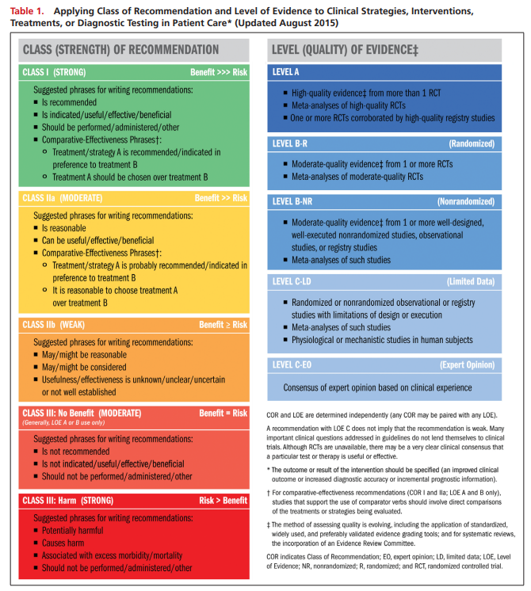
Example Levels of Evidence Per ACC/AHA

Slide 12
Impact on Healthcare
Improvement of overall health care
Increase in short-term health care costs
Higher prescription drug utilization
Higher number of office visits
Higher number of laboratory tests
Reduction of long-term medical costs
Avoidance of emergency room visits
Avoidance of hospitalizations

Slide 13
Adherence to Clinical Practice Guidelines – DSM vs. DRR
LTC facilities w/ DSM (107 pts) vs. traditional drug regimen review (DRR) (304 pts)
Adherence to Clinical Practice Guidelines statistically improved in DSM vs. DRR:
DM – HgbA1c* < 7% (86.2% vs. 62%), antiplatelet tx* (89.7% vs. 71%)
CAD – ASA/clopidogrel (88.2% vs. 56.1%), ACEI/ARB (82.4% vs. 40.9%)
HF – ACEI/ARB (73.3% vs. 44.9%)
Osteoporosis – Calcium tx (85% vs. 56.3%)
No statistical difference between groups in stroke, HTN, hyperlipidemia guideline adherence
KK Horning, et al. JMCP 2007;13(1):28-36.
*guideline has been updated since the publication of this study

Slide 14
Important to Remember…
To critically evaluate literature
When limited data or low-level evidence is available for patient population
One study of infectious disease guidelines showed that 47.1% strong recommendations were supported by low or very low-quality evidence
To critically evaluate resources available to patients
Patient self-management using internet search, mobile apps
One study showed that of 69 depression and suicide prevention mobile applications, only 5 offered all six evidence based suicide prevention strategies. Six apps also contained erroneous crisis helpline numbers.
It is important to direct patients towards reputable resources if they plan to gather information on their own (e.g, CDC, organizations like the American Heart Association or American Diabetes Association, medical journals like JAMA)
Notes:
Miles KE, et al. Strength of Recommendation and Quality of Evidence for Recommendations in Current Infectious Diseases Society of America Guidelines, Open Forum Infectious Diseases. 2021:8(2);ofab033. https://doi.org/10.1093/ofid/ofab033
Martinengo, L., Van Galen, L., Lum, E. et al. Suicide prevention and depression apps’ suicide risk assessment and management: a systematic assessment of adherence to clinical guidelines. BMC Med 17, 231 (2019). https://doi.org/10.1186/s12916-019-1461-z
Other links of interest:
Burns KEA, Laird M, Stevenson J, et al. Adherence of Clinical Practice Guidelines for Pharmacologic Treatments of Hospitalized Patients With COVID-19 to Trustworthy Standards: A Systematic Review. JAMA Netw Open. 2021;4(12):e2136263. doi:10.1001/jamanetworkopen.2021.36263
Guharoy V. ClinicalTrials.Gov: Is the Glass Half Full? Hosp Pharm 2014;49(10):893–895.
Poonacha TK, Go RS. Level of Scientific Evidence Underlying Recommendations Arising From the National Comprehensive Cancer Network Clinical Practice Guidelines. J Clin Oncol. 2011;29(2):186-191.
https://www.mayoclinicproceedings.org/article/S0025-6196(17)30025-3/pdf

Slide 15
Summary
Treatment guidelines help providers maintain consistency and quality of care
Guidelines should serve as a guide
One size does not fit all
Individualized patient care plans may require analysis and balance of multiple guidelines
Disease state management programs
Based on treatment guidelines
Help improve patient outcomes
Help reduce overall health care costs

Slide 16
References
1. RS Hadsal, LJ Sargent. Disease State Management. JMCP 1995;1(2):128-133.
2. M Zitter. The Genesis Report®/MCx. February 1995;1(3):12-13.
3. Academy of Managed Care Pharmacy. A Pharmacist’s Guide to Principles and Practices of Managed Care Pharmacy. 1995.
4. American Diabetes Association; Summary of Revisions: Standards of Medical Care in Diabetes—2021. Diabetes Care 1 January 2021; 44 (Supplement_1): S4–S6.
5. National Diabetes Quality Improvement Alliance. National Diabetes Quality Improvement Alliance performance measurement set for adult diabetes. Approved January 21, 2005. Available at: www.nationaldiabetesalliance.org . Accessed November 7, 2007.
6. DK Arnett, et al. 2019 ACC/AHA Guideline on the Primary Prevention of Cardiovascular Disease: A Report of the American College of Cardiology/American Heart Association Task Force on Clinical Practice Guidelines. Circulation. 2019;140:e596–e646
7. CW Yancy, et al. 2017 ACC/AHA/HFSA Focused Update of the 2013 ACCF/AHA Guideline for the Management of Heart Failure: A Report of the American College of Cardiology/American Heart Association Task Force on Clinical Practice Guidelines and the Heart Failure Society of America. Circulation. 2017;136:e137–e161
8. PK Whelton, et al. 2017 ACC/AHA/AAPA/ABC/ACPM/AGS/APhA/ASH/ASPC/NMA/PCNA Guideline for the Prevention, Detection, Evaluation, and Management of High Blood Pressure in Adults: A Report of the American College of Cardiology/American Heart Association Task Force on Clinical Practice Guidelines. J Am Coll Cardiol 2018;71:e127-e248.

Slide 17
References
9. AV Chobanian, et al. Seventh report on the joint national committee on prevention, detection, evaluation, and treatment of high blood pressure. Hypertension. 2003;42:1206-52.
10. SM Grundy, et al. 2018 AHA/ACC/AACVPR/AAPA/ABC/ACPM/ADA/AGS/APhA/ASPC/NLA/PCNA Guideline on the Management of Blood Cholesterol: A Report of the American College of Cardiology/American Heart Association Task Force on Clinical Practice Guidelines. Circulation. 2019;139:e1082–e1143
11. SM Grundy, JI Cleeman, CM Merz. Implications of recent clinical trials for the national cholesterol education program adult treatment panel III guidelines. Circulation. 2004;110:227-39.
13. KK Horning, et al. Adherence to clinical practice guidelines for 7 chronic conditions in long-term-care patients who received pharmacist disease management services versus traditional drug regimen review. JMCP 2007;13(1):28-36.
14. Miles KE, et al. Strength of Recommendation and Quality of Evidence for Recommendations in Current Infectious Diseases Society of America Guidelines, Open Forum Infectious Diseases. 2021:8(2);ofab033. https://doi.org/10.1093/ofid/ofab033
15. Martinengo, L., Van Galen, L., Lum, E. et al. Suicide prevention and depression apps’ suicide risk assessment and management: a systematic assessment of adherence to clinical guidelines. BMC Med 17, 231 (2019). https://doi.org/10.1186/s12916-019-1461-z

Slide 18
Mission & Vision
To improve patient health by ensuring access to
high-quality, cost-effective medications and other therapies.

Slide 19
Thank you to AMCP SOPRC members for updating this presentation for 2022.

