Slide 1
Personalized Medicine & Pharmacogenomics
Created by the School of Pharmacy Relations Committee for AMCP
Updated: March 2022

Slide 2
Objectives
Define the various terms associated with pharmacogenomics & personalized medicine
Discuss the genetic basis of personalized medicine
Discuss the possible patient benefits and limitations of personalized medicine
Provide examples of specific medications and associated pharmacogenomic considerations

Slide 3
“Doctors have always recognized that every patient is unique, and doctors have always tried to tailor their treatments as best they can to individuals. You can match a blood transfusion to a blood type — that was an important discovery. What if matching a cancer cure to our genetic code was just as easy, just as standard? What if figuring out the right dose of medicine was as simple as taking our temperature?” -- President Barack Obama, January 30, 2015

Slide 4
Precision Medicine Initiative (PMI)
Launched by President Obama in January 2015
A new research effort to revolutionize how we improve health and treat disease and empower health care providers to tailor treatment and prevention strategies to individuals’ unique characteristics
Goals
Make health data more portable
Ensure patients can easily access and share their own health information, including contributing it for research
Rigorously protect patient privacy, security and choice
Support new research platforms connecting researcher and participants as partners
The White House – President Barack Obama. The Precision Medicine Initiative. 2015. https://obamawhitehouse.archives.gov/precision-medicine. Accessed December 2021.
Notes:
Most medical treatments are designed for the “average patient ” as “one-size-fits-all-approach,” that is successful for some patients but not for others. Precision medicine, sometimes known as "personalized medicine" is an innovative approach to disease prevention and treatment that takes into account differences in people’s genes, environments and lifestyles.

Slide 5
Pharmacogenomics
AMCP defines pharmacogenomics as the intersection of pharmacology and genetics which studies how an individual’s inherited variations in genes affects the body’s response to medications and may be used to predict future response to therapy.
This helps to guide optimal drug selection and dosing, improving treatment efficacy and decreasing patient adverse reactions.
AMCP website. Pharmacogenomics. http://www.amcp.org/pharmacogenomics/ Accessed December 2021.
Notes:
Per FDA Report:
Pharmacogenomics (PGx), the study of variations of DNA and RNA characteristics as related to drug response, is one of the most exciting areas of personalized medicine today. The field arises from the convergence of advances in pharmacology (the science of drugs) and genomics (the study of genes and their functions). Patients typically have variability in response to many drugs that are currently available. It can be difficult to predict who will benefit from a medication, who will not respond at all, and who will experience adverse effects. PGx seeks to understand how differences in genes and their expression affect the body’s response to medications. More specifically, PGx uses genetic information (such as DNA sequence, gene expression, and copy number) for purposes of explaining interindividual differences in drug metabolism (pharmacokinetics) and physiological drug response (pharmacodynamics), identifying responders and non-responders to a drug, and predicting the efficacy and/or toxicity of a drug. Advances in PGx have opened new possibilities in drug discovery and development. PGx has allowed for more tailored treatment of a wide range of health problems, including cardiovascular disease, cancer, and HIV/AIDS. FDA’s Center for Drug Evaluation and Research (CDER) has supported pharmacogenomics for more than a decade by providing regulatory advice, reviewing applications, and developing policies and processes centered on genomics and individualized therapeutics.

Slide 6
Personalized Medicine (PM) Defined
President’s Council of Advisors on Science and Technology defines PM as “the tailoring of medical treatment to the specific characteristics of each patient.[It]does not literally mean the creation of drugs or medical devices that are unique to a patient. Rather, it involves the ability to classify individuals into subpopulations that are uniquely or disproportionately susceptible to a particular disease or responsive to a specific treatment.”¹
The National Cancer Institute defines PM as “a form of medicine that uses information about a person’s genes, proteins, and environment to prevent, diagnose, and treat disease.”²
President’s Council of Advisors on Science and Technology. Priorities for Personalized Medicine. President’s Council of Advisors on Science and Technology, 2008.
National Cancer Institute. Personalized medicine In NCI Dictionary of Cancer Terms. https://www.cancer.gov/publications/dictionaries/cancer-terms/def/personalized-medicine. Accessed December 2021.

Slide 7
Associated Definitions
Genomics – The study of the entire set of genetic instructions found in a cell (DNA)
Pharmacogenomics (PGx) – The study of how genetic variation affects drug response.
Pharmacogenetics (PGt) – The study of the relationship between variations in a gene and the variability in drug response, toxicity, absorption, distribution, and metabolism.

Slide 8
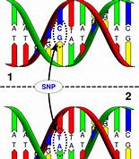
Single Nucleotide Polymorphisms (SNPs)
Single nucleotide polymorphisms (SNPs) are the most common type of genetic variation in humans
A single nucleotide is substituted with a different nucleotide in the genetic sequence
Different SNP expressions may modify a drug’s therapeutic response or adverse effect incidence
Courtesy: National Human Genome Research Institute. http://www.genome.gov/10000533.
www.snipscreen.com/genetics.php

Slide 9
Personalized Medicine Mechanics
Natural variations (DNA polymorphisms) play a role in our risk of getting or not getting certain diseases
External factors such as environment, diet, and exercise, along with polymorphisms can also determine an individual’s risk for disease
Natural genetic variations can, in part, determine drug efficacy. Variations in DNA can lead to differences in pharmacodynamics and pharmacokinetics (metabolism) in the individual patient
This ties in with metabolic phenotype.
Based on the patient’s individual genetic expression, biomarkers and DNA microarrays can help detect the best medication for the patient.
http://www.personalizedmedicinecoalition.org/about/about-personalized-medicine/personalized-medicine-101/science.

Slide 10
Metabolic Phenotype
Ultrarapid Metabolizer (UM)
Breaks down medications rapidly May require higher doses, OR for prodructs activated by metabolism, lower doses
Extensive Metabolizer (EM)
Breaks down medications normally Tolerates normal dosing
Intermediate Metabolizer (IM)
Breaks down medications slowly May require lower doses, OR for prodrugs activated by metabolism, higher doses
Poor Metabolizer (PM)
Breaks down medications very slowly Alternative medications should be considered

Slide 11
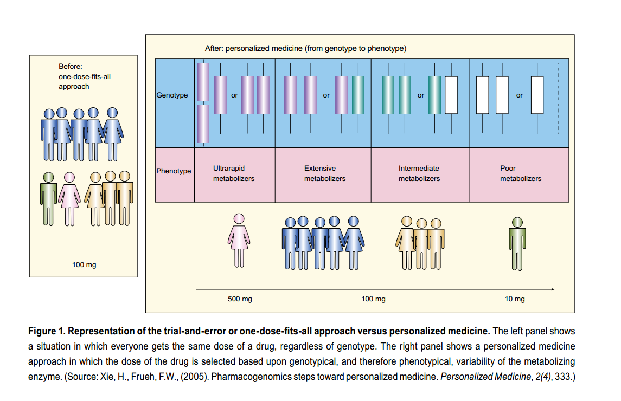
Changing the Medical Diagnostic Paradigm
Notes:
Traditional medicine has focused on an assumed diagnosis and utilization of medications that have been shown efficacious in the clinical trial environment
Trial and error doses exists in finding the “correct” medication for the patient., i.e., various nonsteroidal anti-inflammatory agents for the treatment of osteoarthritis
The most effective (performance of a drug in a real world environment) agent may not always be utilized first increasing cost of treatment and possibly exposing the patient to drug adverse effects
How do Genes Influence Medication Response? The Human Genome Project has estimated that humans have between 20,000 and 25,000 genes. Genetic variations can affect an individuals respond to therapy and efficacy and safety can be adversely affected by these variations.

Slide 12
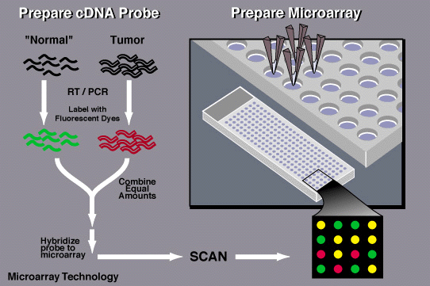
DNA Microarray Technology
Notes:
“DNA microarrays arrange minuscule amounts of hundreds or thousands of gene sequences on a single microscope slide”
The resulting product is known as messenger RNA (mRNA), which is the body's template for creating proteins
To determine which genes are turned on and which are turned off in a given cell, messenger RNA molecules are collected and a scanner is used to measure the fluorescent intensity for each spot/areas on the microarray slide
“If a particular gene is very active, it produces many molecules of messenger RNA, thus, more labeled cDNAs, which hybridize to the DNA on the microarray slide and generate a very bright fluorescent area”

Slide 13
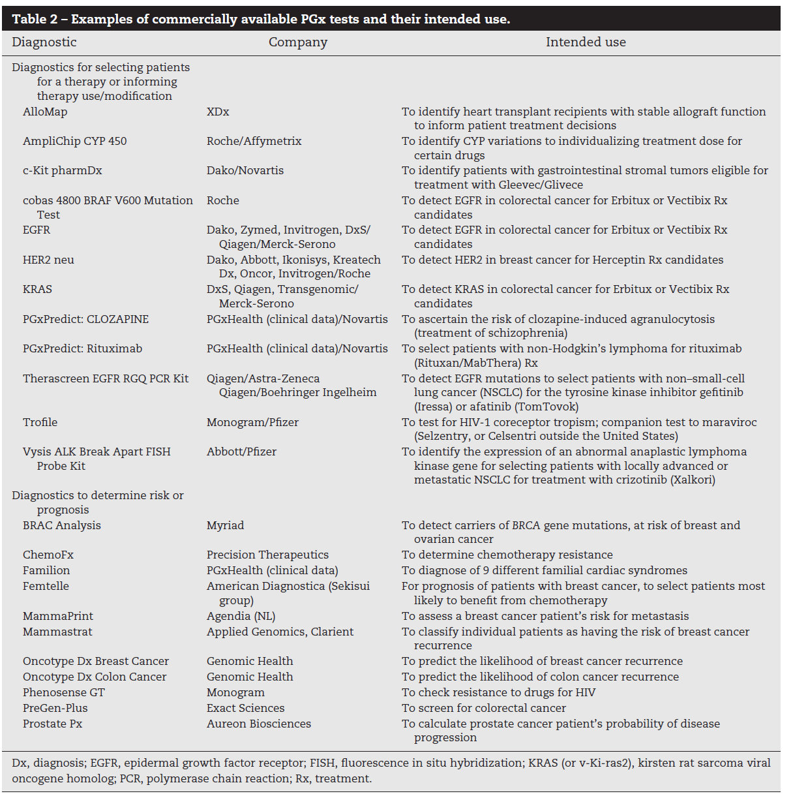
Commercially Available Pharmacogenetic Tests
Faulkner E, et al. Value Health;2012;15(8):1162-1171.

Slide 14
Potential Benefits of Personalized Medicine
Prescribe more safe and effective drugs and avoid prescribing drugs with predictable side effects
Shift the emphasis in medicine from reaction to prevention
Predict disease susceptibility, improve disease detection, preempt disease progression
Customize disease-prevention strategies
Increase patient adherence to treatment by targeting the right patient with the right drug
Improve quality of life
Reduce the time, cost, and failure rate of pharmaceutical clinical trials
Revive drugs that failed in clinical trials or were withdrawn from the market
Control health care cost by avoiding drugs in clinical situations where it’s been proven ineffective
http://genetichealth.jax.org/personalized-medicine/what-is/benefits.html

Slide 15
Societal Impact of Personalized Medicine
Potential legal and ethical questions that we must answer as a society
Who should have access to a person’s genetic profile?
How will we protect genetic privacy and prevent genetic discrimination in the workplace and in our health care?
How will we as consumers use genetic information to our benefit?
http://genetichealth.jax.org/personalized-medicine/what-is/benefits.html

Slide 16
Limitations of Personalized Medicine
Reimbursement pathway of testing not established
Ethical issues with genetic testing and data sharing
Integration of pharmacogenomics, personalized medicine, and the payer and regulatory environment is still ongoing
Clinician are generally not educated concerning available tests, associate drugs, and outcomes
The response to a medication may be a result of the interactions of multiple genes
Towse A, et al. Value Health.2013;16:S39-43. Towse A, et al. Value Health.2013;16:S39-43.

Slide 17
Pharmacogenomic Biomarkers in Drug Labeling
Pharmacogenomics can play an important role in identifying responders and non-responders to medications, avoiding adverse events, and optimizing drug dose.
Drug labeling may contain information on genomic biomarkers and can describe:
Drug exposure and clinical response variability
Risk for adverse events
Genotype-specific dosing
Mechanisms of drug action
Polymorphic drug target and disposition genes

Slide 18
FDA Novel Drug Approvals
Over the past decade, over 400 novel drugs have been approved by the FDA. The proportion of new drug approvals with pharmacogenomic (PGx) information within the drug labeling has increased substantially, from 10.3 % (3 drugs) in 2000 to 28.2% (11 drugs) in 2020.
Cancer therapies hold the highest proportion of biomarker-drug pairs that require PGx testing (75.5%).
Examples of drugs with PGx information in their labeling:
Orkambi (lumacaftor-ivacaftor) for cystic fibrosis, 2015
Vizimpro (dacomitinib) for lung cancer, 2018
Evkeeza (evinacumab) for hypercholesterolemia, 2021
FDA. Precision Medicine. September 2018. https://www.fda.gov/medical-devices/in-vitro-diagnostics/precision-medicine Accessed December 2021.
Kim JA, Ceccarelli R, Lu CY. Pharmacogenomic Biomarkers in US FDA-Approved Drug Labels (2000-2020). J Pers Med. 2021;11(3):179. Published 2021 Mar 4. doi:10.3390/jpm11030179

Slide 19
Abacavir (Ziagen)
Nucleoside analog reverse transcriptase inhibitor (NRTI) used to treat HIV and AIDS first approved in 1998
Subsequent studies showed that patients who carry the HLA-B*5701 allele were at high risk for hypersensitivity to abacavir due to this allele being strongly associated with a single-nucleotide polymorphism at the HLA-B*5701 locus
The label was changed to recommended pre-therapy screening for the HLA-B*5701 allele and the use of alternative therapy in subjects with this allele.
Clinicians can now safely prescribe abacavir for the right patient and the incidence of these reactions has diminished worldwide.

Slide 20
Carbamazepine (Tegretol)
Genetic variants have been associated with two forms of life-threatening skin conditions (Stevens-Johnson syndrome and toxic epidermal necrolysis) experienced by carbamazepine patients.
In particular, two HLA-related variants (HLAB*1502 in Asian populations and HLA-A* 3101 in Caucasians populations) are more likely than other patients to have dangerous skin reactions
Testing of this allele can reduce the frequency of these reactions

Slide 21
Codeine
Patients with two or more copies of the variant CYP2D6*2 allele may have extensive conversion of codeine to morphine. Increased levels of morphine increases analgesic effects.
These patients are classified as “ultrarapid metabolizers”.
This phenotype is seen in 16 to 28% of North African, Ethiopian, and Arab patients.
Codeine should be avoided in this population to avoid serious toxicity, and an alternative opioid should be used.
Also, if a patient is a poor metabolizer, codeine should be avoided as the patient will have decreased analgesic effects due to the minimal conversion of codeine to active morphine.
CYP2D6 testing in pain management can improve patient response and decrease risk for toxicity.

Slide 22
Trastuzumab (Herceptin)
Human Epidermal Growth Factor 2 (HER-2) positive tumors comprise 20-25% of all breast cancers and are associated with worse clinical outcomes
Trastuzumab is a humanized monoclonal antibody designed to target the HER2 receptor domain
Today, HER2 testing is a routine part of clinical diagnosis for breast cancer patients
Likewise, due to specific biomarker data, trastuzumab is a foundation therapy for many patients with HER-2 positive breast cancer
Slamon et al., Science 1987;235:177-82; 2. Saini KS et al., Breast. 2011 Oct;20 Suppl 3:S20-7.

Slide 23
Warfarin (Coumadin, Jantoven)
Warfarin has a narrow therapeutic window and a wide range of inter-individual variability in response, requiring careful clinical dose adjustment for each patient.
In 2007, FDA approved label changes to warfarin noting precautions for patients with variations in two genes, CYP2C9 and Vitamin K Epoxide Reductase Complex-1 (VKORC1) which may require a lower initial dose.
Testing for these variants can assist in dosing
Individualized dosing can possibly increase effectiveness of therapy while decreasing the risk of adverse events

Slide 24
FDA Approvals with Companion Diagnostics
Vemurafenib/BRAF V600E: In August 2011, FDA simultaneously approved the drug vemurafenib (Zelboraf) along with its companion diagnostic, the Cobas 4800 BRAF V600E mutation test, for use in treating metastatic or unresectable melanoma. Vemurafenib works by inhibiting the BRAF V600E mutation that is found in approximately 50% of melanoma patients. Melanomas that lack the mutation are not inhibited by the drug. The combination of drug and its diagnostic resulted in an accelerated development of the drug, facilitated a successful regulatory review, and led to an improved therapeutic profile. Vemurafenib was approved by FDA in near record time (3.6 months) through an expedited process.
Crizotinib/ALK testing: Also in August 2011, FDA approved crizotinib (Xalkori), a drug along with an ALK FISH probe companion diagnostic for the treatment of non-small cell lung cancer. Crizotinib targets tumors with an abnormal ALK gene, which occurs in approximately 5% of non-small cell lung cancer patients. Crizotinib’s safety and effectiveness was established through a clinical trial involving only 255 patients, and the approval process for the drug and its associated test took only 4.9 months, well below average review times for priority drugs.

Slide 25
Example: Cystic Fibrosis
Incorporation of pharmacogenomics to approval criteria
Ivacaftor (Kalydeco)
Appropriate diagnosis [cystic fibrosis with G551D, G1244E, G1349D, G178R, G551S, S1251N, S1255P, S549N, S549R and R117H mutation]
Age is ≥ 2 years of age
One of the following:
Request does not exceed 60 tablets or packets/30 days
Prescriber provides medical necessity for requesting over the recommended dose/day
Notes:
Kalydeco® (ivacaftor) was originally approved by the Food and Drug Administration (FDA) on January 31, 2012, for the treatment of CF in patients six years of age and older with a G551D mutation in the CFTR gene.⁵ Soon after, it also received approval for the following mutations in the CFTR gene: G1244E, G1349D, G178R, G551S, S1251N, S1255P, S549N, or S549R. On December 29, 2014, the FDA followed up with an approval for its use in CF patients six years of age and older with a R117H mutation.
Kalydeco® (ivacaftor) is the first therapy that appears to restore the functioning of a mutant CF protein.^{9,10} In patients with these mutations, the CFTR protein is located at the proper place on the cell surface but does not function correctly, inhibiting normal cellular flow of salt and fluid.

Slide 26
Resources for More Information
Personalized Medicine Coalition. http://www.personalizedmedicinecoalition.org/
National Human Genome Research Institute. http://www.genome.gov/
U.S. Food and Drug Administration. https://www.fda.gov/medical-devices/in-vitro-diagnostics/precision-medicine
National Institute of General Medical Sciences https://www.nigms.nih.gov/education/fact-sheets/Pages/pharmacogenomics.aspx
NIH: Pharmacogenomics Knowledge Base http://www.pharmgkb.org/
FDA Table of approved valid genomic biomarkers http://www.fda.gov/drugs/scienceresearch/researchareas/pharmacogenetics/ucm083378.htm
AMCP Format for Formulary Submission https://www.amcp.org/format-formulary-submissions

Slide 27
Mission & Vision
To improve patient health by ensuring access to
high-quality, cost-effective medications and other therapies.

Slide 28
Thank you to AMCP SOPRC members for updating this presentation for 2022.

