Slide 1
AMCP Faculty Advisor Webinar
Thursday, September 15, 2022

Slide 2
AMCP Antitrust Statement
AMCP's policy is to comply fully and strictly with all federal and state antitrust laws. Meetings held under the auspices of the Academy must be conducted in a manner that avoids the fact or appearance of conduct that may violate the antitrust laws. Participants are not to discuss industry- wide or individual company prices (current or projected) or matters relating to pricing such as costs, profits, contractual terms and conductions (e.g., discounts, credit terms), wages/salaries, market allocation, market shares/sales or clients/customers. Please see www.amcp.org/antitrust for full statement.

Slide 3
Agenda
Welcome and Introductions
AMCP Overview
Member Benefits and Resources
SOPRC Role
Faculty Advisor Survey
AMCP Diplomat Program
P&T Competition
Open Discussion

Slide 4
Introductions
Sarah Hulvershorn, PharmD – Chair, Schools of Pharmacy Relations Committee
Kheelan Gopal, PharmD – Vice Chair, Schools of Pharmacy Relations Committee
Fatima Ali, PharmD – Task Lead, Schools of Pharmacy Relations Committee
Nasir Kaker, PharmD – School of Pharmacy Relations Committee
Zach Riley, AMCP Manager Student Pharmacist & New Practitioner Programs
Betty Whitaker, AMCP VP Membership & Meetings

Slide 5
Mission
To improve patient health by ensuring access to
high-quality, cost-effective medications and other therapies.
Notes:
We’re the people who help patients get the medications they need at a cost they can afford.

Slide 6
Notes:
AMCP is the professional society that connects these pharmacists, doctors, nurses, biopharmaceutical experts and others across the health care continuum… working to design a more effective and equitable health care system. And since our founding, AMCP continues to be the hub for health plans, manufacturers, PBMs, and other health care decision makers to catalyze meaningful conversation and create actionable solutions to get patients the medications they need at a cost they can afford.

Slide 7
About AMCP
8,000 members
Members manage medication therapies more than 250 million Americans
Networking, education, advocacy, and more
Notes:
National professional society of approximately 8,000 members made up of pharmacists and other health care professionals.
AMCP provides a wealth of information, education, networking, advocacy and more.
AMCP members manage medication therapies for nearly 300 million Americans served by health plans, PBM firms, emerging care models, and government.
Dedicated to increasing patient access to affordable medicines, improving health outcomes, ensuring the wise use of health care dollars.

Slide 8
Strategic Priorities - Title

Slide 9
School of Pharmacy Relations Committee (SOPRC)
Committee Mission: To raise faculty and student awareness of both AMCP and managed care pharmacy consistent with the mission of AMCP.
The Schools of Pharmacy Relations Committee provides guidance and expertise on the importance of managed care pharmacy to schools and colleges of pharmacy and oversees the AMCP Diplomat program.

Slide 10
Membership Overview
Betty Whitaker
AMCP VP Membership & Meetings

Slide 11
Membership Statistics
83 chapters
Average members: 25
Range: 1-140
23 schools of pharmacy with no chapter but members

Slide 12
Benefits and Resources
Nasir Kaker, PharmD
School of Pharmacy Relations Committee
Southern Scripts

Slide 13
Membership Benefits for Students
APPE rotations (Association and Leadership Management)
National leadership positions (AMCP’s Student Pharmacist Committee)
P&T Competition resources and support
Mentorship opportunities
AMCP Conference Buddy program
Mock Interview program
Mock residency/fellowship interviews (September through January)
Member-only webinars (variety of topics)
National Meetings (AMCP NEXUS and AMCP Annual)
Residency Showcase
Residency/Fellowship Database
APPE/IPPE Intern Database
Notes:
APPE rotation: Chance for students to see how a national pharmacy organization is managed with experiences in many different departments.

Slide 14
Chapter Recognition
Chapter Collaborate Program – matches up chapters with each other
Chapter of the Year Award – recognized at Nexus each year
Chapter Member of the Year Award – selected by each chapter
Graduation Cords – available for all AMCP members who meet the leadership criteria.
Notes:
-Chapter of the year award: requires an online submission by the student chapter. Deadline for 2022 was at the end of July, so keep it on the radar for next year
-Chapter member of the year award: Presented to the recipient in the spring of every year. To the member that has made outstanding contributions to their AMCP Student Pharmacist Chapter. There is an online nomination form that needs to be filled out. There is still time for this.

Slide 15
Explaining Managed Care Pharmacy Tools
“What is Managed Care Pharmacy”– amcp.org/What_is_MCP
Short overview video
“What is Managed Care Pharmacy?’ Webinar (Sept 28) and slides
Managed Care Glossary
Managed Care PowerPoints
Managed Care Pharmacy Careers
Fundamentals of Managed Care Pharmacy Certificate Course
Managed Care Pharmacy Curriculum
Notes:
We have several schools using Fundamentals of Managed Care Pharmacy in their programs – bulk discounts are available
Managed Care Pharmacy Curriculmn is being updated. Pdf

Slide 16
AMCP Resource Center

Slide 17
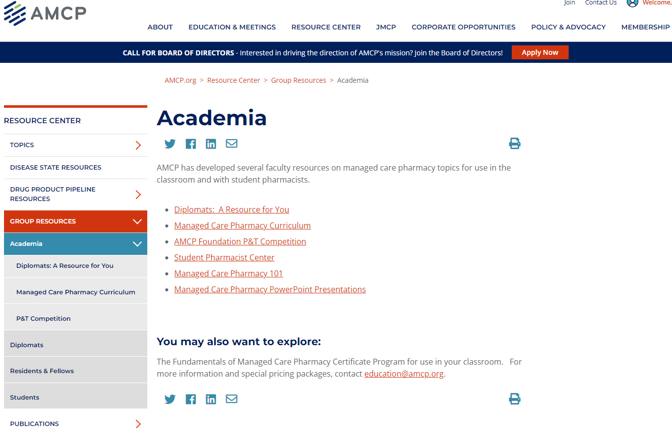
Academia Resources
Notes:
-You can find your chapters diplomat
-Learn more about the managed care pharmacy curriculum course that was developed to assist faculty
-Resources for the P&T competition
-Managed Care Pharmacy 101: Provides a broad overview of what managed care pharmacy is and the tools we use
-PPT Presentations: MC career paths, what is MC pharmacy, MTM, MC models, etc

Slide 18
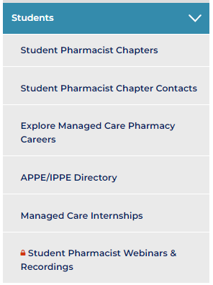
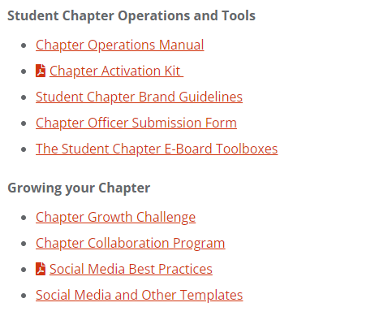
Student Pharmacist Center
Notes:
-Chapter operations manual: useful information on how to manage and grow your student-chapters
-Toolboxes: Toolboxes are intended to guide AMCP Student Chapter E-Boards on certain key topics that all Chapter leaders face
-Social media and other templates: provides many different types of AMCP logo templates

Slide 19
Faculty Advisor Survey
Purpose:
Understand faculty advisor views and opinions
Helps AMCP grow future pharmacists/pioneers of our profession
Topics covered
Faculty Advisor demographics
Managed care opportunities at your school
Managed care education opportunities at your school
Assistance that AMCP can give to you and your group
Deadline: September 23, 2022
Notes:
Survey was sent out on September 9th

Slide 20
Faculty Advisor In-Person Meeting at Nexus
Wednesday, October 12th (1:20 – 2:30 pm)
Notes:
-Part of our goal to have more regular touchpoints with the faculty. So definitely be sure to add this meeting on your calendar through the agenda section on your AMCP NEXUS app so you get the notification.

Slide 21
AMCP Diplomat Program
Kheelan Gopal, PharmD
Vice-Chair, School of Pharmacy Relations Committee
LEO Pharma

Slide 22
What is an AMCP Diplomat?
Diplomats are volunteer AMCP members who volunteer to work with a school/college of pharmacy as a managed care pharmacy resource for student pharmacists and faculty.
Raise faculty awareness of AMCP and managed care pharmacy
Expose student pharmacists to career opportunities in managed care pharmacy
Enhance communication between the Schools/Colleges of Pharmacy and local AMCP members
Notes:
Work with the school of pharmacy and student chapters - speak, participate in career fairs, etc.

Slide 23
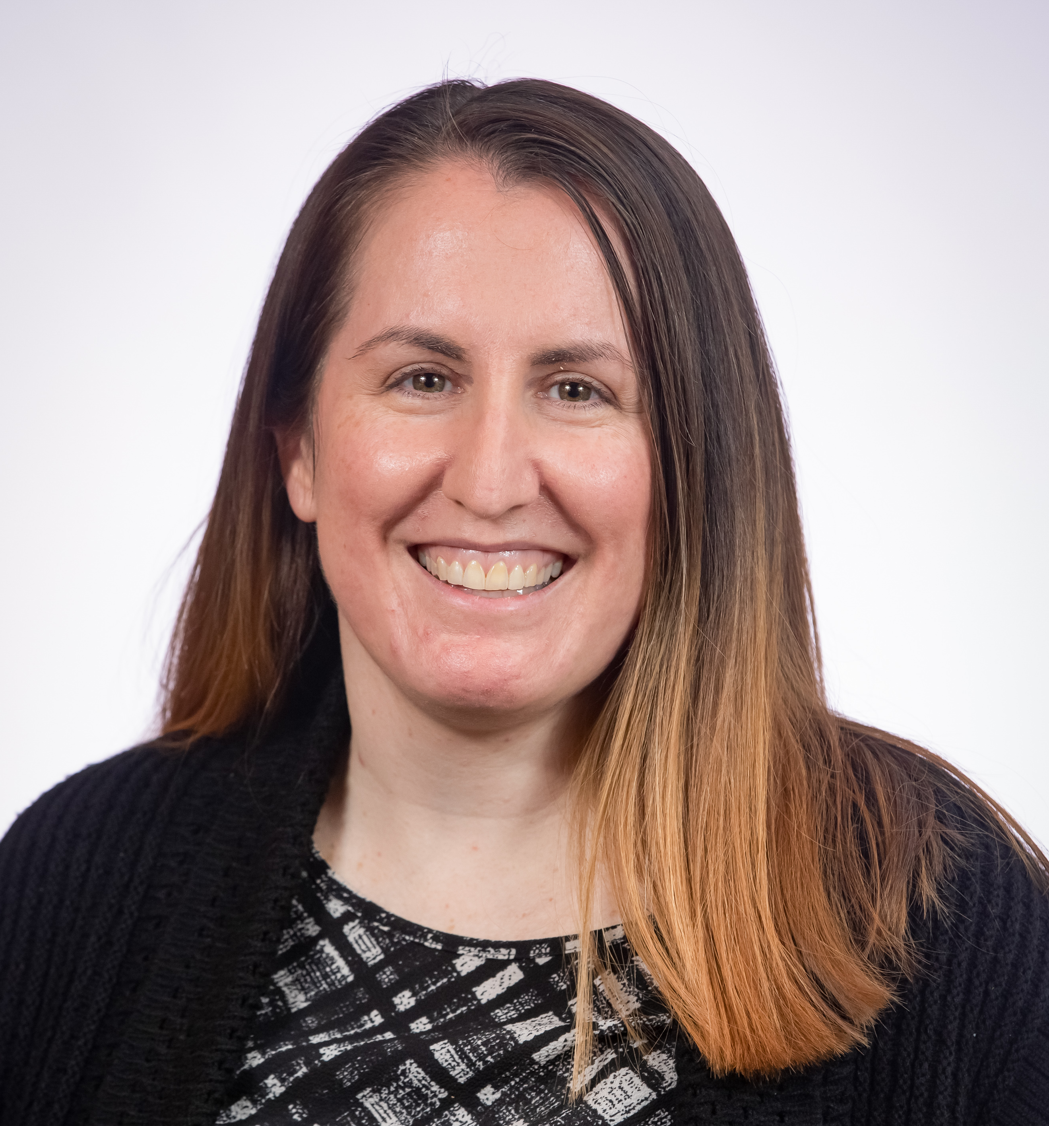
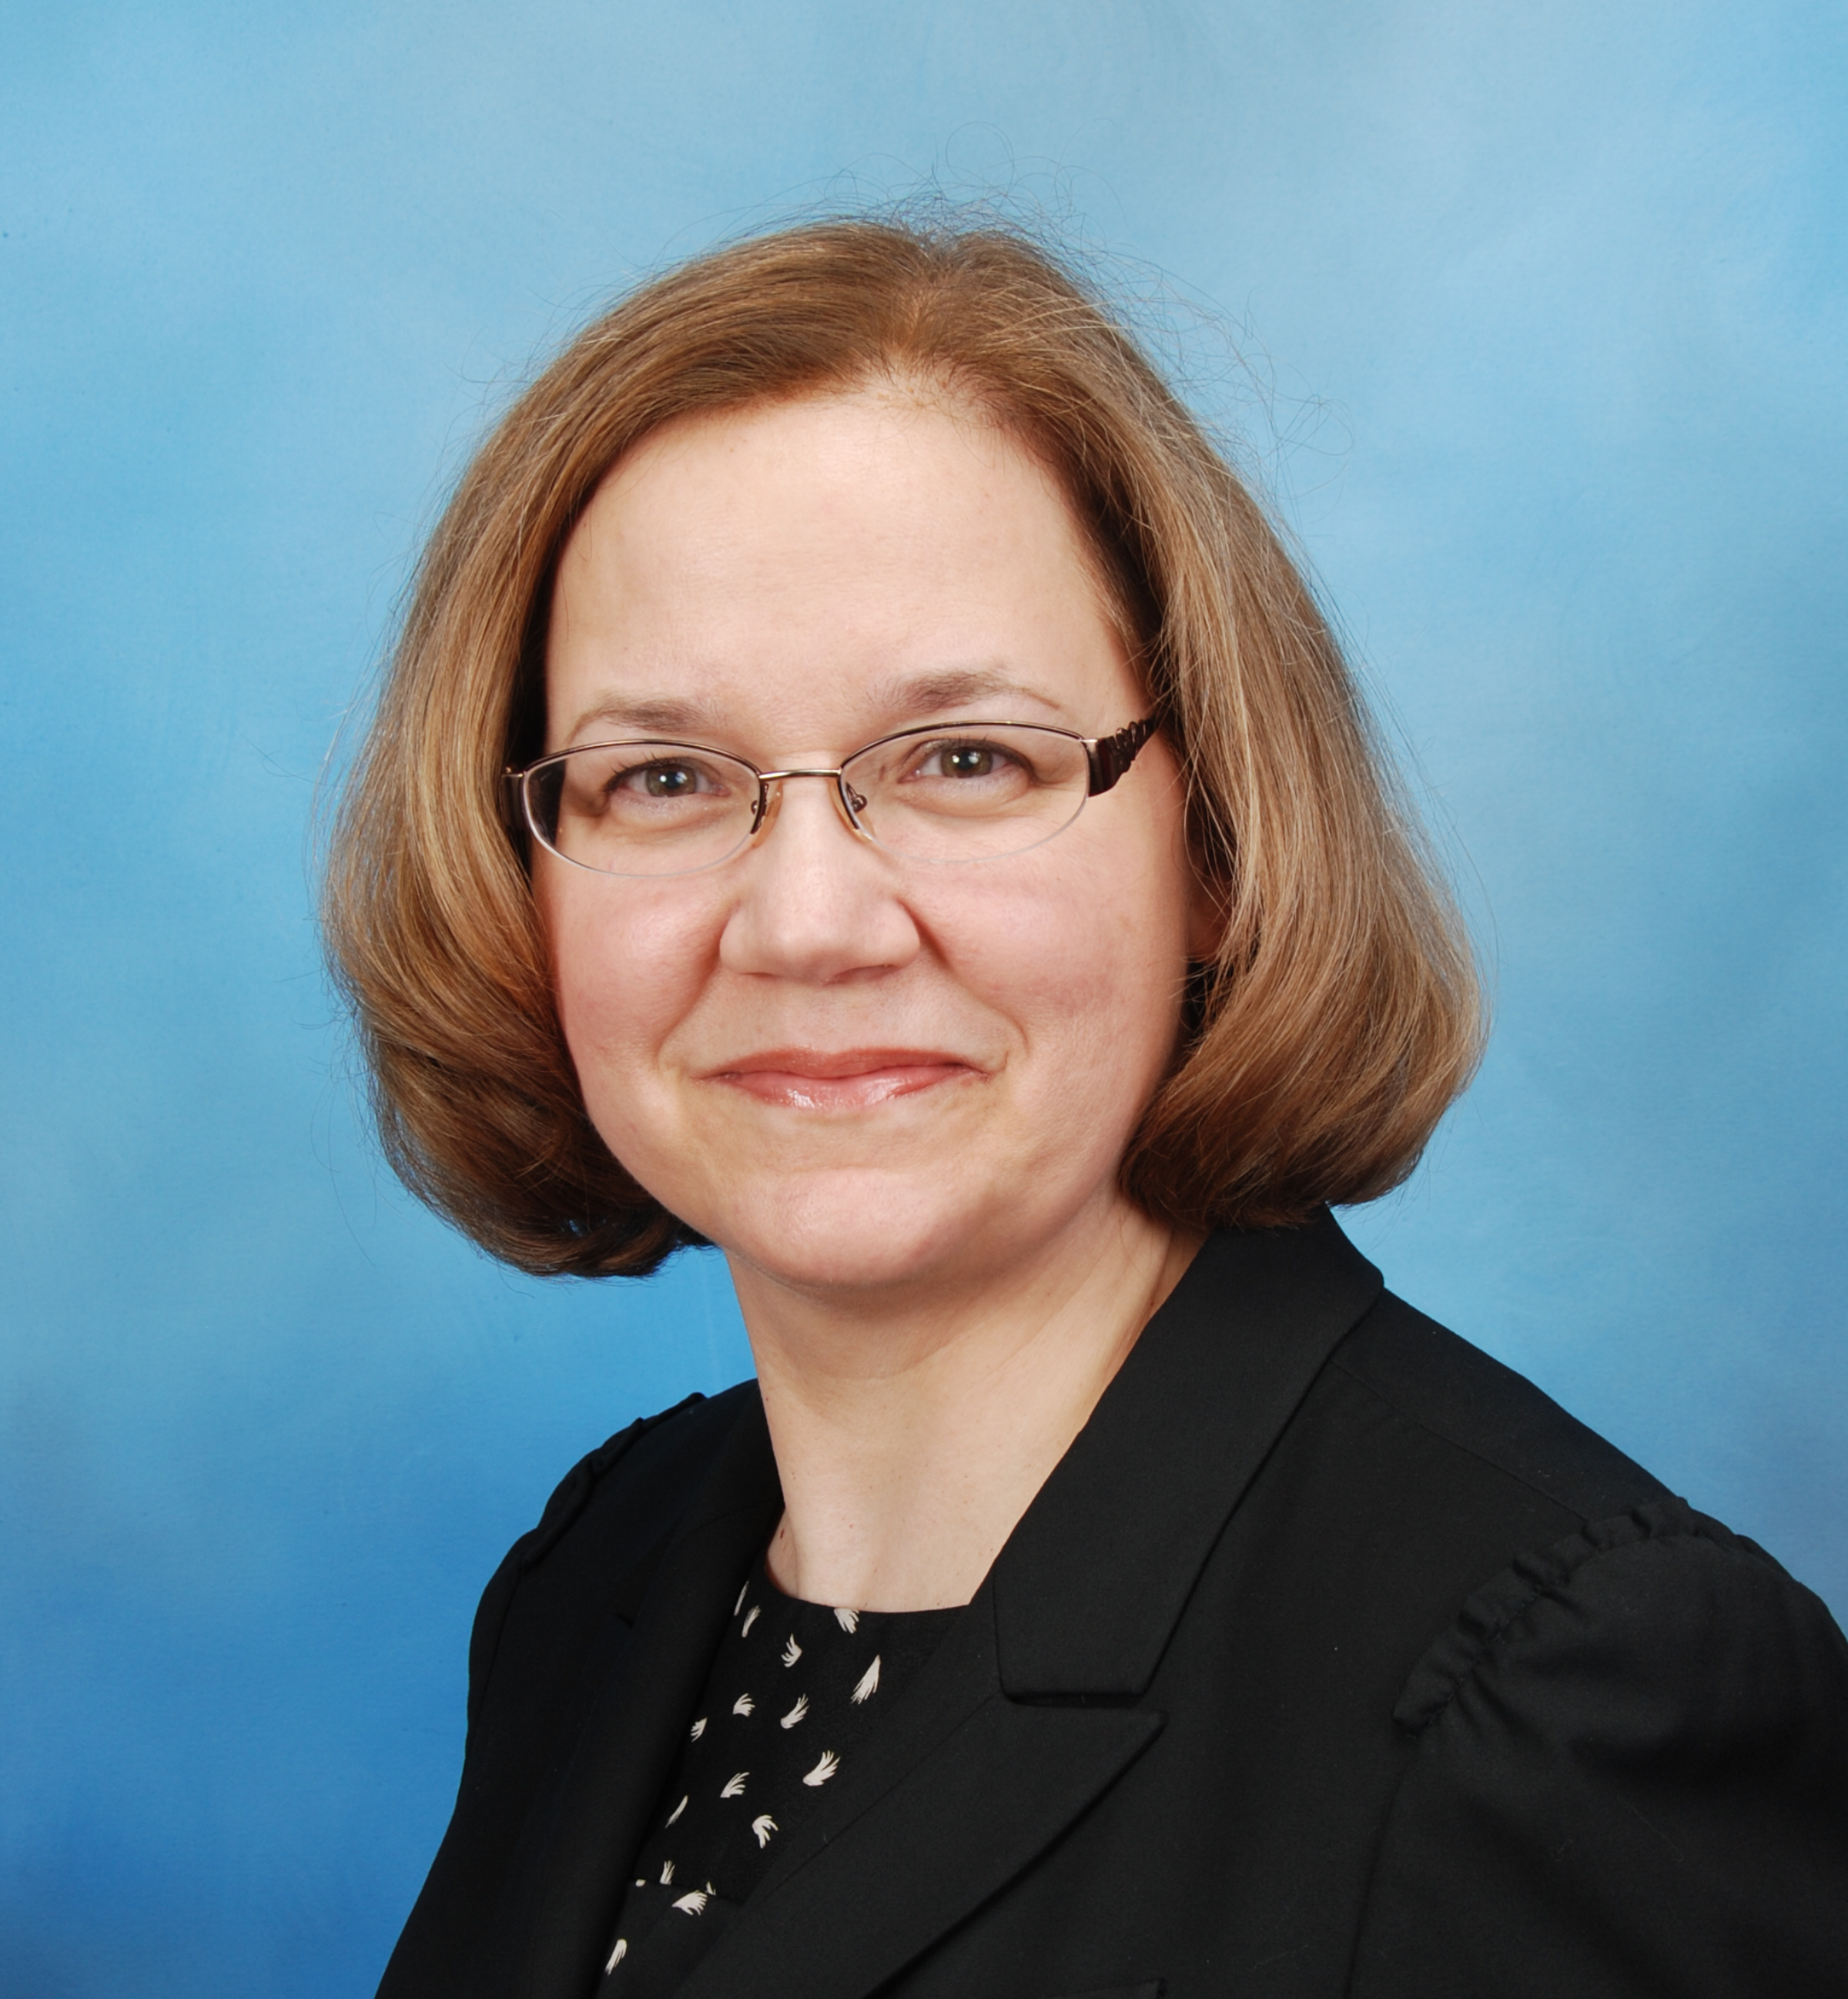
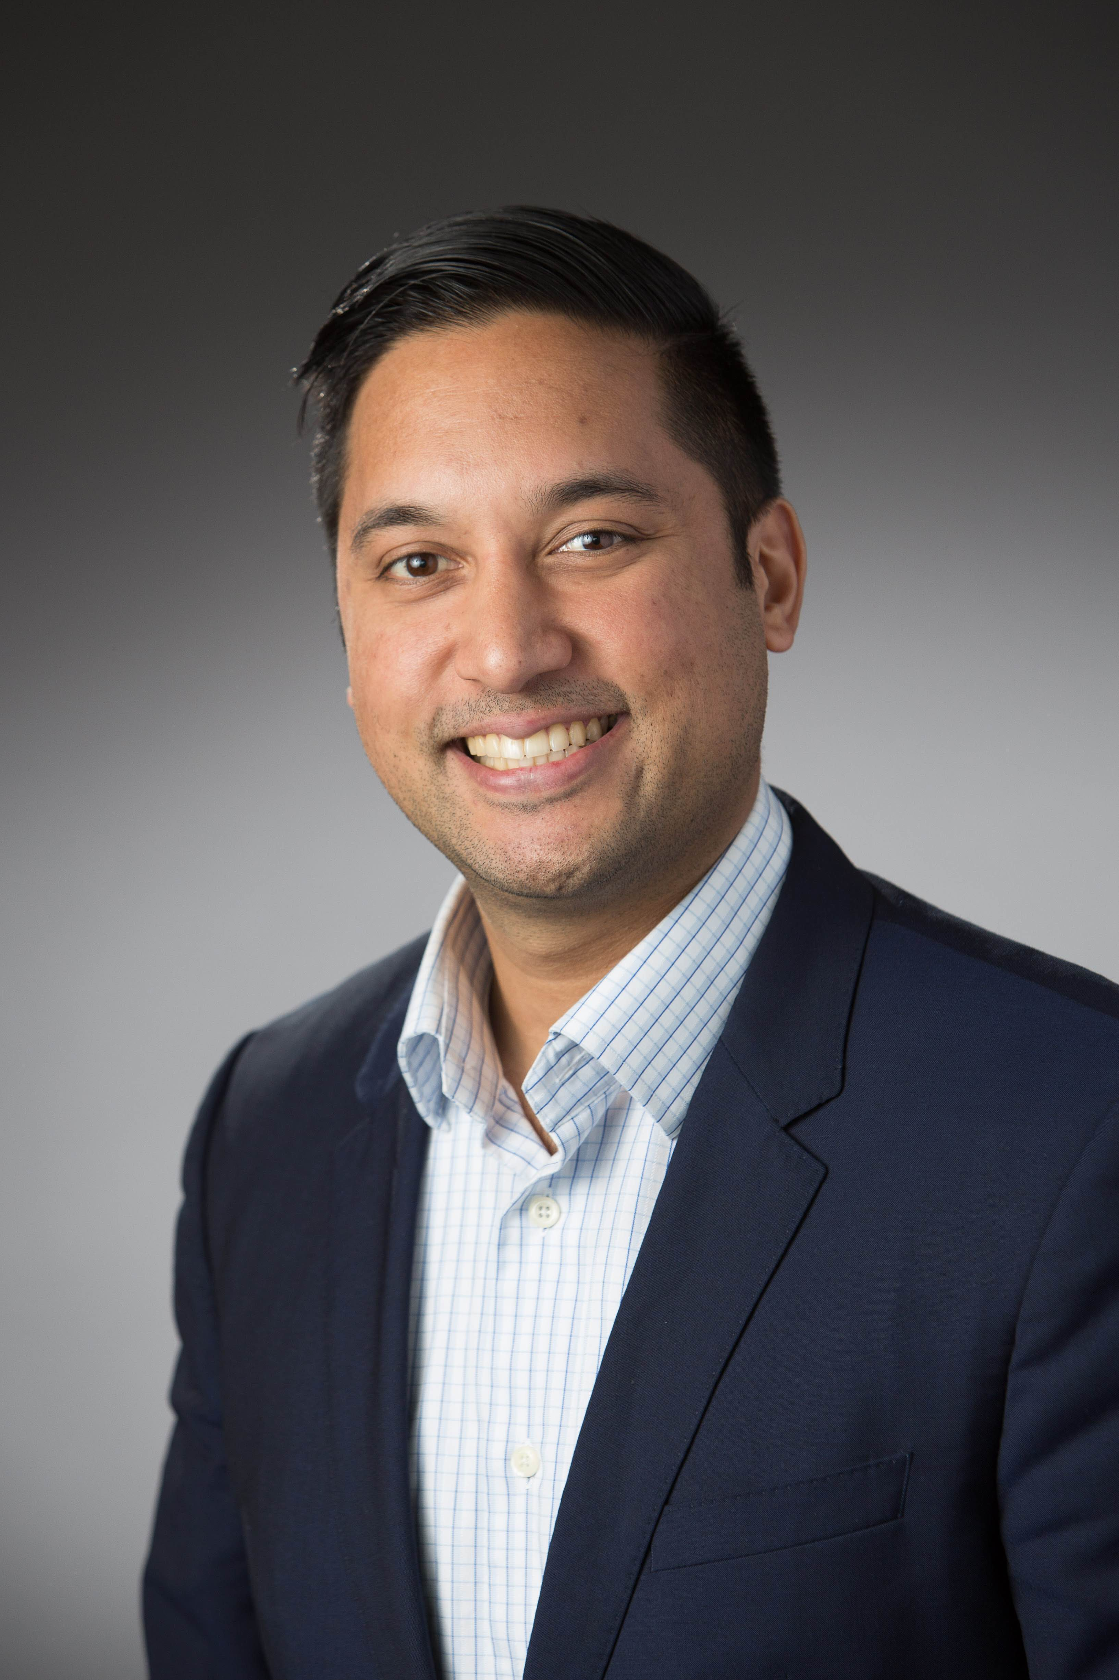
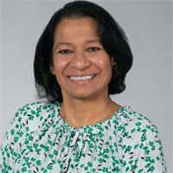
Diplomat Regional Directors
Midwest – Amanda Bain
WA
ID
MT
ME
OR
ND
MN
WI
NY
WY
SD
MI
East – Christine Dube
CA
NV
IA
PA
UT
NE
IL
OH
CO
IN
WV
KS
MO
VA
KY
West – Michael Pazirandeh
AZ
NM
NC
OK
TN
TX
AR
SC
MS
AL
GA
LA
AK
FL
South – Shobna Butler
HI

Slide 24
AMCP Diplomat Program
Refer to AMCP website for list of Diplomats for each school
Reach out to Zack Riley, zriley@amcp.org, for Diplomat related questions
AMCP Diplomat Roster on the website (for members)

Slide 25
P&T Competition
Fatima Ali, PharmD
Task Chair, School of Pharmacy Relations Committee

Slide 26
Key dates for 2023:
Intent to compete due Nov 18, 2022
Deadline for entries to the 2023 National P&T Competition is January 23, 2023
Resources:
AMCP Foundation 2023 Competition site
AMCP Student Resource Center - Student developed tools
Sign up Competition News

Slide 27
How to Conduct a Local Competition
How to Conduct a Local P&T Competition Guide

Slide 28
AMCP Survey Highlights
Zack Riley
AMCP Manager, Student Pharmacist and New Practitioner Programs

Slide 29
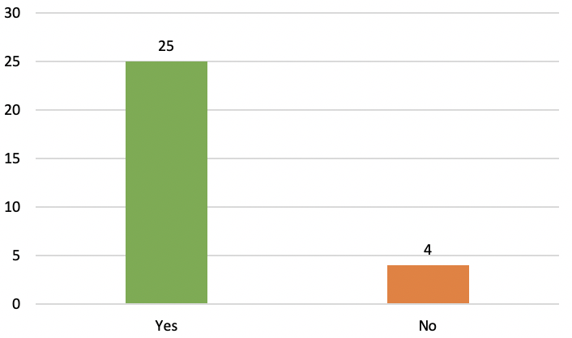
Chapter Survey
Did your chapter participate in the AMCP Foundation P&T Competition?
Factors that led to nonparticipation:
Limited chapter knowledge
Difficulty sparking interest
Competition timing conflicts with local P&T competition

Slide 30
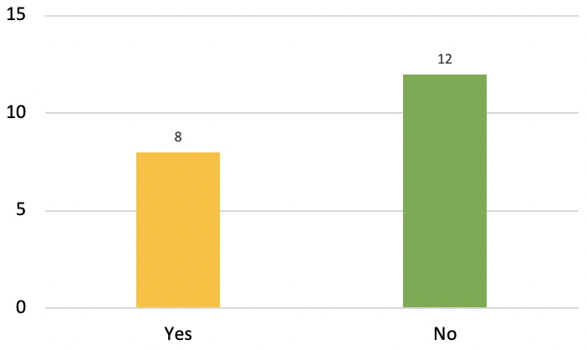
Chapter Survey
Does your school provide academic credit for participating in the P&T Competition?
Notes:
5 schools offer between 1 and 3 elective credit hours

Slide 31
Faculty Advisor Survey
What Managed Care opportunities, if any, are offered at your institution? (check all that apply)
Notes:
5 schools offer between 1 and 3 elective credit hours

Slide 32
Faculty Advisor Survey
What is the role of the AMCP Diplomat(s) within your institution? Additional information found here. Please select all that apply.
Notes:
5 schools offer between 1 and 3 elective credit hours

Slide 33
Questions?

Slide 34
Challenges?
What challenge(s) has your AMCP chapter faced in the recent years with membership, engagement, etc.?
How did your AMCP chapter overcome these challenges?
Example: APhA/other larger pharmacy orgs lure in students, leaving little room for AMCP/other orgs
Example: Challenges with COVID-19 for students who haven’t had to put on in-person events in the past
Notes:
Fatima or Task 4 Member

Slide 35
Successes
What positive outcomes has your AMCP chapter seen in the recent years? (e.g., increase in membership, P&T competition involvement, etc.)
How does your AMCP chapter plan to continue achieving positive outcomes?
Example: more collaboration between schools of pharmacy due to COVID-19 especially on virtual platforms
Notes:
Fatima or Task 4 Member

Slide 36
Advice
What advice would you give to someone starting a new AMCP chapter?
What do you wish you had known at the time?
Example: knowing your AMCP resources
Notes:
Fatima or Task 4 Member

Slide 37
Questions?

