Slide 1
Pharmacy Quality Measures
Created by the School of Pharmacy Relations Committee for AMCP
Updated: December 2019

Slide 2
Purpose of Quality Measures
Quality measures are a mechanism to help quantify the quality of care provided
Quality measures address aspects of care such as:
Utilization of evidence-based medicine
Efficiency and effectiveness
Quality of Life
Patient Satisfaction
Useful in pay-for-performance and value-based purchasing reimbursement programs

Slide 3
Development of a Quality Measure
Primary and secondary research is reflected in guidelines
Agency for Healthcare Research and Quality (AHRQ)
Measures are developed from guideline recommendations
Professional societies
Measures are field tested, and potentially endorsed if appropriate
National Quality Forum (NQF)
National Institutes of Health (NIH)
Industry
Professional societies
National Committee for Quality Assurance (NCQA)
CMS
URAC
Pharmacy Quality Alliance (PQA)
Multiple years
4-12 months
9-24 months

Slide 4
Quality Organizations

Slide 5
NCQA
NCQA is a private, non-profit organization dedicated to improving healthcare quality through:
Accreditation of health plans, ACOs, PCMHs
Development of quality measures
Design of providers recognition programs
Health plans seeking accreditation assess performance through administration and submission of the HEDIS measures, developed by NCQA, and CAHPS surveys
Notes:
NCQA offers accreditation to health plans, accountable care organizations (ACOs), patient centered medical homes (PCMH), wellness and health promotion, and disease management programs.
NCQA Health Plan Accreditation includes two major components on which a plan’s performance is scored: standards, an evaluation of the plan’s structure and processes to maintain and improve quality in five core areas; and Healthcare Effectiveness Data and Information Set (HEDIS®), an evaluation of the plan’s performance on process and outcomes in clinical care and member experience of care.
CAHPS, or Consumer Assessment of Healthcare Providers and Systems, was developed by AHRQ (Agency for Healthcare Research and Quality) to support and promote the assessment of consumers' experiences with health care.

Slide 6
Health Plan Employer Data and Information Set (HEDIS)
Data categories for HEDIS measures evaluate five care domains:
Effectiveness of care
Access/availability of care
Experience of care
Utilization and Relative Resource Use
Health plan descriptive data
Notes:
HEDIS measures health plan performance on several aspects of health care and managed care pharmacy including asthma medication use, controlling high blood pressure, antidepressant medication management and medication management.

Slide 7
Consumer Assessment of Health Plan Survey (CAHPS)
CAHPS survey evaluates member satisfaction measures including:
Overall satisfaction
Access to care
How well doctors communicate
Availability of health plan information
NCQA uses the CAHPS survey as part of the Satisfaction With Experience of Care domain of HEDIS
AHRQ. CAHPS Health Plan Surveys. Available at https://www.ahrq.gov/cahps/about-cahps/index.html
AHRQ. NCQA's version of the Health Plan Survey. Available at: https://cahps.ahrq.gov/surveys-guidance/hp/about/NCQAs-CAHPS-HP-Survey.html.

Slide 8
URAC
URAC is an independent, non-profit organization that promotes health care quality through accreditation, education, and measurement programs
Notes:
A list of all available accreditations through URAC is available at: https://www.urac.org -> Menu ->Accreditation and Certification Programs

Slide 9
URAC
Accreditation types include:
Health Plan Programs (ex. Medicare Advantage Accreditation)
Healthcare Management Programs (ex. Disease Management Accreditation)
Healthcare Operations Programs (ex. Health Network Accreditation)
Pharmacy Quality Management Programs (ex. Pharmacy Benefits Manager (PBM) Accreditation)
Provider Integration and Coordination Programs (ex. Patient-Centered Medical Home (PCMH) Certification)
Notes:
A list of all available accreditations through URAC is available at: https://www.urac.org -> Menu ->Accreditation and Certification Programs

Slide 10
URAC
Quality Measures for Accreditation
Aligned closely with the six National Quality Measure Domains identified in the HHS National Quality Strategy
Patient Safety, Patient and Family Engagement, Care Coordination, Clinical Processes/ Effectiveness, Population and Public Health, Efficient Use of Healthcare resources
Requires reporting on consumer satisfaction utilizing the CAHPS Survey
URAC. Health Plan Quality Measures. Available at https://www.urac.org/programs/health-plan-accreditation
Notes:
https://www.urac.org/programs/health-plan-accreditation

Slide 11
Center for Pharmacy Practice Accreditation (CPPA)
Nonprofit organization established in 2012 by APhA, NABP, and ASHP
Recognizes pharmacy practices that provide an advanced level of patient care, services, quality, and safety
Establishes measurable pharmacist clinical services across the medication use continuum
Notes:
https://www.pharmacypracticeaccredit.org/about
APhA: American Pharmacists Association
NABP: National Association Boards of Pharmacy
ASHP: American Society of Health-system Pharmacists

Slide 12
CPPA
Programs
Community pharmacy practice
Specialty pharmacy practice
Telehealth pharmacy practice
Notes:
https://www.pharmacypracticeaccredit.org/our-programs
Community pharmacy practice:
CPPA developed consensus-based community pharmacy practice standards. It focuses on three areas:
Practice management: organizational structure, staffing, environment, information systems and technology, integrity and privacy of patient information
Patient care services: MTM, patient counseling, staffing, setting goals
Quality improvement: operation, training and education of staff, consumer feedback
Specialty pharmacy practice:
Represents broad range of specialty pharmacy stakeholders including chain, independent and health systems, and payer and manufacture
Designed to create a consensus around the specialty practice and organized 4 domains:
Organizational infrastructure: appropriate documents and current licensure, clear organizational structure with a mission statement, appropriate environment, information systems, having contingency plan
Medication access support: provide comprehensive benefits investigation, prior authorization assistance, have mechanisms to support patient safety and compliance
Clinical management services: coordinated patient management, communication, comprehensive patient profile, consistent procedures
Quality improvement: evaluate quality outcomes, implement continuous quality improvement projects, provide accurate data reports
Telehealth pharmacy practice:
Establishes standards to meet the public’s need and measurable pharmacist clinical services
Practice management: organizational structure, staffing, information systems, integrity, security and privacy, business model
Patient care services: improving patient medication use, health and wellness, MTM, process for evaluation patient care services
Quality improvement: operations, training and education of staff, consumer feedback, call center performance

Slide 13
Pharmacy Quality Alliance (PQA)
Established in 2006
Non-profit alliance with over 250 member organizations
Mission:
Optimizing Health by Advancing the Quality of Medication Use
PQA. PQA Mission and Strategic Objectives. Available at https://www.pqaalliance.org/our-story
Notes:
http://pqaalliance.org/about/default.asp

Slide 14
PQA & Measure Development
Develops medication-use measures in areas of Adherence, Appropriate Medication Use, Medication Safety and Medication Therapy Management
Identifies high-priority areas for health care and gaps in existing performance measure sets
Consensus process used to draft, test, refine and endorse measures
PQA. PQA Performance Measures. Available at https://www.pqaalliance.org/pqa-measures
Notes:
https://www.pqaalliance.org/pqa-measures
https://www.pqaalliance.org/measure-development

Slide 15
CMS Star Ratings

Slide 16
CMS Star Ratings - Overview
CMS rates the quality of Medicare Advantage and Medicare Prescription drug plans (Part C and/or Part D) by using a scale of 1 (Poor) to 5 stars (Excellent)
Since 2012, Medicare Advantage plan payments and rebate amounts are tied to quality ratings
Annual quality rating of Medicare Advantage plans is based on assessment of:
Clinical performance (Screening, tests, vaccines, managing chronic conditions)
Patient experience (Plan responsiveness and care)
Enrollee complaints
Customer services
Notes:
https://www.medicareinteractive.org/get-answers/medicare-health-coverage-options/changing-medicare-coverage/how-to-compare-plans-using-the-medicare-star-rating-system

Slide 17
CMS Star Rating - Overview
Timeframes
2019 Star Ratings
Primarily based on 2017 data
Utilizes CAHPS Survey data 03/2018 - 05/2018
2020 Star Ratings
Primarily based on 2018 data
Utilizes CAHPS Survey data 03/2019 - 05/2019
CMS. Medicare 2020 Part C & D Star Rating Technical Notes. Available at: https://www.cms.gov/Medicare/Prescription-Drug-Coverage/PrescriptionDrugCovGenIn/PerformanceData

Slide 18
CMS Star Ratings - Overview
Plan Ratings - www.medicare.gov/find-a-plan/
Medicare members may switch to a 5-star plan at any point during the year, including non-enrollment periods
Symbol -
Low performing plans are indicated on the site & online enrollment is disabled
Medicare.gov. Medicare Plan Finder. Available at: https://www.medicare.gov/sign-up-change-plans/when-can-i-join-a-health-or-drug-plan/5-star-special-enrollment-period . .
Notes:
https://www.cms.gov/Medicare/Prescription-Drug-Coverage/PrescriptionDrugCovGenIn/Downloads/Star-Ratings-Technical-Notes-Oct-10-2019.pdf

Slide 19
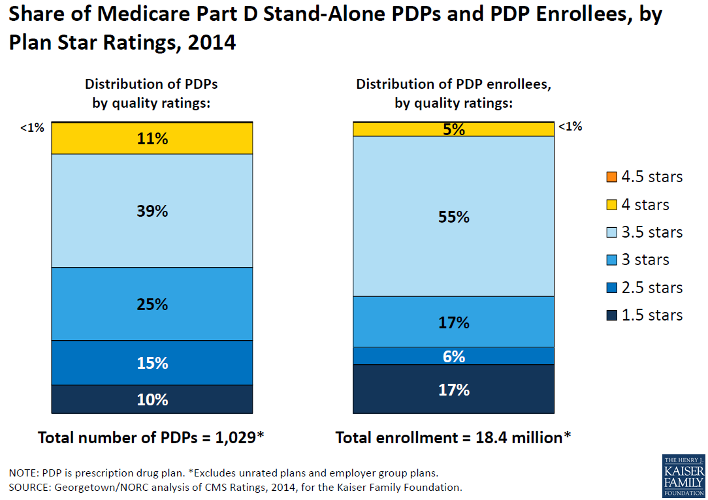
Part D PDP Enrollees by Plan Star Rating
Notes:
http://kaiserfamilyfoundation.files.wordpress.com/2014/08/8621-medicare-part-d-in-its-ninth-year.pdf

Slide 20
CMS Star Ratings - Overview
Star Ratings are based upon various sets of performance measures
Healthcare Effectiveness Data and Information Set (HEDIS)
Consumer Assessment of Healthcare Providers and Systems (CAHPS)
Health Outcomes Survey (HOS)
Complaint Tracking Module (CTM)
Independent Review Entity (IRE)
Pharmacy Quality Alliance (PQA) endorsed medication-use measures
CMS. Medicare 2015 Part C & D Star Rating Technical Notes. Available at: http://www.cms.gov/Medicare/Prescription-Drug-Coverage/PrescriptionDrugCovGenIn/PerformanceData.html.

Slide 21
CMS Star Ratings - Overview
Star ratings are separated into nine domains, four of which apply directly to drug plans
Drug plan (Part D) rating domains
Patient safety and accuracy of drug pricing
Member complaints, problems getting services, and improvement in the drug plan’s performance
Member experience with drug plan
Drug plan customer service
Health plan (Part C) rating domains
Staying healthy: screenings, tests, and vaccines
Member complaints, problems getting services, and improvement in the health plan’s performance
Member experience with the health plan
Health plan customer service
Managing chronic conditions
Notes:
Found in Star Rating Technical notes https://www.cms.gov/Medicare/Prescription-Drug-Coverage/PrescriptionDrugCovGenIn/Downloads/Star-Ratings-Technical-Notes-Oct-10-2019.pdf

Slide 22
CMS Prescription Drug Plan (Part D) Measures
Drug plan customer service
Member complaints, problems getting services, and improvement in the drug plan’s performance
Availability of TTY/TDD services and foreign language interpretation when prospective members call the drug plan
Drug plan makes timely decisions about appeals
Fairness of drug plan’s denials to member appeals, based on an independent reviewer
Complaints about the drug plan
Members Choosing to Leave the Plan
Improvement in the Drug Plan’s Performance
Notes:
Reference – Part D Prescription Drug Plan Domain Measures are located above

Slide 23
CMS Prescription Drug Plan (Part D) Measures
Patient safety and accuracy of drug pricing
Member experience with the drug plan
Plan Provides Accurate Drug Pricing Information for Medicare’s Plan Finder Website
Medication Therapy Management (MTM) completion rate for Comprehensive Medication Review (CMR)
Using a statin for People with Diabetes
Taking Oral Diabetes Medication as Directed (Medication Adherence)
Taking Blood Pressure Medication as Directed (Medication Adherence)
Taking Cholesterol Medication as Directed (Medication Adherence)
Members’ Overall Rating of Drug Coverage
Ease of Getting Prescriptions Filled When Using the Plan
Notes:
Reference – Part D Prescription Drug Plan Domain Measures are located above
Managed Care Pharmacy Quality Initiatives often focus on the Patient Safety domain measures outlined above, including High Risk Medications, Treatment of Blood Pressure in People with Diabetes, and Medication Adherence measures for oral diabetes medications, blood pressure medications, and cholesterol medications.

Slide 24
Star Rating Example
Part C Rating: “Statin Therapy for Patients with Cardiovascular Disease”
Shows the percent of plan members with heart-disease who get the right cholesterol lowering medication
2020 Rating Cut Points:
All ratings within a domain are then averaged to calculate the domain’s star rating
Measure | Star Rating
> 87% | 5 stars
> 83% – < 87% | 4 stars
> 79% – < 83% | 3 stars
> 75% - < 79% | 2 stars
< 75% | 1 star
CMS. Medicare 2020 Part C & D Star Rating Technical Notes. Available at: http://www.cms.gov/Medicare/Prescription-Drug-Coverage/PrescriptionDrugCovGenIn/PerformanceData.html.
Notes:
Star rating cut points and thresholds change from year to year.

Slide 25
CMS Star Ratings – Bonus Payments
Plans receive bonus payments based on Star Rating
4-5 Stars: 5%
MA Plan Beneficiary Rebate Amounts
4.5 – 5 stars: 70%
4.0 – 4.4 stars: 65%
<3.0 stars: 50%
Less than 4 Stars: 0%
3.5- 3.9 stars: 60%
3.0-3.4 stars: 55%
2019 Quality Bonus Payments
Plans with Part C or D rating of 2.5 or lower for at least 3 years receive a low performing icon on the Medicare plan finder website
CMS. Medicare 2015 Part C & D Advance Notice and Final Call Letter. Available athttps://www.cms.gov/Medicare/Prescription-Drug-Coverage/PrescriptionDrugCovGenIn/PerformanceData

Slide 26
CMS Star Ratings Updates for 2021
New Measures (2021 Display) –
Concurrent Use of Opioids and Benzodiazepines (COB)
Polypharmacy Use of Multiple Anticholinergic Medications in Older Adults (Poly-ACH)
Polypharmacy Use of Multiple Central Nervous System-Active Medications in Older Adults (Poly-CNS)
High Risk Medication – Retired from the display page 2021 rating year
Source: Announcement of Calendar Year (CY) 2020 Medicare Advantage Capitation Rates and Medicare Advantage and Part D Payment Policies and Final Call Letter. Retrieved from
https://www.cms.gov/Medicare/Health-Plans/MedicareAdvtgSpecRateStats/Downloads/Announcement2020.pdf.

Slide 27
Strategies for Adhering to Quality Measures
Stimulate accountability within the healthcare organization by educating employees and providers on the significance of quality measurement
Encourage advancements in technology to help integrate patient and provider data
Promote the appropriate use of medical and pharmaceutical services through frequent utilization reviews

Slide 28
Conclusion
Quality organizations and programs, such NCQA, URAC, and CMS Star Ratings, contribute to the development and endorsement of quality measures impacting pharmacy quality programs in all managed care settings
Pharmacists contribute to quality-focused programs through initiation and advancement of medication management programs including:
Retrospective and concurrent DUR programs
Benefit design recommendations
Comprehensive and Targeted Medication Reviews (MTM)

Slide 29
Helpful Resources
Navarro RP, et al. Managed Care Pharmacy Practice. 2nd edition. Jones and Bartlett Publishers: Sudbury, MA; 2009.
Ransom ER, et al. The Healthcare Quality Book. 2nd Edition. Health Administration Press: Chicago, IL; 2012.
NCQA – http://www.ncqa.org/HomePage.aspx
URAC – https://www.urac.org/
PQA - http://www.pqaalliance.org/
CMS Part C and D Performance Data. http://www.cms.gov/ Medicare/Prescription-Drug-Coverage/PrescriptionDrugCovGenIn/ PerformanceData.html
AMCP Resources for Medicare Plan Star Ratings
Framework for Improving Medicare Plan Star Ratings: http://www.amcp.org/QBP_framework/
Quality Bonus Payments and Star Ratings: http://www.amcp.org/WorkArea/DownloadAsset.aspx?id=13599

Slide 30
Thank you to AMCP member Brenden O’Hara for updating this presentation for 2019

Slide 31
Mission & Vision
To improve patient health by ensuring access to
high-quality, cost-effective medications and other therapies.

