Slide 1
Pharmacoeconomics
Created by the School of Pharmacy Relations Committee for AMCP
Updated: January 2020

Slide 2
Objectives
Define pharmacoeconomics
Differentiate various pharmacoeconomic evaluation methods
Discuss various considerations essential to evaluating a pharmacoeconomic analysis
Provide examples of how pharmacoeconomics is applied in practice and various roles for the pharmacist

Slide 3
Background - Pharmacoeconomics
Process of identifying, measuring, and comparing costs and consequences of therapies and determining which alternative produces best outcomes for resources invested

Slide 4
True or False
The goal of pharmacoeconomics is to find the cheapest alternative
Notes:
Answer is False – Goal of pharmacoeconomics is to find the therapeutic option that provides the best VALUE. Cost is just one part of the value story of a pharmaceutical product/service

Slide 5
Types of Economic Evaluation
Economic Evaluation
Full Economic Evaluation
Partial Economic Evaluation
Cost-Minimization Analysis
Cost-Benefit Analysis
Cost-Effectiveness Analysis
Cost-Utility Analysis
Cost-of-Illness Analysis
Notes:
Full Economic Evaluation accounts for BOTH cost and consequences
Partial Economic Evaluation accounts for EITHER cost/consequences
The analyses differ based on the unit of measurement for the outcomes. These will be discussed in detail in the upcoming slides

Slide 6
Cost of Illness Evaluation
Aims to identify and measure total costs attributable to a particular disease
Can demonstrate economic burden of disease
Units of Measurement
Cost – Monetary ($)
Consequence – Not measured
Notes:
Can be used to quantify disease burden for various stakeholders. For example, it can quantify cost of opioid abuse/smoking for legal settlements.

Slide 7
Cost Minimization Analysis
Compares costs for therapeutically equivalent drugs to identify the least costly alternative
Units of measurement
Cost – Monetary ($)
Consequences – assumed equivalent
Notes:
Advantages: Ease-of-use
Disadvantages: Few alternatives are known to have the “same” outcomes

Slide 8
Cost Benefit Analysis
Primarily used to determine allocative efficiency
Units of Measurement
Cost – Monetary ($)
Consequences – Monetary ($)
Notes:
Advantages: Comprehensive, Allows comparison of different interventions which may not have similar outcomes for measurement. Converting these outcomes into $$ can help level the field to compare the interventions
Disadvantages: Complex; the patient experience is hard to convert into $$

Slide 9
Cost Effectiveness Analysis
Compares costs of two or more alternatives versus outcomes measured in natural units (eg: BP, HbA1c)
Units of measurement
Cost – Monetary ($)
Consequence – health outcome (eg: BP, HbA1c)
ICER – Incremental Cost Effectiveness Ratio
ICER = ∆Cost/∆Effect
= (C_{Tx1} – C_{Tx2})/(E_{Tx1} – E_{Tx2})
Notes:
Advantages: Most commonly used form of analysis
Disadvantages: Unable to compare different programs or therapeutic classes, Unable to judge “true” worth.
ICER - Incremental cost to achieve a one unit increase in outcome

Slide 10
Cost Utility Analysis
Analysis that account for both quality and quantity of life which are expressed as “utilities”
Utilities represent patient preferences and quality of life associated with disease and/or treatment
Units of Measurement
Cost – Monetary ($)
Consequence – Quality adjusted life year (QALY)
Quality adjusted life year – factor of life expectancy and utility
ICER = ∆Cost/∆Effect
= (C_{Tx1} – C_{Tx2})/(QALY_{Tx1} – QALY_{Tx2})
Notes:
Advantages: Able to evaluate years of life as well as quality of life
Disadvantages: Concerns with validity
QALY - e.g., 4 years at 25% QoL = 1 year at 100% QoL
Utility weights are quantified using questionnaires like SF36 or EURQoL. These may be general or disease-specific.

Slide 11
Cost Effectiveness Plane

Slide 12
Cost Effectiveness Plane
Reject
Accept
Notes:
Point to note – this pharmacoeconomic evaluation adopts a drug in Quadrant 1 – which is MORE costly and MORE effective. This shows that the aim of pharmacoeconomics is not to find the CHEAPEST alternative.

Slide 13
Recap of Pharmacoeconomic Analyses
Model Type | Cost | Consequences | Aim
Cost-minimization | Monetary | Assumed to be equal | Efficiency
Cost-effectiveness | Monetary | Health Outcome | Determine efficiency when comparators are not therapeutically equivalent
Cost-benefit | Monetary | Monetary | Resource allocation
Cost-utility | Monetary | QALY | Health related quality of life gains for comparators with similar or different clinical outcome measures

Slide 14
Considerations for Designing or Evaluating Pharmacoeconomic Studies
Costs
Direct medical – e.g., medication and administration
Direct non-medical – e.g., transportation for treatment
Indirect – e.g., lost wages due to illness
Intangible – e.g., pain, suffering
Perspective
Patient, Provider, Payer, Society
Perspective dictates what costs are considered
Notes:
Direct Health Care Costs: Drug, services, health care professionals time, health care facilities
Direct Non-Health Care Costs: Private transportation, patient and family time, special diet
Indirect Costs: Productivity losses related to illness, Productivity losses related to death, Different than the “accounting” concept
Intangible Costs: Costs associated with pain and suffering
Perspective – drives costs and consequences considered

Slide 15
Considerations for Designing or Evaluating Pharmacoeconomic Studies
Discounting - value of money changes over time
A dollar is worth more today than in the future
Sensitivity Analysis
Challenges results and tests assumptions by altering variables
Accuracy and transparency
Clearly documented study design, assumptions, inputs
Face Validity
Do the assumptions/input and alternatives reflect reality
Notes:
Discounting Costs & Outcomes: Allowance for the development of the differential effects of the options
Sensitivity Analysis: Changing the value of variables to account for uncertainty; identifies what factors, which if changed, impact conclusions
Sensitivity analysis – these analyses or models assume multiple items. In real world, these assumptions may not be true. Sensitivity analysis is a technique where these assumptions are varied to see how the ICERs change with it. Sensitivity analyses allows the researchers to test how robust their findings are if they were to vary the assumptions.

Slide 16
Economic Modeling
Analytic models used to predict economic consequences of coverage, treatment, and access decisions
Constructed by health plans, pharmaceutical manufacturers, academic groups, and consultants
These models are associated with uncertainty
Notes:
Economic models are utilized to get ICERs in many cases. Once these models are created, values (from clinical trials and other evidence) are fed into these models.
These values may not represent every single patient/case and are associated with a lot of uncertainty. A robust pharmacoeconomic analysis tries to address the issues of uncertainty using sensitivity analysis.

Slide 17
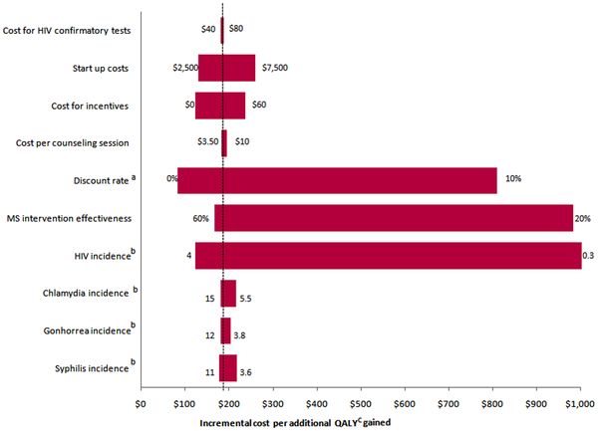
One-Way Sensitivity Analysis
Change one parameter at a time while keeping all others constant
Notes:
There are 2 kinds of sensitivity analysis
One way
Probabilistic
In one way sensitivity analysis, the input values are changed one at a time while keeping others a constant. The results of such a sensitivity analysis is presented as a tornado diagram. In the tornado diagram above, the dotted line represents the base case ICER value. Base case ICER represents the ICER value obtained based on the values fed into the model. In this analysis, the model included
Cost for HIV tests
Start up costs
Cost/counseling session …….and the other variables mentioned on the y-axis
The numbers at the end of each bar represents the range over which each of the variables was changed. We can see that ICER changes are sensitive to changes in HIV incidence, discount rate, and intervention effectiveness
Burgos JL, Gaebler JA, Strathdee SA, Lozada R, Staines H, et al. (2010) Cost-Effectiveness of an Intervention to Reduce HIV/STI Incidence and Promote Condom Use among Female Sex Workers in the Mexico–US Border Region. PLOS ONE 5(6): e11413. https://doi.org/10.1371/journal.pone.0011413

Slide 18
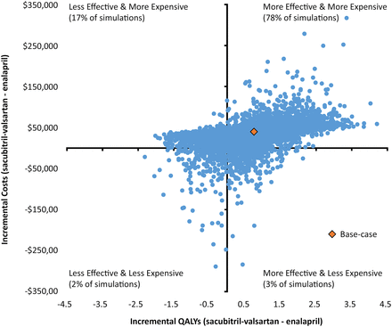
Probabilistic Sensitivity Analysis
Instead of changing one or more variables at a time, all variables are simultaneously changed using a simulation
Notes:
One-way sensitivity analysis is not how things happen in the real-world. We do not change one parameter at a time in reality. All variables are dynamic in nature. To address this drawback of one-way sensitivity analysis, we have probabilistic sensitivity analysis,
Here, instead of changing one or more variables at a time, we change all the variables simultaneously using a simulation.
The results of this sensitivity analysis can be shown in the following manner. The base case analysis can be found in the second quadrant. Each blue dot represents an ICER value for one set of simulation. In this example, there were 10,000 simulations that gave us the above scatter plot.
Jordan B. King, Rashmee U. Shah, Adam P. Bress, Richard E. Nelson, Brandon K. Bellows. Cost-Effectiveness of Sacubitril-Valsartan Combination Therapy Compared With Enalapril for the Treatment of Heart Failure With Reduced Ejection Fraction. J Am Coll Cardiol HF. 2016 May, 4 (5) 392-402.

Slide 19
Applications in Practice & Roles of the Pharmacist
Assist in the design and implementation of research studies
Evaluate pharmacoeconomic literature
Apply results to clinical decision making
Individual patient care
Formulary/utilization management
Disease management
Resource allocation
Notes:
For students – there are multiple opportunities within pharma (market access, HEOR) and managed care (analytics and outcomes, P&T, HEOR). Typical career path for those interested in pharmacoeconomics is a fellowship/residency. Additionally, students could pursue MPH/MS/PhD to gain quantitative skills for these roles.

Slide 20
Helpful Resources
Navarro RP, ed. Managed Care Pharmacy Practice. 2nd edition. Jones and Bartlett Publishers: Sudbury, MA; 2009.
www.ispor.org
https://icer-review.org/
https://www.equator-network.org/wp-content/uploads/2013/04/Revised-CHEERS-Checklist-Oct13.pdf
Husereau D, Drummond M, Petrou S, et al. Consolidated Health Economic Evaluation Reporting Standards (CHEERS)—Explanation and Elaboration: A Report of the ISPOR Health Economic Evaluation Publication Guidelines Good Reporting Practices Task Force. Value in Health. 2013; 16:231-250.

Slide 21
Conclusion
Pharmacoeconomic evaluations consider cost compared to consequences of treatment alternatives
Results are used to support population-level decisions regarding medication coverage and use
Best-Practice principles should be used in designing pharmacoeconomic studies to optimize transparency and reduce bias

Slide 22
Purpose of Quality Measures
Quality measures are a mechanism to help quantify the quality of care provided
Quality measures address aspects of care such as:
Utilization of evidence-based medicine
Efficiency and effectiveness
Quality of Life
Patient Satisfaction
Useful in pay-for-performance and value-based purchasing reimbursement programs

Slide 23
Thank you to AMCP member Pranav Patel and Michael Pazirandeh for updating this presentation for 2020.

Slide 24
Mission & Vision
To improve patient health by ensuring access to
high-quality, cost-effective medications and other therapies.

