Slide 1
HEDIS &
HEDIS Measures
Created by the School of Pharmacy Relations Committee for AMCP
Updated: March 2020

Slide 2
Objectives
Understand the purpose of HEDIS measures within healthcare
Demonstrate how HEDIS measures are developed through examples
Examine strategies for applying HEDIS measures
Identify ways get involved in the HEDIS development process

Slide 3

National Committee for Quality Assurance (NCQA)
The National Committee for Quality Assurance (NCQA) was established in 1990 as a non-profit organization dedicated to improving healthcare quality through accreditation and certification
Employers now require or strongly encourage NCQA Accreditation from health plans
NCQA Health Plan Accreditation include
  Clinical Performance: Healthcare Effectiveness Data and Information Set (HEDIS®)
  Consumer Experience: Member Satisfaction through Consumer Assessment of Health Providers and Systems (CAHPS®) Survey
Notes:
The National committee for quality assurance is a private, non-profit organization that works to improve healthcare quality. NCQA offers several accreditations and certifications to health plans, accountable care organizations (ACOs), patient centered medical homes (PCMH), wellness and health promotion, and disease management recognition programs.
HEDIS and CAHPs surveys are taken into consideration for plans looking achieve a high level of accreditation

Slide 4
Healthcare Effectiveness Data and Information Set (HEDIS®)
Developed by NCQA, HEDIS is a standardized performance measurement of health plans
  191 million people are enrolled in health plans that report out HEDIS measures
Health plans seeking NCQA accreditation are assessed by performance of HEDIS measures
Applicable to Commercial, Medicare, and Medicaid
Health plan results on HEDIS measures are made publicly available
HEDIS
may be used by
Patients
Government
Agencies
Employers
Notes:
HEDIS measures allow an “apples-to-apples” comparison amongst different health plans
Health plans include health maintenance organizations (HMO), point of service (POS) organizations, and preferred provider organizations (PPO)

Slide 5
Health Plan Employer Data and Information Set (HEDIS®)
Data categories for approximately 90 HEDIS measures evaluate six care domains:
  Effectiveness of care
  Access/availability of care
  Experience of care
  Utilization and Risk Adjusted Utilization
  Health Plan Descriptive Information
  Measures Collected Using Electronic Clinical Data Systems

Slide 6

HEDIS® Measure Development
HEDIS measures are continuously reviewed based on published guidelines and scientific evidence
Feedback is gathered from multi-stakeholder advisory panels that complete development of measures, examples include
  NCQA Committee on Performance Measurement
  Measurement Advisory Panels
  HEDIS Expert Panels
  HEDIS Technical Measurement Advisory Panel
  Consumer Advisory Panel
Notes:
- NCQA Committee on Performance Measurement, a diverse panel of independent scientists and representatives from health plans, consumers, federal policymakers, purchasers and clinicians, oversees the evolution of the measurement set
- Measurement Advisory Panels provide clinical and technical knowledge required to develop the measures
-HEDIS Expert Panels and the Technical Measurement Advisory Panel focuses on methodology and providing feedback on new and existing measures

Slide 7
Health Plan Employer Data and Information Set (HEDIS®)
Rates for clinical measures can be reported as
  Prevention Measure: Proportion of eligible members who received preventive services
  Treatment Measure: Proportion of eligible members who received recommended care for certain conditions

Slide 8
Health Plan Employer Data and Information Set (HEDIS®)
Rates for clinical measures can be reported as
  Prevention Measure: Proportion of eligible members who received preventive services
  Examples
    Childhood Immunization Status (CIS)
    Flu Vaccinations for Adults Ages 18 – 64 (FVA)
    Breast Cancer Screening (BCS)
    Controlling High Blood Pressure (CBP)

Slide 9

Health Plan Employer Data and Information Set (HEDIS®)
Rates for clinical measures can be reported as
  Treatment Measure: Proportion of eligible members who received recommended care for certain conditions
  Examples
    Use of Opioids at High Dosage (UOD)
    Acute Hospitalization Utilization (AHU)
    Comprehensive Diabetes Care (CDC)

Slide 10



Measure Example: Statin Therapy for Patients With Cardiovascular Disease and Diabetes (SPC/SPD)
Moderate-to-High intensity statin are recommended to those with established clinical ASCVD
The treatment measure Statin Therapy for Patients with Cardiovascular Disease (SPC) assesses
  Males 21–75 years of age and females 40–75 years of age, AND
  Have clinical ASCVD, AND
  Received and adhered to statin therapy
Notes:
https://www.ncqa.org/hedis/measures/statin-therapy-for-patients-with-cardiovascular-disease-and-diabetes/

Slide 11

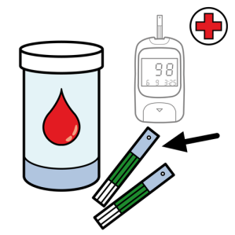
Measure Example: Statin Therapy for Patients With Cardiovascular Disease and Diabetes (SPC/SPD)
Statins are recommended for primary prevention of cardiovascular disease for persons with diabetes
The treatment measure Statin Therapy for Patients with Diabetes (SPD) assesses
  Adults 40-75 years of age who have diabetes, AND
  Do not have clinical ASCVD, AND
  Received and adhered to statin therapy
Notes:
https://www.ncqa.org/hedis/measures/statin-therapy-for-patients-with-cardiovascular-disease-and-diabetes/

Slide 12




Measure Example: Antidepressant Medication Management (AMM)
Appropriate medication management and monitoring of depression can improve a person’s daily functioning, well-being, and potentially reduce risk of suicide
Potential to alleviate overall economic burden of inadequate medication management
The AMM treatment measure assesses people
  18 years and older, AND
  Diagnosed with major depression, AND
  Newly prescribed medication and remained on therapy
Assessment reports out 2 rates
  Effective Acute Phase Treatment: People who remained on an antidepressant for at least 84 days (12 weeks)
  Effective Continuous Phase Treatment: People who remained on an antidepressant medication for at least 180 days (6 months)
84
180
Notes:
https://www.ncqa.org/hedis/measures/antidepressant-medication-management/

Slide 13
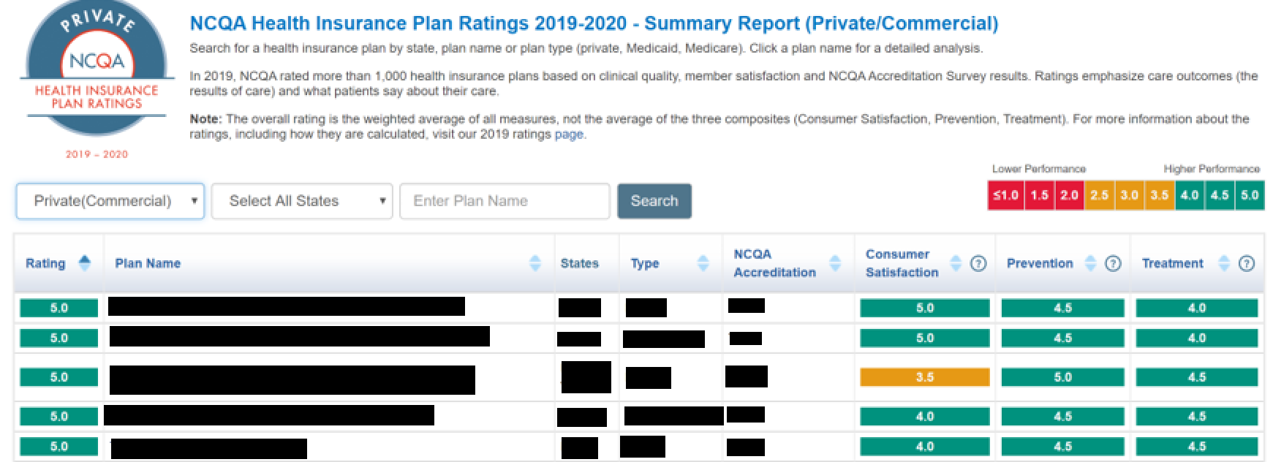
HEDIS Ratings and Results
Points are awarded based on measure-specific thresholds
NCQA’s Health Insurance Plan Ratings list health insurance plans based on their combined HEDIS®, CAHPS® and NCQA Accreditation standards scores
Publicly available on NCQA website
Information can be used during open enrollment by patients, employers, and government agencies
Notes:
http://healthinsuranceratings.ncqa.org/2019/Default.aspx

Slide 14

Updates to HEDIS
To stay current with clinical guideline recommendations and best practices, NCQA releases updates related to measures on an annual basis
  Information and resources related to changes are provided
  Requests Public Comment during a specific period time to provide feedback on the NCQA website

Slide 15

Strategies to Meet HEDIS Measures
Educate and promote HEDIS measures and goals within the health plan and to providers
Develop strategies to meet measures through clinical, drug utilization, and monitoring programs
Encourage advancements in technology to help integrate patient and provider data

Slide 16
Conclusion
HEDIS consists of preventative and treatment measures based on clinical guidelines and evidence
These measures provide a uniform “apples-to-apples” comparison of care provided across health plans
Information can be used by patients, employers, and government agencies

Slide 17
Helpful Resources
Kongstvedt PR. Health Insurance and Managed Care: What They Are and How They Work. 5th Edition. Jones & Bartlett Learning: Burlington, MA; 2020.
Navarro RP, et al. Managed Care Pharmacy Practice. 2nd edition. Jones and Bartlett Publishers: Sudbury, MA; 2009.
NCQA – http://www.ncqa.org/

Slide 18
Topics Covered
History of Managed Care
Introduction to Managed Care Organizations

Slide 19

Mission & Vision
To improve patient health by ensuring access to
high-quality, cost-effective medications and other therapies.

