Slide 1
Pharmacy Quality Measures
Presentation Developed for the
Academy of Managed Care Pharmacy
Updated: February 2015

Slide 2
Objectives
Explain the purpose of quality measures and how they are developed
Identify quality organizations impacting managed care pharmacy services and specify the measures being utilized
Examine current strategies for promoting adherence to quality measures

Slide 3
Purpose of Quality Measures
Quality measures are a mechanism to help quantify the quality of care provided
Quality measures address aspects of care such as:
  Utilization of evidence-based medicine
  Efficiency and effectiveness
  Quality of Life
  Patient Satisfaction
Useful in pay-for-performance and value-based purchasing reimbursement programs

Slide 4
Development of a Quality Measure
Primary and secondary research is reflected in guidelines
Agency for Healthcare Research and Quality (AHRQ)
Measures are developed from guideline recommendations
Professional societies
Measures are field tested, and potentially endorsed if appropriate
National Quality Forum (NQF)
National Institutes of Health (NIH)
Industry
Professional societies
National Committee for Quality Assurance (NCQA)
CMS
URAC
Pharmacy Quality Alliance (PQA)
Multiple years
4-12 months
9-24 months

Slide 5
Quality Organizations

Slide 6
NCQA
NCQA is a private, non-profit organization dedicated to improving healthcare quality through:
  Accreditation of health plans, ACOs, PCMHs
  Development of quality measures
  Design of providers recognition programs
Health plans seeking accreditation assess performance through administration and submission of the HEDIS measures, developed by NCQA, and CAHPS surveys
Notes:
NCQA offers accreditation to health plans, accountable care organizations (ACOs), patient centered medical homes (PCMH), wellness and health promotion, and disease management programs.
NCQA Health Plan Accreditation includes two major components on which a plan’s performance is scored: standards, an evaluation of the plan’s structure and processes to maintain and improve quality in five core areas; and Healthcare Effectiveness Data and Information Set (HEDIS®), an evaluation of the plan’s performance on process and outcomes in clinical care and member experience of care.
CAHPS, or Consumer Assessment of Healthcare Providers and Systems, was developed by AHRQ (Agency for Healthcare Research and Quality) to support and promote the assessment of consumers' experiences with health care.

Slide 7
Health Plan Employer Data and Information Set (HEDIS)
Data categories for HEDIS measures evaluate five care domains:
  Effectiveness of care
  Access/availability of care
  Experience of care
  Utilization and Relative Resource Use
  Health plan descriptive data
Notes:
HEDIS measures health plan performance on several aspects of health care and managed care pharmacy including asthma medication use, controlling high blood pressure, antidepressant medication management and medication management.

Slide 8
Consumer Assessment of Health Plan Survey (CAHPS)
CAHPS survey evaluates member satisfaction measures including:
  Overall satisfaction
  Access to care
  How well doctors communicate
  Availability of health plan information
NCQA uses the CAHPS survey as part of the Satisfaction With Experience of Care domain of HEDIS
AHRQ. CAHPS Health Plan Surveys. Available at https://cahps.ahrq.gov/surveys-guidance/hp/about/index.html.
AHRQ. NCQA's version of the Health Plan Survey. Available at: https://cahps.ahrq.gov/surveys-guidance/hp/about/NCQAs-CAHPS-HP-Survey.html.

Slide 9
URAC
URAC is an independent, non-profit organization that promotes health care quality through accreditation, education, and measurement programs
  Accreditation types include:
    Health Plans
    Pharmacy Benefit Management (PBM)
    Comprehensive Wellness Programs
    Patient-Centered Medical Home
Notes:
A list of all available accreditations through URAC is available at: https://www.urac.org/programs/

Slide 10
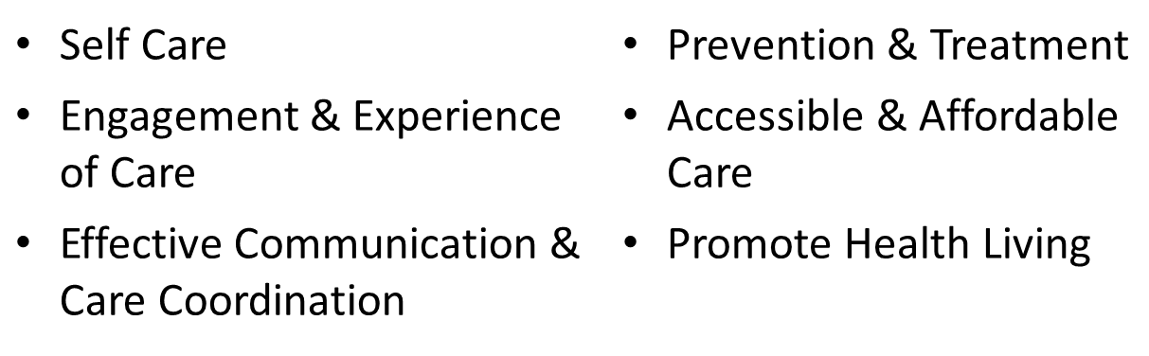
URAC
Quality Measures for Accreditation
  Focus on the Health & Human Services (HHS) National Quality Strategy measure domains
  Requires reporting on consumer satisfaction utilizing the CAHPS Survey
URAC. Health Plan Quality Measures. Available at https://www.urac.org/accreditation-and-measurement/accreditation-programs/health-plan-programs/health-plan/health-plan-quality-measures/.

Slide 11
Pharmacy Quality Alliance (PQA)
Established in 2006
Non-profit alliance with over 100 member organizations
Mission:
  Improve the quality of medication management and use across healthcare settings
  Develop and implement performance measures and recognize examples of exceptional pharmacy quality
PQA. PQA Mission and Strategic Objectives. Available at http://pqaalliance.org/about/default.asp.
Notes:
http://pqaalliance.org/about/default.asp

Slide 12
PQA & Measure Development
Develops medication-use measures in areas of medication safety, medication adherence and appropriateness
Identifies high-priority areas for health care and gaps in existing performance measure sets
Consensus process used to draft, test, refine and endorse high-priority measures of medication-use quality
PQA. PQA Performance Measures. Available at http://pqaalliance.org/measures/default.asp.
Notes:
http://pqaalliance.org/measures/default.asp

Slide 13
CMS Star Ratings

Slide 14
CMS Star Ratings - Overview
  CMS rates the quality of Medicare Advantage and Medicare Prescription drug plans (Part C and/or Part D) by using a scale of 1 (Poor) to 5 stars (Excellent)
  Since 2012, Medicare Advantage plan payments and rebate amounts are tied to quality ratings
  Annual quality rating of Medicare Advantage plans is based on assessment of:
    Clinical performance
    Patient experience
    Enrollee complaints
    Customer services
Medicare. Star Ratings. Available at http://www.medicare.gov/find-a-plan/staticpages/rating/planrating-help.asp.
Notes:
http://www.medicare.gov/find-a-plan/staticpages/rating/planrating-help.aspx

Slide 15
CMS Star Rating - Overview
Timeframes
2014 Star Ratings
  Primarily based on 2012 data
  Utilizes CAHPS Survey data 02/15/2013 - 05/31/2013
2015 Star Ratings
  Primarily based on 2013 data
  Utilizes CAHPS Survey data 02/15/2014 - 05/31/2014
CMS. Medicare 2014 Part C & D Star Rating Technical Notes. Available at: http://www.cms.gov/Medicare/Prescription-Drug-Coverage/PrescriptionDrugCovGenIn/PerformanceData.html.
CMS. Medicare 2015 Part C & D Star Rating Technical Notes. Available at: http://www.cms.gov/Medicare/Prescription-Drug-Coverage/PrescriptionDrugCovGenIn/Downloads/2015StarRatingsTechnicalNotes.pdf.

Slide 16

CMS Star Ratings - Overview
Plan Ratings - www.medicare.gov/find-a-plan/
Medicare members may switch to a 5-star plan at any point during the year, including non-enrollment periods
  Symbol -
Low performing plans are indicated on the site & online enrollment is disabled
  Symbol -
Medicare.gov. Medicare Plan Finder. Available at: https://www.medicare.gov/find-a-plan/questions/home.aspx. .

Slide 17
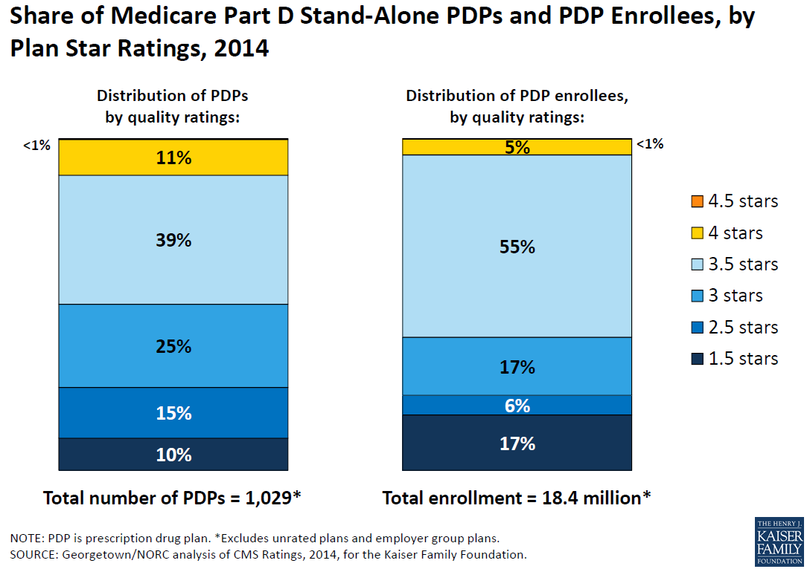
Part D PDP Enrollees by Plan Star Rating
Notes:
http://kaiserfamilyfoundation.files.wordpress.com/2014/08/8621-medicare-part-d-in-its-ninth-year.pdf

Slide 18
CMS Star Ratings - Overview
Star Ratings are based upon various sets of performance measures
  Healthcare Effectiveness Data and Information Set (HEDIS)
  Consumer Assessment of Healthcare Providers and Systems (CAHPS)
  Health Outcomes Survey (HOS)
  Complaint Tracking Module (CTM)
  Independent Review Entity (IRE)
  Pharmacy Quality Alliance (PQA) endorsed medication-use measures
CMS. Medicare 2015 Part C & D Star Rating Technical Notes. Available at: http://www.cms.gov/Medicare/Prescription-Drug-Coverage/PrescriptionDrugCovGenIn/PerformanceData.html.

Slide 19
CMS Star Ratings - Overview
Star ratings are separated into nine domains, four of which apply directly to drug plans
Health plan (Part C) rating domains
  Staying healthy: screenings, tests, and vaccines
  Member complaints, problems getting services, and improvement in the health plan’s performance
  Member experience with the health plan
  Health plan customer service
  Managing chronic conditions
Drug plan (Part D) rating domains
  Patient safety and accuracy of drug pricing
  Member complaints, problems getting services, and improvement in the drug plan’s performance
  Member experience with drug plan
  Drug plan customer service

Slide 20
CMS Prescription Drug Plan (Part D) Measures
Drug plan customer service
Member complaints, problems getting services, and improvement in the drug plan’s performance
Availability of TTY/TDD services and foreign language interpretation when prospective members call the drug plan
Drug plan makes timely decisions about appeals
Fairness of drug plan’s denials to member appeals, based on an independent reviewer
Complaints about the drug plan
Problems Medicare Found in Members’ Access to Services and in the Plan’s Performance
Members Choosing to Leave the Plan
Improvement in the Drug Plan’s Performance
Notes:
Reference – Part D Prescription Drug Plan Domain Measures are located above

Slide 21
CMS Prescription Drug Plan (Part D) Measures
Member experience with the drug plan
Patient safety and accuracy of drug pricing
Members’ Overall Rating of Drug Coverage
Ease of Getting Prescriptions Filled When Using the Plan
Plan Provides Accurate Drug Pricing Information for Medicare’s Plan Finder Website
Plan Members 65 and Older Who Received Prescriptions for Certain Drugs with a High Risk of Side Effects, When There May Be Safer Drug Choices
Using the Kind of Blood Pressure Medication That Is Recommended for People with Diabetes
Taking Oral Diabetes Medication as Directed (Medication Adherence)
Taking Blood Pressure Medication as Directed (Medication Adherence)
Taking Cholesterol Medication as Directed (Medication Adherence)
Notes:
Reference – Part D Prescription Drug Plan Domain Measures are located above
Managed Care Pharmacy Quality Initiatives often focus on the Patient Safety domain measures outlined above, including High Risk Medications, Treatment of Blood Pressure in People with Diabetes, and Medication Adherence measures for oral diabetes medications, blood pressure medications, and cholesterol medications.

Slide 22
Star Rating Example
Part C Rating: “Cholesterol screening for patients with diabetes”
Shows the percent of plan members with diabetes who have had a test for LDL cholesterol within the past year
2015 Rating Cut Points:
All ratings within a domain are then averaged to calculate the domain’s star rating
Measure | Star Rating
> 91% | 5 stars
85% – < 91% | 4 stars
83% – < 85% | 3 stars
81% - < 83% | 2 stars
< 81% | 1 star
CMS. Medicare 2015 Part C & D Star Rating Technical Notes. Available at: http://www.cms.gov/Medicare/Prescription-Drug-Coverage/PrescriptionDrugCovGenIn/PerformanceData.html.
Notes:
Star rating cut points and thresholds change from year to year.

Slide 23
CMS Star Ratings – Bonus Payments
2015 Quality Bonus Payments
Plans with Part C or D rating of 2.5 or lower for at least 3 years receive a low performing icon on the Medicare plan finder website
Plans receive bonus payments based on Star Rating
4-5 Stars: 5%
Criteria for Double Quality Bonus for Qualifying Counties
Urban floor county (population > 250,000)
Medicare Advantage market share greater than 25% for county
MA Plan Beneficiary Rebate Amounts
4.5 – 5 stars: 70%
3.5 – 4.4 stars: 65%
<3.5 stars: 50%
Less than 4 Stars: 0%
Local fee-for-service spending below national average
CMS. Medicare 2015 Part C & D Advance Notice and Final Call Letter. Available at: http://www.cms.gov/Medicare/Health-Plans/MedicareAdvtgSpecRateStats/Announcements-and-Documents.html?DLSort=2&DLPage=1&DLSortDir=descending
Notes:
2014 was the final year for the CMS Star bonus demonstration project, where 3 and 3.5 star plans received quality bonus payments. The purpose of the demonstration was to test whether providing scaled bonuses to Medicare Advantage organizations with 3 or more stars leads to more rapid and larger year-to-year quality improvements in quality scores.
Beginning in 2015, plans with 3.5 stars or lower will no longer receive bonuses once the demonstration project ends. Only plans with 4 stars or higher will receive quality bonus payment.

Slide 24
CMS Star Ratings Updates for 2015
New Measure – Special Needs Plan (SNP) Care Management
Breast Cancer Screening – transitioning to display measure for 2015
Annual Flu Vaccine – CAHPS question will ask members if received flu shot since July instead of September
High Risk Medication – Use updated Pharmacy Quality Alliance (PQA) HRM list
CMS. Medicare 2015 Part C & D Star Rating Technical Notes. Available at http://www.cms.gov/Medicare/Prescription-Drug-Coverage/PrescriptionDrugCovGenIn/Downloads/2015StarRatingsTechnicalNotes.pdf.

Slide 25
CMS Star Ratings Updates for 2015
Medication Adherence for Diabetes Medication–Meglitinides and Incretin mimetic agents added
Removal of Glaucoma Testing (Part C) measure
Display Measures to remain include:
  Pharmacotherapy Management of COPD Exacerbation (Part C)
  Medication Therapy Management Program Completion Rate for Comprehensive Medication Reviews (Part D)
CMS. Medicare 2015 Part C & D Star Rating Technical Notes. Available at http://www.cms.gov/Medicare/Prescription-Drug-Coverage/PrescriptionDrugCovGenIn/Downloads/2015StarRatingsTechnicalNotes.pdf.

Slide 26
Strategies for Adhering to Quality Measures
Stimulate accountability within the healthcare organization by educating employees and providers on the significance of quality measurement
Encourage advancements in technology to help integrate patient and provider data
Promote the appropriate use of medical and pharmaceutical services through frequent utilization reviews

Slide 27
Conclusion
Quality organizations and programs, such NCQA, URAC, and CMS Star Ratings, contribute to the development and endorsement of quality measures impacting pharmacy quality programs in all managed care settings
Pharmacists contribute to quality-focused programs through initiation and advancement of medication management programs including:
  Retrospective and concurrent DUR programs
  Benefit design recommendations
  Comprehensive and Targeted Medication Reviews (MTM)

Slide 28
Helpful Resources
Navarro RP, et al. Managed Care Pharmacy Practice. 2nd edition. Jones and Bartlett Publishers: Sudbury, MA; 2009.
Ransom ER, et al. The Healthcare Quality Book. 2nd Edition. Health Administration Press: Chicago, IL; 2012.
NCQA – http://www.ncqa.org/HomePage.aspx
URAC – https://www.urac.org/
PQA - http://www.pqaalliance.org/
CMS Part C and D Performance Data. http://www.cms.gov/ Medicare/Prescription-Drug-Coverage/PrescriptionDrugCovGenIn/ PerformanceData.html
AMCP Resources for Medicare Plan Star Ratings
  Framework for Improving Medicare Plan Star Ratings: http://www.amcp.org/QBP_framework/
  Quality Bonus Payments and Star Ratings: http://www.amcp.org/WorkArea/DownloadAsset.aspx?id=13599

Slide 29
Thank you to AMCP member Tracy McDowd for updating this presentation for 2015

