Slide 1
OPPORTUNITIES IN MANAGED CARE: ENHANCING THE FOUNDATION FOR SUCCESSFUL CAREERS IN PHARMACY:
Executive Summary
July 2018

Slide 2
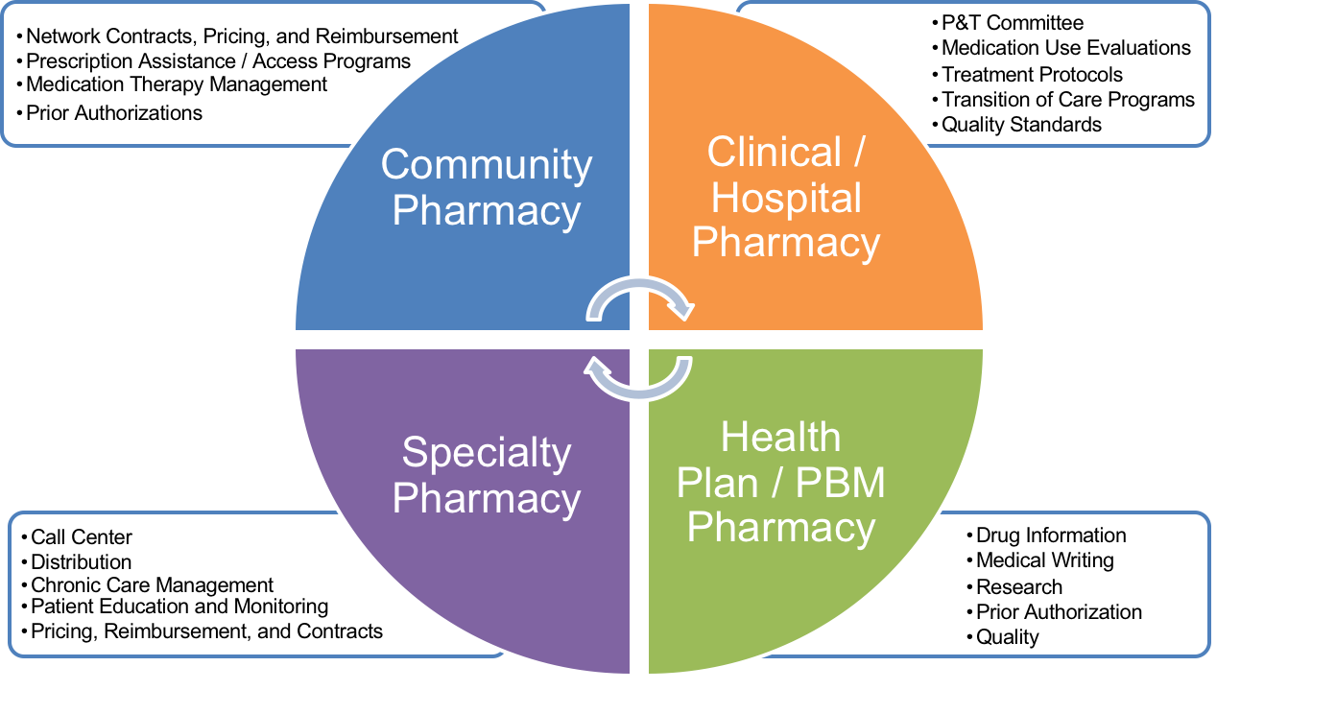
Managed Care Principles Can Be Applied to All Areas of Pharmacy

Slide 3

AMCP Is the Nation’s Leading Managed Care Pharmacy Organization
Vision Statement
– Managed care pharmacy improving health care for all
Mission Statement
– Empower its members to serve society by using sound medication management
principles and strategies to improve healthcare for all
Membership Milestones
In 2017, the membership has grown to 8,000, 74 student chapters, and over 2,500 student members
1996, AMCP activated its first student pharmacist chapter at the University of Illinois at Chicago
By 1993, the membership grew to 1,288
1st meeting at ASHP in Nashville – 135 people attended and 50 joined

Slide 4
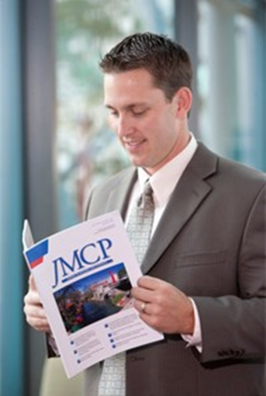
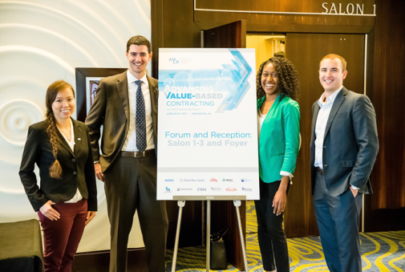
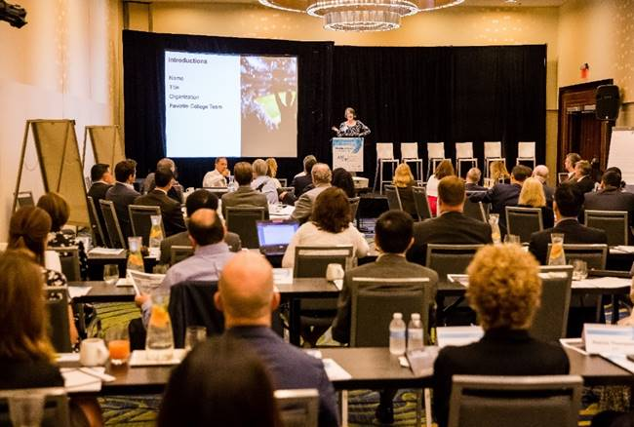
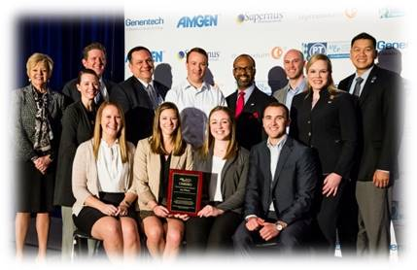
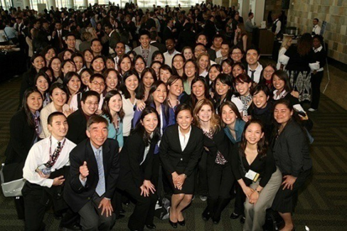
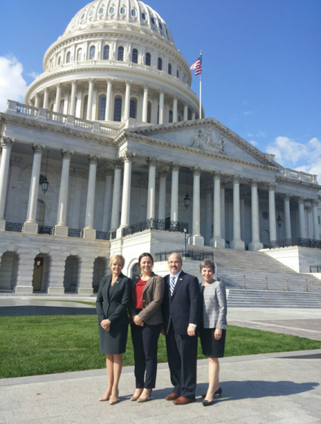
Students Membership Offers Several Benefits
Internship Opportunities
Information and Education
P&T Competition
Networking
Professional Development
Advocacy
Additional resources available for colleges of pharmacy:
APPE/IPPE Diretory
AMCP Managed Care Curriculum
AMCP’s Virtual Conference Center

Slide 5
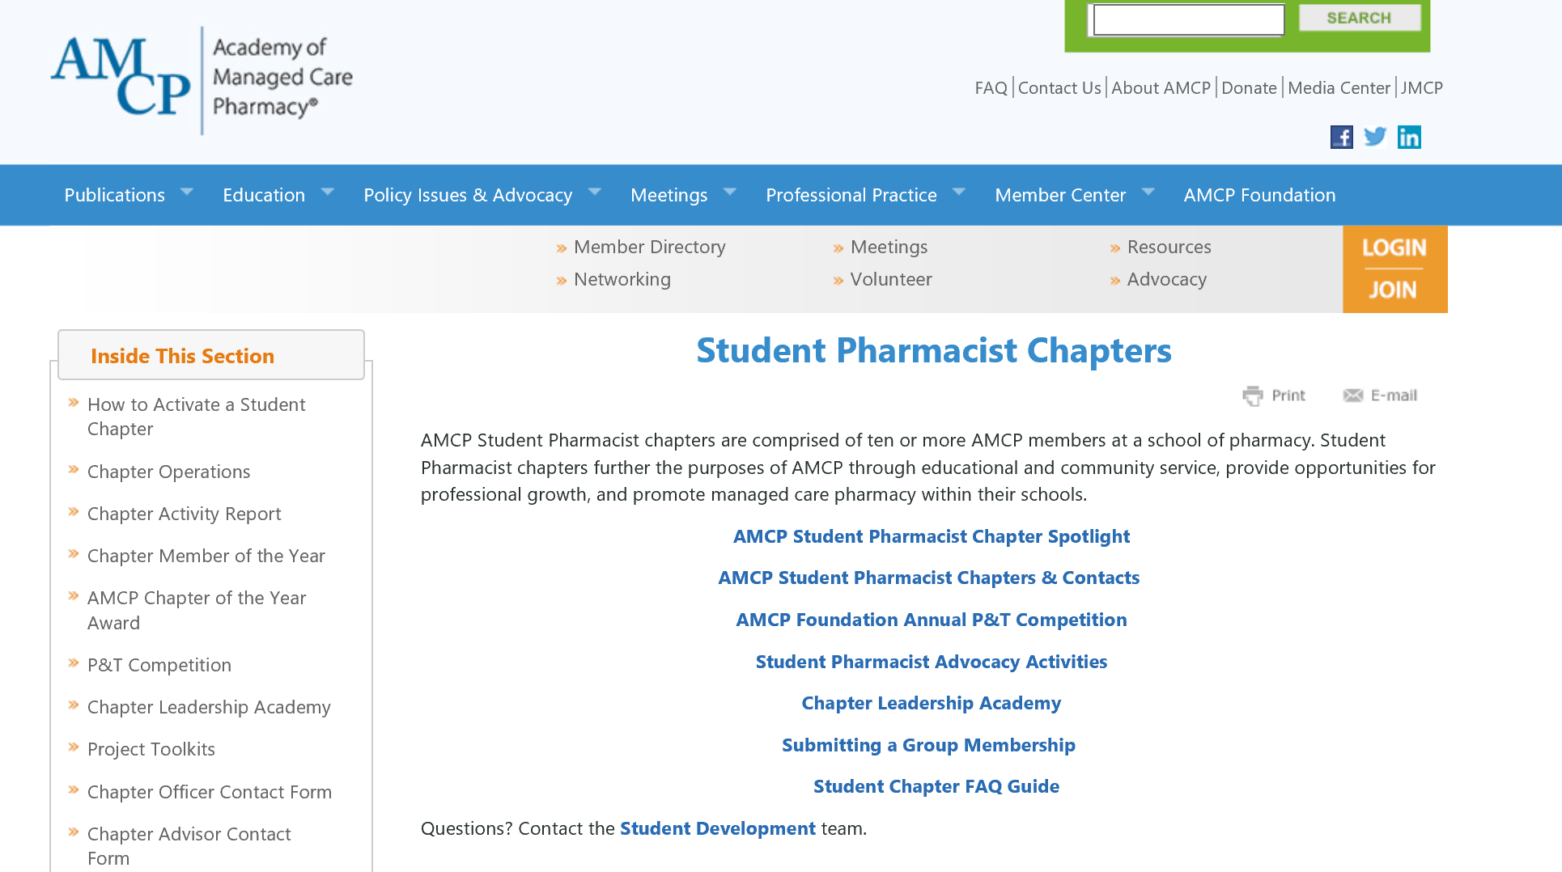
Looking to Start an AMCP Student Chapter? We Can Help!
Visit www.amcp.org/chapters to access our step-by-step toolkit that will help guide you through the activation process.
Need more help? Contact the Student Development team at studentdevelopment@amcp.org

