Slide 1
OPPORTUNITIES IN MANAGED CARE: ENHANCING THE FOUNDATION FOR SUCCESSFUL CAREERS IN PHARMACY
Notes:
The objectives of this presentation are to:
Understand the universal nature of managed care principles throughout all sectors of pharmacy and importance of exposing students to opportunities early in their career
Discuss how AMCP can support goals of student education and exposure

Slide 2
Mission Statement
Empower its members to serve society by using sound medication management principles and strategies to improve healthcare for all
Vision Statement
Managed care pharmacy improving healthcare for all
Notes:
WHO and WHAT is AMCP

Slide 3
The Origin of Student Involvement
AMCP activated its first student pharmacist chapter at the University of Illinois at Chicago in 1996
Today there are 74 student pharmacist chapters and over 2,500 student pharmacist members

Slide 4
Managed Care Principles are Ubiquitous
Primary managed care principles:
Cost-effective care
Evidence-based medicine
Population-based health
Quality metrics
Treatment guidelines
Utilization management
These can be applied to all areas of pharmacy and in many non-related industries

Slide 5
Preparing Student Pharmacists
Managed care student pharmacists get an early start in understanding how basic managed care principles will affect them in their respective settings or areas of practice
Managed care principles impact all pharmacists at some point in their careers
Managed care is relevant to pharmacists in many practice areas including:
Community
Hospital
Specialty Pharmacies
Academia
Health Plans and PBMs

Slide 6
Community Pharmacists
Managed care concepts/integration in community pharmacy:
Medication therapy management
District/regional management projects
Independent pharmacy management
Network contracts, pricing, and reimbursement
Connected care/Transition of care programs
Prescription assistance/access programs
Prior authorization
Immunizations
Notes:
MTM promotes evidence-based medicine, cost-effective care and also has cost component. Impacts many national quality metrics – Star ratings as well as identifying potential medication therapy problems which can impact other quality measures.
Community pharmacy provides opportunity to understand relationships between network pharmacies and health plans/pbms. Gain understanding of prior authorization processes and plan policies for area.
District/regional management projects – opportunity to lead special project, utilization management

Slide 7
Hospital Pharmacists
Managed care concepts/integration in hospital pharmacy:
Pharmacy & Therapeutic (P&T) Committee
Supply chain / Group Purchasing Order (GPO) initiatives
Contracting / strategic sourcing
Medication use evaluations
Coverage criteria / treatment protocols
Medication reconciliation
Transition of care programs
Quality standards / accreditation
Notes:
Medication reconciliation is a theme you’ll see in each of these practice sites
P&T committee---AMCP has a P&T competition to practice these skills for students

Slide 8
Specialty Pharmacy Pharmacists
Managed care concepts/integration in specialty pharmacy
Call center
Clinical programs
Patient education and monitoring
Chronic care management/education
Distribution
Patient access/assistance programs
Pricing, reimbursement, and contracts
Prior authorization
Quality standards
Notes:
CCM - huge area for pharmacy for provider status

Slide 9
Pharmacists in Academia
Managed care concepts/integration in academia:
Adjunct faculty appointments
Guest lecturing opportunities
Preceptorship
Informal mentorship
Networking
Collaborative projects
Notes:
Annual meetings provide excellent opportunity for students to network

Slide 10
Health Plans / PBM Pharmacists
Managed care concepts/integration in health plans and PBMs:
Prior authorization coverage determinations
Call center
Drug information
Medical writing
Medication therapy management
Special projects
Research
Notes:
MTM once again

Slide 12
Membership Advantages
General Membership Benefits
Valuable Resources
Access to the Journal of Managed Care & Specialty Pharmacy
(JMCP) and www.amcp.org
Daily Dose email news briefings
Monthly Webinars
Nexus and Annual Meeting
Student Pharmacist Benefits
Student pharmacist-specific programming
Meetings
Webinars
Managed Care Pharmacy Residency Showcase
Student Pharmacist Resource Center: www.amcp.org/studentcenter

Slide 13
Benefits of Student Membership
Information
& Education
Professional Development
Networking
P&T Competition
Career and Internship Opportunities
Advocacy
Notes:
Information: AMCP News & Views - Monthly Newsletter Journal of Managed Care & Specialty Pharmacy (JMCP) – Peer Reviewed AMCP Daily Dose – eNews AMCP Student E-Link Newsletter Student Center –
Education: AMCP National Conferences (AMCP Annual Meeting and AMCP Nexus); AMCP Foundation National P&T Competition; AMCP Learn; AMCP Partnership Forums
Networking: AMCP National Meetings; AMCP Student Pharmacist Chapters; AMCP Affiliates; AMCP Diplomats; AMCP Chapter Leadership Academy; AMCP Membership Directory; SOCIAL MEDIA: LinkedIn, Facebook, Twitter
Professional Development: APPE/IPPE rotations provide early exposure to managed care pharmacy (list on website); Managed Care Internships are 10-week internships nationwide sponsored by pharmaceutical companies with a stipend and housing provided which also includes 1 week in Alexandria, VA at AMCP Headquarters; Managed Care Residency or Fellowships; AMCP Chapter Leadership Academy includes leadership training provided to chapter executive committee members at the Annual Meeting
Advocacy: Representation on Capitol Hill; State Advocacy Coordinators; AMCP Legislative Action Center (for members only); AMCP’s Legislative/Regulatory Briefing
Career and Internship Opportunities: AMCP Foundation Summer Internships; APPE/IPPE Experiential Education Sites; Managed Care Pharmacy Summer Internship Directory; AMCP Managed Care Pharmacy; Residency and Fellowship Showcase; AMCP Career Center; LinkedIn
***NEW IN 2017: Managed Care Research and Nonprofit Leadership Internship

Slide 14
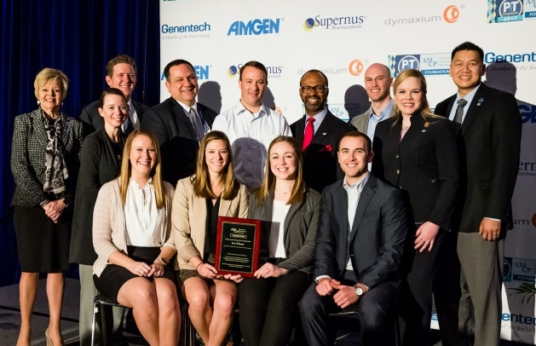
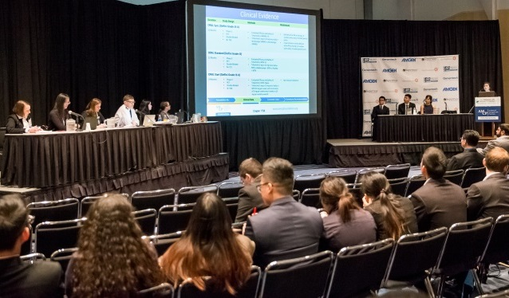
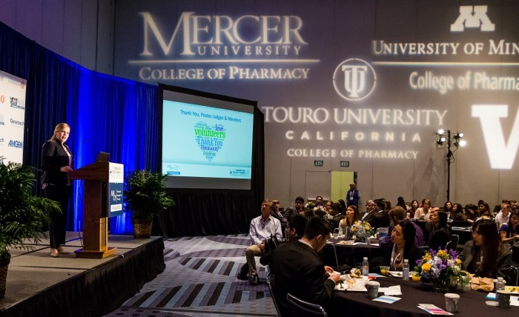
AMCP Foundation P&T Competition
Opportunity to practice clinical skills:
Pharmacoeconomics
Drug Info
Clinical Evaluation
Gain transferable skills with a simulation of real world P&T presentation
Chance to win scholarship for your chapter and national recognition
Notes:
Watch the archived training webinars!!

Slide 15
Starting an AMCP Chapter
Why Activate a Student Chapter:
Student Pharmacist chapters provide educational and community service, provide opportunities for professional growth, and promote managed care pharmacy within their schools.
How to Activate a Student Chapter:
A step-by-step toolkit will guide you through the activation process www.amcp.org/chapters
Notes:
University of Utah College of Pharmacy piloted a Managed Care Elective Course Pilot
through utilization of the AMCP eleven module Fundamentals course as primary content for the elective
They enrolled 15 students in the course in Fall 2017
Results
More than 53% of students strongly agreed as a response rate for the course structure, stated objectives and effectiveness; followed by the remaining percentages as “Agree”
Students highlighted their enjoyment in hearing from guest speakers and learning about topics such as insurance payment systems and health care management in free text responses

Slide 16
Conclusions
Managed care pharmacy principles extend across all practices of pharmacy and have become increasingly important to understand to navigate the complexities in any field of pharmacy
Early exposure to managed care principles through educational opportunities and organizations such as AMCP will help put students ahead of the curve in whichever field they pursue

Slide 17
Resources from AMCP
AMCP Student Pharmacist Resource Center!!
APPE/IPPE Directory - www.amcp.org/APPE
AMCP Managed Care Curriculum - www.amcp.org/curriculum
AMCP’s Student Pharmacist Webinars - www.amcp.org/student_webinars/
AMCP’s Virtual Conference Center - www.amcp.org/webinars
Managed Care Pharmacy Topics slide deck templates - www.amcp.org/slidedecks
Residency Listings - www.amcp.org/residencies
Best Practices for Post-Graduate Opportunities
Internship Listings - www.amcp.org/internships
Managed Care Fundamentals Course - http://amcplearn.org
Notes:
Provides links and information on managed care pharmacy terms, managed care internships and residencies and AMCP Student Chapter resources.
There are also Academia and Diplomat Centers with additional resources – including a number of slide decks on managed care pharmacy topics.

