Slide 1
AMCP Legislative & Regulatory Briefing
Text AMCP to 50457 to sign up for alerts
August 23, 2022
Notes:
Tom

Slide 2
Disclaimer
Organizations may not re-use material presented at this AMCP webinar for commercial purposes without the written consent of the presenter, the person or organization holding copyright to the material (if applicable), and AMCP. Commercial purposes include but are not limited to symposia, educational programs, and other forms of presentation, whether developed or offered by for-profit or not-for-profit entities, and that involve funding from for-profit firms or a registration fee that is other than nominal. In addition, organizations may not widely redistribute or re-use this webinar material without the written consent of the presenter, the person or organization holding copyright to the material (if applicable), and AMCP. This includes large quantity redistribution of the material or storage of the material on electronic systems for other than personal use.

Slide 3
Presenters
Adam Colborn
Geni Tunstall
Tom Casey
Director, Government Relations
AMCP
Director, Regulatory Affairs
AMCP
Manager, Policy & Government Relations
AMCP

Slide 4
Federal Legislation
Notes:
Jennifer

Slide 5
Pre-approval Information Exchange Act (H.R. 7008)
Introduced by Congressman Brett Guthrie (R-KY-02) on March 9
Creates legislative safe-harbor for proactive PIE by manufacturers + clarifies scope of permissible communications under 2018 FDA guidance
Included as Sec. 810 in House UFA reauthorization package (H.R. 7667), passed House on June 8
Not included in Senate UFA reauth
Next steps: Work through “conference” process to secure inclusion in final bicameral UFA package

Slide 6
Access to Prescription Digital Therapeutics Act of 2022 (S.3791/H.R.7051)
Creates a benefit category for DTx in Medicare/Medicaid
Limited to FDA approved prescription DTx
Necessary for coverage under these programs
“Benefit category” is generic statutory term for types of covered services (example: “diagnostic x-ray tests” is a benefit category). Does not refer to the Medicare Parts.
Cosponsors – 19 in House, 0 in Senate
Currently exploring year end legislative vehicles (i.e., spending bills)
Low odds of attachment

Slide 7
Pharmacy Reimbursement for COVID-19 and Related Future Emergency Services Act (H.R.7213)
Introduced in House on March 24 by Reps. Kind, Barragan, McKinley, and Carter
Authorizes pharmacists to receive reimbursement under Part B for certain COVID-19 care
Also authorizes Part B reimbursement for care delivered in response to any future PHE issued under same authority as COVID-19 PHE

Slide 8
User Fee Amendment Acts
PDUFA VII
BsUFA III
GDUFA III
MDUFA V
Authorizes FDA to collect fees from companies that produce prescription, biosimilar, and generic drugs and medical devices
Reauthorization every 5 years (currently through Sept. 2022)

Slide 9
User Fee Amendment Acts
Passed House of Representatives on June 8 (Food & Drug Amendments of 2022, H.R. 7667)
Senate version has stalled out (FDA Safety & Landmark Achievements Act, S. 4348)
Senator Burr demanding “clean” bill with no riders
Riders will be attached but unclear which ones will survive Burr + conference
After Senate passes: House + Senate meet in conference to negotiate differences and create final bill
Deadline for passage is September 30, but we may see an FDA continuing resolution to extend deadline

Slide 10
UFA Riders – House Version
Riders
ARPA-H
FDA modernization
Accelerated approval drugs
Pharmaceutical manufacturing
Biologics and biosimilars
Diversity and equity in clinical trials
Notes:
Advanced Research Project Agency – Health Act
Introduced by Rep. Eshoo, Chair of the Health Subcommittee
Establishes ARPA-H within HHS to accelerate innovation in health and medicine by investing in high-risk, high-reward research projects
Does not mention specific research priorities, but drafted broadly enough for agency to support research in broad platform technologies (e.g. cell and gene therapies), licensable production capabilities (e.g. rapid vaccine manufacturing "hot base"), as well as health disparities
Omnibus spending bill authorized $1 billion for ARPA-H, but Congress has yet to establish it. This was a key component of the BBBA, but with that package stalled lawmakers are considering creating the agency as part of UFA or the 21st Century Cures 2.0 Act

Slide 11
Inflation Reduction Act (H.R. 5376)
Originally introduced as the Build Back Better Act by Congressman John Yarmuth (D-KY-03) on September 27, 2021
Following significant changes, passed the Senate on Aug. 7 and the House on Aug. 12, signed by President Biden on Aug. 16
Drug pricing provisions include:
Drug Price Negotiation program
Inflationary rebates
Part D redesign
Also enhances payments for biosimilars, extends expanded Affordable Care Act (ACA) tax credits, and delays the Trump-era Rebate Rule

Slide 12
Inflation Reduction Act – Drug Pricing Provisions
Drug Price Negotiation Program
Requires government negotiation of the prices of certain prescription drugs under Medicare beginning in 2026
Inflationary Rebates
Requires manufacturers to pay rebates for certain drugs paid under Medicare Parts B or D if their average prices increase faster than the rate of inflation
Part D Redesign

Slide 13
Inflation Reduction Act – Other Healthcare Provisions
Enhanced Payments for Biosimilars
Temporarily increases the Part B add-on payment for qualifying biosimilars from 6% to 8% of the reference product’s ASP for a 5-year period
Extension of Expanded ACA Premium Tax Credit
Extends the temporary ACA premium tax credit expansions that were included in the American Rescue Plan Act through 2025
Rebate Rule Delay
Prevents implementation or enforcement of the Trump-era Rebate Rule until January 1, 2032

Slide 14
Federal Regulation
Notes:
Jennifer

Slide 15
SUNSET Rule
Originally finalized under the previous administration in January, 2021.
Would have automatically expired all regulations issued by HHS on the later of:
two (2) years after the SUNSET Rule’s effective date,
ten (10) years after a regulation’s promulgation, or
ten (10) years after HHS’s most recent assessment of the regulation.
Update: on May 26, 2022, HHS repealed the SUNSET Rule.

Slide 16
Notice of Benefit & Payment Parameters
Final Rule was published on May 6, 2022.
Requires certain issuers to offer standardized plan options beginning in PY 2023.
Indirect Quality Improvement Activity (QIA) expenses that can be included for Medical Loss Ratio (MLR) reporting and rebate calculation must be directly related to activities that improve health care quality.
Adverse tiering - policies that place most or all drugs that treat a specific condition on the highest tier are presumptively discriminatory.

Slide 17
CMS RFI on Medicare Advantage
CMS released a Request for Information (RFI) seeking public comment on the Medicare Advantage program.
CMS is asking for input on ways to achieve the agency’s vision so that all parts of Medicare are working towards a future where people with Medicare receive more equitable, high quality, and person-centered care that is affordable and sustainable.
AMCP is commenting on advancing health equity and value-based care.
The public comment period ends August 31, 2022.

Slide 18
HHS Notice of Proposed Rulemaking
Proposed Rule was published on August 4, 2022.
Reinstates protections on the basis of gender identity and sexual orientation and aligns sex discrimination requirements with Federal court decisions.
Clarifies the application of Section 1557 nondiscrimination requirements to health insurance issuers.
Requires covered entities to provide notice of the availability of language assistance services and auxiliary aids and services.
Comments are due October 3, 2022.

Slide 19
MA-PD Final Rate Notice
On April 4, 2022, CMS issued the capitation rates for Part C and Part D payment policies.
CMS updated the RxHCC risk adjustment model for Part D sponsors other than PACE. The RxHCC model is used to adjust direct subsidy payments for Part D benefits offered by stand-alone prescription drug plans (PDPs) and Medicare Advantage prescription drug plans (MA-PDs).

Slide 20
Medicaid/CHIP RFI
RFI released on February 17, 2022.
Objective of the RFI was to identify strategies to:
increase access to coverage for individuals eligible for Medicaid and CHIP
keep coverage consistent
establish minimum standard for equitable and timely access to providers
measure, monitor, and support improvement efforts for access to services
assure that payments are sufficient to enlist and retain enough providers to keep services accessible
AMCP submitted a comment encouraging CMS to recognize the role of pharmacists in whole person care and care coordination as well as being health care providers that address primary health care needs.

Slide 21
Part C/D Final Rule
In January, CMS published a Proposed Rule that would require pharmacy price concessions be applied at the point-of-sale (POS).
In March, AMCP submitted comments opposing this requirement.
On May 9, 2022, CMS finalized the rule, including the pharmacy price concession requirement.

Slide 22
State Legislation
Notes:
Jennifer

Slide 23
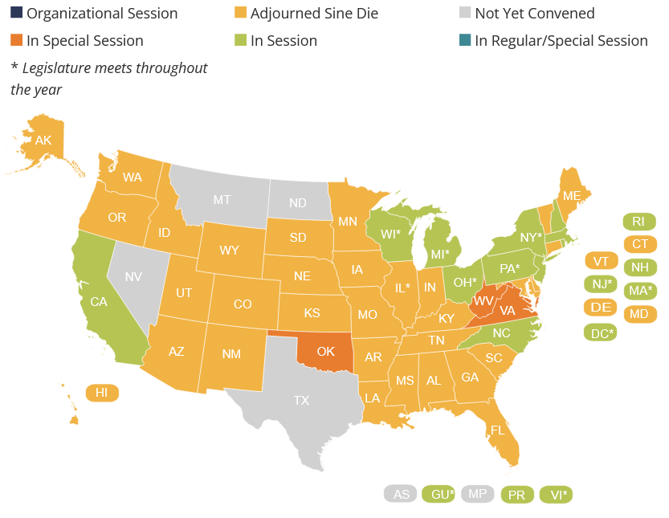
State Legislative Sessions
*Source: NCSL
As of 8/18/22

Slide 24
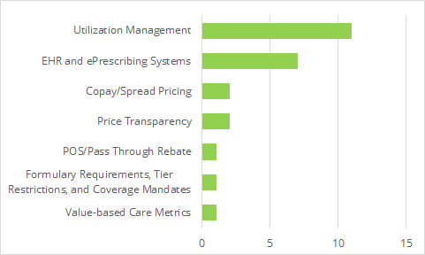
Bills Enacted by Issue

Slide 25
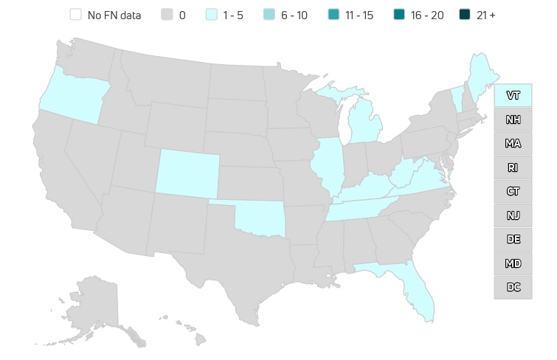
Bills Enacted by State

Slide 26
PBM Transparency and Oversight
FL HB 357 – establishes standards for PBM audits
MI SB 447 – requires insurers to supply claims utilization and cost information to large employers, including fees paid to PBMs, upon request
TN HB 2661 - requires PBMs to adopt certain reimbursement methods
VT H 353 – prohibits patient steering and requires state to investigate PBM practices

Slide 27
PBM Rebates and Spread Pricing
CO HB 22-1370 – requires plans and PBMs to use all rebates received from formulary drugs to reduce costs for either the plan sponsor or individuals beginning in 2024
VA SB 663 – prohibits spread pricing in contracts between Medicaid MCOs and PBMs

Slide 28
Step Therapy and ePA
FL HB 459; TN HB 677 – establishes guidelines for step-therapy programs and requires plans to provide an exception process
MI SB 247 – requires insurers to utilize a standard electronic prior authorization (ePA) transaction process beginning June 1, 2023
VA SB 428 – requires insurers to establish an ePA program that links to electronic health record systems that use the SCRIPT standard by July 1, 2025

Slide 29
Other Key Bills
Oklahoma Medicaid Managed Care: OK SB 1337; OK HB 2322
Canadian Reference Pricing: ME SP 520
North Carolina Medicaid Expansion

Slide 30
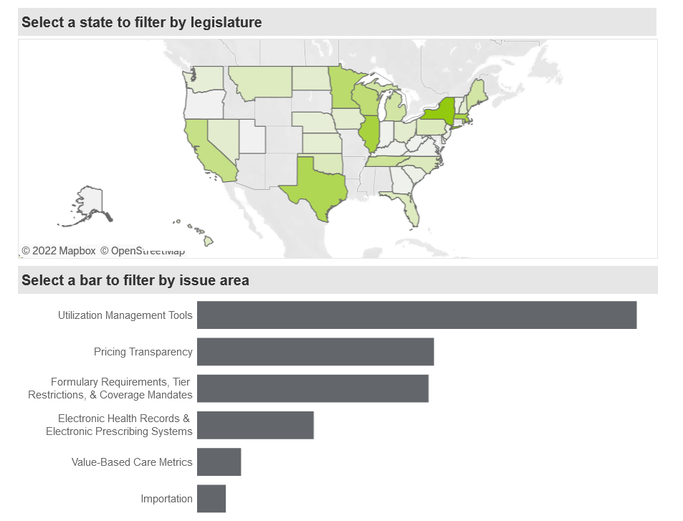
https://www.amcp.org/policy-advocacy/take-action/find-legislation

Slide 31
Federal Election
Outlook
Information provided to AMCP by Tiber Creek Group
Notes:
Jennifer

Slide 32
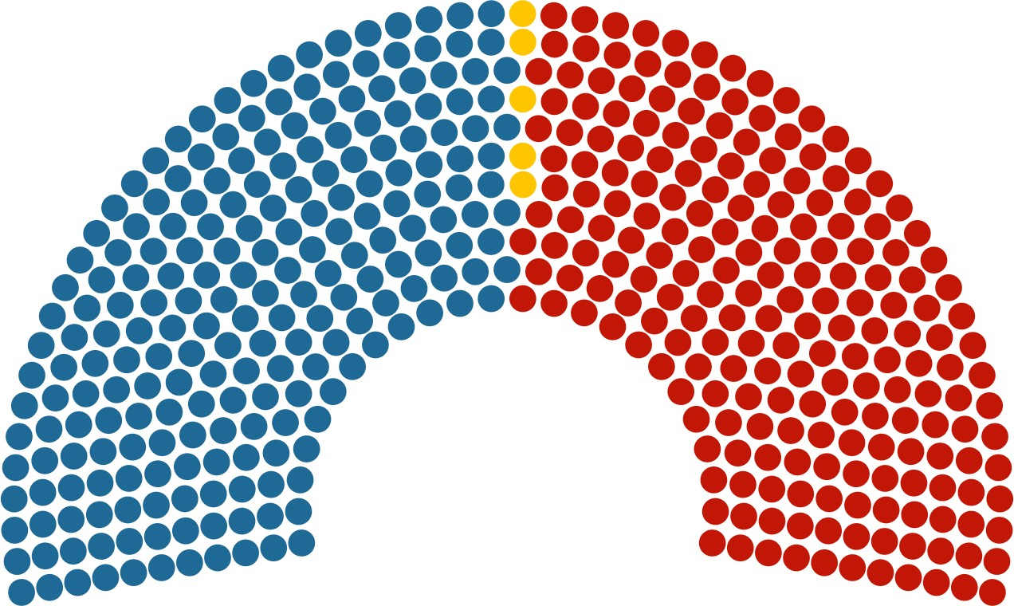
Current Congressional Make-up
U.S. Senate 50 Ds – 50 Rs
(Includes 2 independents who participate in the Democratic caucus; VP Harris serves as tiebreaking 51st vote)
Key races to watch: Arizona, Georgia, Nevada, Pennsylvania, Wisconsin
House of Representatives 220 Ds – 211 Rs
(5 vacancies: AK-At Large, IN-2, MN-1, NY-19, NY- 23)

Slide 33
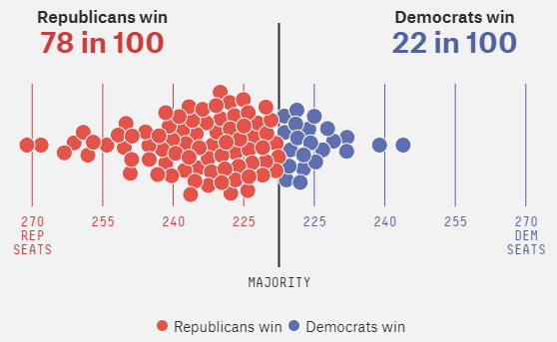
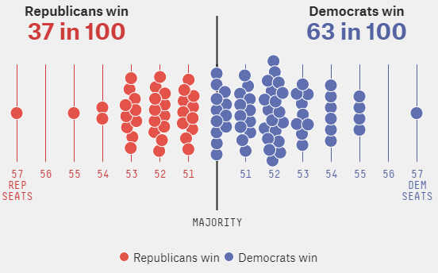
Midterm Election Predictions
House: Republicans favored to win
Senate: Democrats slightly favored to win
Republicans have a 78% chance of taking over the House
Republicans’ best chances of gaining a seat are in Georgia and Nevada; Democrats’ best chance is in Pennsylvania
Source 8/22/22, FiveThirtyEight *Data from Deluxe model stimulates the election 40,000 times to see who wins most

Slide 34
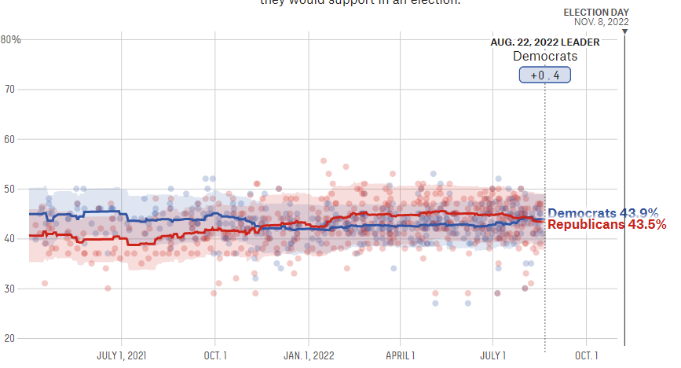
Generic Ballot
Estimate based on polls that inquire which party voters would support in an election
FiveThirtyEight

Slide 35
Key Issues
Based on a survey that required voters to identify which issues are “very important”
Jobs and the economy are the public’s top concern, followed by health care and national security.
67
Jobs/Economy
57
66
76
Health Care
₆₂ 65
49
78
National Security
57
61
53
75
Notably, following the climate surrounding abortion after the Dobbs decision, the issue increased importance among Democrats by 12 points since the June Dobbs decision.
Wide partisan gaps remain on a number of issues, but a majority in both parties are concerned with jobs and the economy, national security, and gun policy
Taxes
61 ₆₄
45
76
60
Crime
48
60
76
56
Education ⁵⁴
48
62
56
Guns
55
53
59
Abortion
43
50
36
67
46
Immigration
29
47
70
Climate
41
43
14
68
Total
Independents
Democrats
Republicans
Source: Economist/YouGov survey of
U.S. adults conducted 7/2 – 7/4/2022

Slide 36
Questions?
Notes:
Jennifer

